Slide 1
Systems Design: Logical Requirements

Slide 2
Logical Requirements
The Design phase follows the Analysis phase of the SDLC.
Analysts choose the solution that’s the most realistic and offers the highest payoff for the organization.

Slide 3
Logical Requirements
Output of this phase
Document with exact specifications for implementing the system
Includes files and databases, forms and reports, documentation, procedures, hardware and software, networking components, and general system specifications

Slide 4
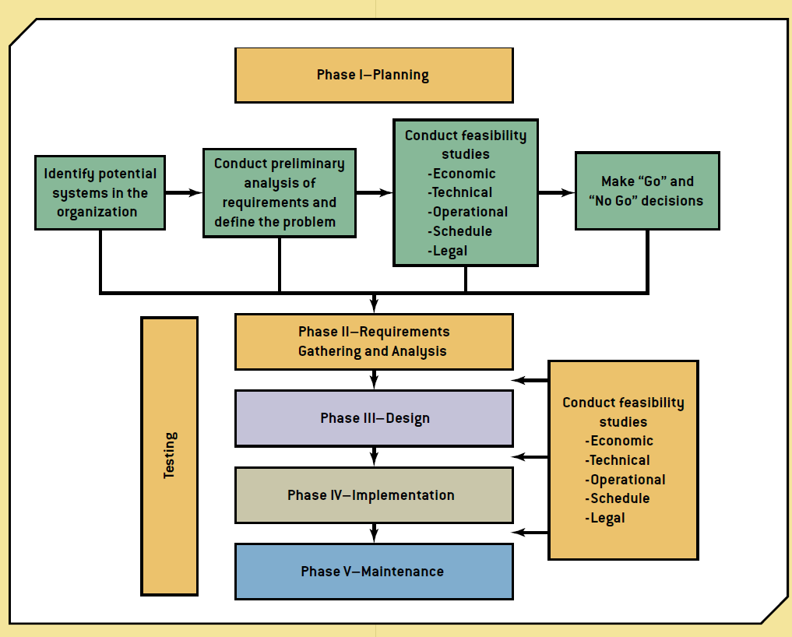
Logical Requirements
Recall this Methodology?
Source: Bidgoli, H. (2014). Building Successful Information Systems. In MIS⁴ ([4th ed., p. 336). Boston: Course Technology.

Slide 5
Logical Requirements
Design phase includes:
Logical design
Conceptual details including workflow and interfaces for data and processes
Physical design
Hardware and platform requirements are addressed

Slide 6
Logical Requirements
A good human-computer interface provides a unifying structure for finding, viewing, and invoking the different components of a system.
Focus on how information is provided to and captured from users

Slide 7
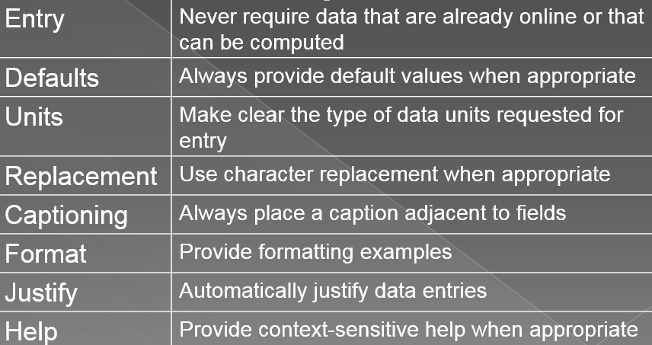
Logical Requirements
When structuring data entry, consider the following:
Source: Valacich, J., George, J., & Hoffer, J. (2015). Systems Planning and Selection. In Essentials of Systems Analysis and Design (6th ed., p. 418). New Jersey: Pearson.

