Slide 1

Mobile Application Development
Chapter 8
[Access to Hardware and Sensors in Android]

Slide 2
Contents
Sensors, Managers and other Hardware
Monitoring the Battery
Using Sensors to create a Compass
Using the Phone
Using the Camera

Slide 3
Sensors, Managers and other Hardware
Sensors
Android devices may have any number of sensors.
In all, the Android platform supports about 12 sensors. However, there is no requirement that a manufacturer of an Android device include all of them.
The Android OS supports sensors for motion, environmental, or position:
    Motion sensors detect how the device is moving.
    Environmental sensors capture measures of the ambient environment such as light level.
    Position sensors capture information used to determine the physical position of the device.

Slide 4
Sensors, Managers and other Hardware
Sensors
  The Sensor class represents all types of sensors.
Sensors are instantiated as a system service by the operating system and not instantiated by the apps that use them.
  Sensors are accessed through the SensorManager class.
The SensorManager is a system service and is not instantiated by an app.
Access is through a reference created by calling the getSystemService method within an app.
Two items are needed to work with sensors:
  SensorEvent : is an object that is created by a Sensor when it has something to report. This object holds information about the event, including a timestamp for when the object was created, the sensor that produced the event, and data that represents the sensor’s measurements at the time of the event.
  SensorEventListener : is an interface that is implemented by any app that wants to use sensor information encapsulated in a SensorEvent

Slide 5
Sensors, Managers and other Hardware
Managers
Android devices are computing devices, they have hardware for processing, memory, long-term storage, and for providing power.
The Android OS provides objects to facilitate the monitoring of the status of this hardware:
  BatteryManager: used to monitor the battery’s status.
  StorageManager: used to monitor the status of long-term storage.
  PowerManager: used to monitor power consumption.
The objects used to monitor the internal environment of the device are instantiated as system services, to use them in an app, you get a reference to the appropriate system service.

Slide 6
Sensors, Managers and other Hardware
Other Hardware
Android devices have hardware features, such as a phone and a camera.
These devices have an app associated with them to provide access to their functionality.
The functionality of the hardware can be accessed by integrating the features within the app by calling the associated app’s API.
The app developer can provide users with exactly the functionality they need from the device.

Slide 7
Monitoring the Battery
Typically, all versions of the Android OS have some sort of battery-level monitoring display so that the user knows when to recharge the device. However, just because the battery level is displayed to the user doesn’t mean that the user will pay attention and plug in the phone or tablet when needed.
To avoid complications from the device shutting down during app execution, you may need to monitor the battery within the app so that the app can take necessary precautions if the level gets too low. You may also require the user to have the device plugged in to external power to carry out certain operations that might require a significant power drain.

Slide 8
Monitoring the Battery
Learning how to do so is useful for understanding one approach used in Android to interact with device hardware. The Android OS has an object that monitors important measures of battery health. Some of these measures include battery temperature, voltage, charge level, and many others. To examine all available measures, review the BatteryManager class on the Android Developer site (search for “android batterymanager”).
The BatteryManager produces a broadcast every few seconds that includes the current reading on these measures. To monitor the battery, the app has to listen for these broadcasts and respond to the measures that are important to the app.

Slide 9
Monitoring the Battery
To demonstrate monitoring the battery, you will put a small TextView in the toolbar on the ContactListActivity to display the current battery level as a percentage.
Begin by adding the TextView to the activity_contact_list.xml layout file. Use the code in Listing 8.1 .
Be sure to place this widget within the toolbar RelativeLayout
Change the layout_margin-Right value of the buttonAdd widget from 20dp to 45dp.

Slide 10
Monitoring the Battery
The next step is to add code to listen for, and respond to, the battery manager’s broadcasts.
To do so, you have to instantiate a BroadcastReceiver object that will capture and respond to the broadcast. A BroadcastReceiver is an object that can receive Intents sent by other Activities both within and outside the app.
Generally, you set up a BroadcastReceiver to respond only to specific types of broadcasts. The code in the BroadcastReceiver typically uses the data from the broadcast Intent to perform some action. The final step is to tell the activity to listen for broadcasts from the BatteryManager using the broadcast receiver you defined. Enter the code in Listing 8.2 in the onCreate method of the ContactListActivity .

Slide 11
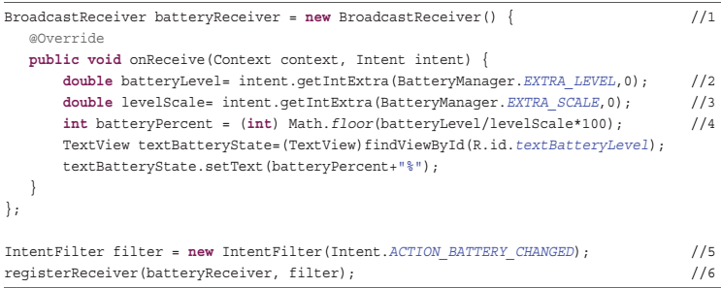
Monitoring the Battery
1// A BroadcastReceiver variable is declared and instantiated with a new BroadcastReceiver.
2// The Intent concerning battery status sent by the OS contains information about the battery as Extras. This line gets the extra associated with the battery’s current charge level.
3// The extra associated with the scale used for measuring the charge is retrieved and assigned to a double variable. Capturing the scale is important because different devices may use different scales for measuring charge.
Scale is the integer containing the maximum battery level.
4// The percentage of battery charge left is calculated by dividing the level by the scale. If these two variables were not defined as doubles, this calculation would produce incorrect results because a divide operation needs to produce double value. The result of the calculation is a number between 0 and 1, which is multiplied by 100 to get a percentage.
The floor function is applied to take on the integer value of the result.
[Extras -- a Bundle of any additional information. This can be used to provide extended information to the component]

Slide 12
Monitoring the Battery
5. A new IntentFilter variable is declared and assigned a new IntentFilter . An IntentFilter listens for Intents that have been broadcast by the system and only lets through the ones the developer is looking for.
In this case, the filter looks for Battery Status changed intent. This is required because a BroadcastReceiver can respond to any intent. However, you want it to respond only to Intents sent by the battery.
6. The BroadcastReceiver is registered, which means that the app is told to listen for battery status intents and handle them with the BroadcastReceiver defined in the activity.

Slide 13
Using Sensors to Create a Compass
In the MyContactList app, you will use sensors to create a simple compass to show users what direction they are headed when they have the contact map displayed.
Creating a graphical compass display is beyond the scope of this book, so you will simply add a TextView to the ContactMapActivity toolbar to display the direction in text (E, W, N, and S).

Slide 14
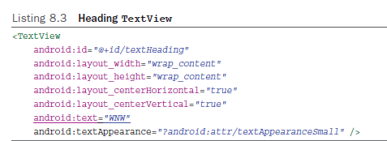
Using Sensors to Create a Compass
The first step is to add the TextView to the toolbar in the activity_contact_map.xml. The TextView must be added between the Location and MapType buttons (Listing 8.3).
Be sure to place this widget within the toolbar RelativeLayout

Slide 15
Using Sensors to Create a Compass
To calculate the device heading, you need to capture information from two sensors: the accelerometer and the magnetometer.
  The accelerometer reports device acceleration in three dimensions.
  The magnetometer reports the geomagnetic field in three dimensions
The Android SDK again does much of the work for you.
Open ContactMapActivity.java and declare four variables where you declared the GoogleMap variable (just after the class declaration). Use the following code:
SensorManager sensorManager ;
Sensor accelerometer ;
Sensor magnetometer ;
TextView textDirection ;

Slide 16
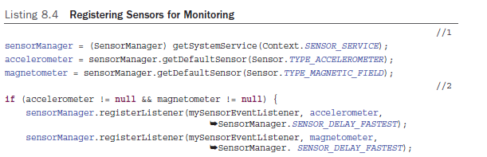
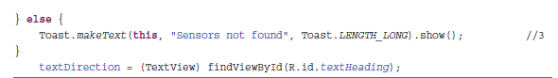
Using Sensors to Create a Compass
Monitoring the sensors requires a SensorManager object and Sensor objects for each sensor used, as shown in Listing 8.4.
This code gets the references to the sensors and registers them to activate a SensorEventListener object when they report changes. The SensorEventListener has yet to be coded.
SensorManager is a system service so you get a reference to it rather than instantiate it.
The SensorManager is used to get references to the two sensors used to measure heading.
If the sensors are present, the SensorManager associates each with the same event
listener and passes a parameter indicating how frequently to process sensor events.
If sensors are not available, the user is informed with a Toast .

Slide 17
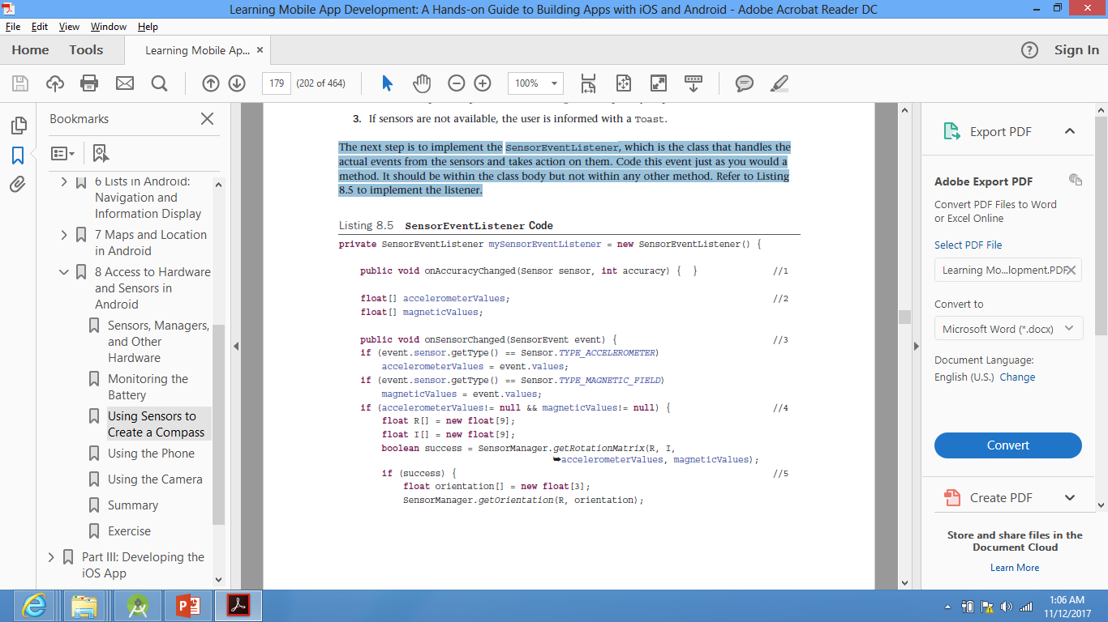
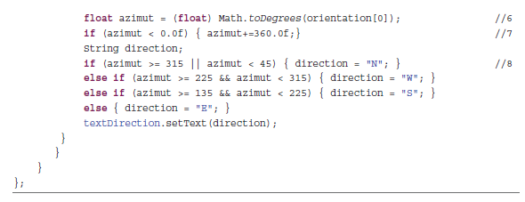
Using Sensors to Create a Compass
The next step is to implement the SensorEventListener , which is the class that handles the actual events from the sensors and takes action on them.
The code should be within the class body but not within any other method. (Listing 8.5 )
1. A SensorEventListener requires the implementation of two events, onAccuracyChanged and onSensorChanged . To calculate a heading, you don’t need accuracy, so its method block is empty
2. Sensor readings are returned as a float array. Two variables to hold the response from each sensor are declared.
3. The onSensorEvent first determines which sensor triggered the event and then captures the values it provided.
4. If there are values available for both sensors, the SensorManager is asked for two rotational matrices used for orientation calculation.
5. If the matrices are successfully calculated, the SensorManager is asked to calculate the orientation of the device. Orientation is measured in three dimensions.
6. The first orientation measure is the value used to calculate the heading. It is reported in radians, so these are changed to degrees.
7. Convert the heading reported to eliminate negative numbers.
8. Use degree heading to get text description. These are done in 90-degree increments. You could add more code to get finer gradations of direction, such as NW or SE.

Slide 18
Using Sensors to Create a Compass
Android Versus iOS
Creating a compass in Android requires accessing two sensors and manipulating the data they provide.
In contrast, the device’s heading is included in the Core Location framework on iOS. Heading is reported as a function of the device’s location, making creating a compass in iOS significantly easier than in Android.

Slide 19
Using the Phone
- Android devices includes hardware capabilities that can be accessed to provide certain functionality for an app.
- To access data from a sensor, the app listens for
a broadcast from a sensor.
- Functionality of hardware (such as phone) can be accessed by calling the API associated with the hardware.

Slide 20
Using the Phone
- In MyContactList app, ContactActivity can be coded so that pressing and holding one of the contact’s phone
numbers will automatically call that number.
-This requires user permission. Add this line in
AndroidManifest.xml file.
- Next, add listener to EditText for “press-and-hold” user action.

Slide 21
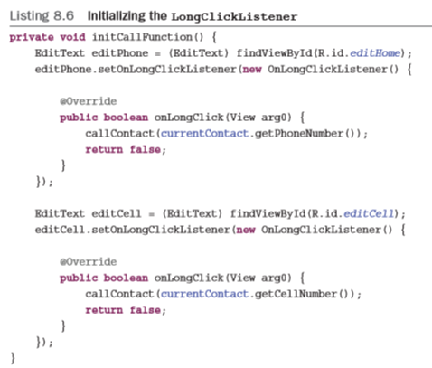
Using the Phone
A reference to the widget is created, and an event is added to the widget.
Next, the widget’s response to the event is coded. In this case, that is a call to another method that accepts the phone number in the EditText as a parameter.
Next, we’ll add the callContact method.

Slide 22
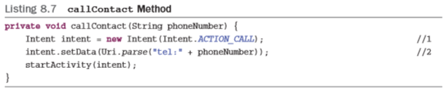
Using the Phone
//1 A new intent is instantiated with the parameter Intent. ACTION_CALL , which tells Android that you want to use the phone to make a call.
//2 The telephone number to be called is passed to the intent as a Uniform Resource Identifier (URI). A URI is similar to a Uniform Resource Locator (URL).
- Next, you need to modify the setForEditing method in ContactActivity.java.
- An EditText has to be enabled to allow it to respond to a long click event.

Slide 23


Using the Phone
- Modify the if (enabled) block of code to include the following in the true block:
- Modify the following of the false block (else block).
- You’ll be able to make a call by pressing and holding a phone number

Slide 24
Using the Camera
The camera will be used in the MyContactList app to capture a photo of the contact so that it can be displayed with the contact’s data. To begin, there must be a place to show the image on the ContactActivity’s layout.
To do this, you add ImageButton to the layout. You use the button functionality of the ImageButton to access the camera. An ImageButton must have an image associated with it, so the first step is to import the photoicon.png file into the drawable-hdpi folder.

Slide 25
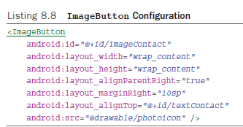
Using the Camera
Modify the attributes of the editName EditText so it does not overrun the ImageButton by adding the following attribute/value pair:
android:layout_toLeftOf= "@+id/imageContact"
Enter the following permission after the other permissions already in the manifest: <uses-permission android:name = "android.permission.CAMERA" />

Slide 26
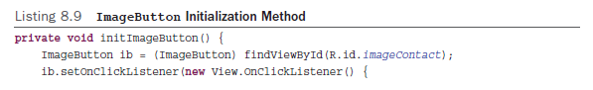
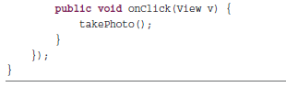
Using the Camera
Next, open ContactActivity.java to code the camera use. This requires initializing the ImageButton to listen for an onClick event, writing code to have the onClick method call a routine to start the camera, and writing code to listen to get the picture after it has been taken.

Slide 27
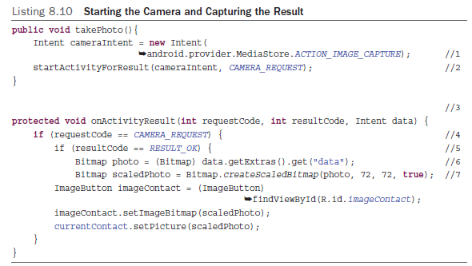
Using the Camera
Next, add the code to access the camera and get the returned picture. The camera app is, of course, an activity, so it must be started with an Intent .

Slide 28
Using the Camera
A new intent is instantiated with a parameter that tells the system to open the camera in image capture mode. You do not have to check whether the camera is present. The permission you added in the manifest would not let your app run on the device if it did not have a camera.
The returned request code is checked to see if it is the one sent to the camera.
1
4
5
Check if the camera returned with a picture.
The Activity is started in a different way than you have seen before. In this case, you want the activity to return a value to the app after it has completed, so you use the startActivityForResult method. The parameters are the new Intent and a static variable called CAMERA_REQUEST. The variable CAMERA_REQUEST is identified as an error because it has not been defined. This variable is an integer that is used to identify the response from the camera when it finishes. The value is not fixed by the SDK but should be given a large integer so it is not confused with other built-in responses. Add this line after the class declaration to fix the error:
private static final int CAMERA_REQUEST = 1888;
The data from the Intent is assigned to a variable declared as a Bitmap . The method .get("data") doesn’t specify a type of data to get from the extras, so it must be cast into a Bitmap. After the photo is captured, it is displayed in the ImageButton , and the contact object’s picture attribute is set to hold the photo.
2
6
The picture is scaled so that a consistent-sized photo is displayed in the ImageButton .
The parameters of this method are the picture to be scaled, the height and width to scale to in pixels, and whether a filter should be applied during the scaling operation. Generally when scaling down, this filter has no effect but can change the result when
scaling up.
The onActivityResult method is declared. This method receives a request code that was sent to the camera, a result code, and an intent that includes the data (the picture in this case) from the intent you started. This method is executed when the camera finishes.
7
3
The setPicture method must be added, along with a Bitmap variable to the Contact object. Open Contact.java and add a variable to the class using the following code:
private Bitmap picture ;

Slide 29
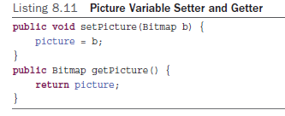
Using the Camera
Next, add the setters and getters as shown below and save the file
But now that you have a picture to save, we need to change the following:
the method to display a contact must be modified to display the saved contact picture
the ContactDataSource methods to save and retrieve contacts must be modified to store and retrieve the picture
the database must be modified to have a field in the table to hold the picture.
To do that:
Tell the app that the database has changed. In the ContactDBHelper.java, increase the version number by 1. ➔ private static final int DATABASE_VERSION = 2;
Add a picture field with a data type of blob to the contact table. The blob (Binary Large Object) data type can hold any type of binary data and is typically used for picture, audio, and video objects. Modify the last line in the CREATE_ TABLE_CONTACT string to the following: + "email text, birthday text, contactphoto blob);";

Slide 30
Using the Camera
3. The last step is to modify the onUpgrade method. To handle a change to the database structure without losing all the user data, modify the onUpgrade method to match the Code below
The modifications comment out the deletion and re-creation of the table and add an SQL state to add the new field to the table.
a try and catch statement so that if the field has already been added, it doesn’t crash the app

Slide 31
Using the Camera
After modifying the ContactDBHelper.java file, modify the ContactDataSource.java file to save and retrieve the picture.
Code Listing 8.13 must be added to both the insertContact and updateContact methods.
It must be placed prior to the call to update or insert the contact.
Note that, in the updateContact method, you need to use updateValues.put(contactphoto", photo) instead of initialValues.put("contactphoto", photo)

Slide 32
Using the Camera
To store a bitmap to the database,
  it must first be converted to a byte array
  The code in Listing 8.13 uses standard objects in the Android SDK to do this conversion
After the photo is converted, it is placed into the values to be updated like any other value
Next, modify the getSpecificContact method to load the Contact object with the picture
Returning the picture from the database is the reverse process from saving to the database, as shown in ( Listing 8.14 ).

Slide 33
Using the Camera
The 10 in the getBlob method is the index of the contactphoto field in the contact table
The objects supplied by Android do most of the work
The byte array is retrieved from the database and is then tested to determine if a picture has been stored
The conversion from byte array to Bitmap will cause a crash if no picture is stored.

Slide 34
Using the Camera
The last step is to modify ContactActivity.java
  to display the retrieved picture along with the rest of the contact’s data
  the initContact method will complete the process
The below code gets a reference to the ImageButton on the layout and checks if the contact has a picture
  If there is a picture, it is set as the button’s image
  If not, the default image resource is displayed

Slide 35
Extra Resources
Interacting with other Apps:
https://developer.android.com/training/basics/intents/index.html

Slide 36
Thank You !

