Slide 1
An important part of developing for the mobile platform is storing data that the user will need to run the app.
Core Data provides support for a database-backed persistence solution for iOS apps.
iOS enables saving data in files in regular text files or by archiving (i.e.serialization in Java and C#).
iOS apps are sandboxed. This means each app is isolated from the other apps and the operating system.

Slide 2
A consequence is each app has a simple file system that by default consists of a few standard directories: Documents, Library, and tmp. \
Developers store files in the Documents and tmp directories.
The Documents folder is backed up when the device is backed up. The tmp folder is not.
By storing data in files, you can store user data.
To save data in your app, use the NSUserDefaults object.
Core Data is a data persistence solution developed by Apple to provide object-oriented storage.

Slide 3
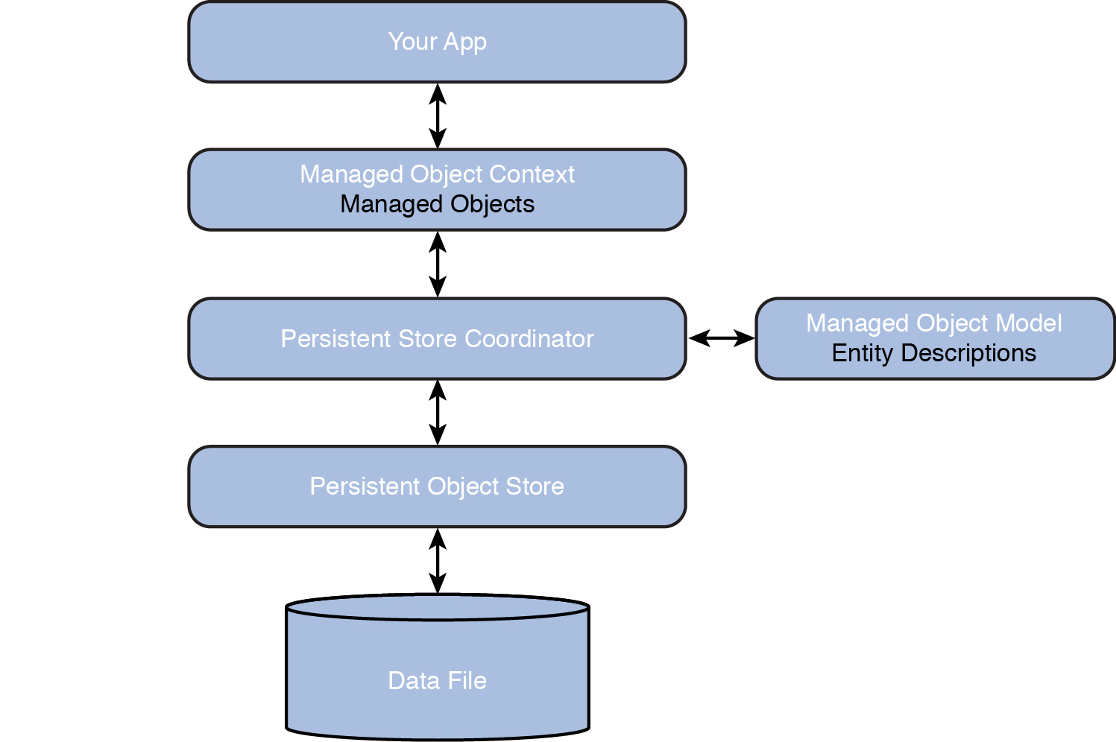
Figure 11.1 shows an overview of the Core Data framework.
Figure 11.1 Overview of the Core Data framework.
Notes:
Figure:

Slide 4
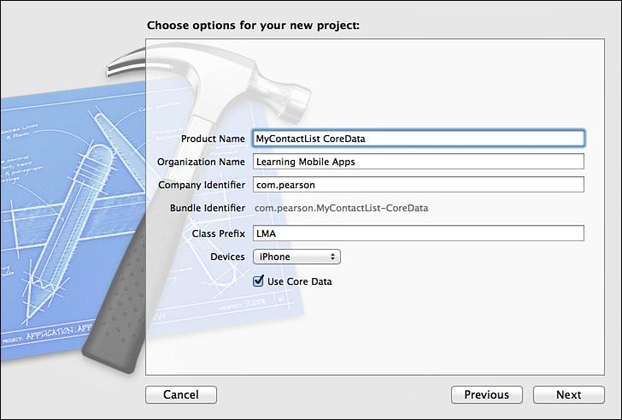
Creating a new project in Xcode (Figure 11.2)
Figure 11.2 Setting up the project to support Core Data.
Notes:
Figure:

Slide 5
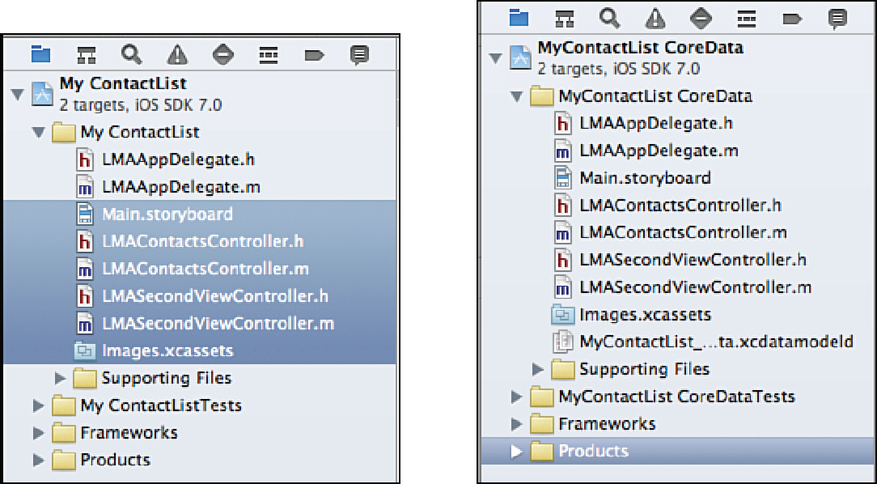
Add the functionality
Select all the files in the MyContactList folder of the original project except LMAAppDelegate.h and MAAppDelegate.m
Drag all the selected files into the new project.
Figure 11.3 Selecting files to copy to the new project on the left. The result of the copy is shown on the right.
Notes:
Figure:

Slide 6
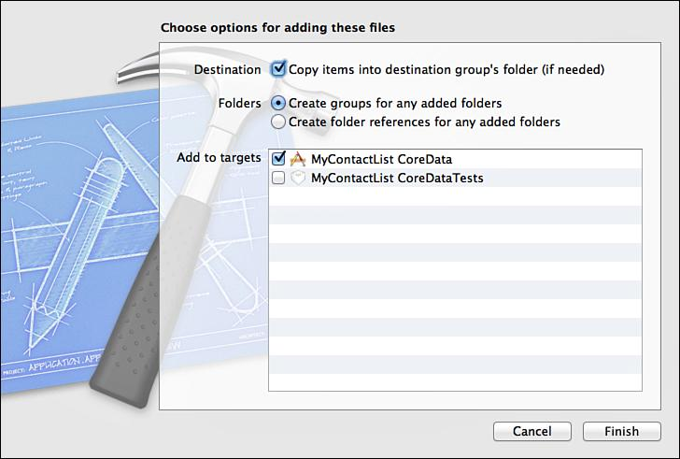
Check Copy Items into Destination Group’s Folder (Figure 11.4)
Figure 11.4 Copying files to the new project.
Notes:
Figure:

Slide 7
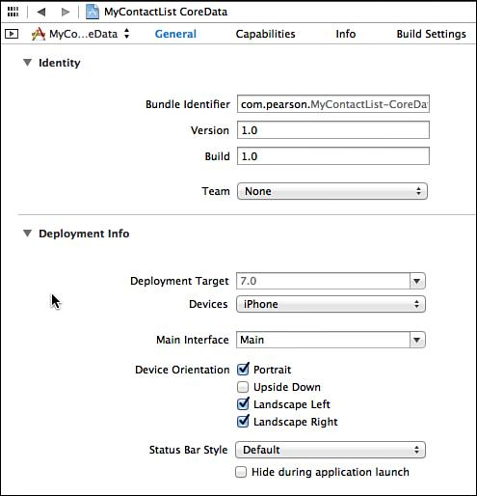
Modify the app delegate to have the correct View Controller show up
when launching the app.
Open the Project Summary and change the Main Interface to
Main.storyboard.
After making the selection, the chosen text will change to Main, as shown in Figure 11.5
Figure 11.5 Setting the Main storyboard.
Notes:
Figure:

Slide 8
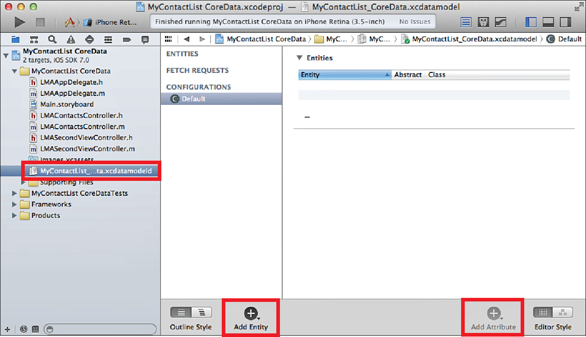
Design the data structure for the MyContactList app.
The data structure for the app is simple with a single entity (Figure 11.6)
Figure 11.6 Using the Core Data Model editor.
Notes:
Figure:

Slide 9
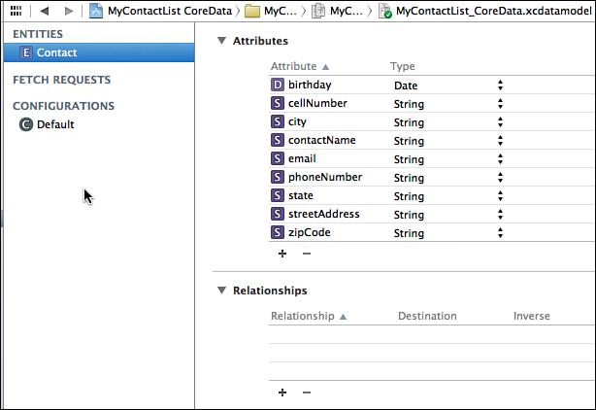
Add attributes as shown in Figure 11.7
Figure 11.7 Attributes of the Contact entity.
Notes:
Figure:

Slide 10
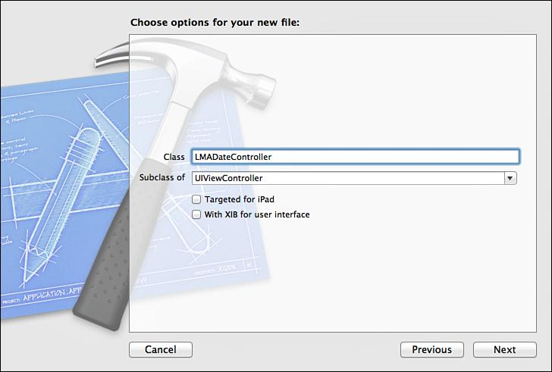
Ensure that none of the check boxes are selected when creating the View Controller.
Figure 11.8 Creating the View Controller for the Date screen.
Notes:
Figure:

Slide 11
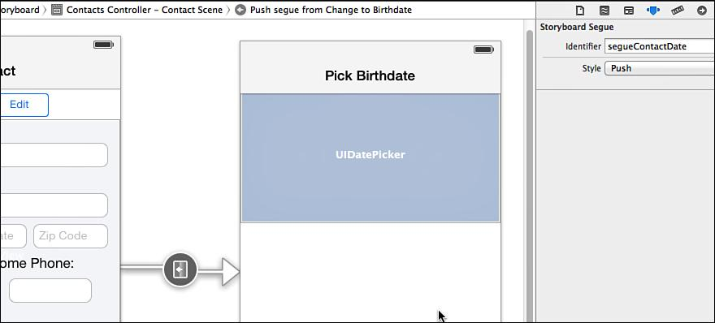
To set the identifier for the segue, open the Storyboard and select the Segue between the Contact and Date screens. Use the Attributes Inspector to set the Identifier to segueContact Date (Figure 11.9).
Figure 11.9 Setting the identifier for the segue.
Notes:
Figure:

Slide 12
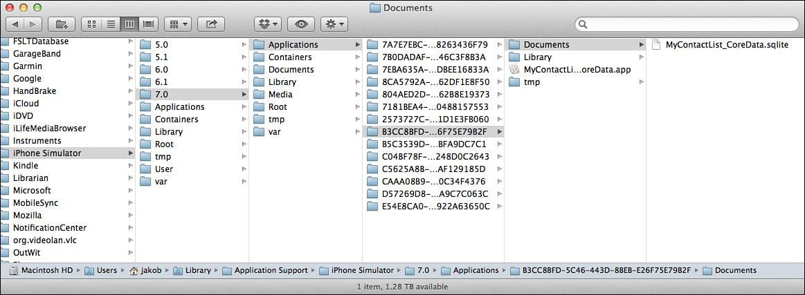
A directory with directories for each version of iOS developed apps for is shown in Figure 11.10.
Open the directory with the highest version number and drill into the Applications folder.
There is a folder for each app created, but they are named with a long string of letters and numbers.
To find the app open each folder and look for the .app file, which will have the name of the app.
Figure 11.10 App file structure and SQLite database for MyContactList.
Notes:
Figure:

Slide 13
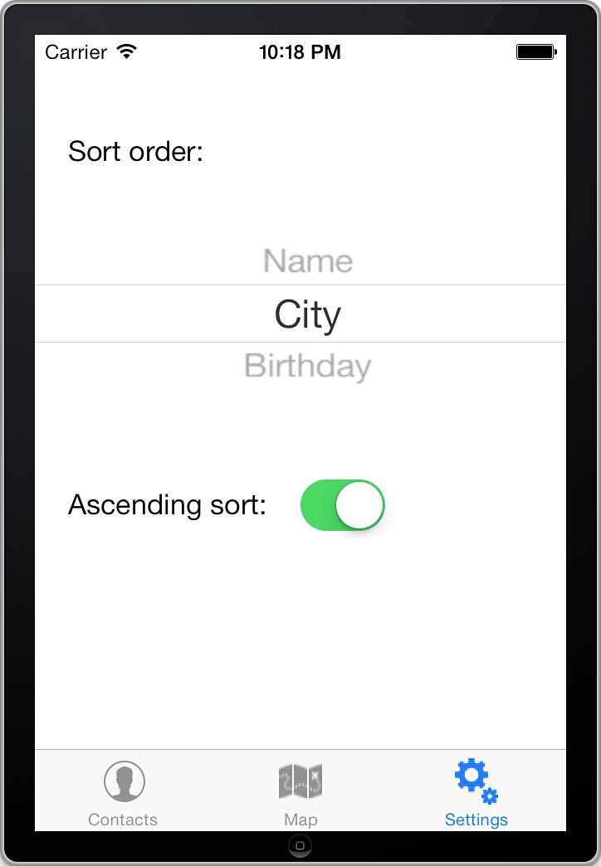
In the settings part of the app, the user is able to change the sort order of the displayed contacts.
The contacts can be sorted in either ascending or descending order by Name, City, or Birthday ( Figure 11.11 ).
Figure 11.11 The completed Settings interface.
Notes:
Figure:

Slide 14
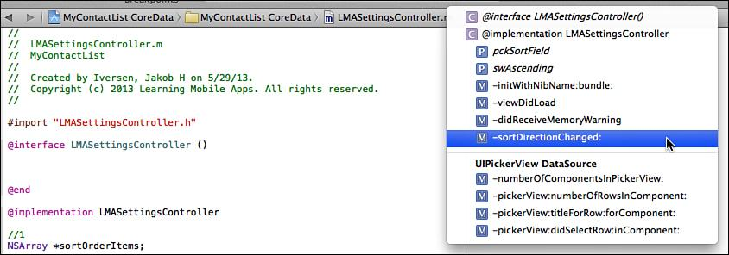
The #pragma notation is used for documentation.
Figure 11.12 Drop-down menu on the right showing the result of #pragma mark in the code.
Notes:
Figure:

