Slide 1
Chapter 4 SNMPv1 Network Management: Organization and Information Models
Chapter 4
SNMPv1 Network Management:
Organization and Information Models
Network Management: Principles and Practice
© Mani Subramanian 2010
*

Slide 2
Objectives
Chapter 4 SNMPv1 Network Management: Organization and Information Models
IETF SNMP standard
History
RFC, STD, and FYI
Organization Model
2- and 3-tier models
Manager and agent
Management messages
Structure of management information, SMI
Object type and instance
Scalar and aggregate managed objects
Management information base, MIB
NMS physical and virtual databases
IETF MIB-2 standard
Network Management: Principles and Practice
© Mani Subramanian 2010
*

Slide 3
Chapter 4 SNMPv1 Network Management: Organization and Information Models
Case Histories
AT&T Network Management Centers
Network Control Centers
Network Operations Center
CNN World Headquarters
Centralized troubleshooting of NIC
Performance degradation due to NMS
Bell Operating company procedure
Notes
Network Management: Principles and Practice
© Mani Subramanian 2010
*

Slide 4
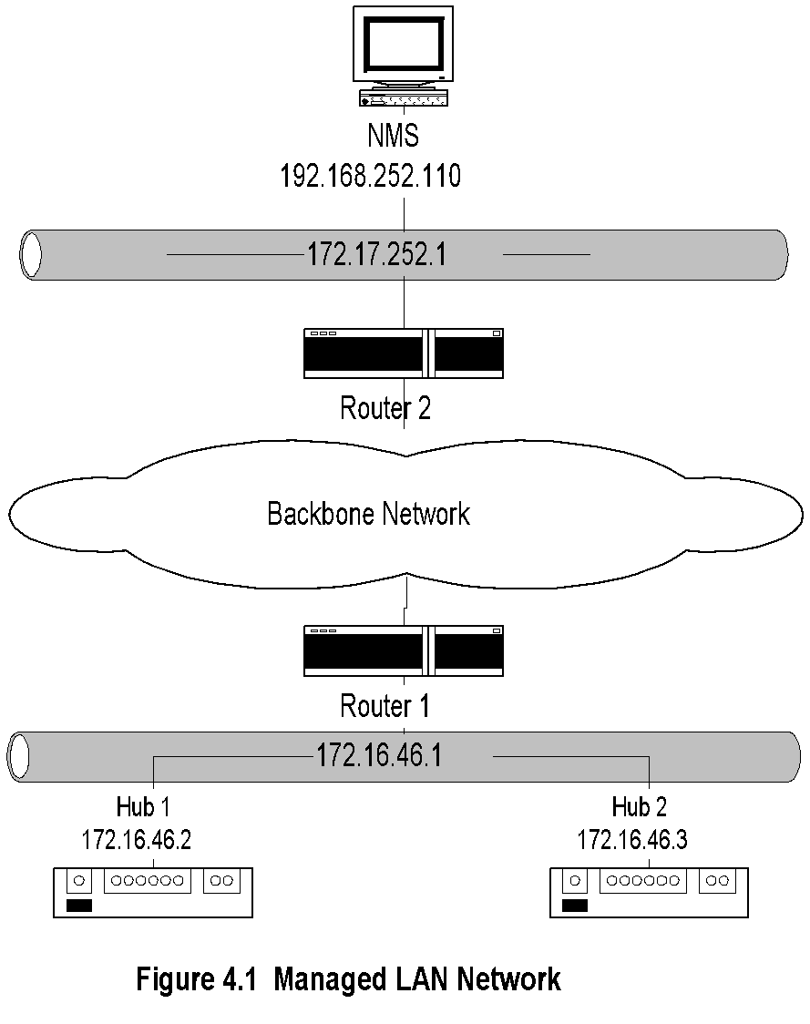
Chapter 4 SNMPv1 Network Management: Organization and Information Models
Managed LAN
Notes
NMS on subnet 192.168.252.1 manages the router and the hubs on subnet 172.16.46.1 across the backbone network
Network Management: Principles and Practice
© Mani Subramanian 2010
*

Slide 5
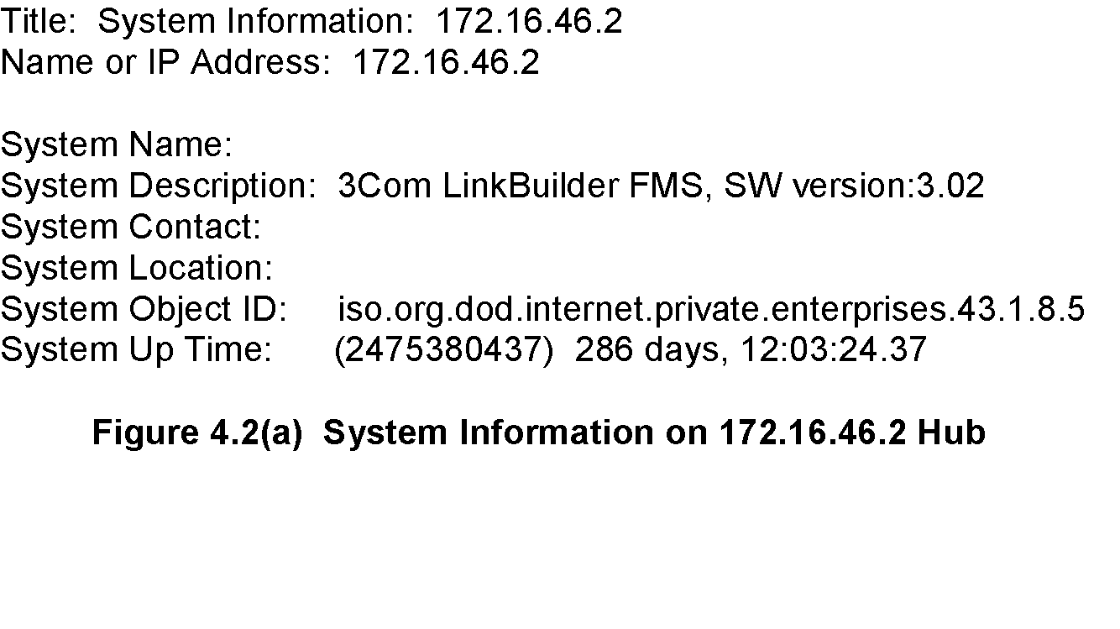
Chapter 4 SNMPv1 Network Management: Organization and Information Models
Managed Hub:
System Information
Notes
Information obtained querying the hub
Data truly reflects what is stored in the hub
Network Management: Principles and Practice
© Mani Subramanian 2010
*

Slide 6
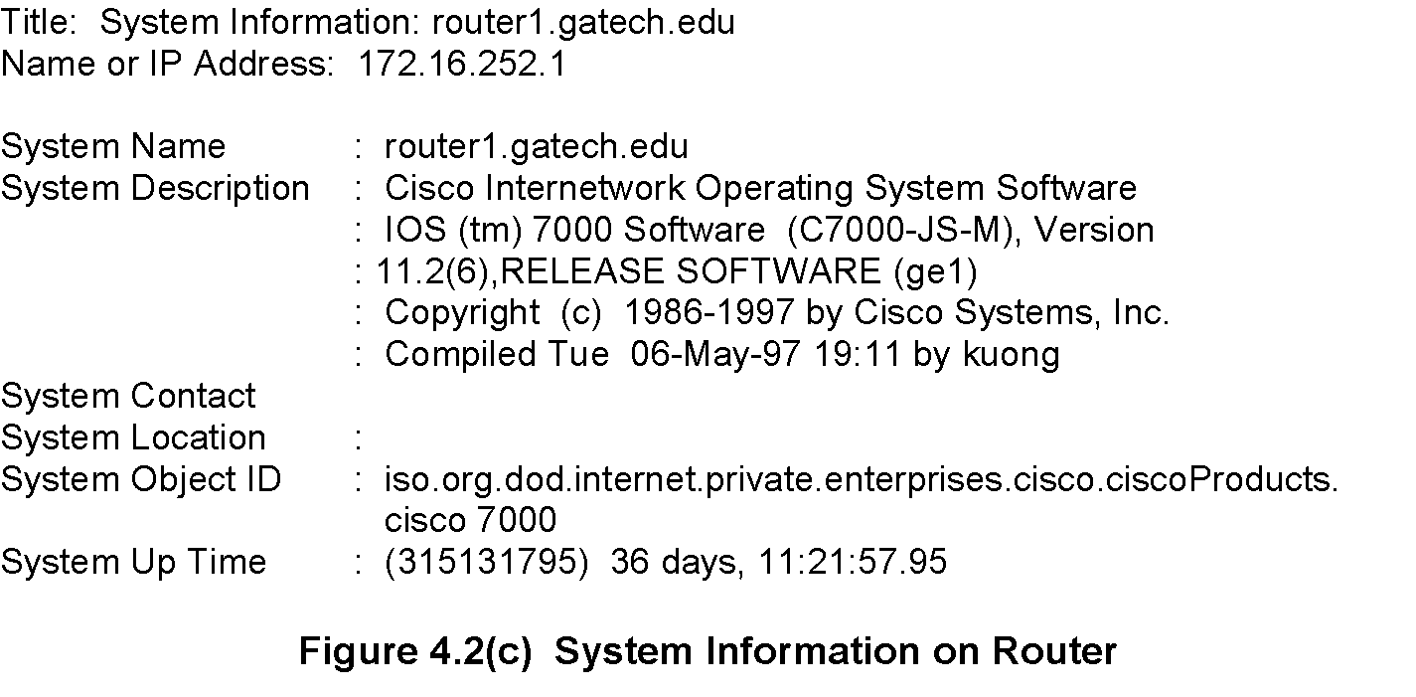
Chapter 4 SNMPv1 Network Management: Organization and Information Models
Managed Router:
System Information
Notes
Network Management: Principles and Practice
© Mani Subramanian 2010
*

Slide 7
Chapter 4 SNMPv1 Network Management: Organization and Information Models
Managed Hub:
Port Addresses
Notes
Information acquired by the NMS on hub interfaces
Index refers to the interface on the hub
Link address is the MAC address
The second row data is a serial link
Network Management: Principles and Practice
© Mani Subramanian 2010
*

Slide 8
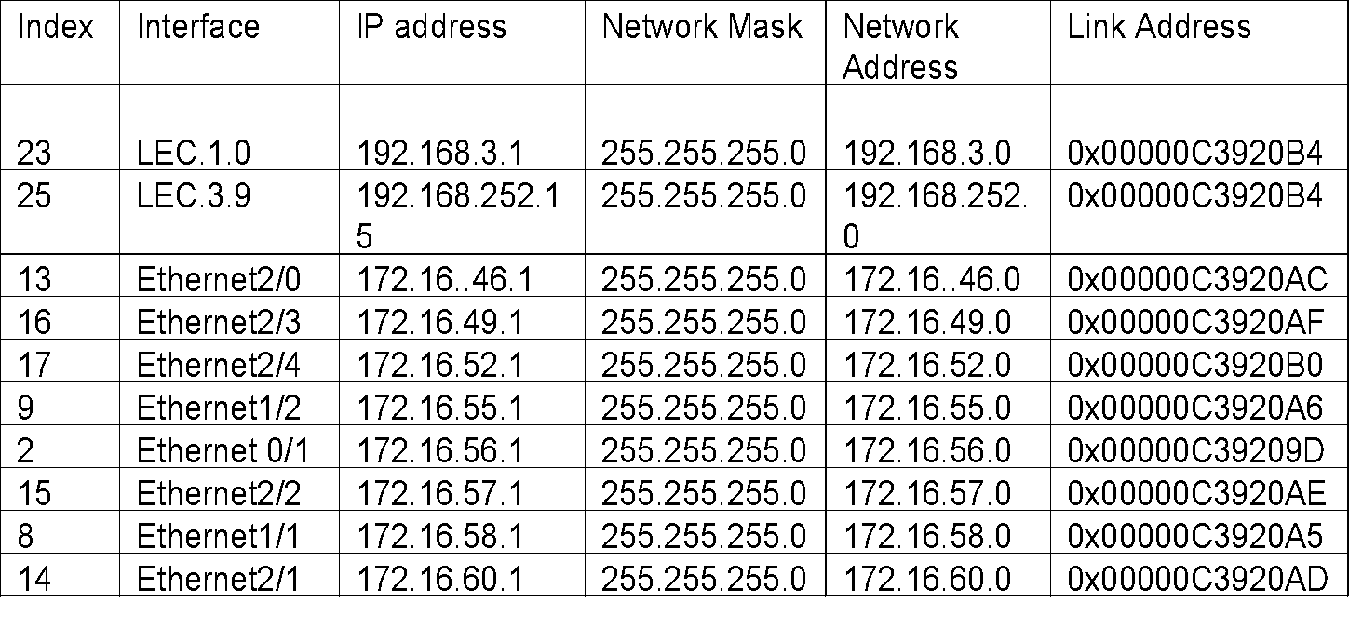
Chapter 4 SNMPv1 Network Management: Organization and Information Models
Managed Router:
Port Addresses
Notes
Information acquired by NMS on the router interfaces
Index refers to the interface on the router
LEC is the LAN emulation card
Ethernet 2/0 interface refers to the interface card 2 and port 0 in that card
Network Management: Principles and Practice
© Mani Subramanian 2010
*

Slide 9
Chapter 4 SNMPv1 Network Management: Organization and Information Models
Internet SNMP Management
1970s Advanced Research Project Agency Network (ARPANET) Internet Control Message Protocol (ICMP)
Internet Engineering Task Force (IETF)
1990 SNMPv1
1995 SNMPv2
1998 SNMPv3
Internet documents:
Request for Comments (RFC)
IETF STD Internet Standard
FYI For Your Information
Source for RFCs
ftp://nic.mil/rfc
ftp://ftp.internic.net/rfc
http://nic/internet.net/
Notes
Network Management: Principles and Practice
© Mani Subramanian 2010
*

Slide 10
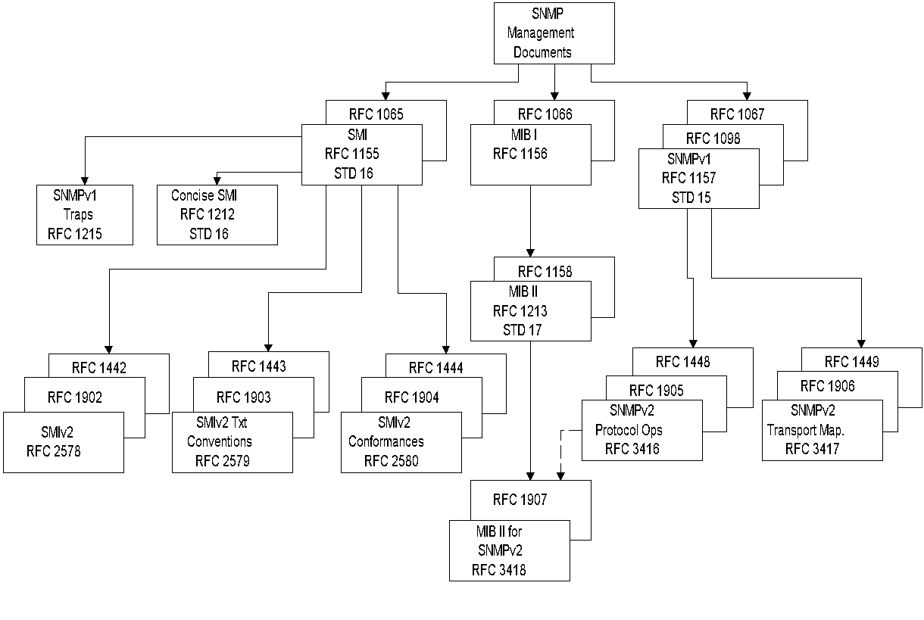
Chapter 4 SNMPv1 Network Management: Organization and Information Models
SNMPv1 & SNMPv2
Documents
Figure 4.4 SNMP Document Evolution
Notes
Network Management: Principles and Practice
© Mani Subramanian 2010
*

Slide 11
Chapter 4 SNMPv1 Network Management: Organization and Information Models
SNMP Model
Organization Model
Relationship between network element, agent, and manager
Hierarchical architecture
Information Model
Uses ASN.1 syntax
SMI (Structure of Management Information)
MIB ( Management Information Base)
Communication Model
Transfer syntax
SNMP over TCP/IP
Communication services addressed by messages
Security framework community-based model
Notes
Network Management: Principles and Practice
© Mani Subramanian 2010
*

Slide 12
Chapter 4 SNMPv1 Network Management: Organization and Information Models
Two-Tier Organization Model
Figure 4.5 Two-Tier Organization Model
Notes
Any host that could query an agent is a manager.
Network Management: Principles and Practice
© Mani Subramanian 2010
*

Slide 13
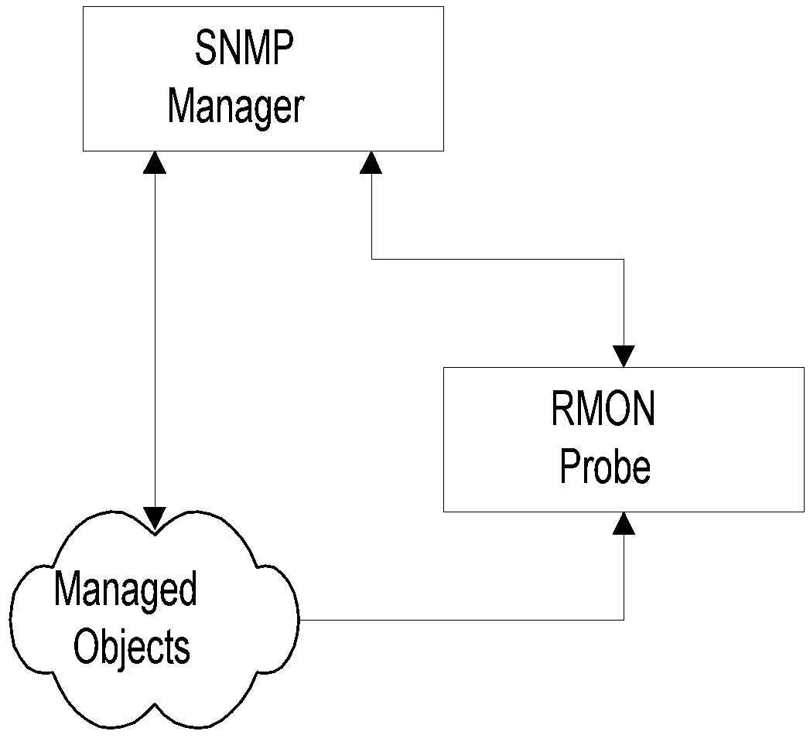
Chapter 4 SNMPv1 Network Management: Organization and Information Models
Three-Tier Organization Model:
RMON
Figure 4.6 Three-Tier Organization Model
Notes
Managed object comprises network element and management agent
RMON acts as an agent and a manager
RMON (Remote Monitoring) gathers data from MO, analyses the data, and stores the data
Communicates the statistics to the manager
Network Management: Principles and Practice
© Mani Subramanian 2010
*

Slide 14
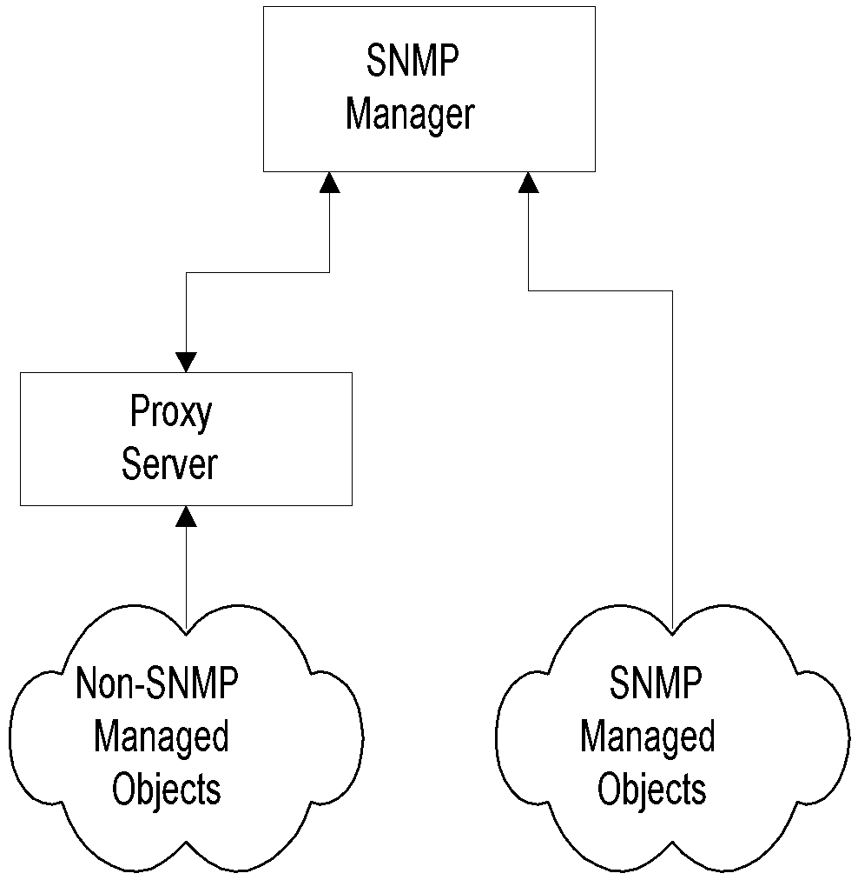
Chapter 4 SNMPv1 Network Management: Organization and Information Models
Three-Tier Organization Model:
Proxy Server
Figure 4.7 Proxy Server Organization Model
Notes
Proxy server converts non-SNMP data from non-SNMP objects to SNMP compatible objects and messages
Network Management: Principles and Practice
© Mani Subramanian 2010
*

Slide 15
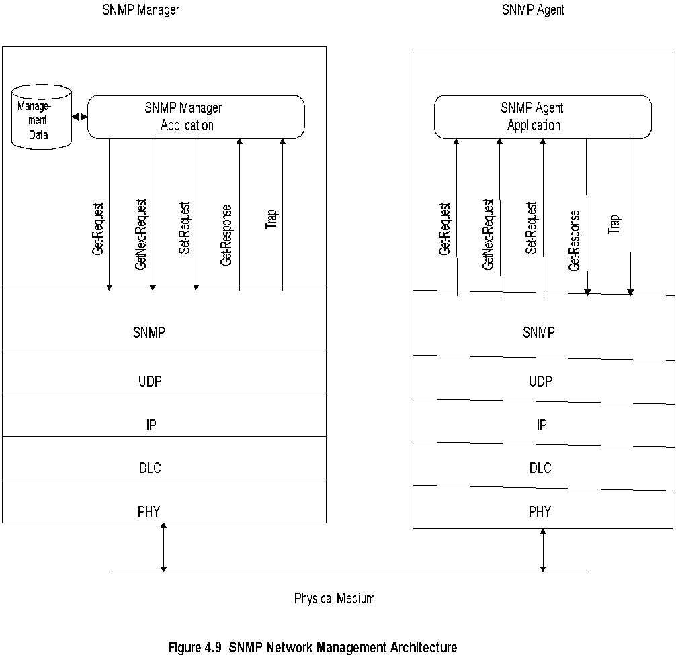
Chapter 4 SNMPv1 Network Management: Organization and Information Models
System Architecture
Notes
Messages between manager and agent
Direction of messages - 3 from manager and 2 from agent
Network Management: Principles and Practice
© Mani Subramanian 2010
*

Slide 16
Chapter 4 SNMPv1 Network Management: Organization and Information Models
SNMP Messages
Get-Request
Sent by manager requesting data from agent
Get-Next-Request
Sent by manager requesting data on the next MO to the one specified
Set-Request
Initializes or changes the value of network element
Get-Response
Agent responds with data for get and set requests from the manager
Trap
Alarm generated by an agent
Notes
Network Management: Principles and Practice
© Mani Subramanian 2010
*

Slide 17
Chapter 4 SNMPv1 Network Management: Organization and Information Models
Information
Structure of Management Information (SMI) (RFC 1155)
Managed Object
Scalar
Aggregate or tabular object
Management Information Base (RFC 1213)
Notes
RFCs can be downloaded from ftp.internic.net/rfc
Network Management: Principles and Practice
© Mani Subramanian 2010
*

Slide 18
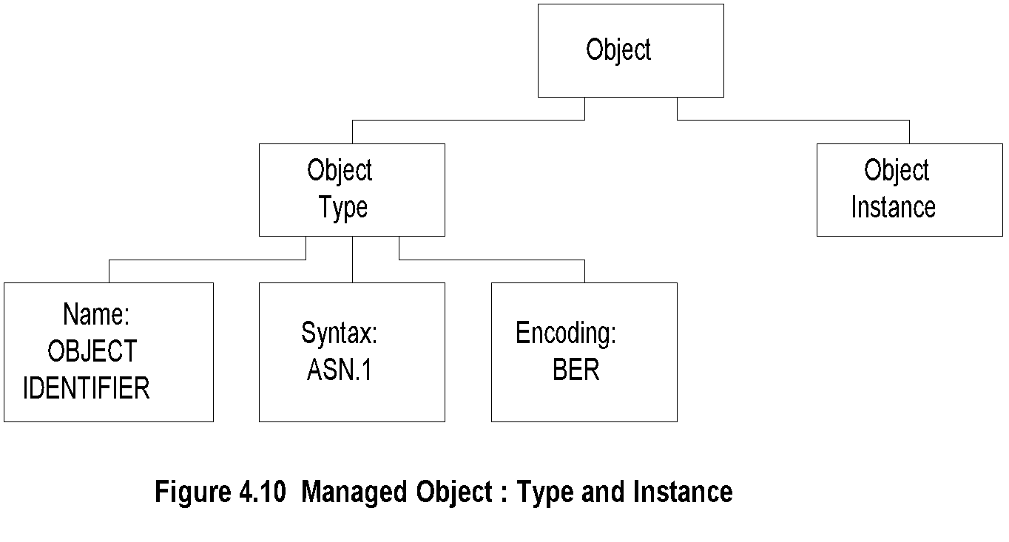
Chapter 4 SNMPv1 Network Management: Organization and Information Models
Managed Object
Notes
Object type and data type are synonymous
Object identifier is data type, not instance
Object instance IP address (See Figure 4.2)
Network Management: Principles and Practice
© Mani Subramanian 2010
*

Slide 19
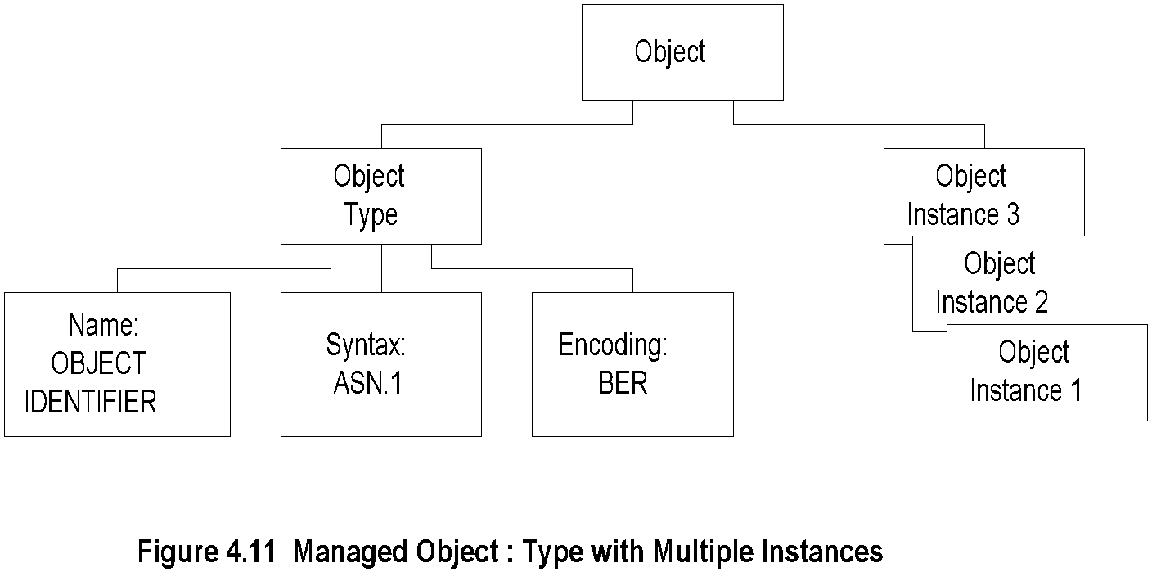
Chapter 4 SNMPv1 Network Management: Organization and Information Models
Managed Object: Multiple Instances
Notes
All 3 Com hubs of the same version have identical identifier; they are distinguished by the IP address.
Each IP address is an instance of the object.
Network Management: Principles and Practice
© Mani Subramanian 2010
*

Slide 20
Chapter 4 SNMPv1 Network Management: Organization and Information Models
Name
Uniquely defined by
DESCRIPTOR AND
OBJECT IDENTIFIER
Notes
Example
ipAddrTable ip 20
Network Management: Principles and Practice
© Mani Subramanian 2010
*

Slide 21
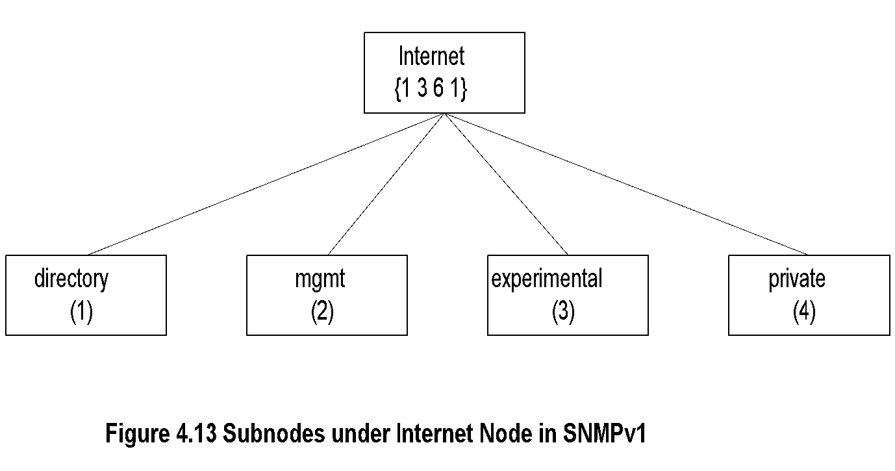
Chapter 4 SNMPv1 Network Management: Organization and Information Models
Internet Subnodes
Notes
directory OBJECT IDENTIFIER ::= {internet 1}
mgmt OBJECT IDENTIFIER ::= {internet 2}
experimental OBJECT IDENTIFIER ::= {internet 3}
private OBJECT IDENTIFIER ::= {internet 4}
Network Management: Principles and Practice
© Mani Subramanian 2010
*

Slide 22
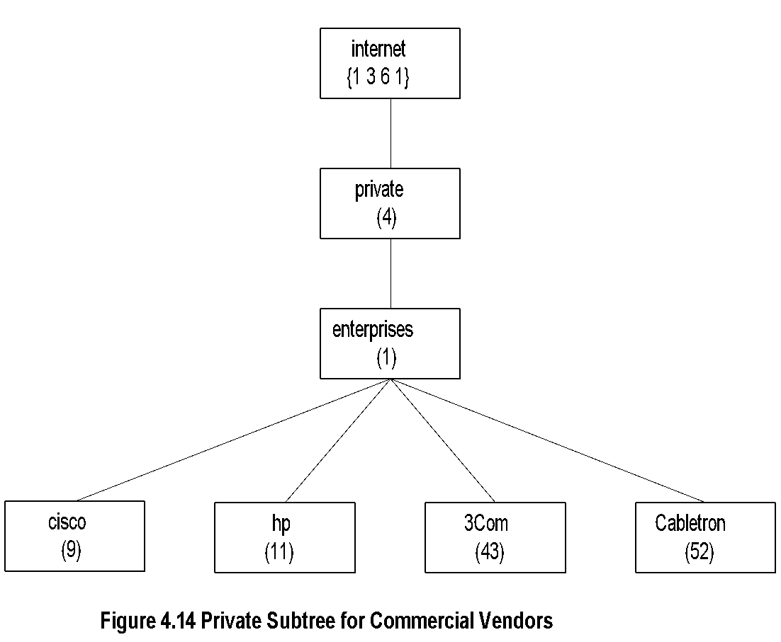
Chapter 4 SNMPv1 Network Management: Organization and Information Models
Private MIB Example
Notes
private MIB intended for vendor equipment
IANA (Internet Assigned Numbers Authority) assigns identifiers
Network Management: Principles and Practice
© Mani Subramanian 2010
*

Slide 23
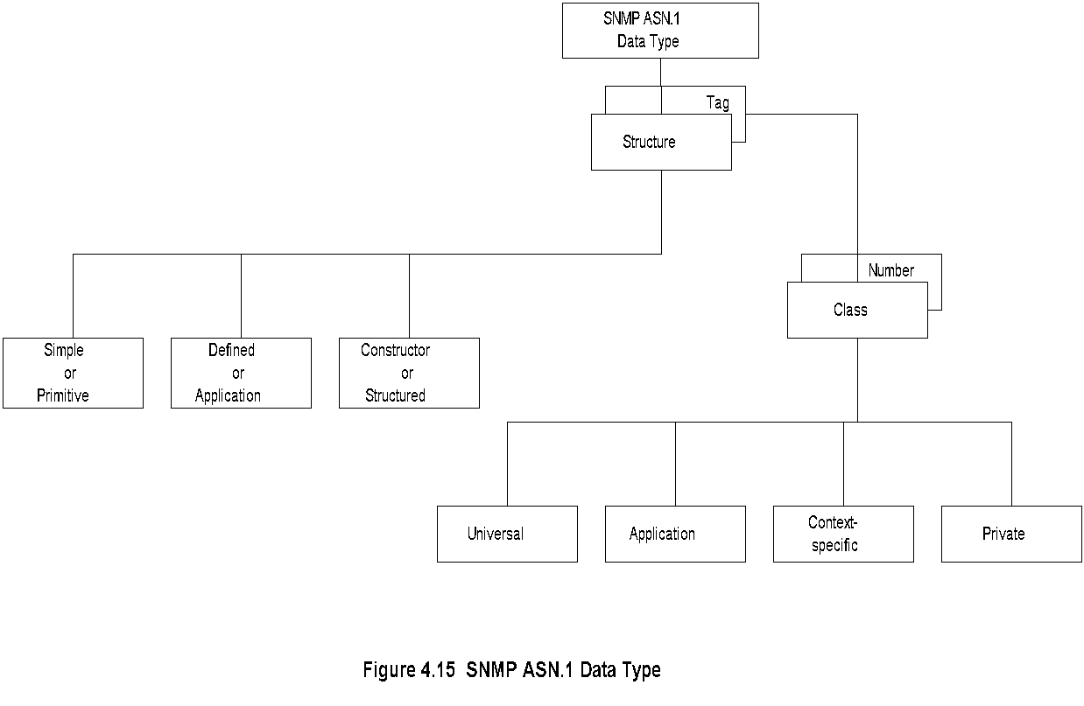
Chapter 4 SNMPv1 Network Management: Organization and Information Models
SNMP ASN.1 Data Type
Network Management: Principles and Practice
© Mani Subramanian 2010
*

Slide 24
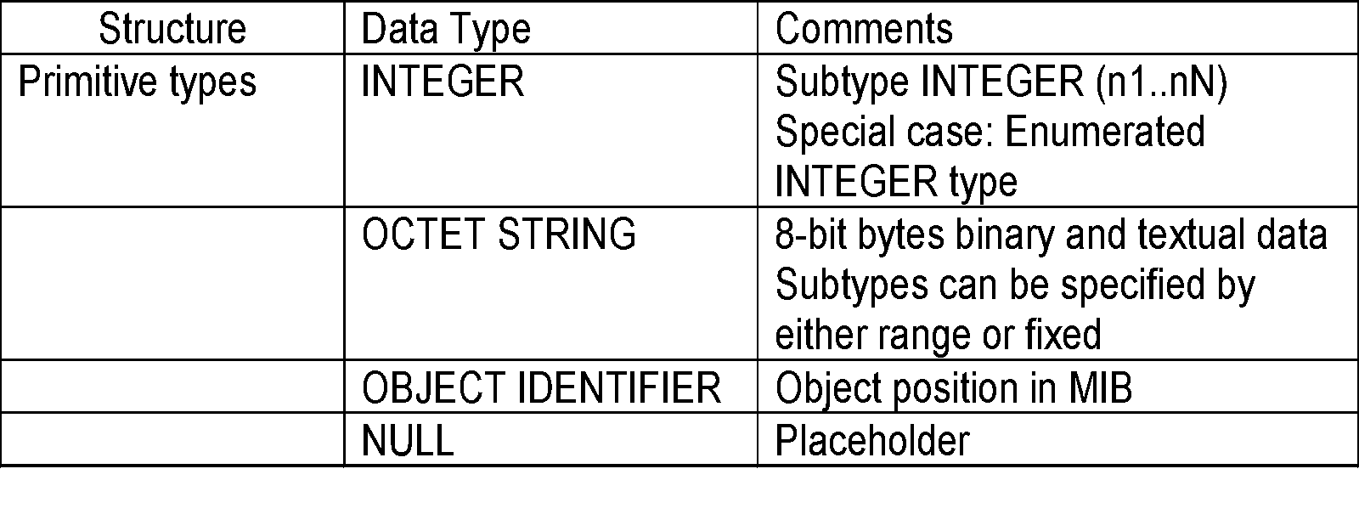
Chapter 4 SNMPv1 Network Management: Organization and Information Models
Primitive Data Types
Notes
get-request message has NULL for value fields and get-response from agent has the values filled in subtype:
INTEGER (0..255)
OCTET STRING (SIZE 0..255)
OCTET STRING (SIZE 8)
Network Management: Principles and Practice
© Mani Subramanian 2010
*

Slide 25
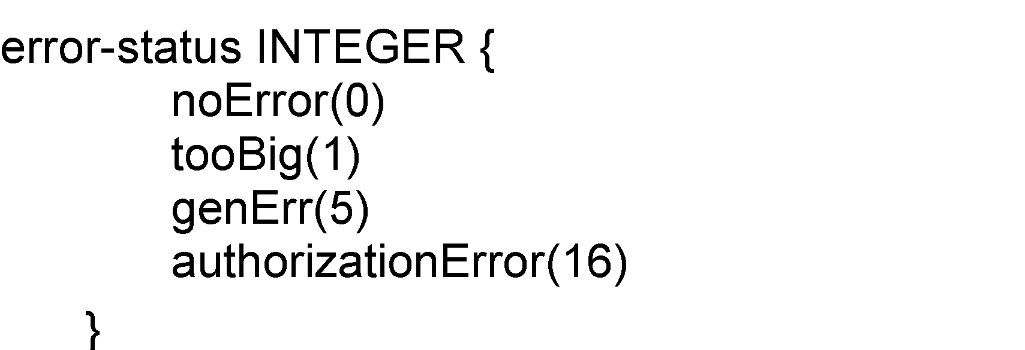
Chapter 4 SNMPv1 Network Management: Organization and Information Models
Enumerated
Special case of INTEGER data type
Notes
noError NULL by convention
Network Management: Principles and Practice
© Mani Subramanian 2010
*

Slide 26
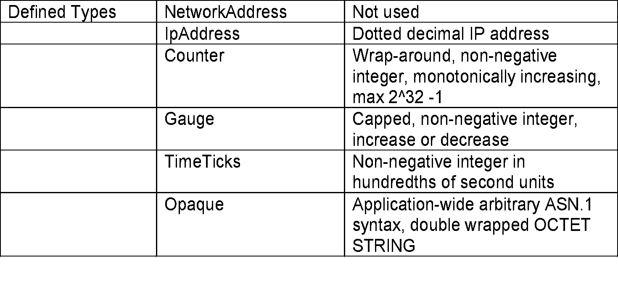
Chapter 4 SNMPv1 Network Management: Organization and Information Models
Defined or Application Data Type
Notes
Defined data types are simple or base types
Opaque is used to create data types based on previously defined data types
Network Management: Principles and Practice
© Mani Subramanian 2010
*

Slide 27
Chapter 4 SNMPv1 Network Management: Organization and Information Models
Constructor or Structured Data Type:
SEQUENCE
List maker
Notes
Network Management: Principles and Practice
© Mani Subramanian 2010
*

Slide 28
Chapter 4 SNMPv1 Network Management: Organization and Information Models
Constructor or Structured Data Type:
SEQUENCE OF
Notes
Network Management: Principles and Practice
© Mani Subramanian 2010
*

Slide 29
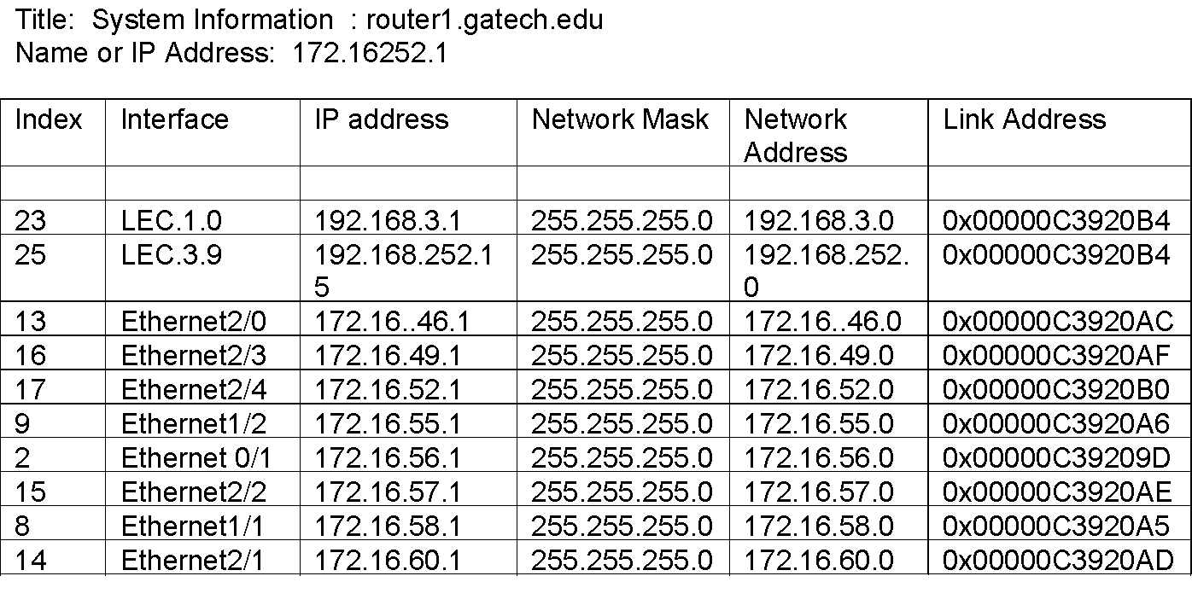
Chapter 4 SNMPv1 Network Management: Organization and Information Models
SEQUENCE OF Example
Notes
The above example (Figure 4.3) uses part of the IP MIB discussed for SEQUENCE OF construct.
Network Management: Principles and Practice
© Mani Subramanian 2010
*

Slide 30
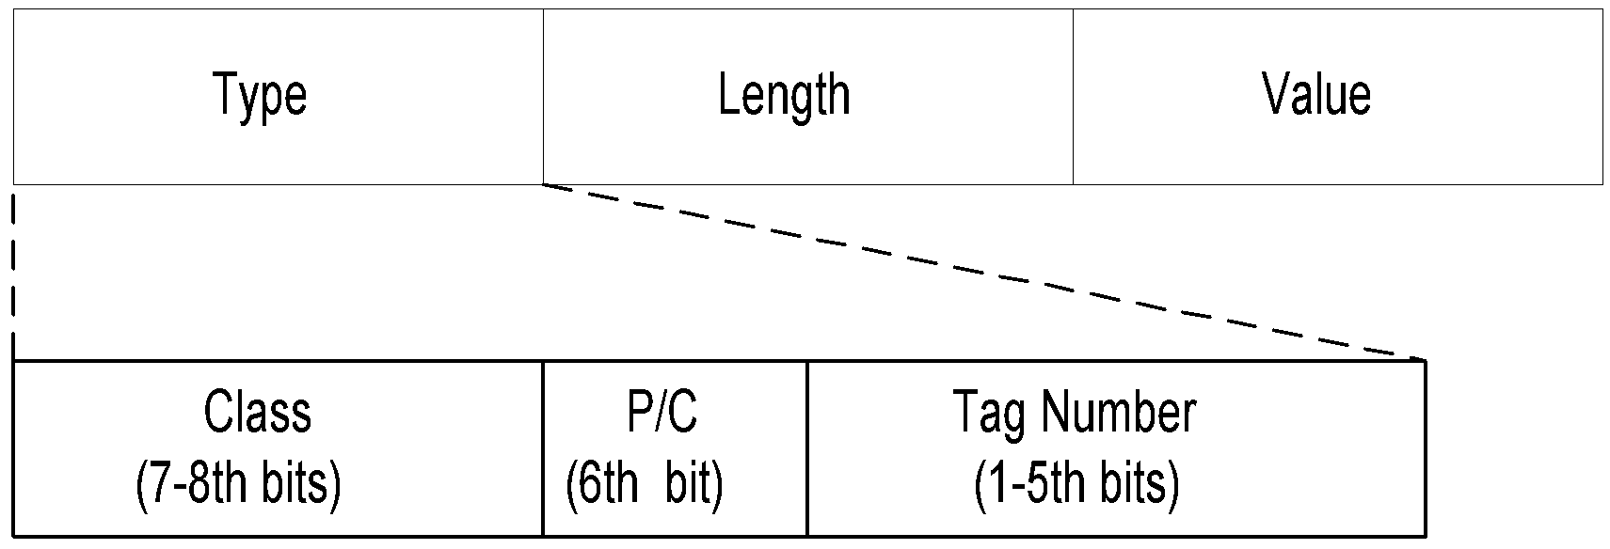
Chapter 4 SNMPv1 Network Management: Organization and Information Models
Encoding
Basic Encoding Rules (BER)
Tag, Length, and Value (TLV)
SNMP Data Types and Tags
Type Tag
OBJECT IDENTIFIER UNIVERSAL 6
SEQUENCE UNIVERSAL 16
IpAddress APPLICATION 0
Counter APPLICATION 1
Gauge APPLICATION 2
TimeTicks APPLICATION 3
Opaque APPLICATION 4
Notes
Network Management: Principles and Practice
© Mani Subramanian 2010
*

Slide 31
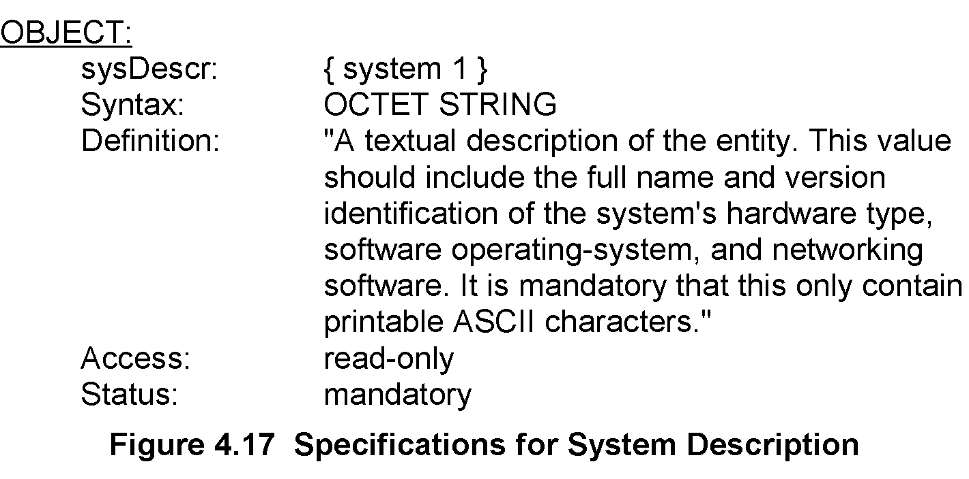
Chapter 4 SNMPv1 Network Management: Organization and Information Models
Managed Object: Structure
Notes
Network Management: Principles and Practice
© Mani Subramanian 2010
*

Slide 32
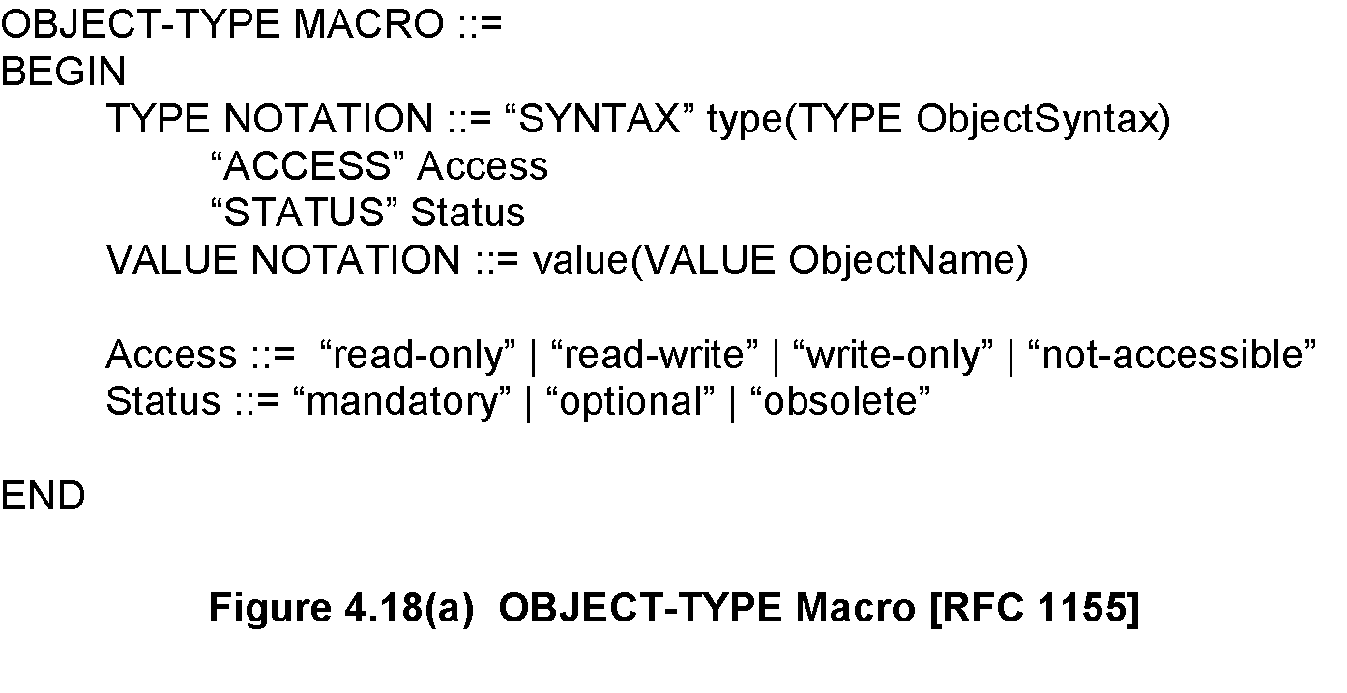
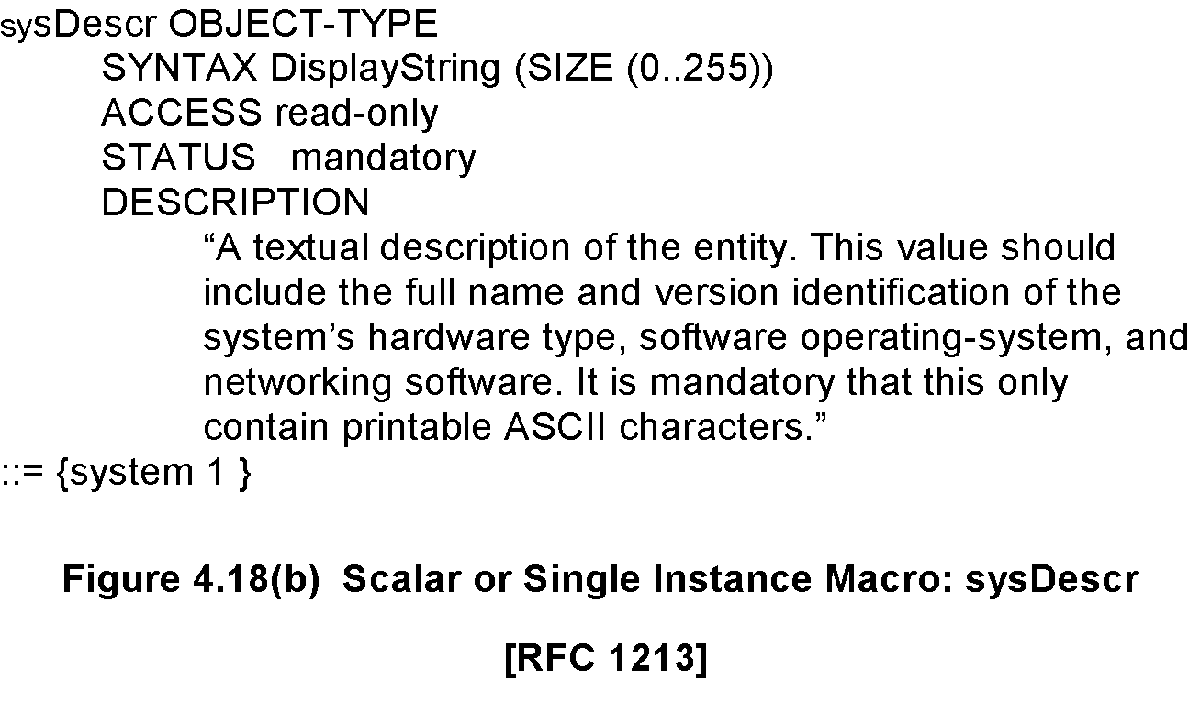
Chapter 4 SNMPv1 Network Management: Organization and Information Models
Managed Object: Macro
Network Management: Principles and Practice
© Mani Subramanian 2010
*

Slide 33
Chapter 4 SNMPv1 Network Management: Organization and Information Models
Aggregate Object
A group of objects
Also called tabular objects
Can be represented by a table with
Columns of objects
Rows of instances
Table of Objects
List of Objects
Objects
Notes
Example: IP address table
Consists of objects:
IP address
Interface
Subnet mask (which subnet this address belongs to)
Broadcast address (value of l.s.b. in IP broadcast address)
Largest IP datagram that can be assembled
Multiple instances of these objects associated with the node
Network Management: Principles and Practice
© Mani Subramanian 2010
*

Slide 34
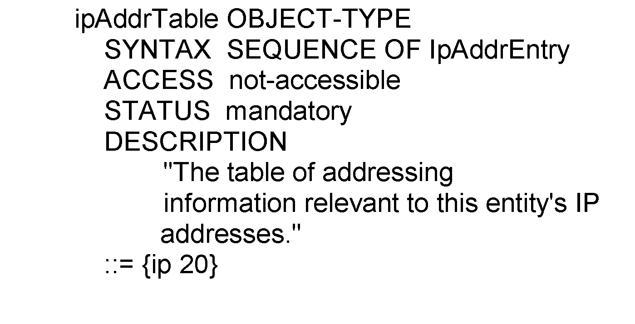
Chapter 4 SNMPv1 Network Management: Organization and Information Models
Aggregate M.O. Macro:
Table Object
ipAddrTable OBJECT-TYPE ::= {ip 20}
ipAddrEntry OBJECT-TYPE
::= {ipAddrTable 1}
Network Management: Principles and Practice
© Mani Subramanian 2010
*

Slide 35
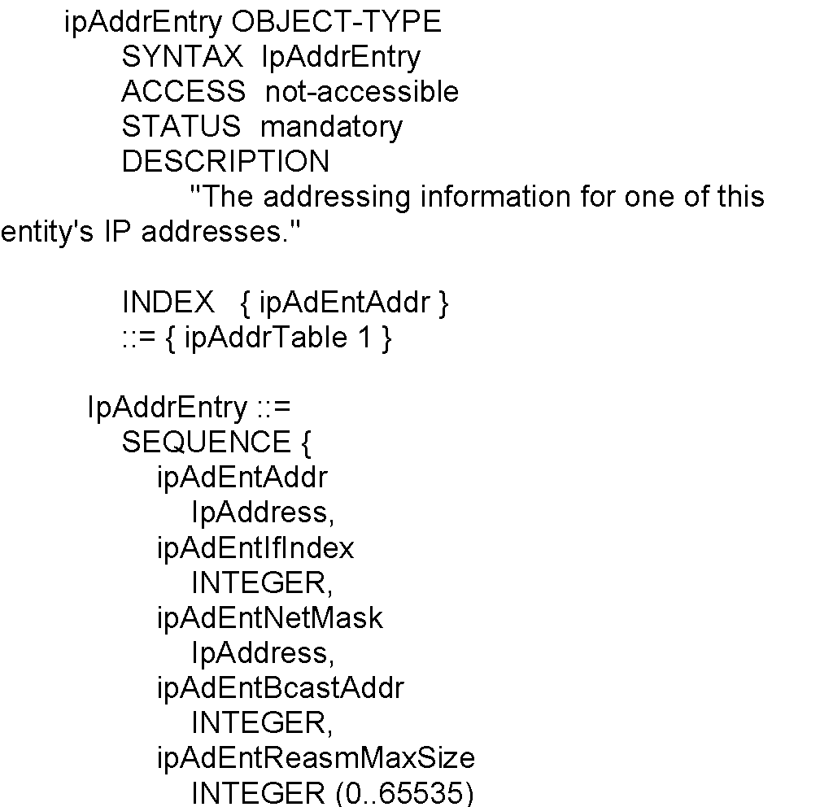
Chapter 4 SNMPv1 Network Management: Organization and Information Models
Aggregate M.O. Macro:
Entry Object
Notes
Index ipAdEntAddr uniquely identifies an instance
May require more than one object in the instance to uniquely identify it
Network Management: Principles and Practice
© Mani Subramanian 2010
*

Slide 36
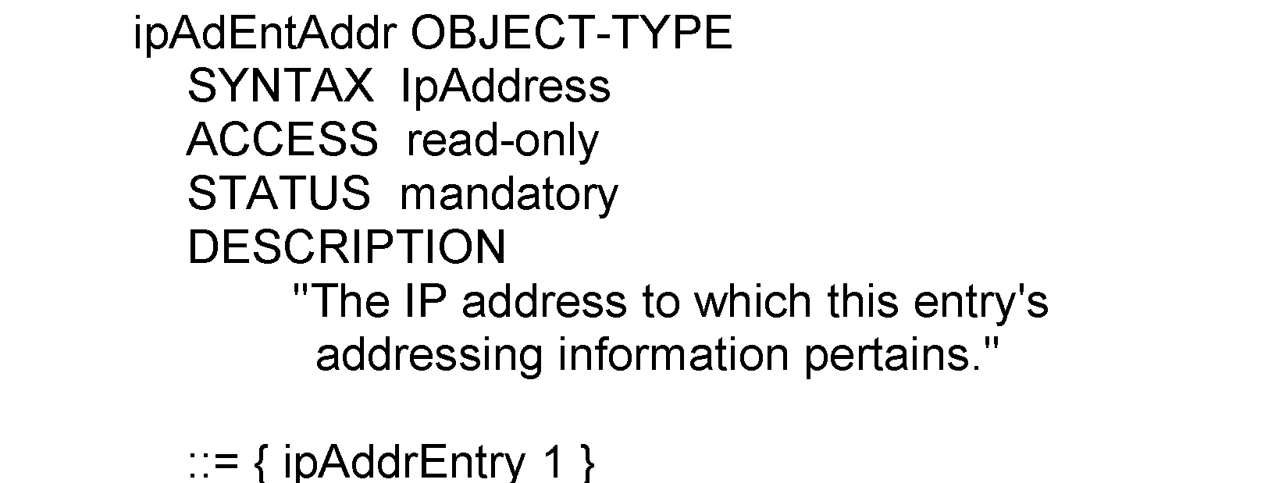
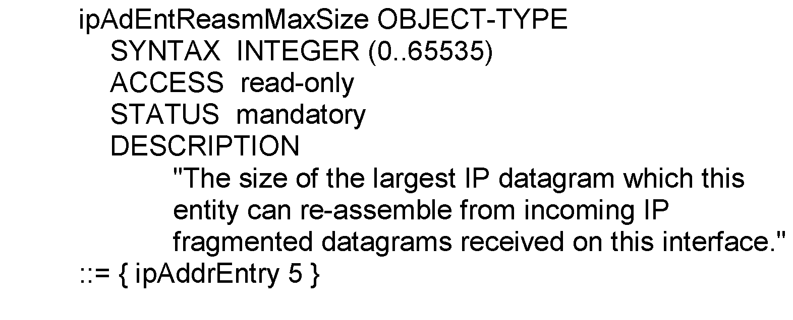
Chapter 4 SNMPv1 Network Management: Organization and Information Models
Aggregate M.O. Macro:
Columnar Objects
Notes
Network Management: Principles and Practice
© Mani Subramanian 2010
*

Slide 37
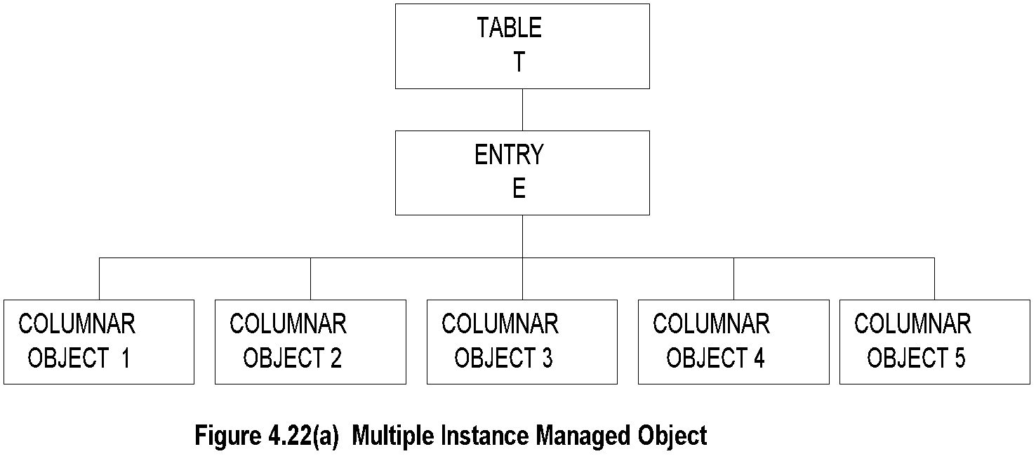
Chapter 4 SNMPv1 Network Management: Organization and Information Models
Tabular Representation of
Aggregate Object
Notes
The objects TABLE T and ENTRY E are objects that are logical objects. They define the grouping and are not accessible.
Columnar objects are objects that represent the attributes and hence are accessible.
Each instance of E is a row of columnar objects 1 through 5.
Multiple instances of E are represented by multiple rows.
Network Management: Principles and Practice
© Mani Subramanian 2010
*

Slide 38
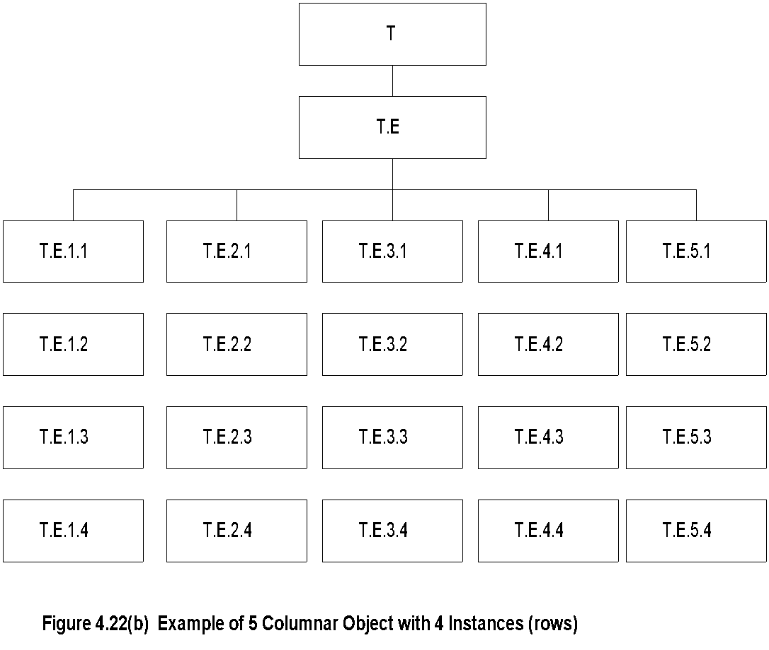
Chapter 4 SNMPv1 Network Management: Organization and Information Models
Tabular Representation of
Aggregate Object (cont.)
Notes
Notice that the column-row numeric designation is reverse of what we are used to as row-column
Network Management: Principles and Practice
© Mani Subramanian 2010
*

Slide 39
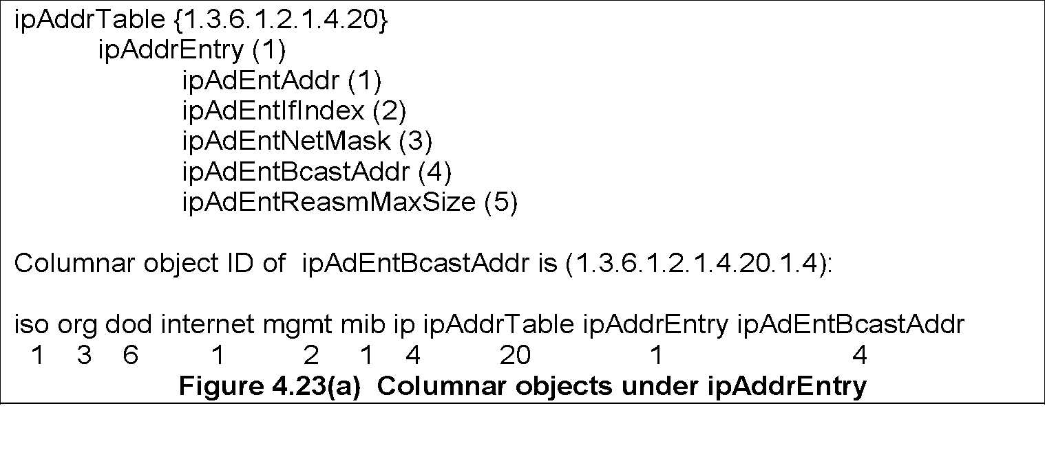
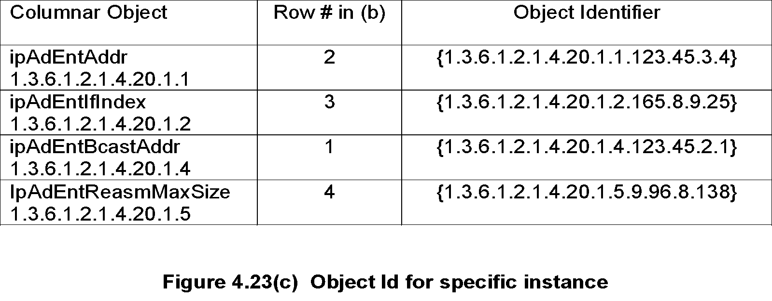
Chapter 4 SNMPv1 Network Management: Organization and Information Models
Multiple Instances of
Aggregate Managed Object
Network Management: Principles and Practice
© Mani Subramanian 2010
*

Slide 40
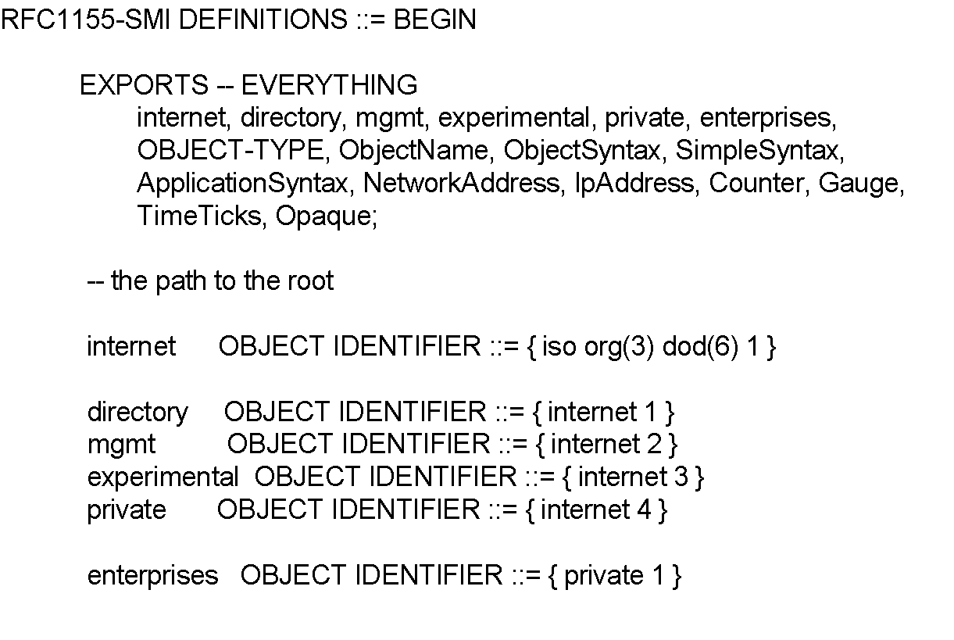
Chapter 4 SNMPv1 Network Management: Organization and Information Models
SMI Definition STD 16 / 1155 RFC
Notes
EXPORTS identifies the objects that any other module could import.
Network Management: Principles and Practice
© Mani Subramanian 2010
*

Slide 41
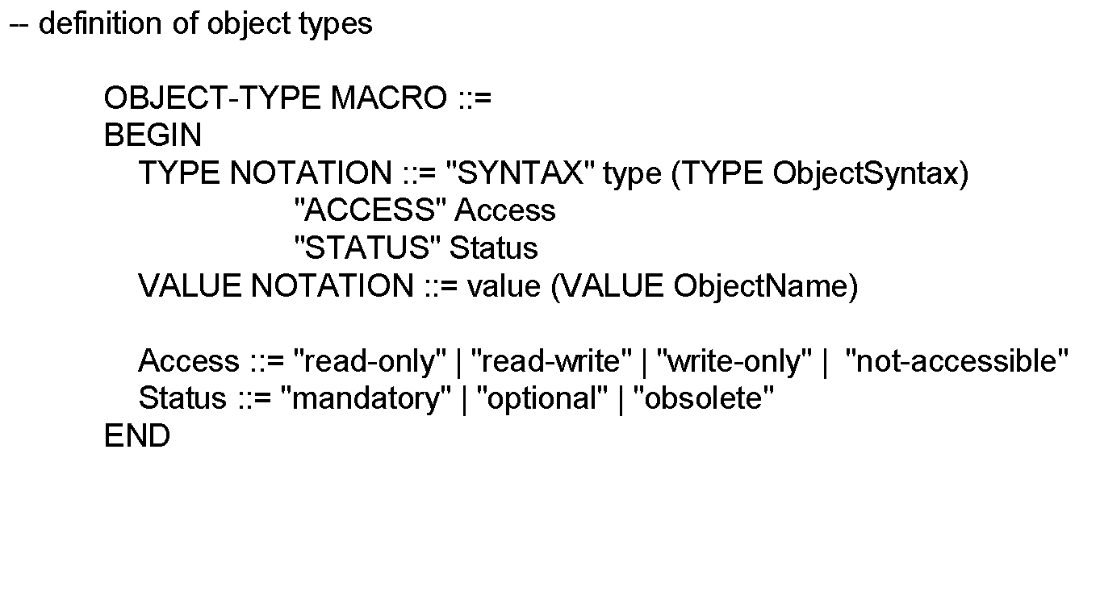
Chapter 4 SNMPv1 Network Management: Organization and Information Models
SMI Definition STD 16 / 1155 RFC (cont.)
Notes
Network Management: Principles and Practice
© Mani Subramanian 2010
*

Slide 42
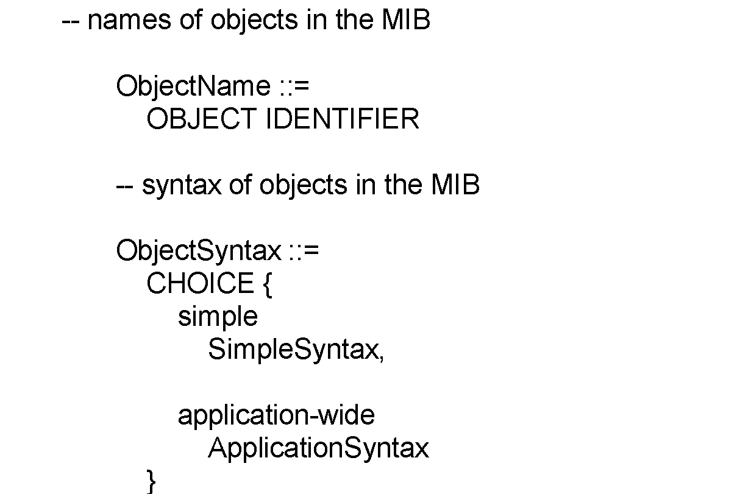
Chapter 4 SNMPv1 Network Management: Organization and Information Models
SMI Definition STD 16 / 1155 RFC (cont.)
Notes
Network Management: Principles and Practice
© Mani Subramanian 2010
*

Slide 43
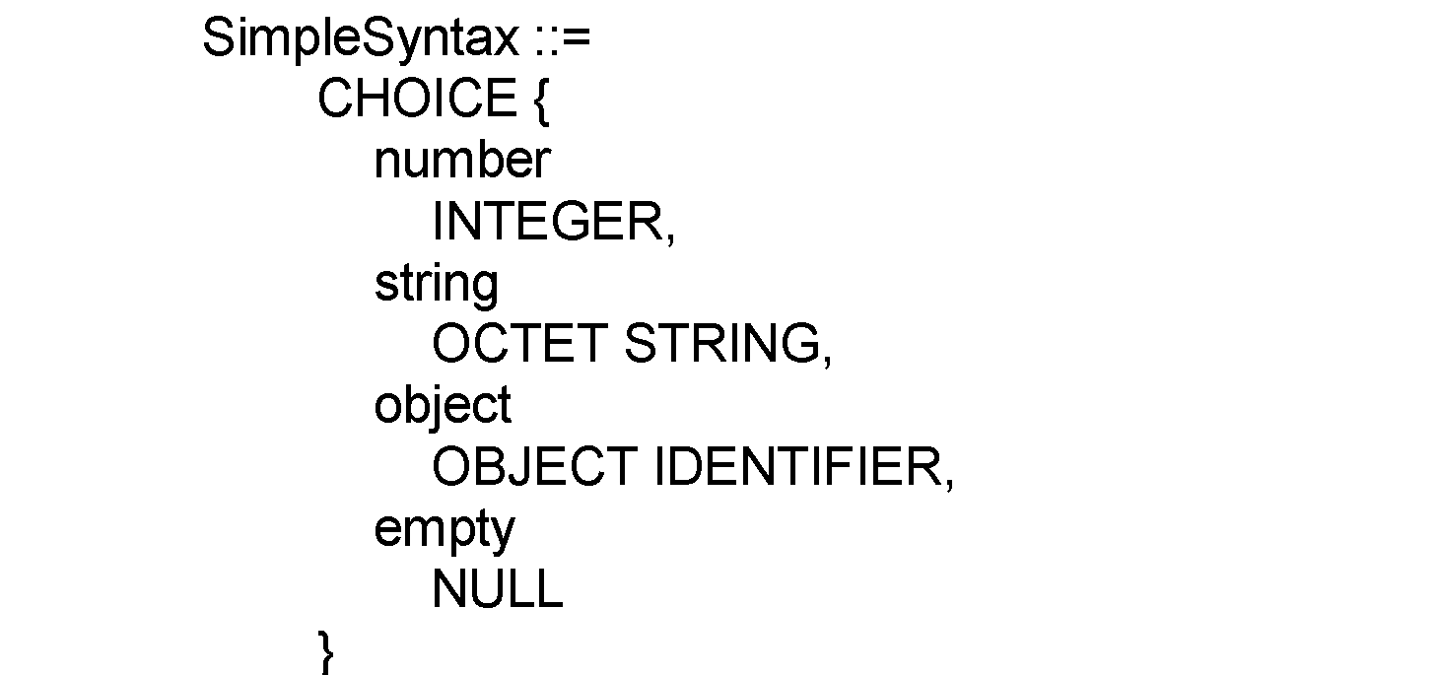
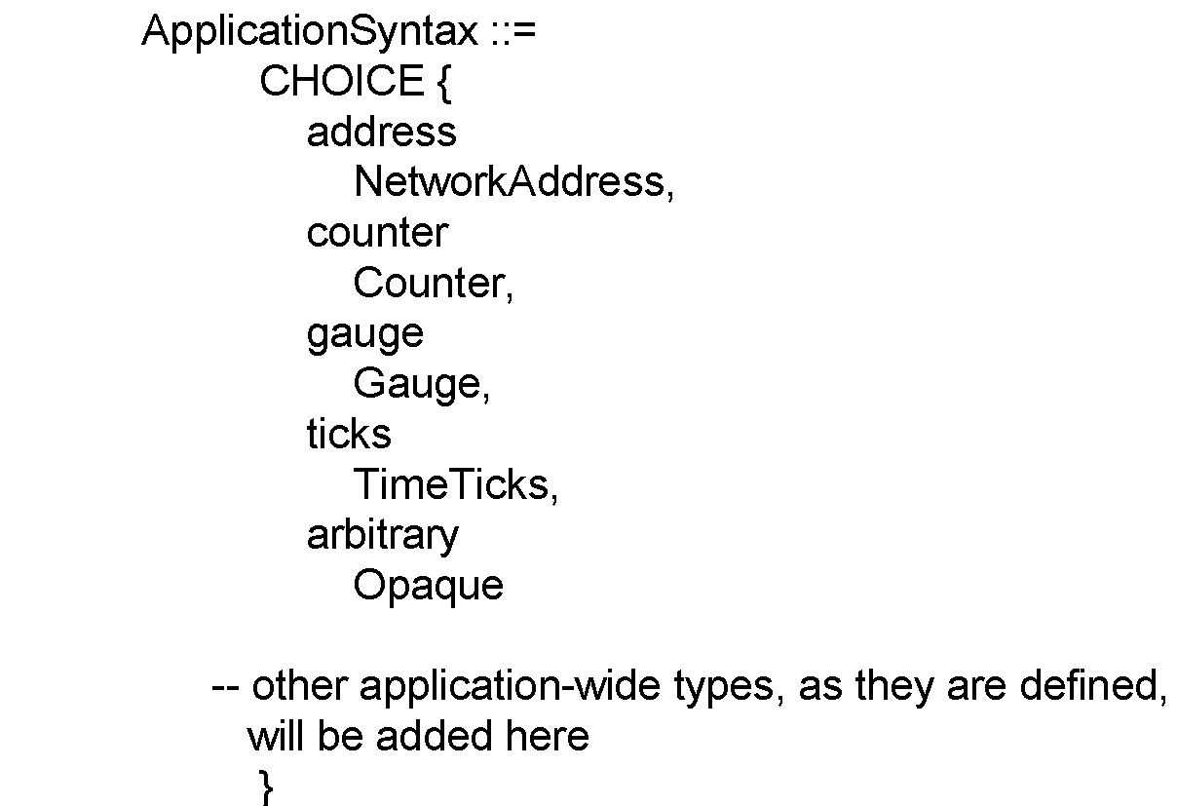
Chapter 4 SNMPv1 Network Management: Organization and Information Models
SMI Definition STD 16 / 1155 RFC (cont.)
Network Management: Principles and Practice
© Mani Subramanian 2010
*

Slide 44
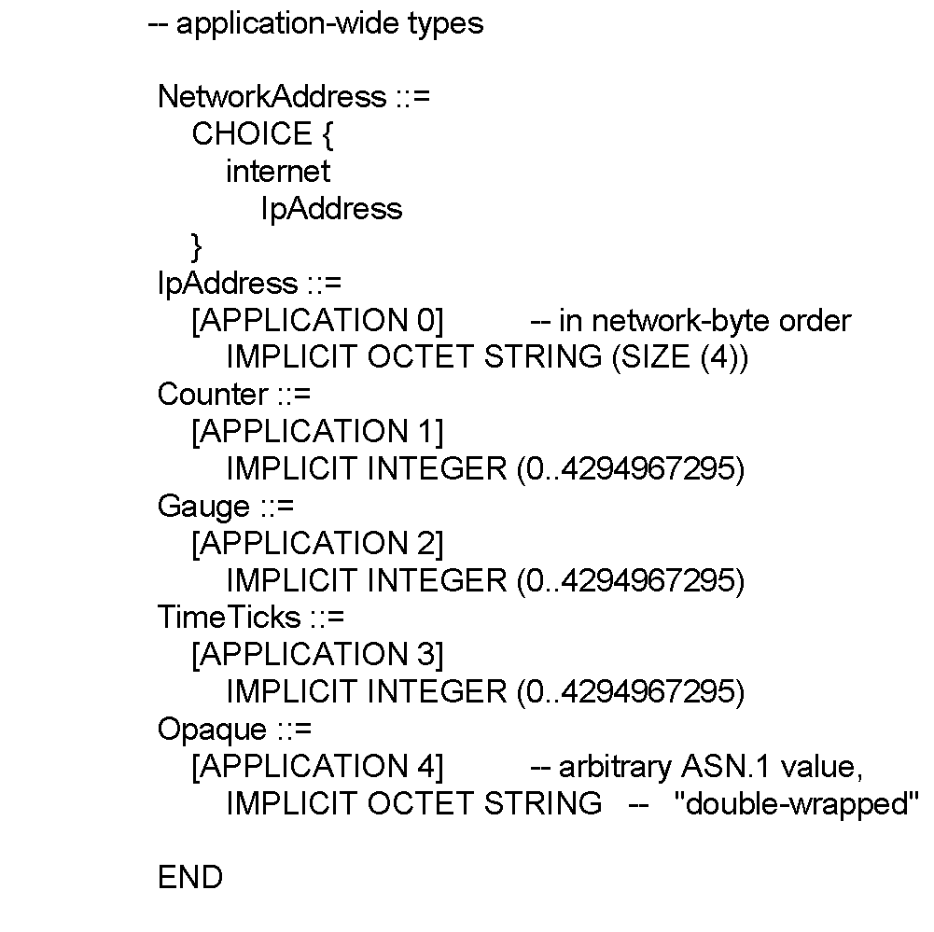
Chapter 4 SNMPv1 Network Management: Organization and Information Models
SMI Definition STD 16 / 1155 RFC (cont.)
Notes
Network Management: Principles and Practice
© Mani Subramanian 2010
*

Slide 45
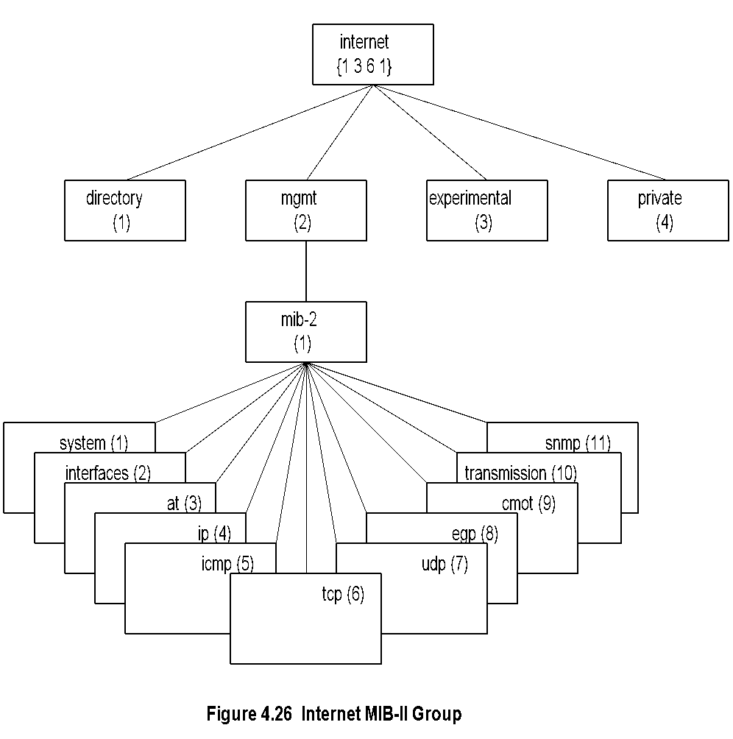
Chapter 4 SNMPv1 Network Management: Organization and Information Models
MIB
Notes
MIB-II (RFC 1213) is superset of MIB-I.
Objects that are related grouped into object groups.
MIB module comprises module name, imports from other modules, and definitions of current module.
RFC 1213 defines eleven groups; expanded later.
Network Management: Principles and Practice
© Mani Subramanian 2010
*

Slide 46
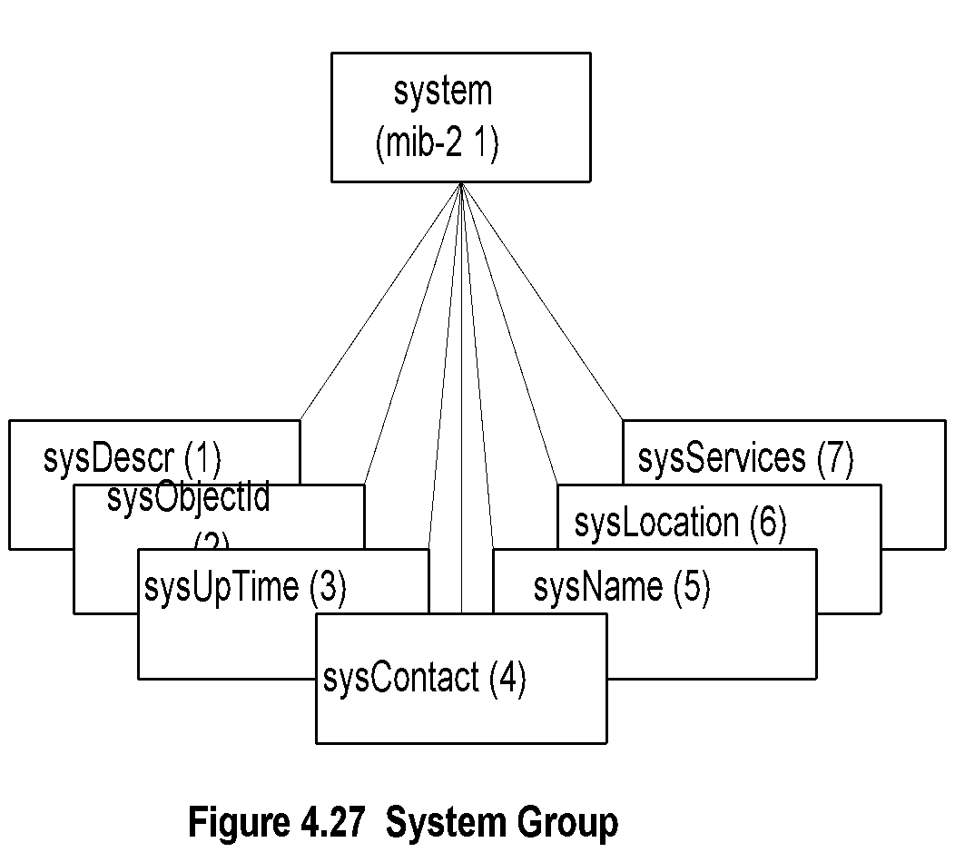
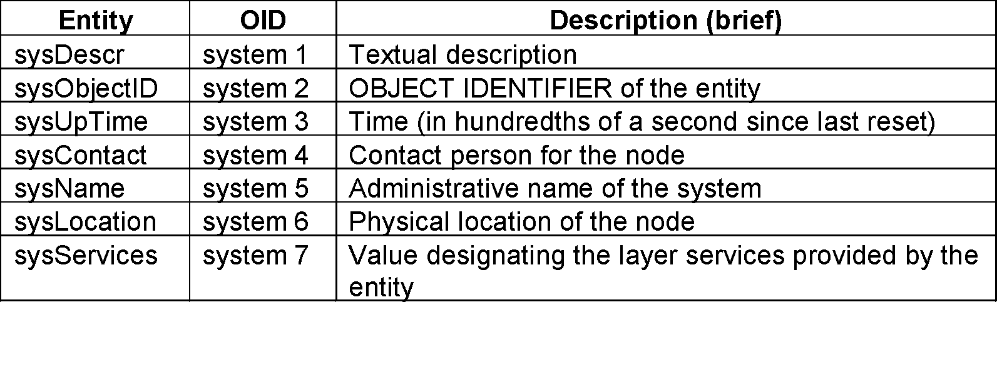
Chapter 4 SNMPv1 Network Management: Organization and Information Models
System Group
Notes
Network Management: Principles and Practice
© Mani Subramanian 2010
*

Slide 47
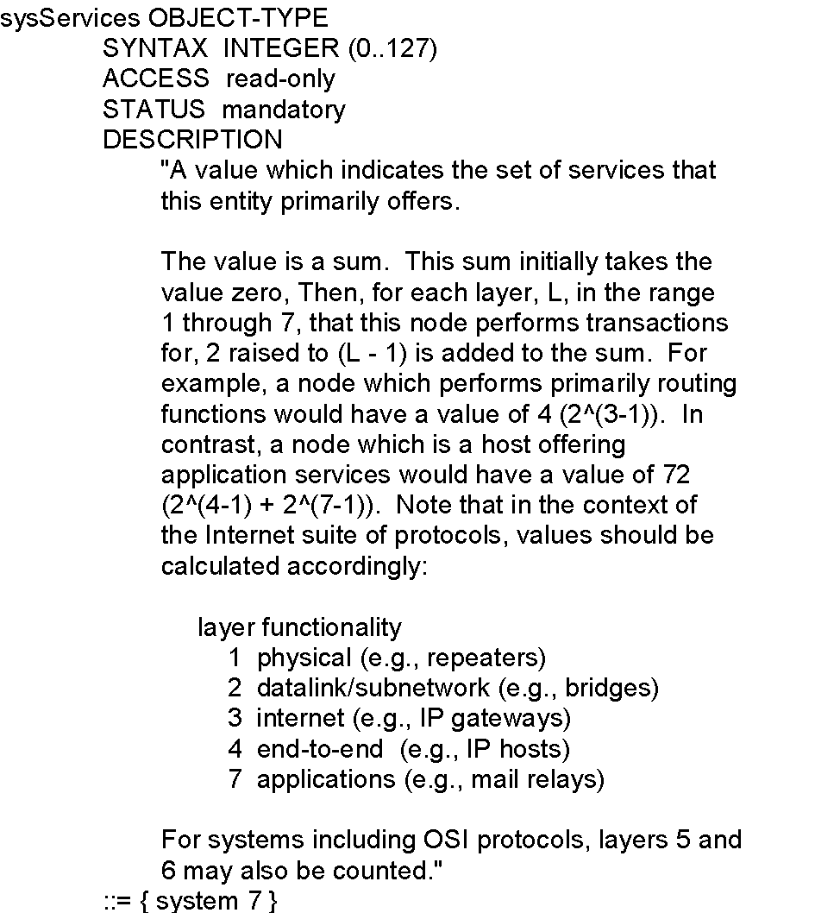
Chapter 4 SNMPv1 Network Management: Organization and Information Models
sysServices
Notes
Network Management: Principles and Practice
© Mani Subramanian 2010
*

Slide 48
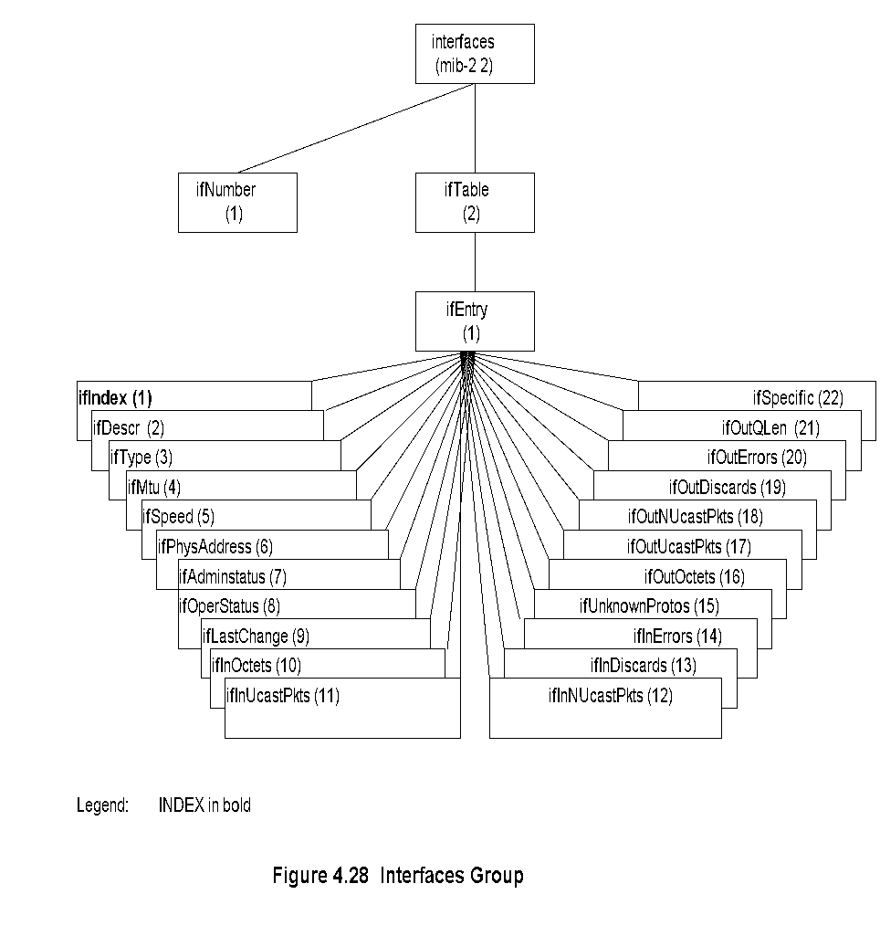
Chapter 4 SNMPv1 Network Management: Organization and Information Models
Interfaces Group
Notes
Network Management: Principles and Practice
© Mani Subramanian 2010
*

Slide 49
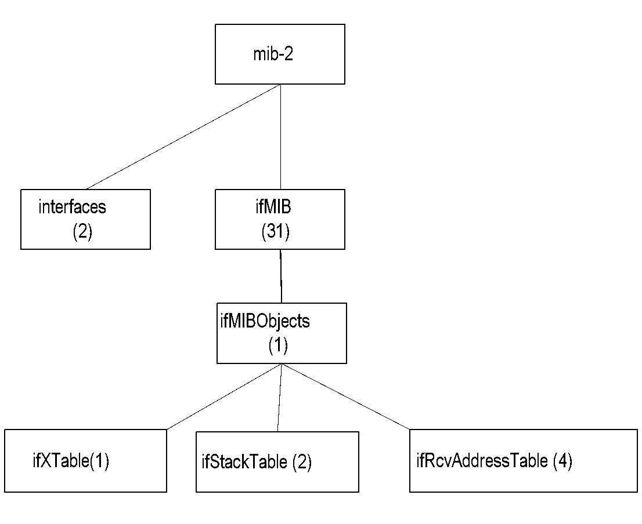
Chapter 4 SNMPv1 Network Management: Organization and Information Models
Extension to Interfaces MIB
Notes
Interfaces MIB limited by maximum number of physical ports
A physical port may have several conceptual ports e.g., channels in cable access network
ifMIB {mib-2 31} created to extend interfaces MIB
ifMIB speicifies extension in generic manner
Specific technology related MIBs supplement details on the conceptual ports
ifIndex in interfaces MIB can exceed the maximum number of physical ports
ifStack definition accommodates interface sublayers
Network Management: Principles and Practice
© Mani Subramanian 2010
*

Slide 50
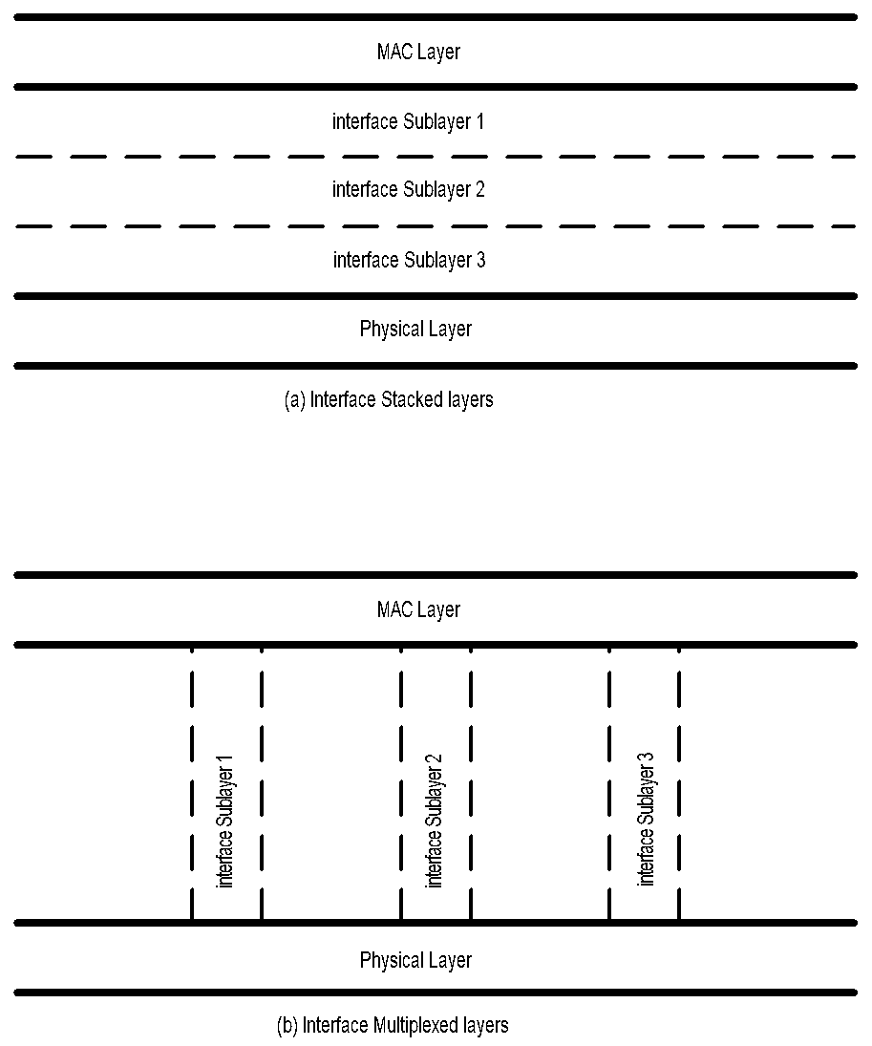
Chapter 4 SNMPv1 Network Management: Organization and Information Models
Interface Sublayers
Figure 4.29 Interface Sublayers
Network Management: Principles and Practice
© Mani Subramanian 2010
*

Slide 51
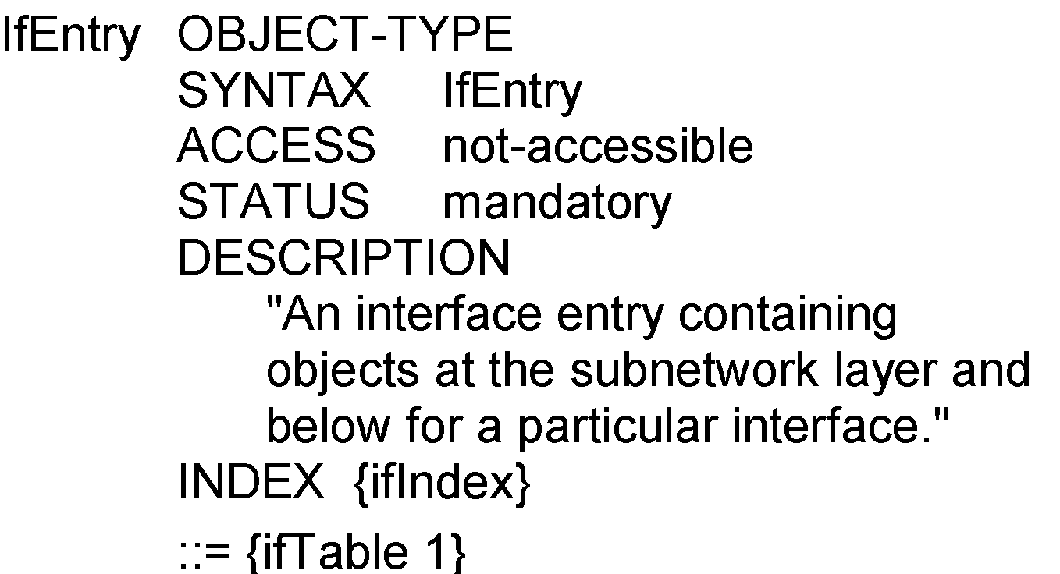
Chapter 4 SNMPv1 Network Management: Organization and Information Models
ifEntry
Notes
ifEntry specifies the objects in a row in the ifTable.
Each interface is defined as a row in the table.
Network Management: Principles and Practice
© Mani Subramanian 2010
*

Slide 52
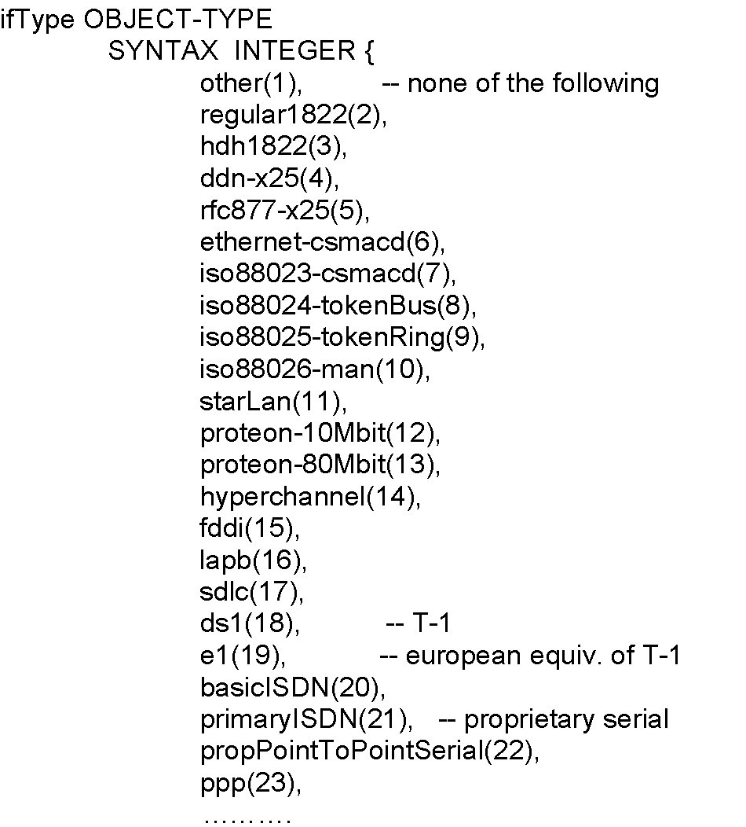
Chapter 4 SNMPv1 Network Management: Organization and Information Models
ifType
Notes
Type of interface below the network layer defined as enumerated integer.
Network Management: Principles and Practice
© Mani Subramanian 2010
*

Slide 53
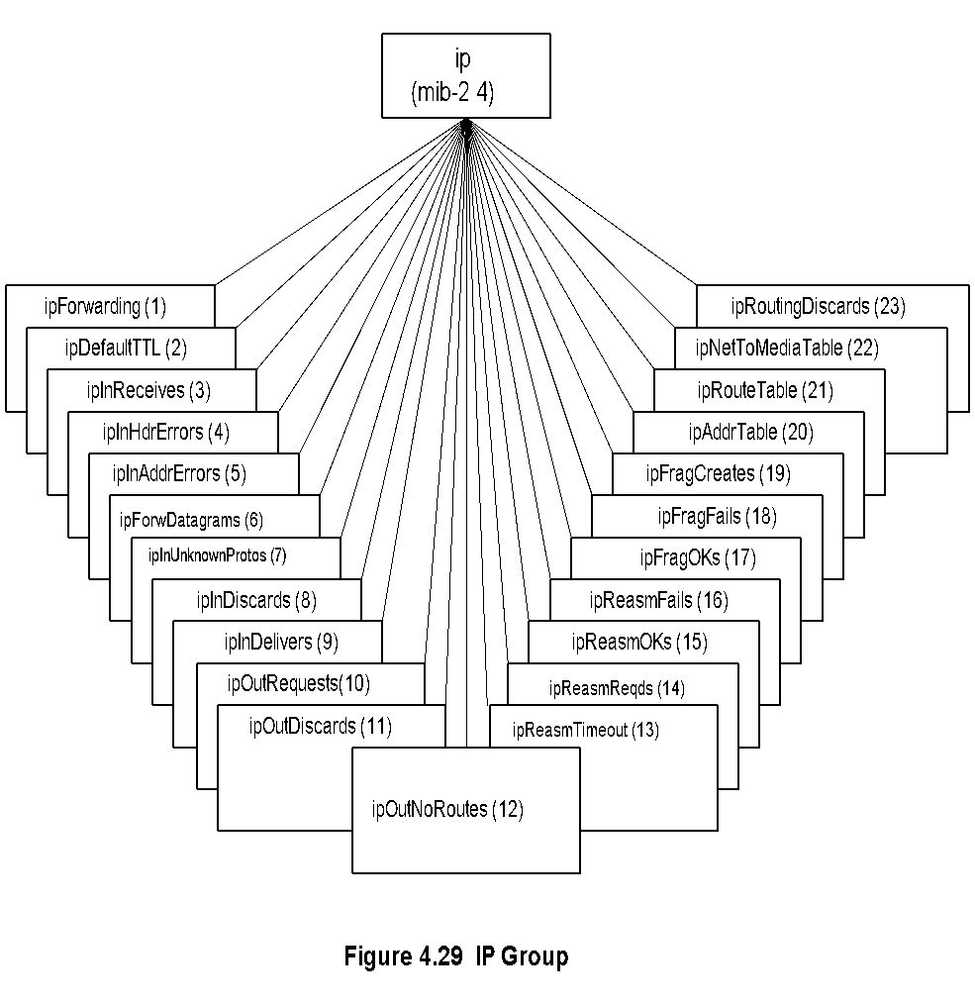
Chapter 4 SNMPv1 Network Management: Organization and Information Models
IP Group
Notes
ipForwarding: Gateway(1) and Router(2)
IP Address Table contains table of IP addresses
IP Route Table contains an entry for each route
IP Network-to-Media Table is address translation table mapping IP addresses to physical addresses
Network Management: Principles and Practice
© Mani Subramanian 2010
*

Slide 54
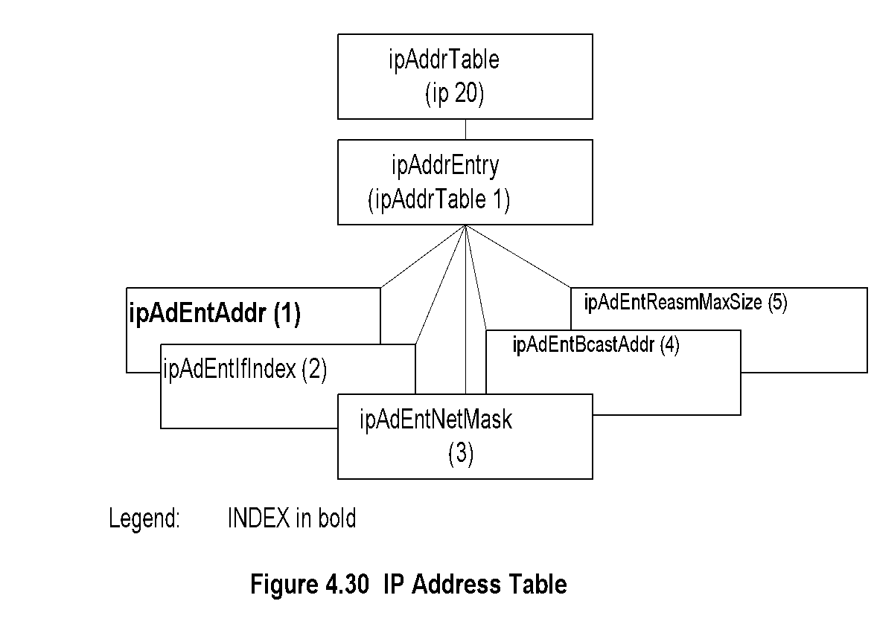
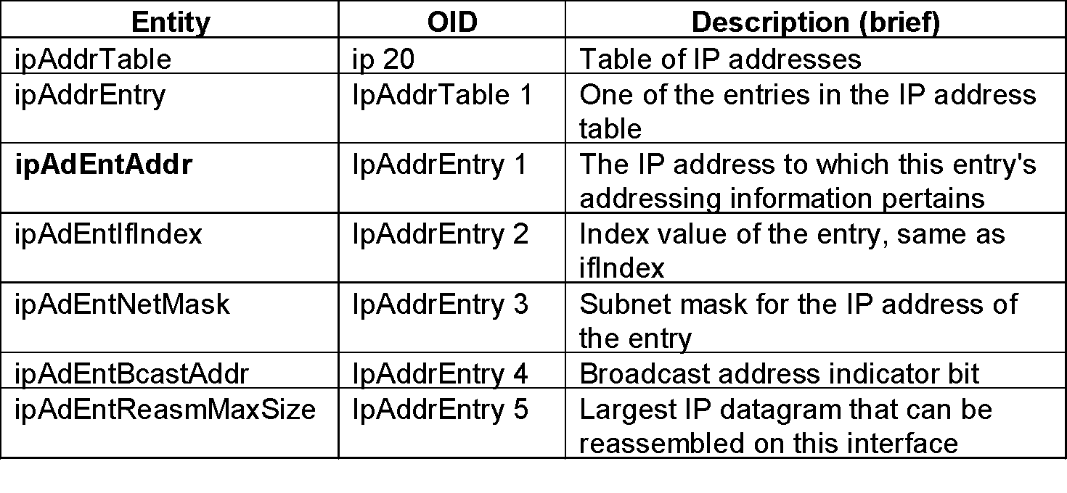
Chapter 4 SNMPv1 Network Management: Organization and Information Models
IP Address Table
Notes
Network Management: Principles and Practice
© Mani Subramanian 2010
*

Slide 55
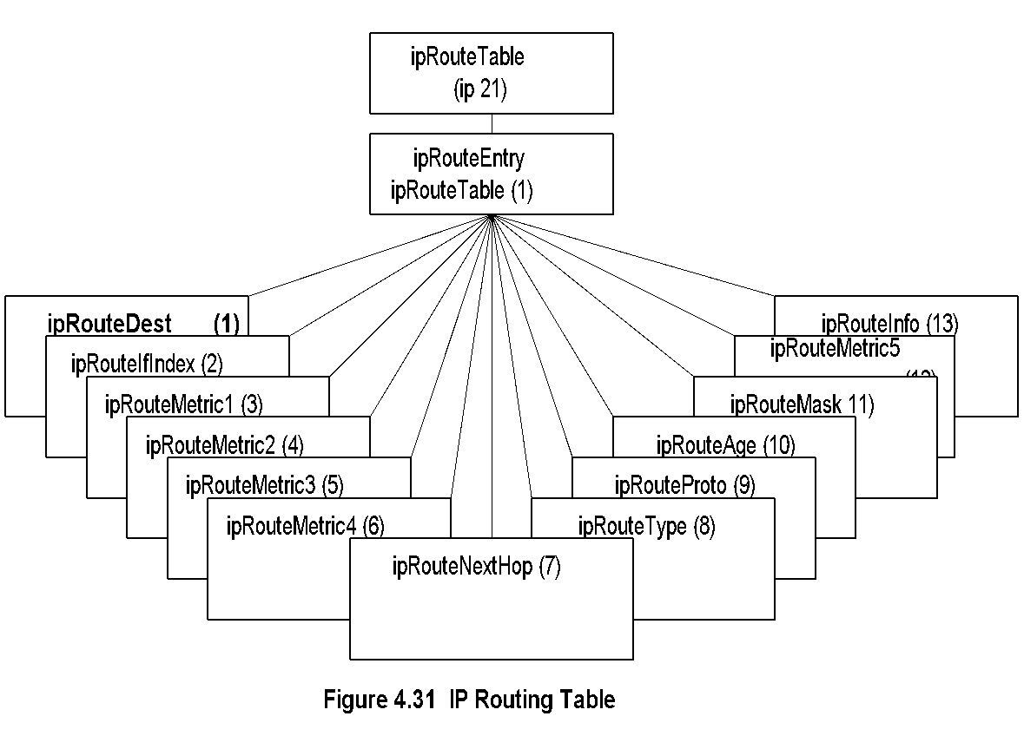
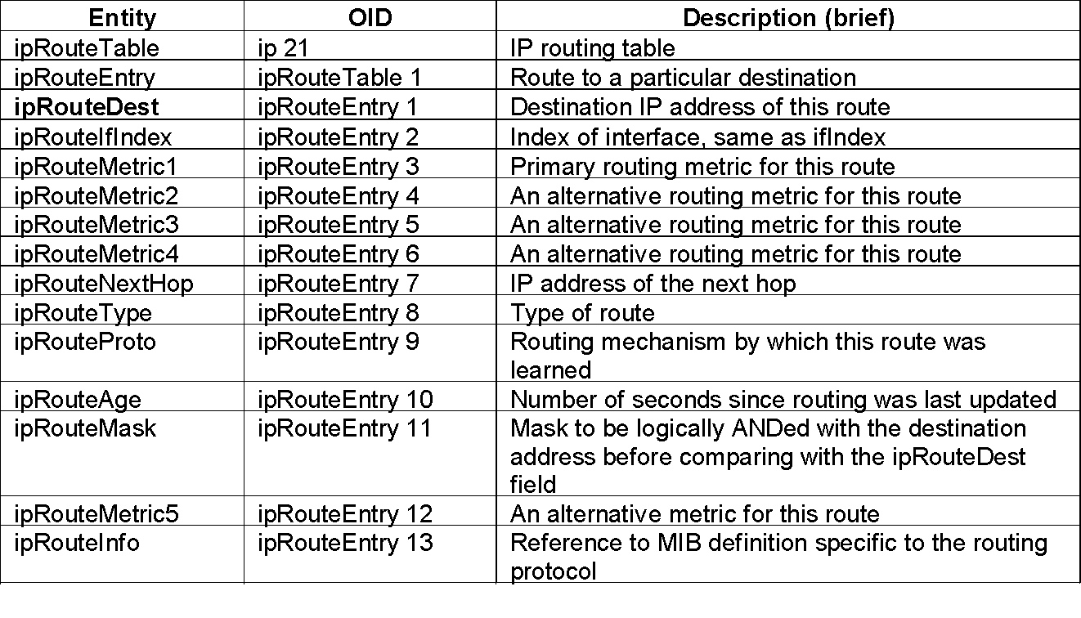
Chapter 4 SNMPv1 Network Management: Organization and Information Models
IP Routing Table
Network Management: Principles and Practice
© Mani Subramanian 2010
*

Slide 56
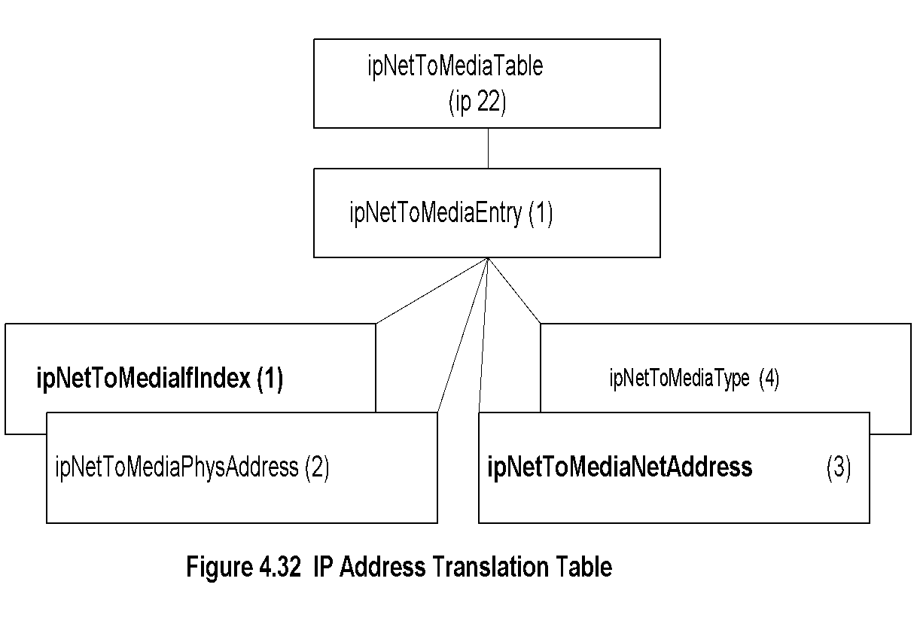
Chapter 4 SNMPv1 Network Management: Organization and Information Models
IP Address Translation Table
Notes
Network Management: Principles and Practice
© Mani Subramanian 2010
*

Slide 57
Chapter 4 SNMPv1 Network Management: Organization and Information Models
ICMP Group
Notes
Objects associated with ping
icmpOutEchos # ICMP echo messages sent
icmpInEchoReps # ICMP echo reply messages received
Objects associated with traceroute/tracert
icmpInTimeExcs # ICMP time exceeded messages received
Network Management: Principles and Practice
© Mani Subramanian 2010
*

Slide 58
Chapter 4 SNMPv1 Network Management: Organization and Information Models
TCP Group
Notes
Connection-oriented transport protocol group
Has one table
Network Management: Principles and Practice
© Mani Subramanian 2010
*

Slide 59
Chapter 4 SNMPv1 Network Management: Organization and Information Models
TCP Connection Table
Notes
Network Management: Principles and Practice
© Mani Subramanian 2010
*

Slide 60
Chapter 4 SNMPv1 Network Management: Organization and Information Models
UDP Group
Notes
Connectionless transport protocol group
Has one table, UDP table
Network Management: Principles and Practice
© Mani Subramanian 2010
*

