Slide 1
Chapter 8 SNMP Management: RMON
Chapter 8
SNMP Management:
RMON
Network Management: Principles and Practice
© Mani Subramanian 2010
*

Slide 2
Objectives
Chapter 8 SNMP Management: RMON
Remote network monitoring, RMON
RMON1: Monitoring Ethernet LAN and token-ring LAN
RMON2: Monitoring upper protocol layers
Generates and sends statistics close to subnetworks to central NMS
RMON MIBs for RMON group objects
Network Management: Principles and Practice
© Mani Subramanian 2010
*

Slide 3
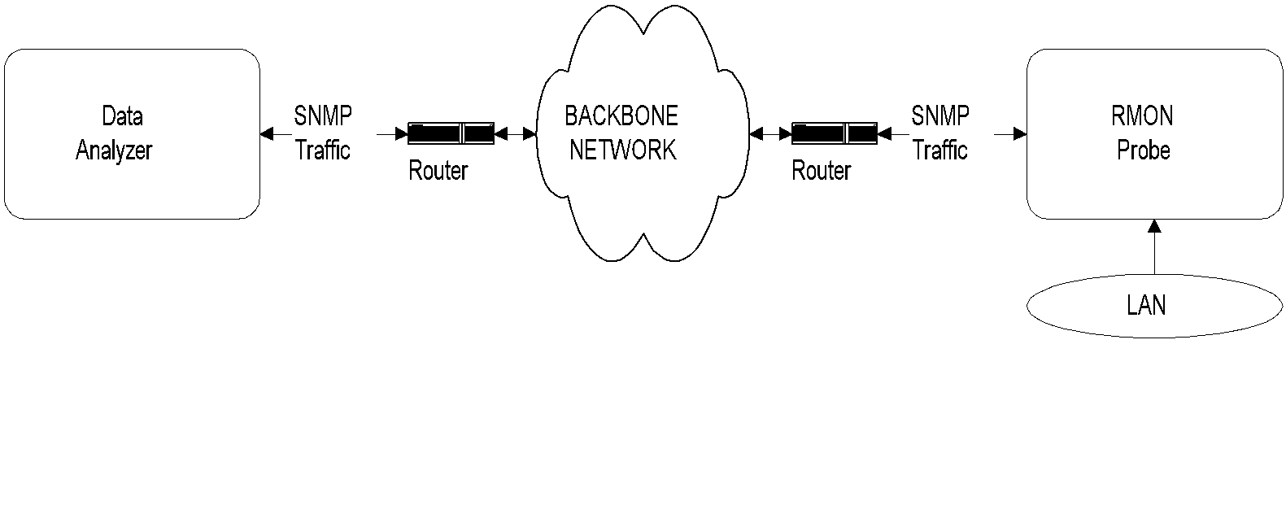
Chapter 8 SNMP Management: RMON
RMON Components
RMON Probe
Data gatherer - a physical device
Data analyzer
Processor that analyzes data
Notes
RMON Remote Network Monitoring
Network Management: Principles and Practice
© Mani Subramanian 2010
*

Slide 4
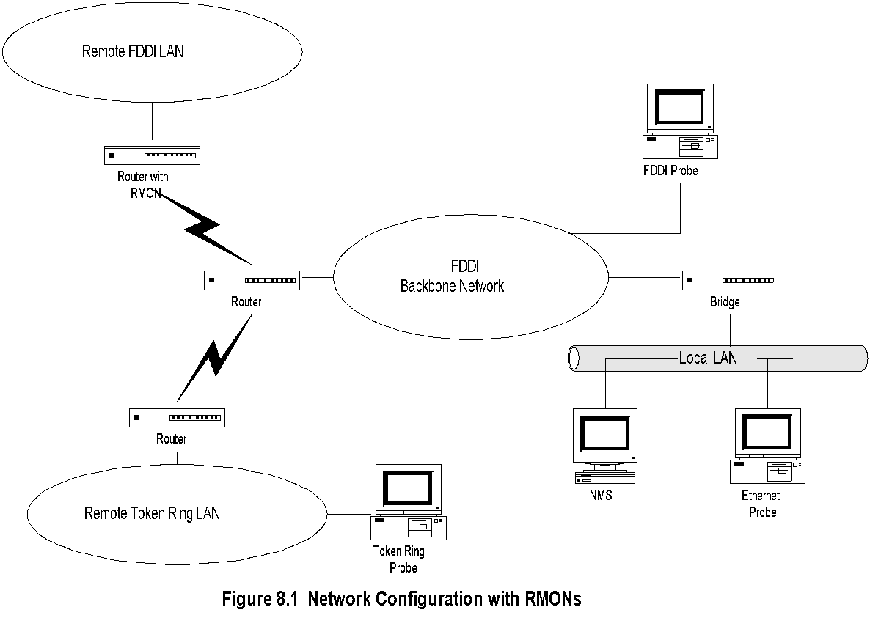
Chapter 8 SNMP Management: RMON
Network with RMONs
Notes
Note that RMON is embedded monitoring remote FDDI LAN
Analysis done in NMS
Network Management: Principles and Practice
© Mani Subramanian 2010
*

Slide 5
Chapter 8 SNMP Management: RMON
RMON Benefits
Monitors and analyzes locally and relays data; Less load on the network
Needs no direct visibility by NMS; More reliable information
Permits monitoring on a more frequent basis and hence faster fault diagnosis
Increases productivity for administrators
Notes
Network Management: Principles and Practice
© Mani Subramanian 2010
*

Slide 6
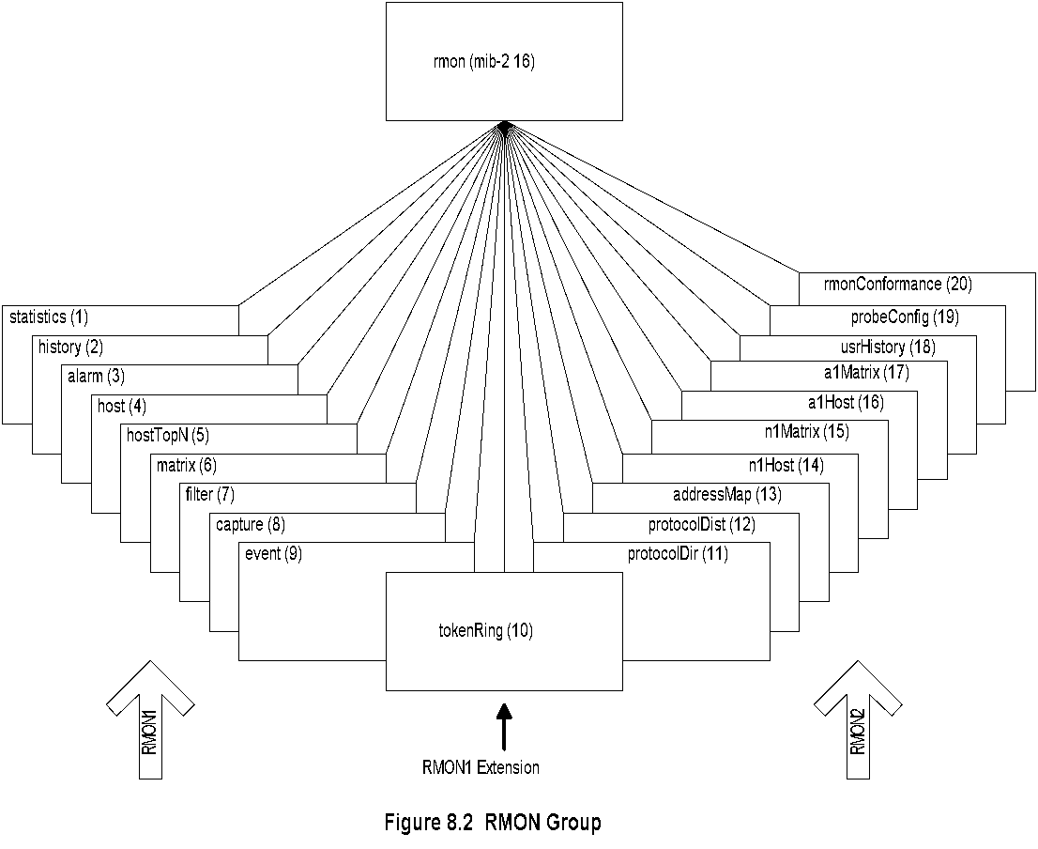
Chapter 8 SNMP Management: RMON
RMON MIB
Notes
RMON1: Ethernet RMON groups (rmon 1 - rmon 9)
RMON1: Extension: Token ring extension (rmon 10)
RMON2: Higher layers (3-7) groups (rmon 11 - rmon 20)
Network Management: Principles and Practice
© Mani Subramanian 2010
*

Slide 7
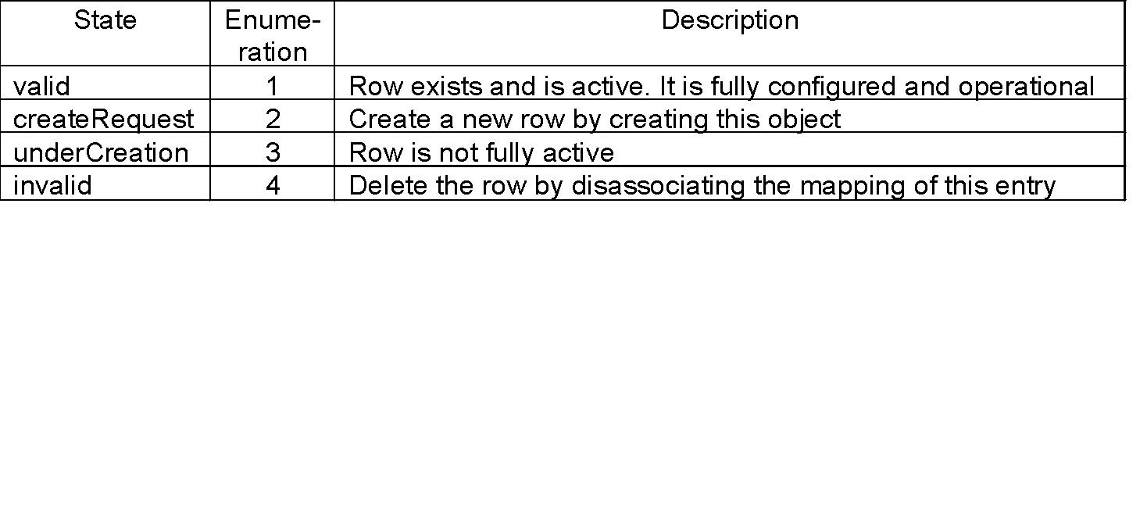
Chapter 8 SNMP Management: RMON
Row Creation & Deletion
Table 8.1 EntryStatus Textual Convention
EntryStatus data type introduced in RMON
EntryStatus (similar to RowStatus in SNMPv2) used to create and delete conceptual row
Only 4 states in RMON compared to 6 in SNMPv2
Notes
Network Management: Principles and Practice
© Mani Subramanian 2010
*

Slide 8
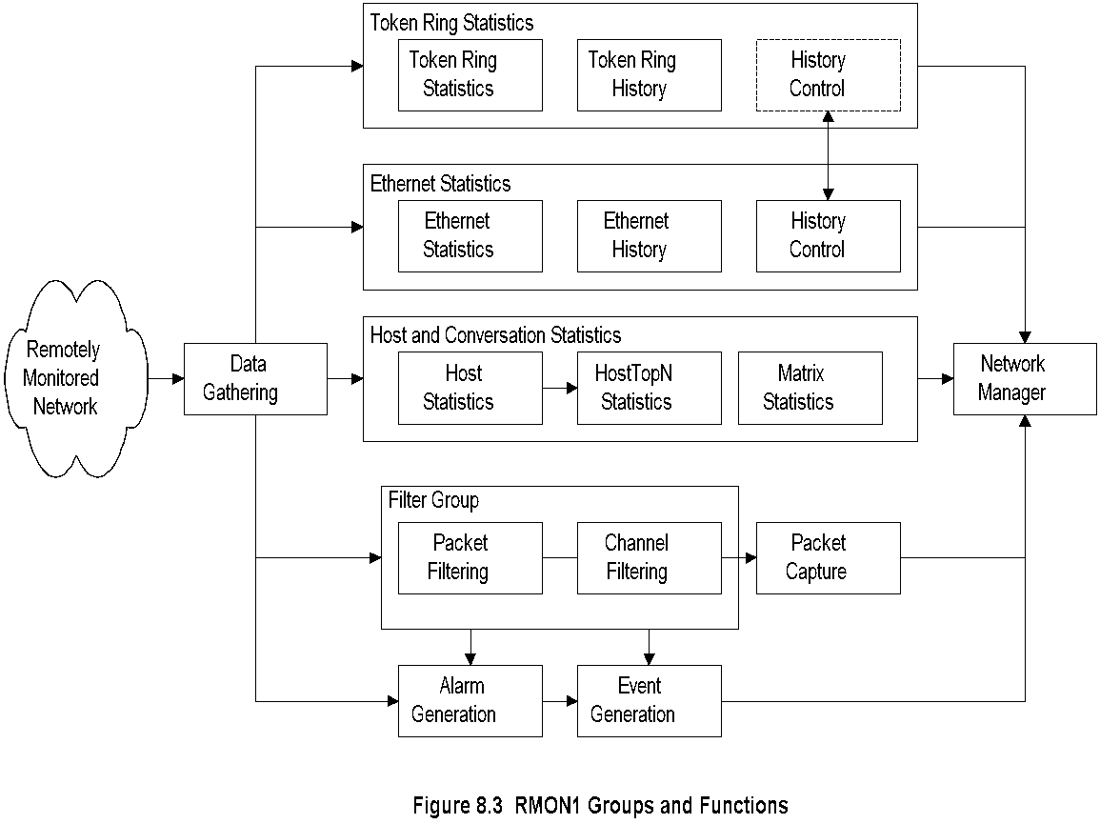
Chapter 8 SNMP Management: RMON
RMON Groups and Functions
Notes
Probe gathers data
Functions
Statistics on Ethernet, token ring, and hosts / conversations
Filter group filters data prior to capture of data
Generation of alarms and events
Network Management: Principles and Practice
© Mani Subramanian 2010
*

Slide 9
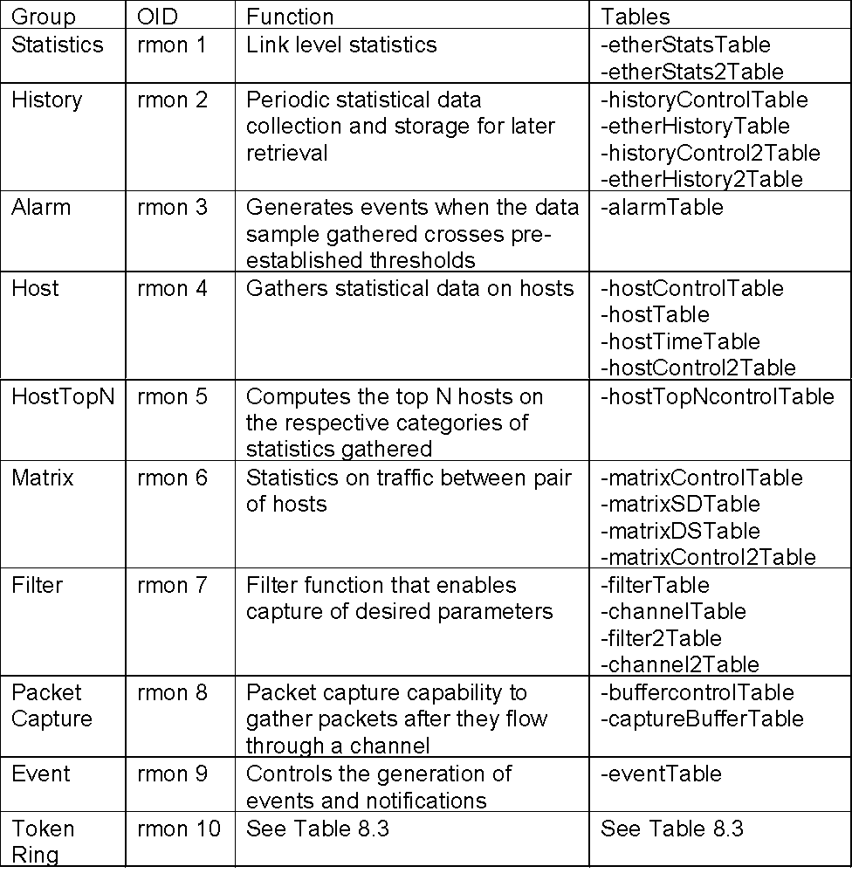
Chapter 8 SNMP Management: RMON
RMON1 MIB Groups & Tables
Notes
Ten groups divided into three categories
Statistics groups (rmon 1, 2, 4, 5, 6, and 10)
Event reporting groups (rmon 3 and 9)
Filter and packet capture groups(romon 7 and 8)
Groups with “2” in the name are enhancements with RMON2
Network Management: Principles and Practice
© Mani Subramanian 2010
*

Slide 10
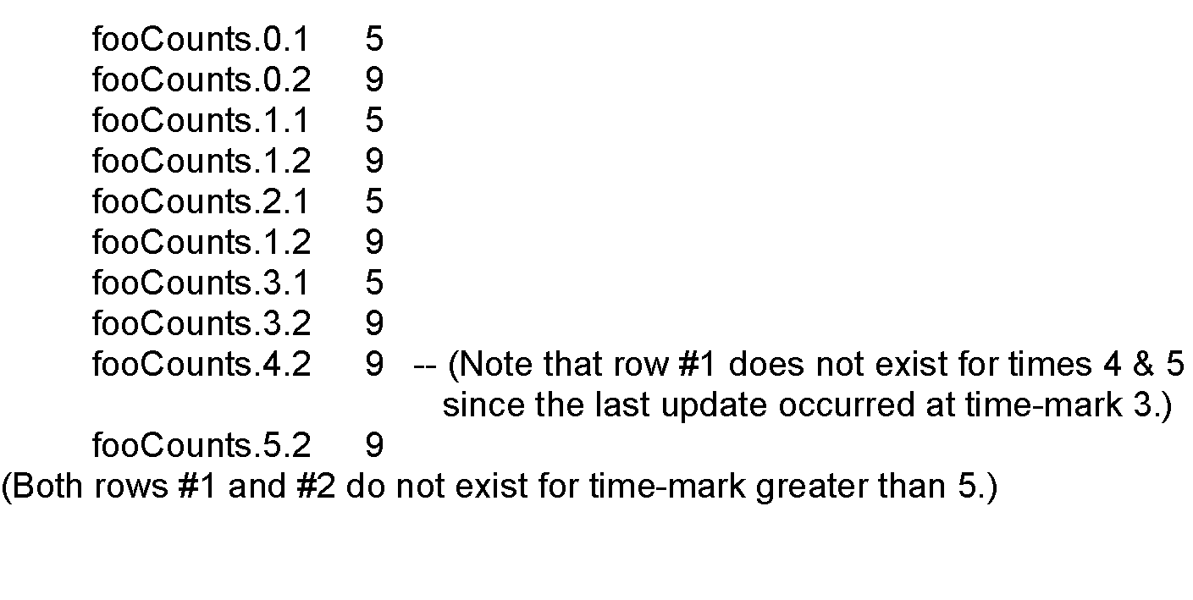
Chapter 8 SNMP Management: RMON
Textual Convention:
LastCreateTime and TimeFilter
LastCreateTime tracks change of data with the changes in control in the control tables
Timefilter used to download only those rows that changed after a particular time
FooTable (bold indicating the indices):
fooTimeMark fooIndex fooCounts
Notes
Bold objects (fooTimeMark and fooIndex) are indices
Network Management: Principles and Practice
© Mani Subramanian 2010
*

Slide 11
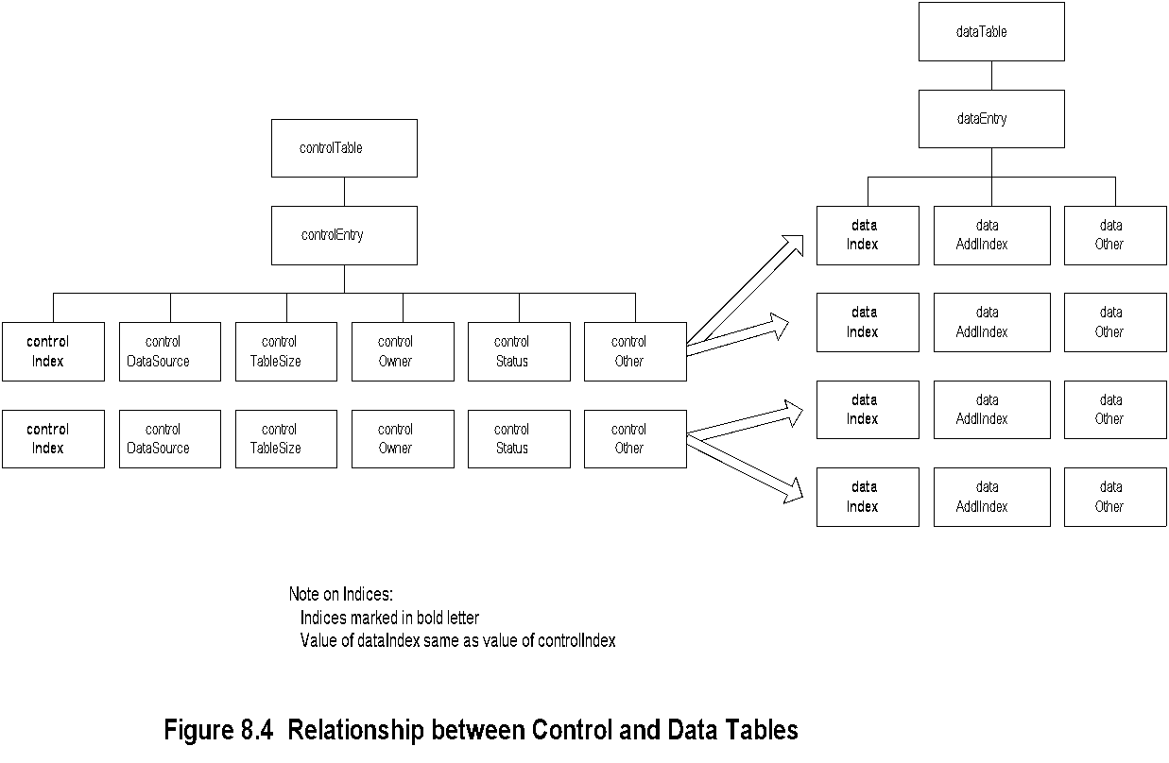
Chapter 8 SNMP Management: RMON
Control and Data Tables
Notes
Control table used to set the instances of data rows in the data table
Values of data index and control index are the same
Network Management: Principles and Practice
© Mani Subramanian 2010
*

Slide 12
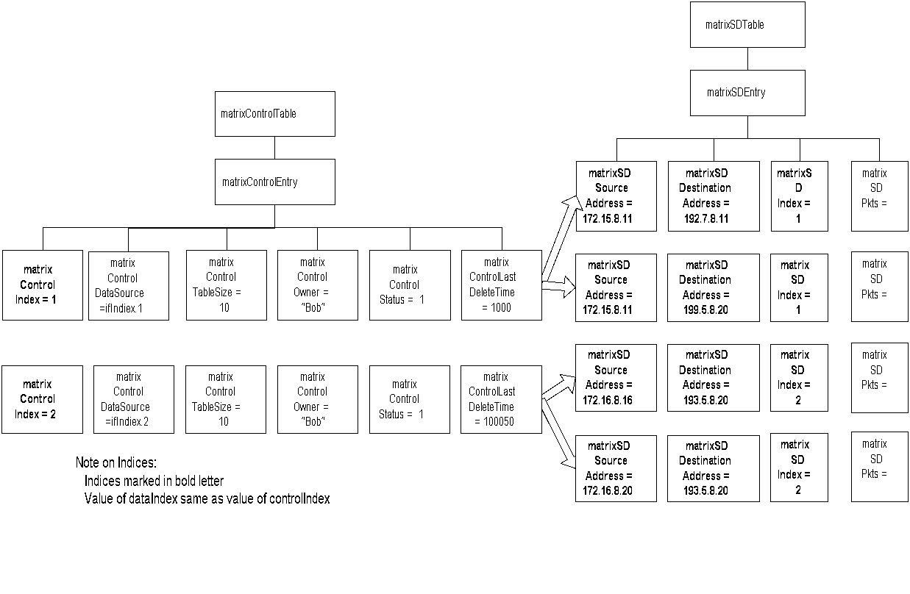
Chapter 8 SNMP Management: RMON
Matrix Control and SD Tables
Notes
matrixSDTable is the source-destination table
controlDataSource identifies the source of the data
controlTableSize identifies entries associated with the data source
controlOwner is creator of the entry
Network Management: Principles and Practice
© Mani Subramanian 2010
*

Slide 13
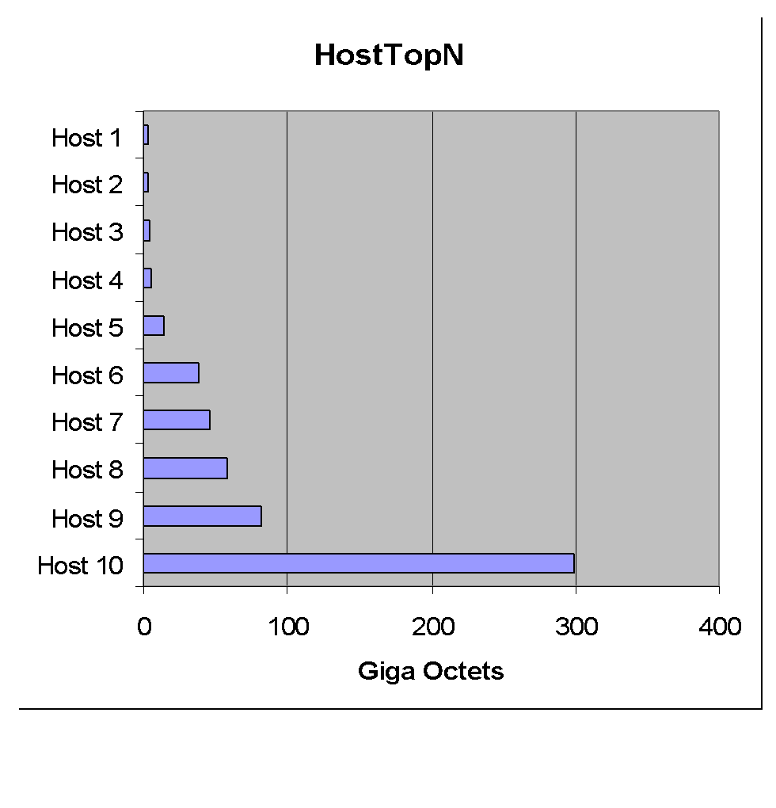
Chapter 8 SNMP Management: RMON
Host Top N Group Example
Notes
Network Management: Principles and Practice
© Mani Subramanian 2010
*

Slide 14
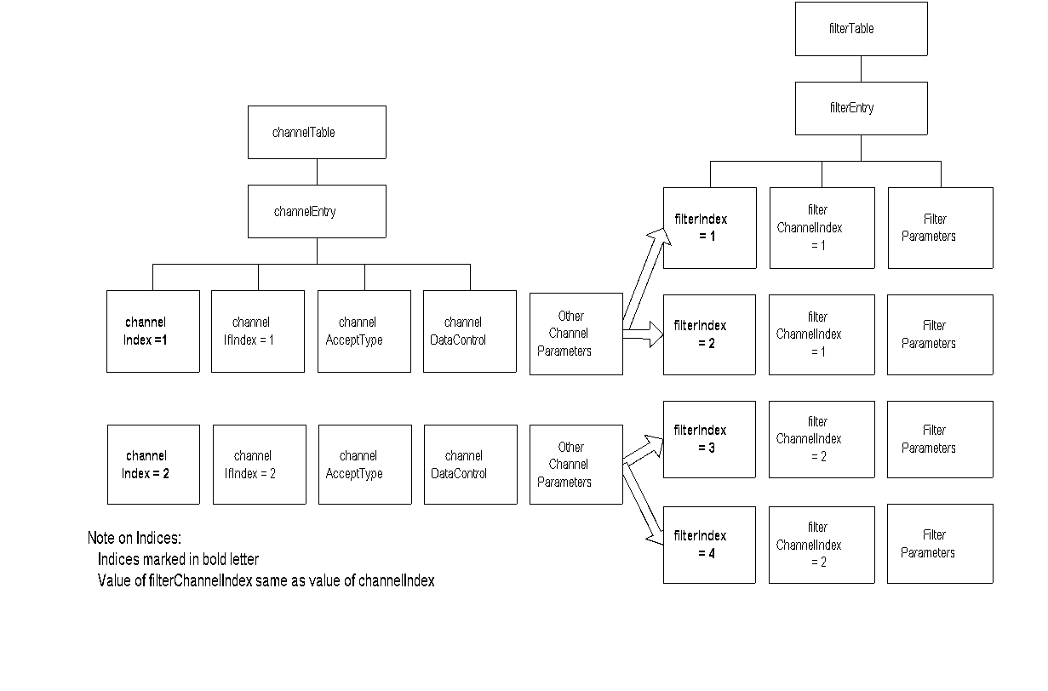
Chapter 8 SNMP Management: RMON
Filter Group
Notes
Filter group used to capture packets defined by logical expressions
Channel is a stream of data captured based on a logical expression
Filter table allows packets to be filtered with an arbitrary filter expression
A row in the channel table associated with multiple rows in the filter table
Capture table accepts data if test of any row in the filter table passes the test
Network Management: Principles and Practice
© Mani Subramanian 2010
*

Slide 15
Chapter 8 SNMP Management: RMON
Packet Capture Group
Channel
Table
Filter
Table
(many
for
each
channel)
Capture
Buffer
Table
(One
entry
per
channel)
Notes
Packet capture group is a post-filter group
Buffer control table used to select channels
Captured data stored in the capture buffer table
Network Management: Principles and Practice
© Mani Subramanian 2010
*

Slide 16
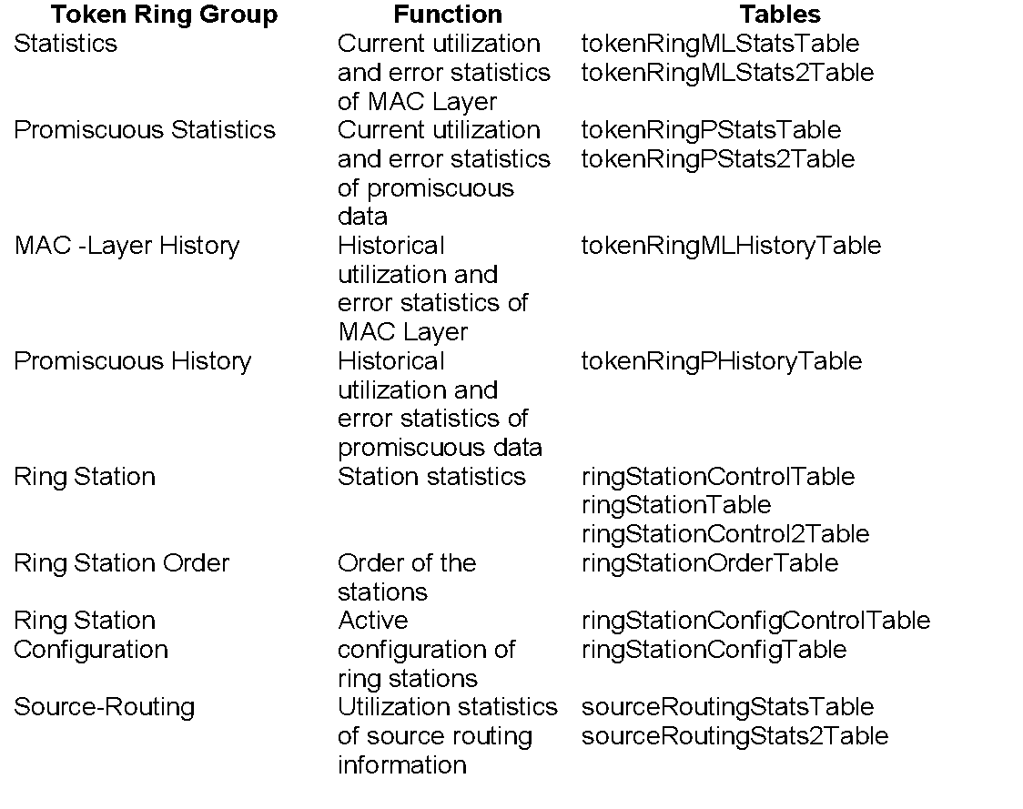
Chapter 8 SNMP Management: RMON
RMON TR Extension Groups
Table 8.3 RMON Token-Ring MIB Groups and Tables
Notes
Two statistics groups and associated history groups
MAC layer (Statistics group) collects TR parameters
Promiscuous Statistics group collects packets promiscuously on sizes and types of packets
Three groups associated with the stations
Routing group gathers on routing
Network Management: Principles and Practice
© Mani Subramanian 2010
*

Slide 17
Chapter 8 SNMP Management: RMON
RMON2
Applicable to Layers 3 and above
Functions similar to RMON1
Enhancement to RMON1
Defined conformance and compliance
Notes
Network Management: Principles and Practice
© Mani Subramanian 2010
*

Slide 18
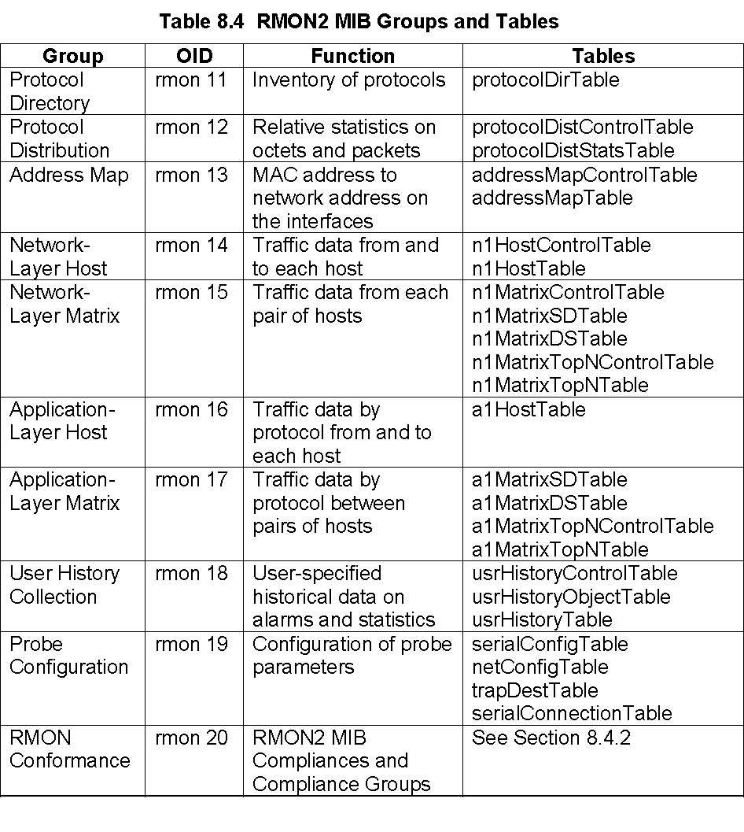
Chapter 8 SNMP Management: RMON
RMON2 MIB
Notes
Network Management: Principles and Practice
© Mani Subramanian 2010
*

Slide 19
Chapter 8 SNMP Management: RMON
Case Study
A study at Georgia Tech on Internet traffic
Objectives
Traffic growth and trend
Traffic patterns
Network comprising Ethernet and FDDI LANs
Tools used
HP Netmetrix protocol analyzer
Special high-speed TCP dump tool for FDDI LAN
RMON groups utilized
Host top-n
Matrix group
Filter group
Packet capture group (for application level protocols)
Notes
Network Management: Principles and Practice
© Mani Subramanian 2010
*

Slide 20
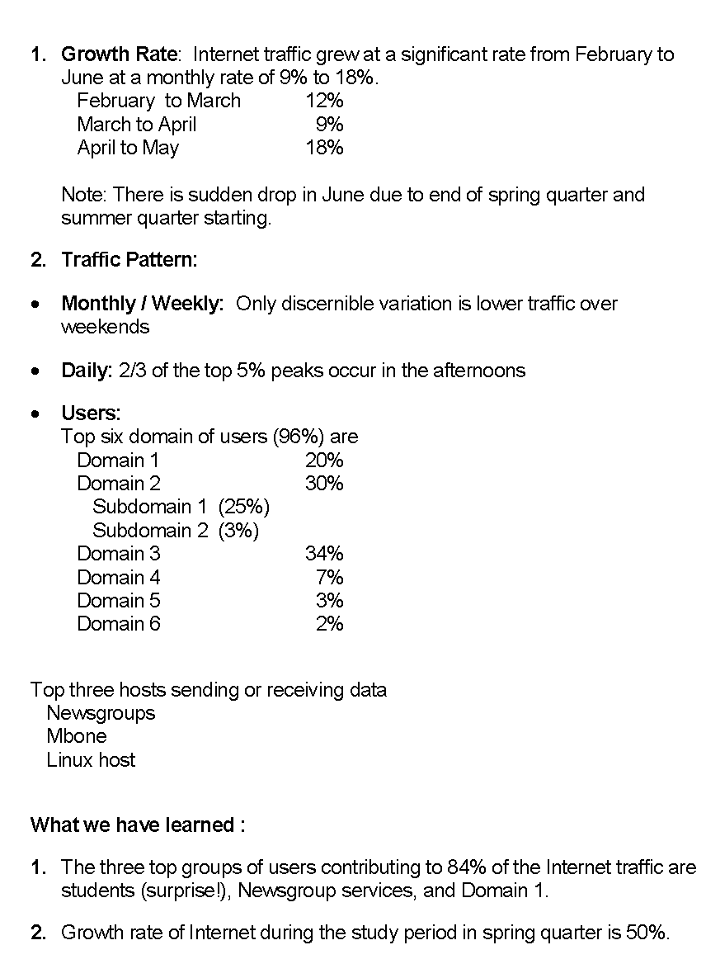
Chapter 8 SNMP Management: RMON
Case Study Results
Network Management: Principles and Practice
© Mani Subramanian 2010
*

