Slide 1
Chapter 3 Basic Foundations: Standards, Models, and Language
Chapter 3
Basic Foundations:
Standards, Models, and Language
Network Management: Principles and Practice
© Mani Subramanian 2010
*
Notes:
*

Slide 2
Objectives
Chapter 3 Basic Foundations: Standards, Models, and Language
Standards, Models, and Language needed for network management
Network Models
OSI
Internet
TMN
IEEE 802
Web-based
Management communication protocols
SNMP
CMIP
XML
CORBA
ASN.1 language
Syntax
Macro
Basic encoding rule
Management application functions
Network Management: Principles and Practice
© Mani Subramanian 2010
*
Notes:
*

Slide 3
Chapter 3 Basic Foundations: Standards, Models, and Language
Introduction
Standards
Standards organizations
Protocol standards of transport layers
Protocol standards of management (application) layer
Management Models
Language
Notes
Network Management: Principles and Practice
© Mani Subramanian 2010
*

Slide 4
Chapter 3 Basic Foundations: Standards, Models, and Language
Table 3.1 Network Management Standards
Standard | Salient Points
OSI/CMIP | International standard (ISO/OSI) Management of data communications network - LAN and WAN Deals with all 7 layers Most complete Object oriented Well structured and layered 7. Consumes large resource in implementation
SNMP/Internet | Industry standard (IETF) Originally intended for management of Internet components, currently adopted for WAN and telecommunication systems Easy to implement Most widely implemented
TMN | International standard (ITU-T) Management of telecommunications network Based on OSI network management framework Addresses both network and administrative aspects of management eTOM industry standard for business processes for implementing TMN using NGOSS framework
IEEE | IEEE standards adopted internationally Addresses LAN and MAN management Adopts OSI standards significantly Deals with first two layers of OSI RM
Web-based Management | Web-Based Enterprise Management (WBEM) Java Management Extension (JMX) XML-Based Network Management CORBA-based Network Management
Network Management: Principles and Practice
© Mani Subramanian 2010
*

Slide 5
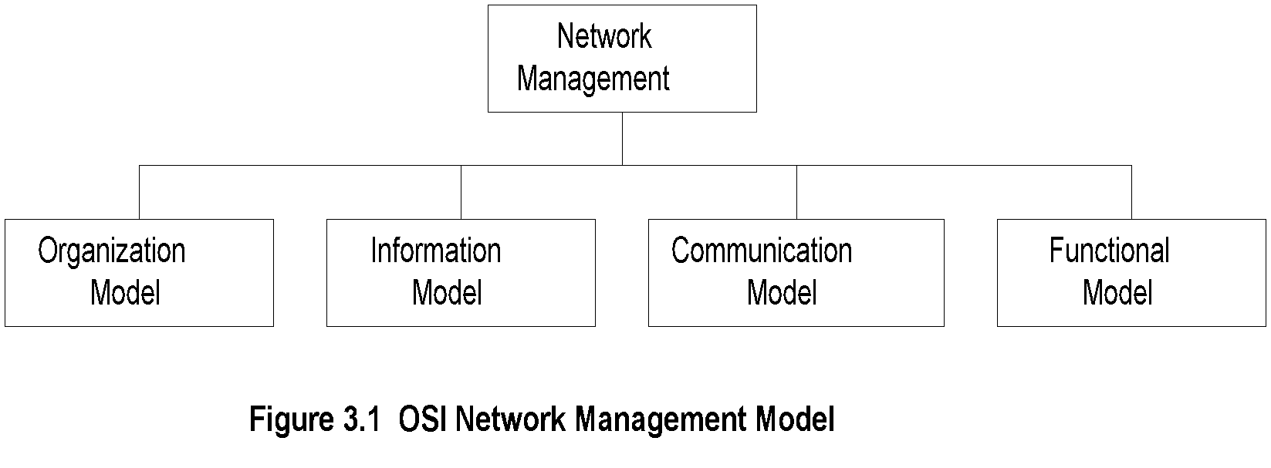
Chapter 3 Basic Foundations: Standards, Models, and Language
OSI Architecture and Model
Notes
Organization
Network management components
Functions of components
Relationships
Information
Structure of management information (SMI)
Syntax and semantics
Management information base (MIB)
Organization of management information
Object-oriented
Network Management: Principles and Practice
© Mani Subramanian 2010
*

Slide 6
Chapter 3 Basic Foundations: Standards, Models, and Language
OSI Architecture and Model (cont.)
Notes
Communication
Transfer syntax with bidirectional messages
Transfer structure (PDU)
Functions
Application functions
Configure components
Monitor components
Measure performance
Secure information
Usage accounting
Network Management: Principles and Practice
© Mani Subramanian 2010
*

Slide 7
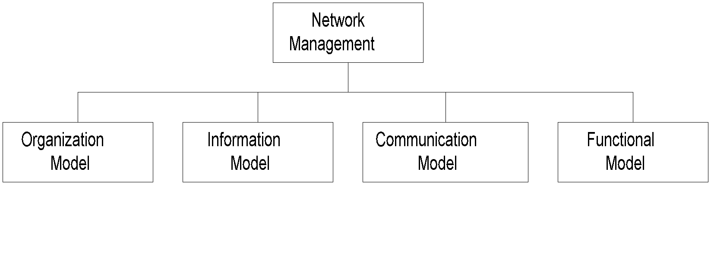
Chapter 3 Basic Foundations: Standards, Models, and Language
SNMP Architecture and Model
Notes
Organization
Same as OSI model
Information
Same as OSI, but scalar
Communication
Messages less complex than OSI and unidirectional
Transfer structure (PDU)
Functions
Application functions
Fault management
Configuration management
Account management
Performance management
Security management
Network Management: Principles and Practice
© Mani Subramanian 2010
*

Slide 8
Chapter 3 Basic Foundations: Standards, Models, and Language
TMN Architecture
Addresses management of telecommunication networks
Based on OSI model
Superstructure on OSI network
Addresses network, service, and business management
Notes
Network Management: Principles and Practice
© Mani Subramanian 2010
*

Slide 9
Chapter 3 Basic Foundations: Standards, Models, and Language
Organizational Model
Manager
Sends requests to agents
Monitors alarms
Houses applications
Provides user interface
Agent
Gathers information from objects
Configures parameters of objects
Responds to managers’ requests
Generates alarms and sends them to managers
Managed object
Network element that is managed
Houses management agent
All objects are not managed / manageable
Notes
Network Management: Principles and Practice
© Mani Subramanian 2010
*

Slide 10
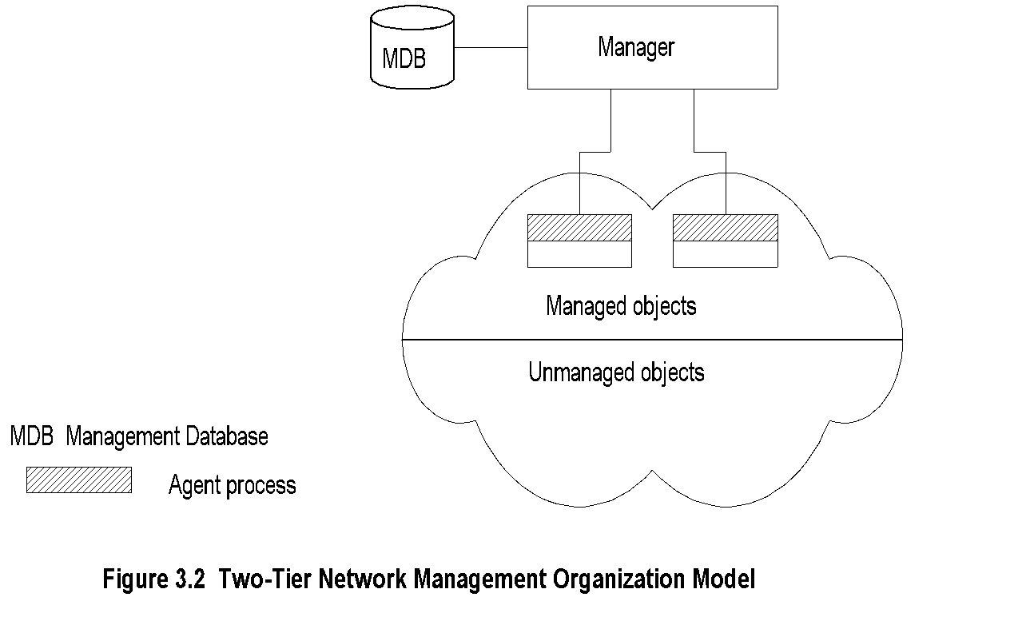
Chapter 3 Basic Foundations: Standards, Models, and Language
Two-Tier Model
Notes
Agent built into network element Example: Managed hub, managed router
An agent can manage multiple elements Example: Switched hub, ATM switch
MDB is a physical database
Unmanaged objects are network elements that are not managed - both physical (unmanaged hub) and logical (passive elements)
Network Management: Principles and Practice
© Mani Subramanian 2010
*

Slide 11
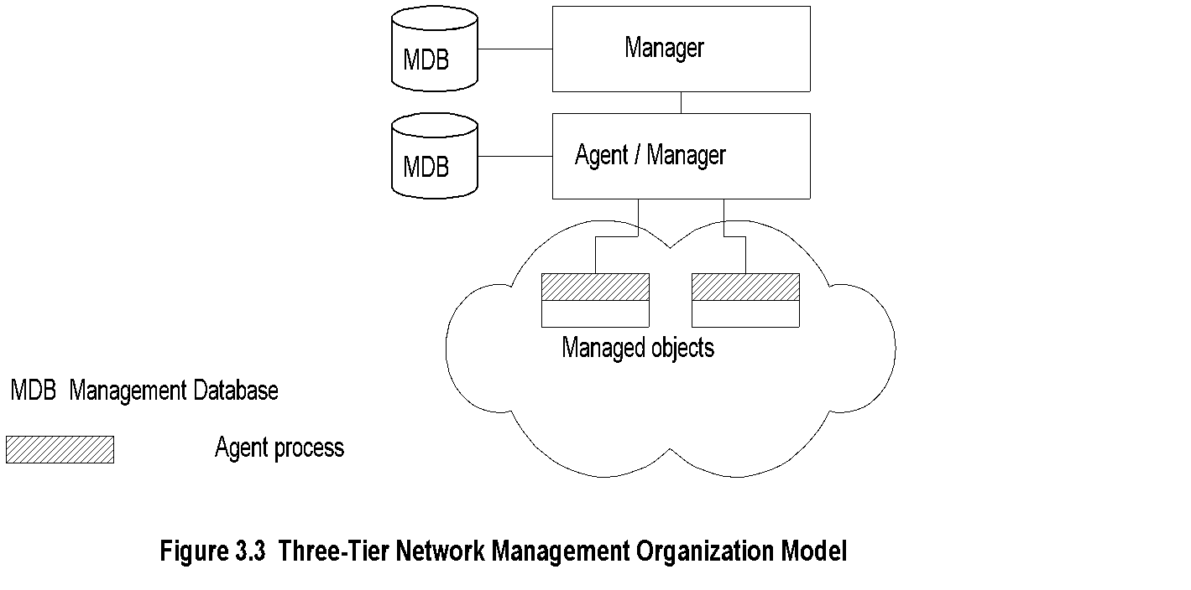
Chapter 3 Basic Foundations: Standards, Models, and Language
Three-Tier Model
Notes
Middle layer plays the dual role
Agent to the top-level manager
Manager to the managed objects
Example of middle level: Remote monitoring agent (RMON)
Network Management: Principles and Practice
© Mani Subramanian 2010
*

Slide 12
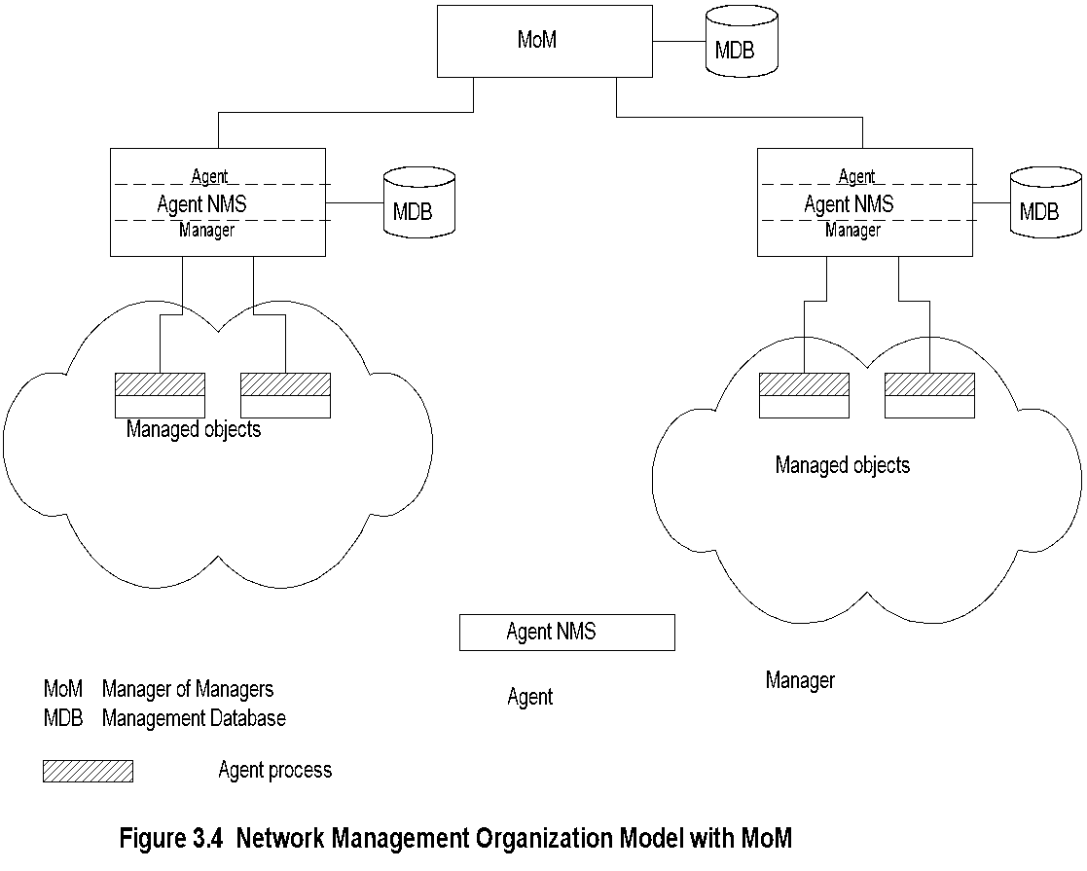
Chapter 3 Basic Foundations: Standards, Models, and Language
Manager of Managers
Notes
Agent NMS manages the domain
MoM presents integrated view of domains
Domain may be geographical, administrative, vendor-specific products, etc.
Network Management: Principles and Practice
© Mani Subramanian 2010
*

Slide 13
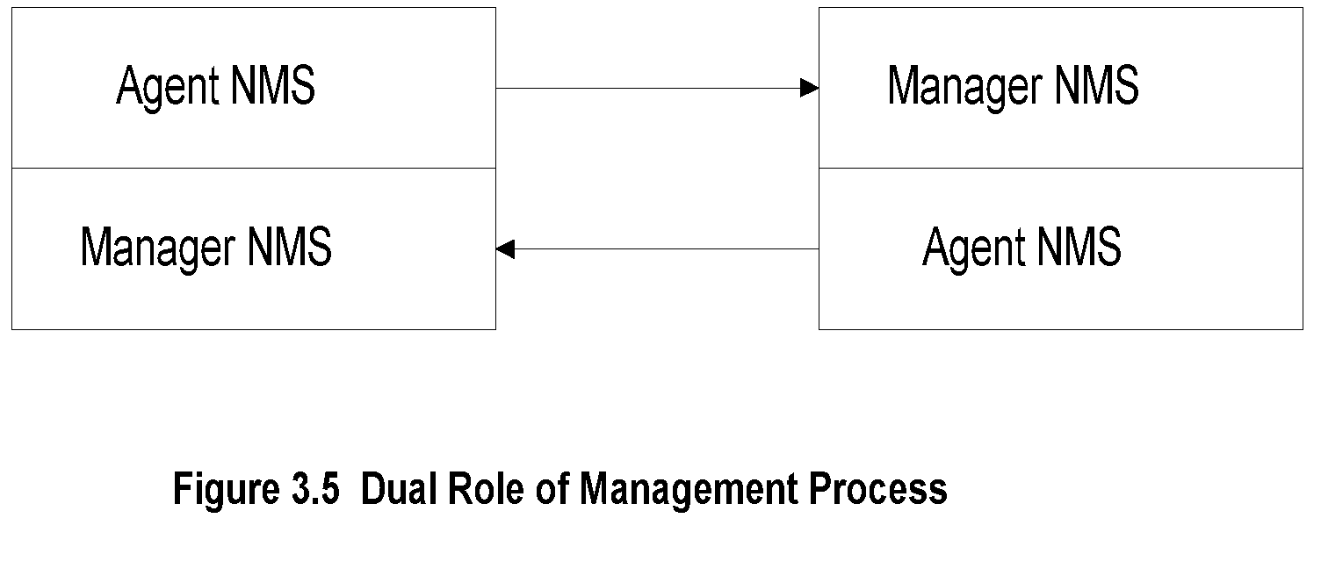
Chapter 3 Basic Foundations: Standards, Models, and Language
Peer NMSs
Notes
Dual role of both NMSs
Network management system acts as peers
Dumbbell architecture discussed in Chapter 1
Notice that the manager and agent functions are processes and not systems
Network Management: Principles and Practice
© Mani Subramanian 2010
*

Slide 14
Chapter 3 Basic Foundations: Standards, Models, and Language
Information Model: Analogy
Figure in a book uniquely identified by
ISBN, Chapter, and Figure number in that hierarchical order
ID: {ISBN, chapter, figure}
The three elements above define the syntax
Semantics is the meaning of the three entities according to Webster’s dictionary
The information comprises syntax and semantics about an object
Notes
Network Management: Principles and Practice
© Mani Subramanian 2010
*

Slide 15
Chapter 3 Basic Foundations: Standards, Models, and Language
Structure of Management Information (SMI)
SMI defines for a managed object
Syntax
Semantics
Plus additional information such as status
Example sysDescr: { system 1 } Syntax: OCTET STRING Definition: "A textual description of the entity. " Access: read-only Status: mandatory
Notes
Network Management: Principles and Practice
© Mani Subramanian 2010
*

Slide 16
Chapter 3 Basic Foundations: Standards, Models, and Language
Management Information Base (MIB)
Information base contains information about objects
Organized by grouping of related objects
Defines relationship between objects
It is NOT a physical database. It is a virtual database that is compiled into management module
Notes
Network Management: Principles and Practice
© Mani Subramanian 2010
*

Slide 17
Chapter 3 Basic Foundations: Standards, Models, and Language
Information Base View: An Analogy
Fulton County library system has many branches
Each branch has a set of books
The books in each branch is a different set
The information base of the county has the view (catalog) of all books
The information base of each branch has the catalog of books that belong to that branch. That is, each branch has its view (catalog) of the information base
Let us apply this to MIB view
Notes
Network Management: Principles and Practice
© Mani Subramanian 2010
*

Slide 18
Chapter 3 Basic Foundations: Standards, Models, and Language
MIB View and Access of an Object
A managed object has many attributes - its information base
There are several operations that can be performed on the objects
A user (manager) can view and perform only certain operations on the object by invoking the management agent
The view of the object attributes that the agent perceives is the MIB view
The operation that a user can perform is the MIB access
Notes
Network Management: Principles and Practice
© Mani Subramanian 2010
*

Slide 19
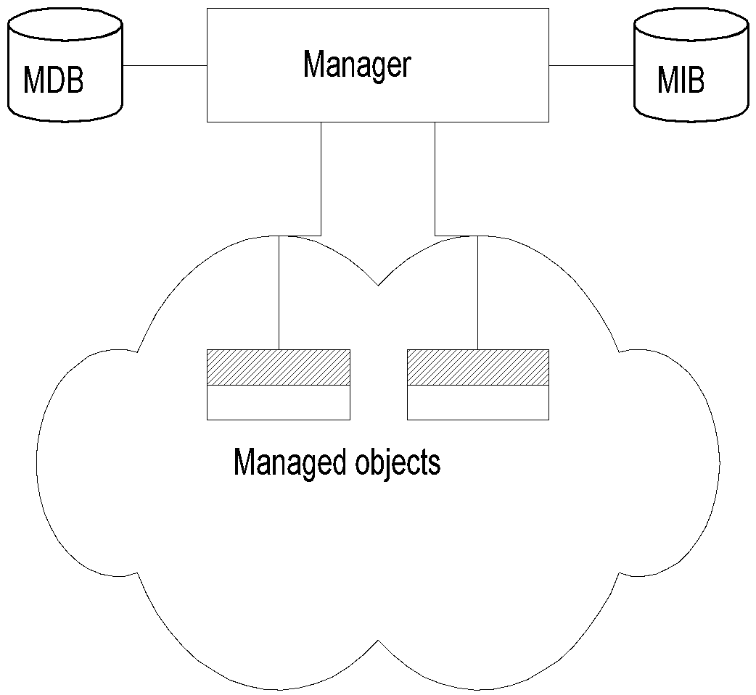
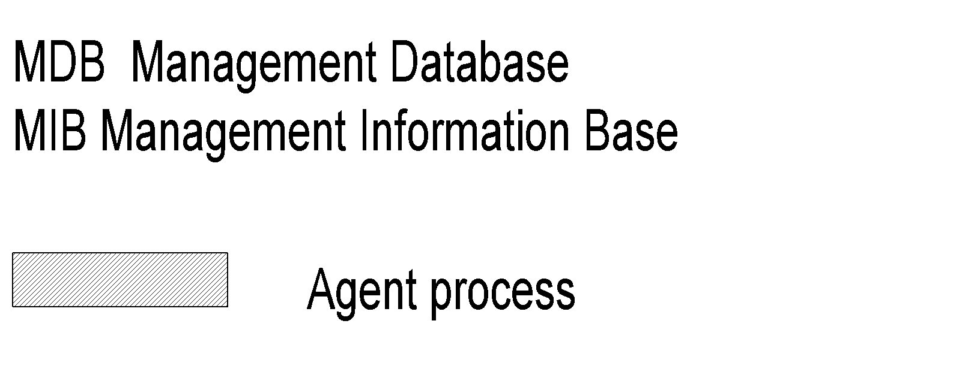
Chapter 3 Basic Foundations: Standards, Models, and Language
Management Data Base / Information Base
Notes
Distinction between MDB and MIB
MDB physical database; e.g., Oracle, Sybase
MIB virtual database; schema compiled into management software.
An NMS can automatically discover a managed object, such as a hub, when added to the network
The NMS can identify the new object as hub only after the MIB schema of the hub is compiled into NMS software.
Network Management: Principles and Practice
© Mani Subramanian 2010
*

Slide 20
Chapter 3 Basic Foundations: Standards, Models, and Language
Managed Object
Managed objects can be
Network elements (hardware, system)
Hubs, bridges, routers, transmission facilities
Software (non-physical)
Programs, algorithms
Administrative information
Contact person, name of group of objects (IP group)
Notes
Network Management: Principles and Practice
© Mani Subramanian 2010
*

Slide 21
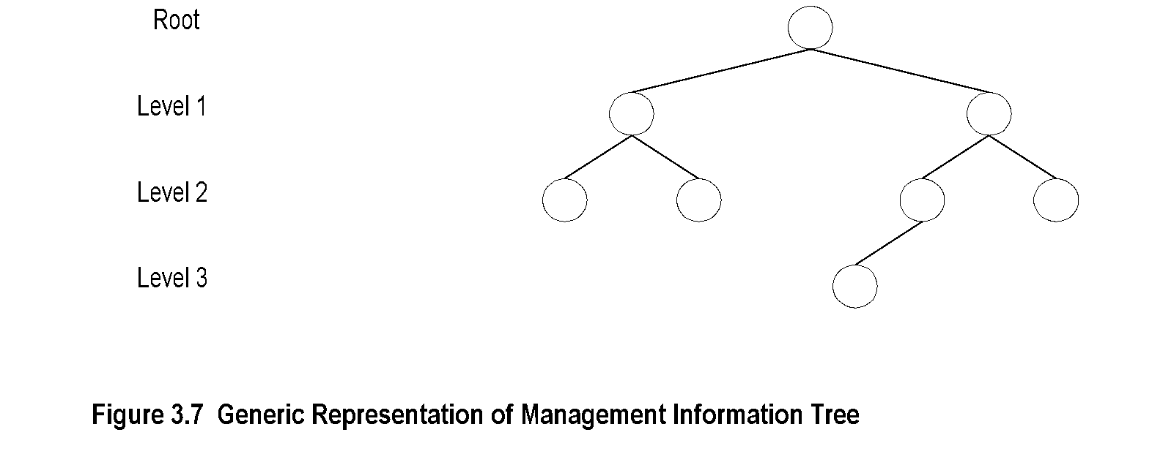
Chapter 3 Basic Foundations: Standards, Models, and Language
Management Information Tree
Notes
Network Management: Principles and Practice
© Mani Subramanian 2010
*

Slide 22
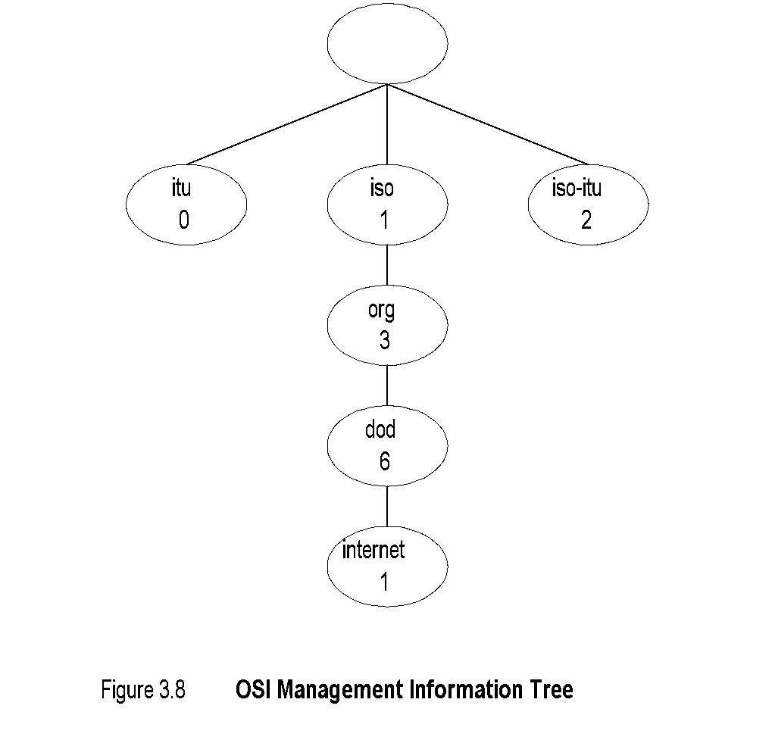
Chapter 3 Basic Foundations: Standards, Models, and Language
OSI Management Information Tree
Notes
iso International Standards Organization itu International Telecommunications Union dod Department of Defense
Designation:
iso 1
org 1.3
dod 1.3.6
internet 1.3.6.1
Network Management: Principles and Practice
© Mani Subramanian 2010
*

Slide 23
Chapter 3 Basic Foundations: Standards, Models, and Language
Object Type and Instance
Type
Name
Syntax
Definition
Status
Access
Instance
Notes
Example of a circle
“circle” is syntax
Semantics is definition from dictionary “A plane figure bounded by a single curved line, every point of which is of equal distance from the center of the figure.”
Analogy of nursery school
Network Management: Principles and Practice
© Mani Subramanian 2010
*

Slide 24
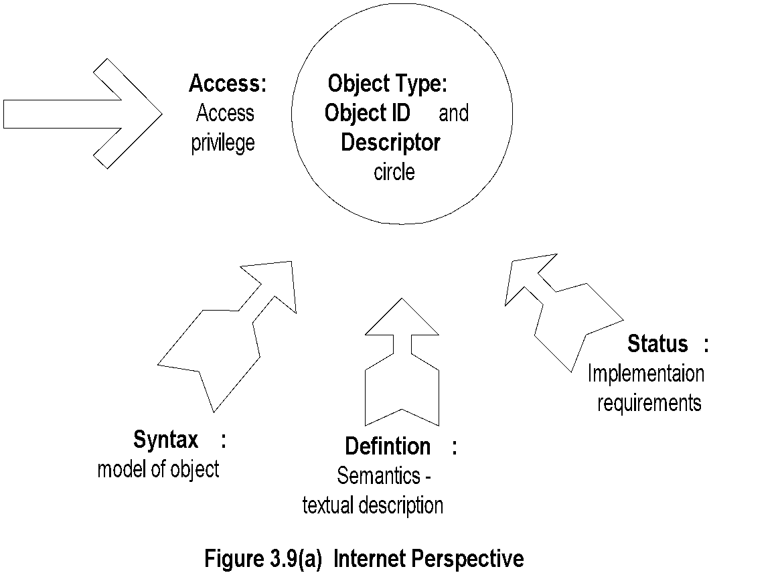
Chapter 3 Basic Foundations: Standards, Models, and Language
Managed Object:
Internet Perspective
Notes
object ID unique ID
and descriptor and name for the object
syntax used to model the object
access access privilege to a managed object
status implementation requirements
definition textual description of the semantics of object type
Network Management: Principles and Practice
© Mani Subramanian 2010
*

Slide 25
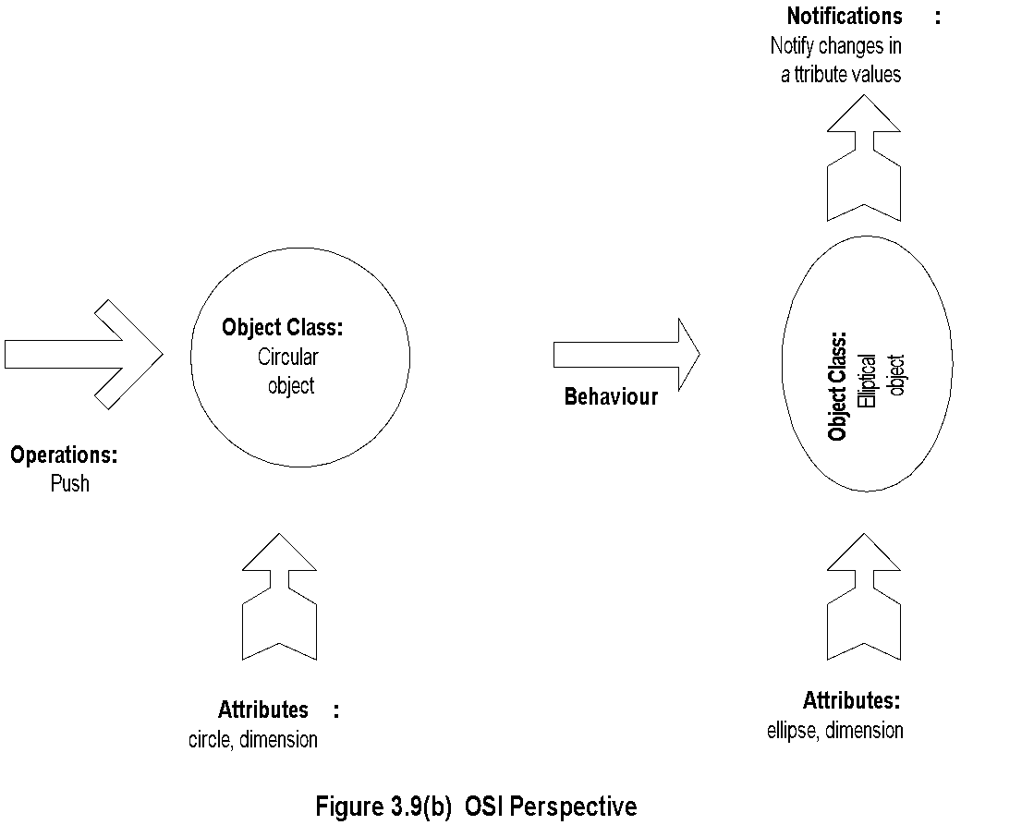
Managed Object:
OSI Perspective
Chapter 3 Basic Foundations: Standards, Models, and Language
Notes
object class managed object
attributes attributes visible at its boundary
operations operations which may be applied to it
behaviour behavior exhibited by it in response to operation
notifications notifications emitted by the object
Network Management: Principles and Practice
© Mani Subramanian 2010
*

Slide 26
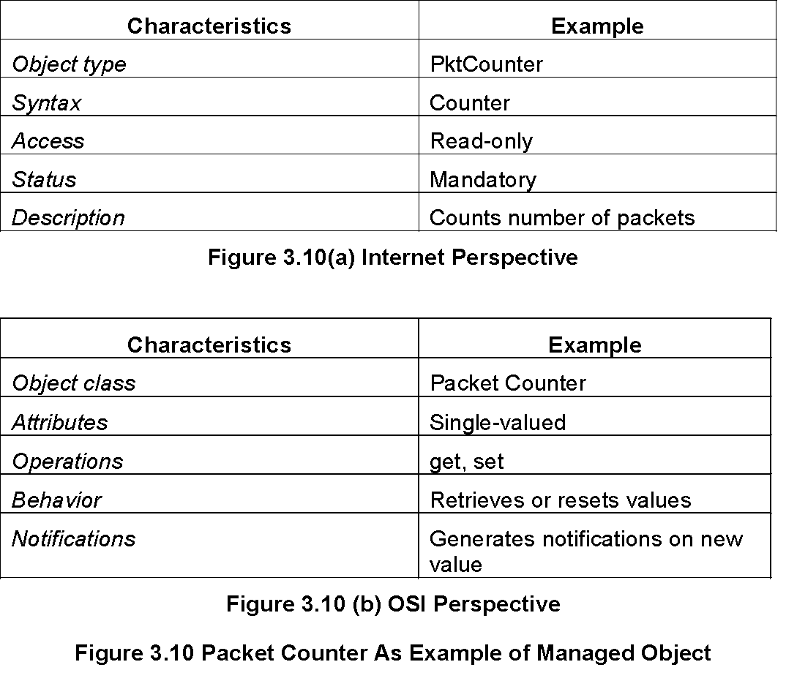
Chapter 3 Basic Foundations: Standards, Models, and Language
Packet Counter Example
Notes
Network Management: Principles and Practice
© Mani Subramanian 2010
*

Slide 27
Chapter 3 Basic Foundations: Standards, Models, and Language
Internet vs. OSI Managed Object
Scalar object in Internet vs. Object-oriented approach in OSI
OSI characteristics of operations, behavior, and notification are part of communication model in Internet: get/set and response/alarm
Internet syntax is absorbed as part of OSI attributes
Internet access is part of OSI security model
Internet status is part of OSI conformance application
OSI permits creation and deletion of objects; Internet does not: Enhancement in SNMPv2
Notes
Network Management: Principles and Practice
© Mani Subramanian 2010
*

Slide 28
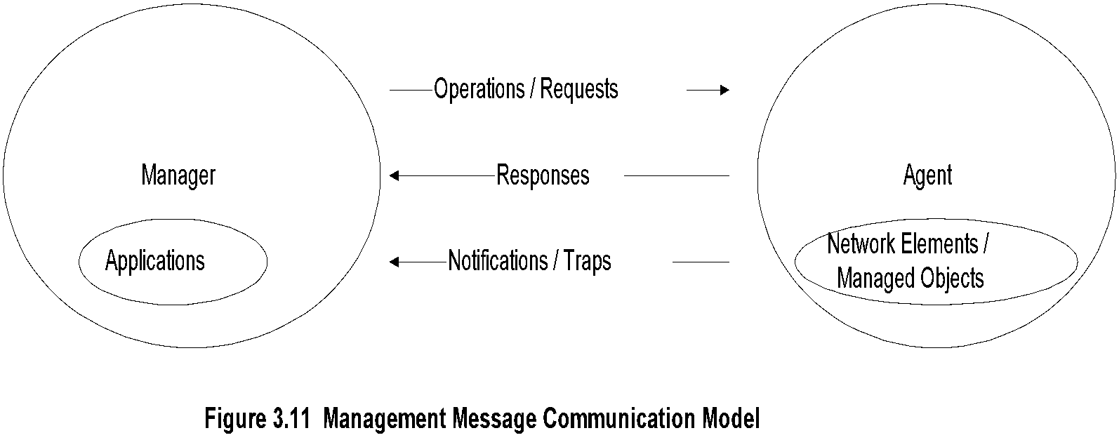
Chapter 3 Basic Foundations: Standards, Models, and Language
Mgmt. Communication Model
Notes
In Internet requests/responses, in OSI operations
In Internet traps and notifications (SNMPv2), in OSI notifications
Network Management: Principles and Practice
© Mani Subramanian 2010
*

Slide 29
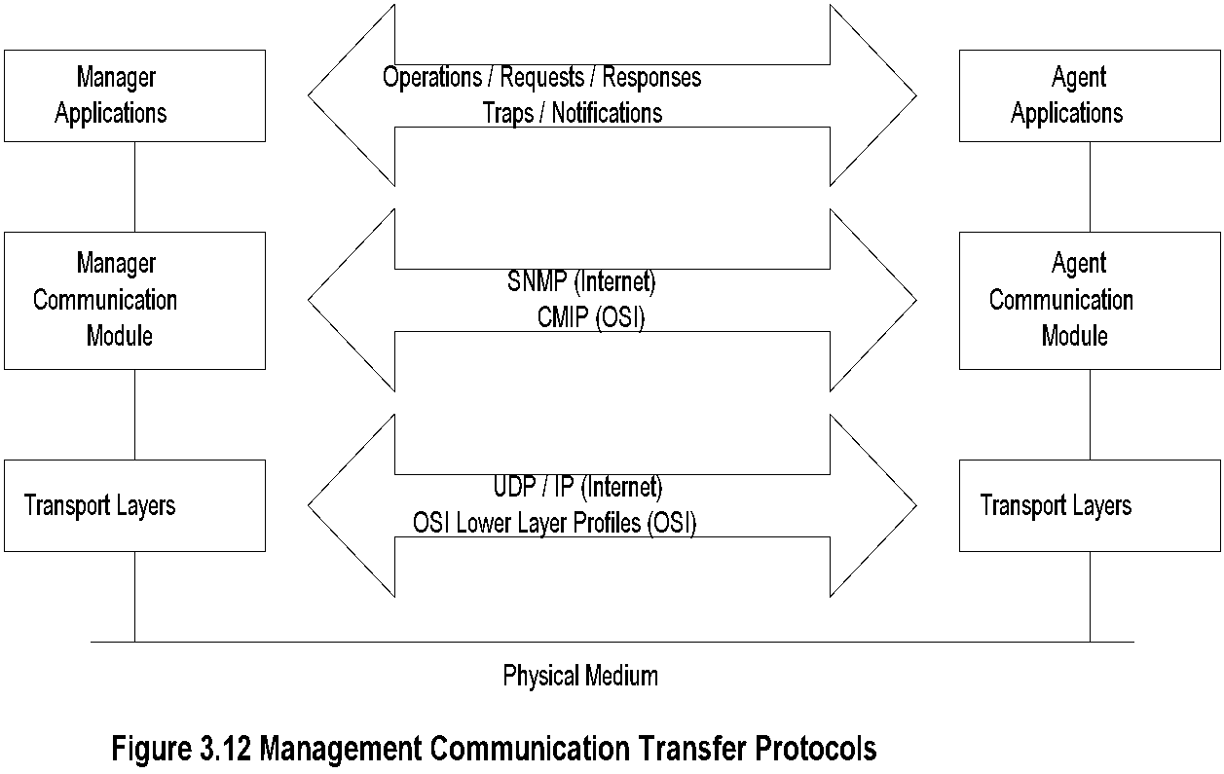
Chapter 3 Basic Foundations: Standards, Models, and Language
Transfer Protocols
Notes
Internet is based on SNMP; OSI is based on CMIP
OSI uses CMISE (Common Management Information Service Element) application with CMIP
OSI specifies both c-o and connectionless transport protocol; SNMPv2 extended to c-o, but rarely used
Network Management: Principles and Practice
© Mani Subramanian 2010
*

Slide 30
Chapter 3 Basic Foundations: Standards, Models, and Language
Abstract Syntax Notation One
ASN.1 is more than a syntax; it’s a language
Addresses both syntax and semantics
Two types of syntax
Abstract syntax: set of rules that specify data type and structure for information storage
Transfer syntax: set of rules for communicating information between systems
Makes application layer protocols independent of lower layer protocols
Can generate machine-readable code: Basic Encoding Rules (BER) is used in management modules
Notes
Network Management: Principles and Practice
© Mani Subramanian 2010
*

Slide 31
Chapter 3 Basic Foundations: Standards, Models, and Language
Backus-Nauer Form (BNF)
Definition:
<name> ::= <definition>
Rules:
<digit> ::= 0|1|2|3|4|5|6|7|8|9
<number> ::= <number> | <digit> <number>
<op> ::= +|-|x|/
<SAE> ::= <number>|<SAE>|<SAE><op><SAE>
Example:
9 is primitive 9
19 is construct of 1 and 9
619 is construct of 6 and 19
Notes
BNF is used for ASN.1 constructs
Constructs developed from primitives
The above example illustrates how numbers are constructed from the primitive <digit>
Simple Arithmetic Expression entity (<SAE>) is constructed from the primitives <digit> and <op>
Network Management: Principles and Practice
© Mani Subramanian 2010
*

Slide 32
Chapter 3 Basic Foundations: Standards, Models, and Language
Simple Arithmetic Expression
<SAE> ::= <number> | <SAE><op><number>
Example: 26 = 13 x 2
Constructs and primitives
Notes
Network Management: Principles and Practice
© Mani Subramanian 2010
*

Slide 33
Chapter 3 Basic Foundations: Standards, Models, and Language
Type and Value
Assignments
<BooleanType> ::= BOOLEAN
<BooleanValue> ::= TRUE | FALSE
ASN.1 module is a group of assignments person-name Person-Name::=
{
first "John",
middle “T",
last "Smith"
}
Notes
Network Management: Principles and Practice
© Mani Subramanian 2010
*

Slide 34
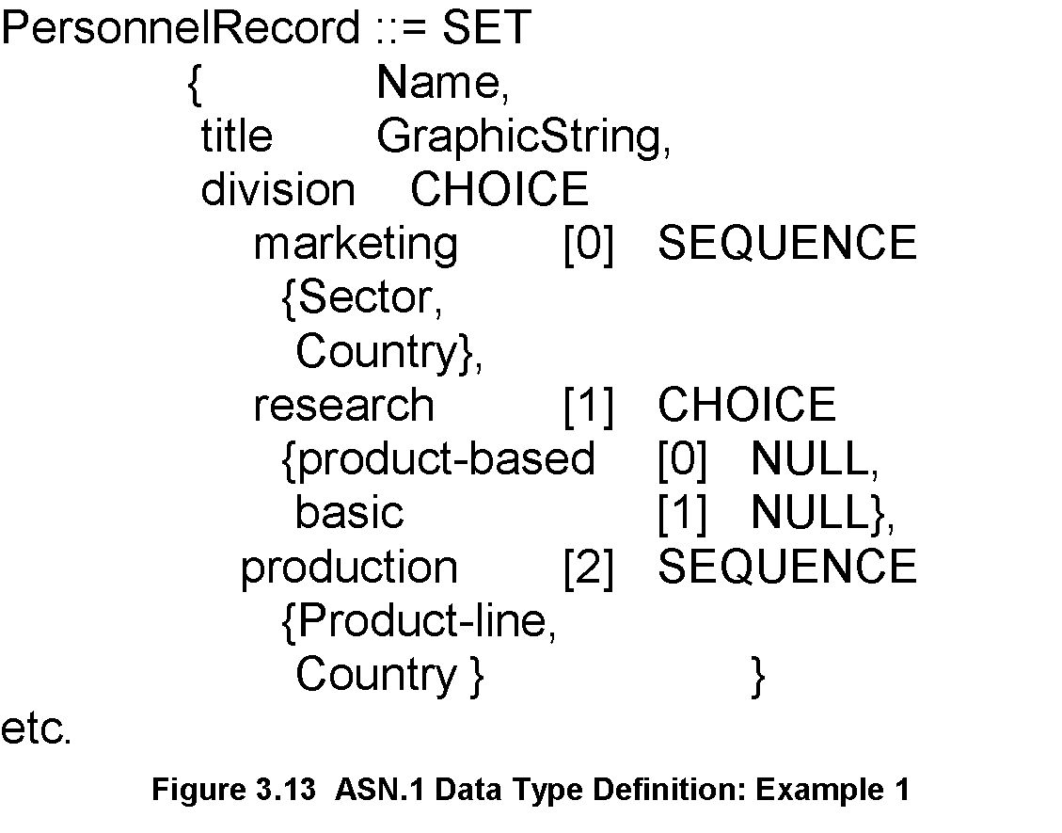
Chapter 3 Basic Foundations: Standards, Models, and Language
Data Type: Example 1
Notes
Module name starts with capital letters
Data types:
Primitives: NULL, GraphicString
Constructs
Alternatives : CHOICE
List maker: SET, SEQUENCE
Repetition: SET OF, SEQUENCE OF:
Difference between SET and SEQUENCE
Network Management: Principles and Practice
© Mani Subramanian 2010
*

Slide 35
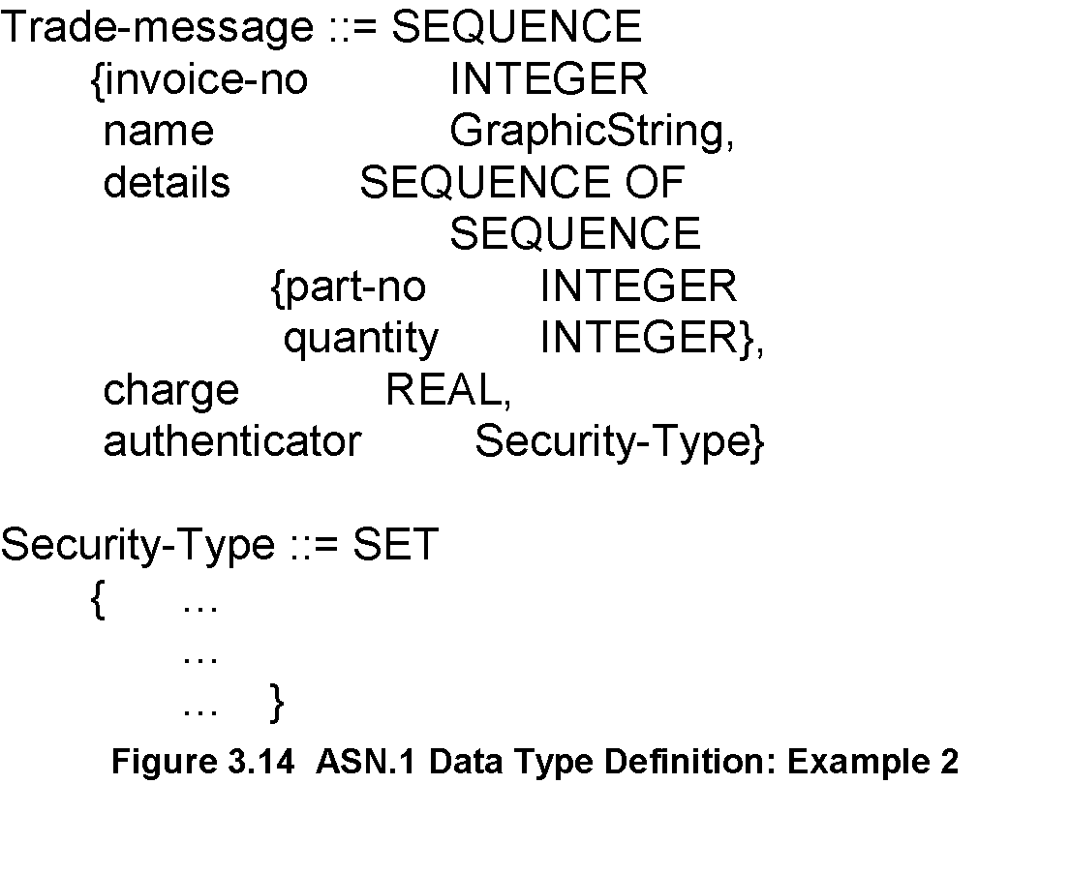
Chapter 3 Basic Foundations: Standards, Models, and Language
Data Type: Example 2
Notes
SEQUENCE OF SEQUENCE makes table of rows
Network Management: Principles and Practice
© Mani Subramanian 2010
*

Slide 36
Chapter 3 Basic Foundations: Standards, Models, and Language
ASN.1 Symbols
Symbol Meaning
::= Defined as
| or, alternative, options of a list
- Signed number
-- Following the symbol are comments
{} Start and end of a list
[] Start and end of a tag
() Start and end of subtype
.. Range
Notes
Network Management: Principles and Practice
© Mani Subramanian 2010
*

Slide 37
Chapter 3 Basic Foundations: Standards, Models, and Language
Keyword Examples
CHOICE
SET
SEQUENCE
OF
NULL
Notes
Keywords are in all UPPERCASE letters
Network Management: Principles and Practice
© Mani Subramanian 2010
*

Slide 38
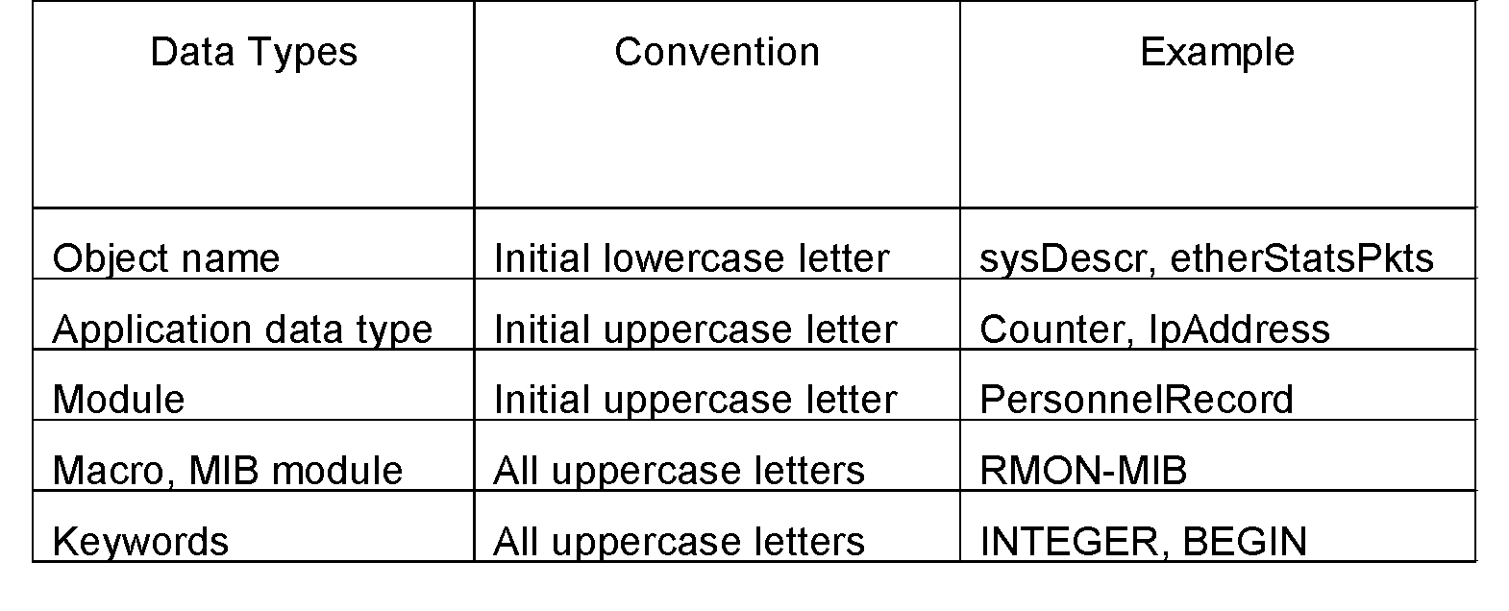
Chapter 3 Basic Foundations: Standards, Models, and Language
ASN.1 Data Type Conventions
Notes
Network Management: Principles and Practice
© Mani Subramanian 2010
*

Slide 39
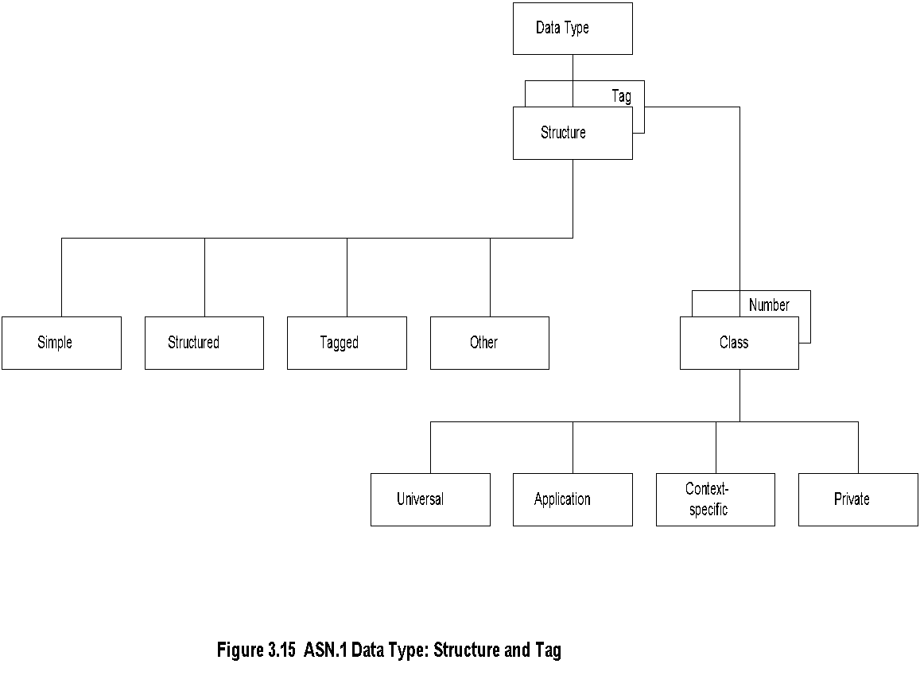
Chapter 3 Basic Foundations: Standards, Models, and Language
Data Type: Structure & Tag
Notes
Structure defines how data type is built
Tag uniquely identifies the data type
Network Management: Principles and Practice
© Mani Subramanian 2010
*

Slide 40
Chapter 3 Basic Foundations: Standards, Models, and Language
Structure
Simple
PageNumber ::= INTEGER
ChapterNumber ::= INTEGER
Structure / Construct
BookPageNumber ::= SEQUENCE {ChapterNumber, Separator, PageNumber Example: {1-1, 2-3, 3-39}
Tagged
Derived from another type; given a new ID
In Fig. 3-14, INTEGER is either universal or application specific
Other types:
CHOICE, ANY
Notes
BookPages ::= SEQUENCE OF { BookPageNumber} or BookPages ::= SEQUENCE OF
{
SEQUENCE
{ChapterNumber, Separator, PageNumber}
}
Network Management: Principles and Practice
© Mani Subramanian 2010
*

Slide 41
Chapter 3 Basic Foundations: Standards, Models, and Language
Tag
Tag uniquely identifies a data type
Comprises class and tag number
Class:
Universal - always true
Application - only in the application used
Context-specific - specific context in application
Private - used extensively by commercial vendors
Notes
Example: BOOLEAN Universal 1 INTEGER Universal 2 research Application [1] (Figure 3.13)
product-based Context-specific under research [0]
Network Management: Principles and Practice
© Mani Subramanian 2010
*

Slide 42
Chapter 3 Basic Foundations: Standards, Models, and Language
Enumerated Integer
Notes
ENUMERATED is a special case of INTEGER
Example: RainbowColors(5) is orange
Network Management: Principles and Practice
© Mani Subramanian 2010
*

Slide 43
Chapter 3 Basic Foundations: Standards, Models, and Language
ASN.1 Module Example
Notes
Network Management: Principles and Practice
© Mani Subramanian 2010
*

Slide 44
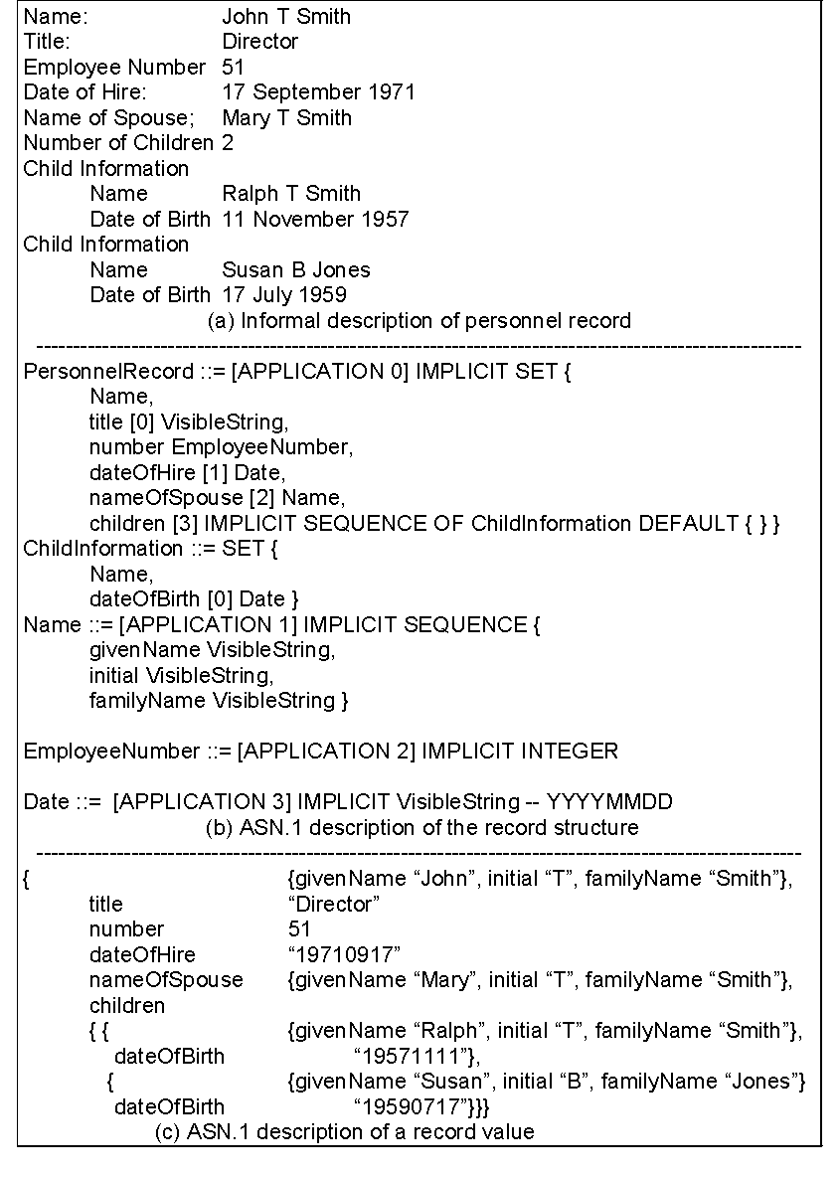
Chapter 3 Basic Foundations: Standards, Models, and Language
Network Management: Principles and Practice
© Mani Subramanian 2010
*

Slide 45
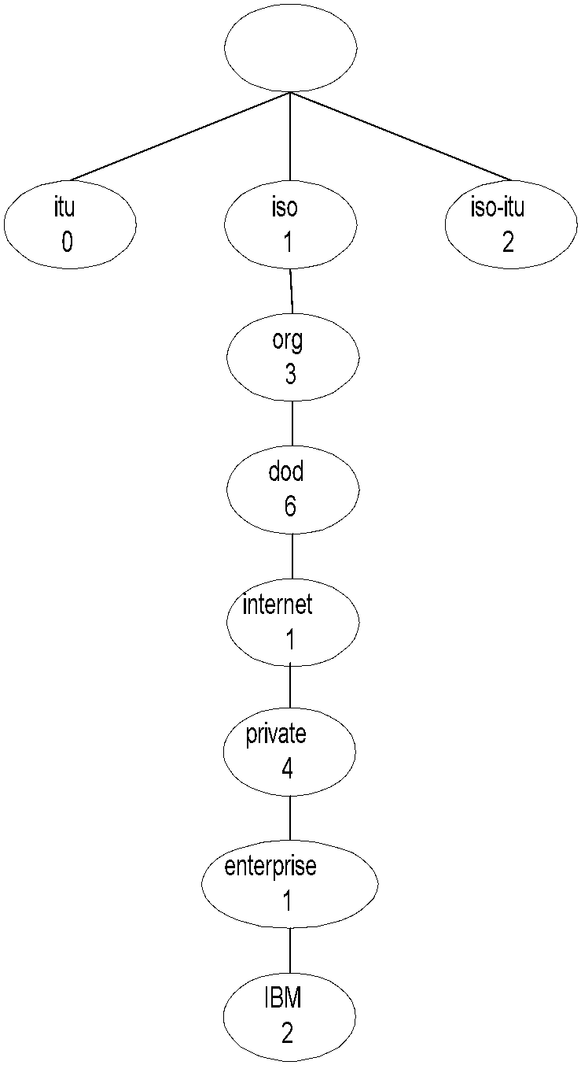
Chapter 3 Basic Foundations: Standards, Models, and Language
Object Name
Notes
internet OBJECT IDENTIFIER ::= {ISO(1) ORG(3) DOD(6) INTERNET(1)}
Network Management: Principles and Practice
© Mani Subramanian 2010
*

Slide 46
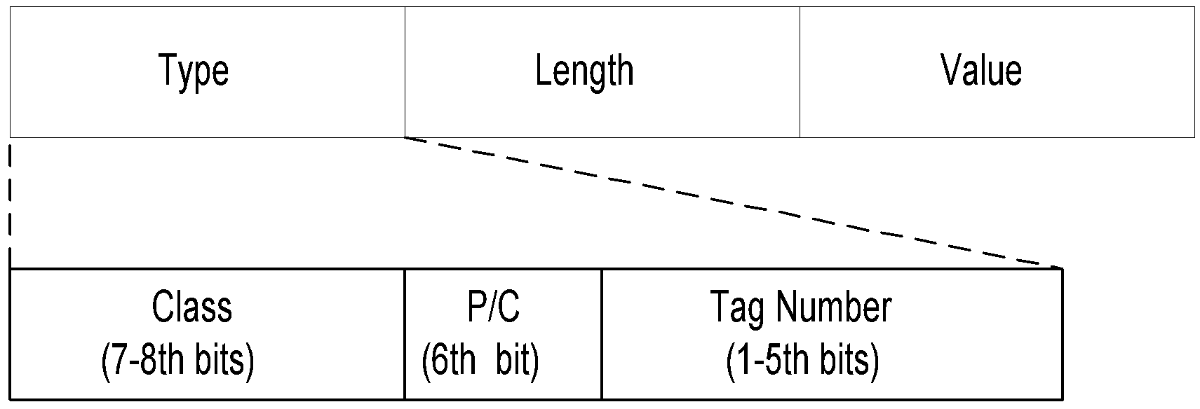
Chapter 3 Basic Foundations: Standards, Models, and Language
TLV Encoding
Notes
TLV Type, length, and value are components of the structure
Network Management: Principles and Practice
© Mani Subramanian 2010
*

Slide 47
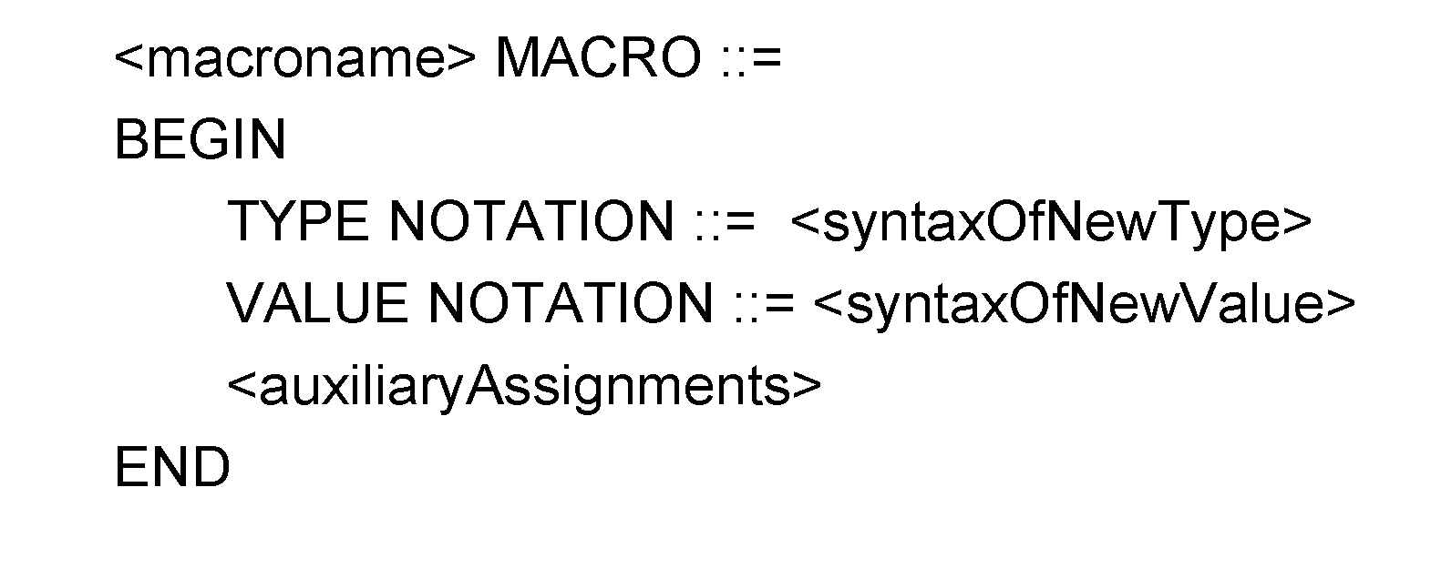
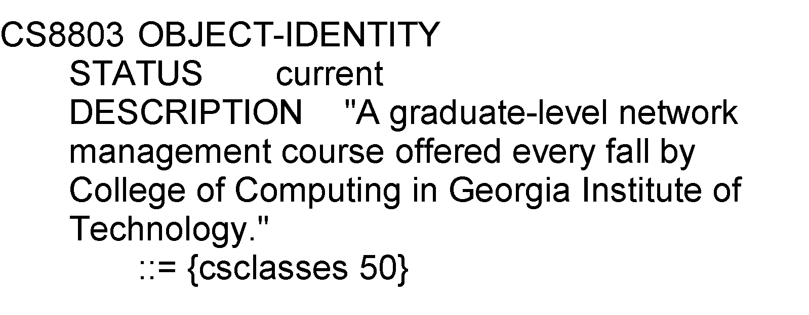
Chapter 3 Basic Foundations: Standards, Models, and Language
Macro
Example:
Notes
Macro is used to create new data types
Network Management: Principles and Practice
© Mani Subramanian 2010
*

Slide 48
Chapter 3 Basic Foundations: Standards, Models, and Language
Functional Model
Notes
Configuration management
Set and change network configuration component parameters
Set up alarm thresholds
Fault management
Detection and isolation of failures in network
Trouble ticket administration
Performance management
Monitor performance of network
Security management
Authentication
Authorization
Encryption
Accounting management
Functional accounting of network usage
Network Management: Principles and Practice
© Mani Subramanian 2010
*

