Slide 1
Information Technology Project Management, Sixth Edition
Note: See the text itself for full citations.
Notes:
*

Slide 2
Explain the importance of good human resource management on projects, including the current state and future implications of the global IT workforce
Define project human resource management and understand its processes
Summarize key concepts for managing people by understanding the theories of Abraham Maslow, Frederick Herzberg, David McClelland, and Douglas McGregor on motivation, H. J. Thamhain and D. L. Wilemon on influencing workers, and Stephen Covey on how people and teams can become more effective
Information Technology Project Management, Sixth Edition
*

Slide 3
Discuss human resource planning and be able to create a human resource plan, project organizational chart, responsibility assignment matrix, and resource histogram
Understand important issues involved in project staff acquisition and explain the concepts of resource assignments, resource loading, and resource leveling
Assist in team development with training, team-building activities, and reward systems
Explain and apply several tools and techniques to help manage a project team and summarize general advice on managing teams
Describe how project management software can assist in project human resource management
Information Technology Project Management, Sixth Edition
*

Slide 4
Many corporate executives have said, “People are our most important asset”
People determine the success and failure of organizations and projects
Information Technology Project Management, Sixth Edition
*

Slide 5
Although there have been ups and downs in the IT labor market, there will always be a need for good IT workers
The Digital Planet 2008 study estimated that the global marketplace for information and communications technology (ICT) would top $3.7 trillion in 2008 and reach almost $4 trillion by 2011
Information Technology Project Management, Sixth Edition
*

Slide 6
Communications products and services represented the largest single category of ICT spending (57 percent) in 2007 with $1.9 trillion; consumers spent 29 percent of ICT dollars worldwide, while spending by business and government accounted for 71 percent
The top ten ICT spending countries are, in descending order: the U.S., Japan, China, Germany, U.K., France, Italy, Brazil, Canada, and Spain; in 2008, China jumped ahead of Germany, the United Kingdom, and France
The Americas’ growth in ICT spending will be the slowest of the three broad regions at 4 percent between 2007 and 2011; the Asia-Pacific region and the Europe, Africa, and Middle East regions will grow annually at 10.5 percent and 5 percent, respectively
Information Technology Project Management, Sixth Edition
*

Slide 7
U.S. IT employment topped 4 million for the first time in 2008
Several IT-related occupations will be among the top 30 fastest-growing occupations in the U.S. between now and 2016, with network systems/data communications analysts and computer software engineers listed as numbers one and four
IT staff struggle to transition to project management, CIOs argue, and complain that educational institutions are not putting adequate focus on these skills through coursework
Information Technology Project Management, Sixth Edition
*

Slide 8
Proactive organizations are addressing workforce needs by:
Improving benefits
Redefining work hours and incentives
Finding future workers
Information Technology Project Management, Sixth Edition
*

Slide 9
Here’s the dirty little secret: U.S. productivity is No. 1 in the world when productivity is measured as gross domestic product per worker, but our lead vanishes when productivity is measured as GDP per hour worked…Europeans take an average of six to seven weeks of paid annual leave, compared with just 12 days in the United States; twice as many American as European workers put in more than 48 hours per week
Sociologists have shown that many Americans, especially men, would like to have more family or leisure time; recent surveys show that many Americans are willing to sacrifice up to a quarter of their salaries in return for more time off
Information Technology Project Management, Sixth Edition
*

Slide 10
A 2006 report by The Conference Board, Corporate Voices for Working Families, Partnership for 21st Century Skills, and the Society for Human Resource Management suggests that entry level workers in the U.S. are ill-prepared for the workplace
Four-year college graduates were listed as deficient in the following three skills:
Written communications - 27.8%
Writing in English - 26.2%
Leadership - 23.8%
Information Technology Project Management, Sixth Edition
*

Slide 11
Making the most effective use of the people involved with a project
Processes include:
Developing the human resource plan: identifying and documenting project roles, responsibilities, and reporting relationships
Acquiring the project team: getting the needed personnel assigned to and working on the project
Developing the project team: building individual and group skills to enhance project performance
Managing the project team: tracking team member performance, motivating team members, providing timely feedback, resolving issues and conflicts, and coordinating changes to help enhance project performance
Information Technology Project Management, Sixth Edition
*

Slide 12
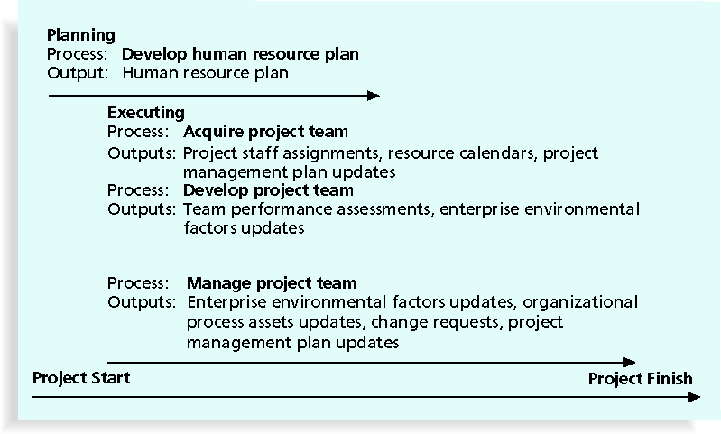
Information Technology Project Management, Sixth Edition
*

Slide 13
Psychologists and management theorists have devoted much research and thought to the field of managing people at work
Important areas related to project management include:
Motivation theories
Influence and power
Effectiveness
Information Technology Project Management, Sixth Edition
*

Slide 14
Intrinsic motivation causes people to participate in an activity for their own enjoyment
Extrinsic motivation causes people to do something for a reward or to avoid a penalty
For example, some children take piano lessons for intrinsic motivation (they enjoy it) while others take them for extrinsic motivation (to get a reward or avoid punishment)
Information Technology Project Management, Sixth Edition
*

Slide 15
Abraham Maslow argued that humans possess unique qualities that enable them to make independent choices, thus giving them control of their destiny
Maslow developed a hierarchy of needs which states that people’s behaviors are guided or motivated by a sequence of needs
Information Technology Project Management, Sixth Edition
*

Slide 16
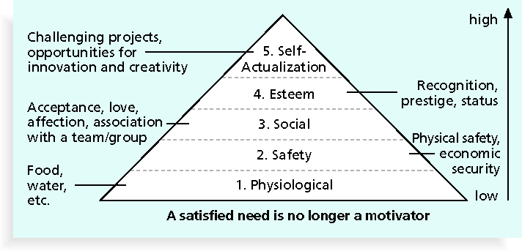
Information Technology Project Management, Sixth Edition
*

Slide 17
Frederick Herzberg wrote several famous books and articles about worker motivation; he distinguished between:
Motivational factors: achievement, recognition, the work itself, responsibility, advancement, and growth, which produce job satisfaction
Hygiene factors: cause dissatisfaction if not present, but do not motivate workers to do more; examples include larger salaries, more supervision, and a more attractive work environment
Information Technology Project Management, Sixth Edition
*

Slide 18
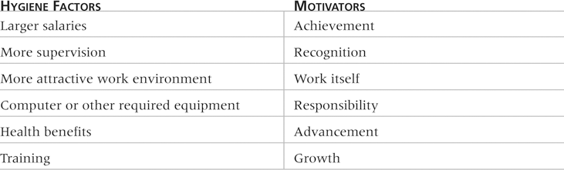
Information Technology Project Management, Sixth Edition
*

Slide 19
Specific needs are acquired or learned over time and shaped by life experiences, including:
Achievement (nAch): achievers like challenging projects with achievable goals and lots of feedback
Affiliation (nAff): people with high nAff desire harmonious relationships and need to feel accepted by others, so managers should try to create a cooperative work environment for them
Power (nPow): people with a need for power desire either personal power (not good) or institutional power (good for the organization); provide institutional power seekers with management opportunities
Information Technology Project Management, Sixth Edition
*

Slide 20
Douglas McGregor popularized the human relations approach to management in the 1960s
Theory X: assumes workers dislike and avoid work, so managers must use coercion, threats, and various control schemes to get workers to meet objectives
Theory Y: assumes individuals consider work as natural as play or rest and enjoy the satisfaction of esteem and self-actualization needs
Theory Z: introduced in 1981 by William Ouchi and is based on the Japanese approach to motivating workers, emphasizing trust, quality, collective decision making, and cultural values
Information Technology Project Management, Sixth Edition
*

Slide 21
1. Authority: the legitimate hierarchical right to issue orders
2. Assignment: the project manager's perceived ability to influence a worker's later work assignments
3. Budget: the project manager's perceived ability to authorize others' use of discretionary funds
4. Promotion: the ability to improve a worker's position
5. Money: the ability to increase a worker's pay and benefits
Information Technology Project Management, Sixth Edition
*

Slide 22
6. Penalty: the project manager's ability to cause punishment
7. Work challenge: the ability to assign work that capitalizes on a worker's enjoyment of doing a particular task
8. Expertise: the project manager's perceived special knowledge that others deem important
9. Friendship: the ability to establish friendly personal relationships between the project manager and others
Information Technology Project Management, Sixth Edition
*

Slide 23
Projects are more likely to succeed when project managers influence with:
Expertise
Work challenge
Projects are more likely to fail when project managers rely too heavily on:
Authority
Money
Penalty
Information Technology Project Management, Sixth Edition
*

Slide 24
Power is the potential ability to influence behavior to get people to do things they would not otherwise do
Types of power include:
Coercive
Legitimate
Expert
Reward
Referent
Information Technology Project Management, Sixth Edition
*

Slide 25
Project managers can apply Covey’s 7 habits to improve effectiveness on projects
Be proactive
Begin with the end in mind
Put first things first
Think win/win
Seek first to understand, then to be understood
Synergize
Sharpen the saw
Information Technology Project Management, Sixth Edition
*

Slide 26
Good project managers are empathic listeners; they listen with the intent to understand
Before you can communicate with others, you have to have rapport, a relation of harmony, conformity, accord, or affinity
Mirroring is the matching of certain behaviors of the other person, a technique to help establish rapport
IT professionals need to develop empathic listening and other people skills to improve relationships with users and other stakeholders
Information Technology Project Management, Sixth Edition
*

Slide 27
Involves identifying and documenting project roles, responsibilities, and reporting relationships
Contents include:
Project organizational charts
Staffing management plan
Responsibility assignment matrixes
Resource histograms
Information Technology Project Management, Sixth Edition
*

Slide 28
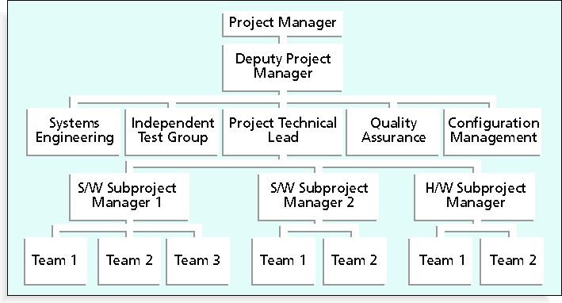
Information Technology Project Management, Sixth Edition
*

Slide 29
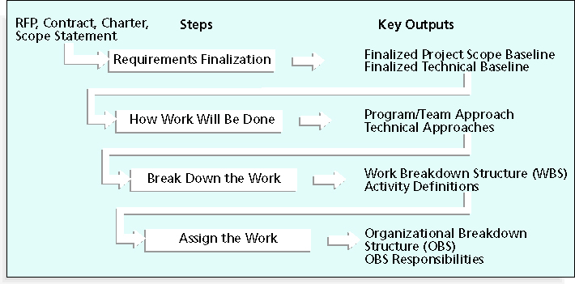
Information Technology Project Management, Sixth Edition
*

Slide 30
A responsibility assignment matrix (RAM) is a matrix that maps the work of the project as described in the WBS to the people responsible for performing the work as described in the OBS
Can be created in different ways to meet unique project needs
Information Technology Project Management, Sixth Edition
*

Slide 31
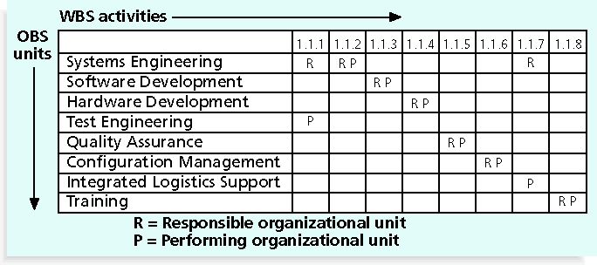
Information Technology Project Management, Sixth Edition
*

Slide 32
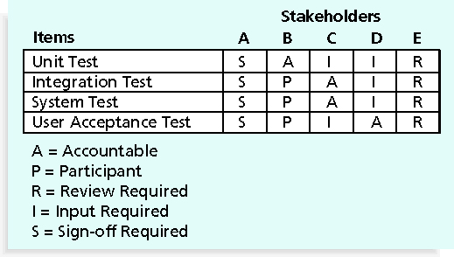
Information Technology Project Management, Sixth Edition
*

Slide 33
R = responsibility
A = accountability, only one A per task
C = consultation
I = informed
Note that some people reverse the definitions of responsible and accountable.
Information Technology Project Management, Sixth Edition
*

Slide 34
A staffing management plan describes when and how people will be added to and taken off the project team
A resource histogram is a column chart that shows the number of resources assigned to a project over time
Information Technology Project Management, Sixth Edition
*

Slide 35
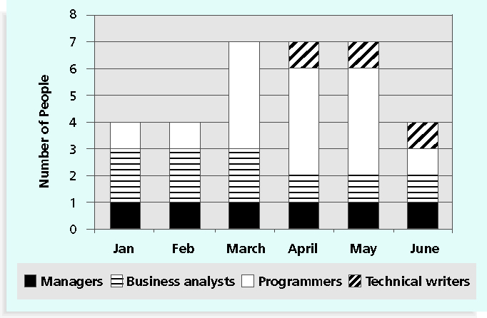
Information Technology Project Management, Sixth Edition
*

Slide 36
In addition to providing technical training for IT personnel, several companies have made significant investments in project management training to provide career paths for project managers
Hewlett Packard employed only six registered PMPs in 1997, but by August 2004, it employed more than 1,500 PMPs and was adding 500 more per year
While most consulting firms offer a single path to a leadership position, IBM has four to allow their people to succeed by focusing on their strengths and interests in one or more disciplines
Information Technology Project Management, Sixth Edition
*

Slide 37
Acquiring qualified people for teams is crucial
The project manager who is the smartest person on the team has done a poor job of recruiting!
It’s important to assign the appropriate type and number of people to work on projects at the appropriate times
Information Technology Project Management, Sixth Edition
*

Slide 38
Staffing plans and good hiring procedures are important, as are incentives for recruiting and retention
Some companies give their employees one dollar for every hour a new person they helped hire works
Some organizations allow people to work from home as an incentive
Enrollment in U.S. computer science and engineering programs has dropped almost in half since 2000, and one-third of U.S. workers will be over the age of 50 by 2010
CIO’s researchers suggest that organizations rethink hiring practices and incentives to hire and retain IT talent
Information Technology Project Management, Sixth Edition
*

Slide 39
Best practices can be applied to include the best places for people to work
For example, Fortune Magazine lists the “100 Best Companies to Work For” in the United States every year, with Google taking the honors in 2007 and 2008
Working Mothers Magazine lists the best companies in the U.S. for women based on benefits for working families
The Timesonline (www.timesonline.co.uk) provides the Sunday Times list of the 100 Best Companies to Work For, a key benchmark against which UK companies can judge their Best Practice performance as employers
Information Technology Project Management, Sixth Edition
*

Slide 40
Resource loading refers to the amount of individual resources an existing schedule requires during specific time periods
Helps project managers develop a general understanding of the demands a project will make on the organization’s resources and individual people’s schedules
Overallocation means that more resources than are available are assigned to perform work at a given time
Information Technology Project Management, Sixth Edition
*

Slide 41
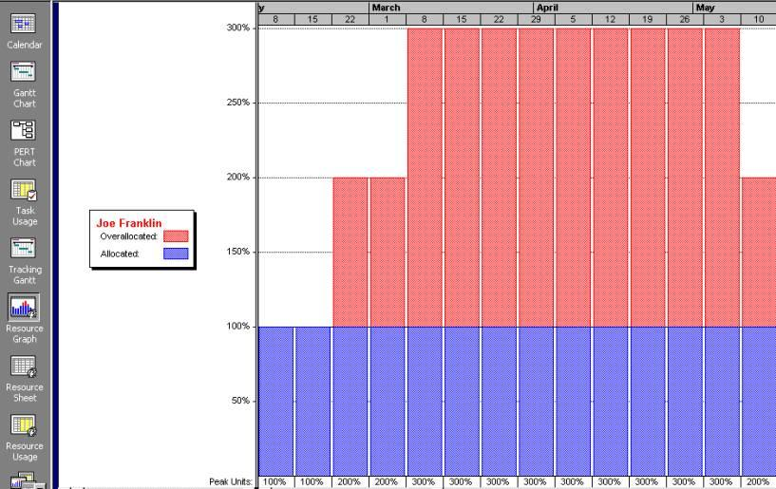
Information Technology Project Management, Sixth Edition
*

Slide 42
Resource leveling is a technique for resolving resource conflicts by delaying tasks
The main purpose of resource leveling is to create a smoother distribution of resource usage and reduce overallocation
Information Technology Project Management, Sixth Edition
*

Slide 43
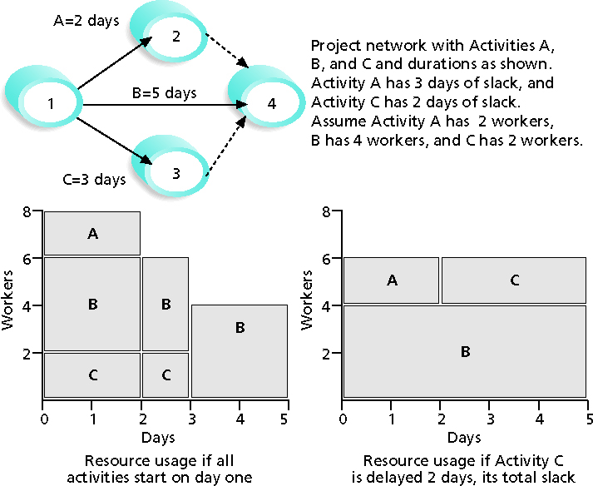
Information Technology Project Management, Sixth Edition
*

Slide 44
When resources are used on a more constant basis, they require less management
It may enable project managers to use a just-in-time inventory type of policy for using subcontractors or other expensive resources
It results in fewer problems for project personnel and accounting department
It often improves morale
Information Technology Project Management, Sixth Edition
*

Slide 45
The main goal of team development is to help people work together more effectively to improve project performance
It takes teamwork to successfully complete most projects
Information Technology Project Management, Sixth Edition
*

Slide 46
Forming
Storming
Norming
Performing
Adjourning
Information Technology Project Management, Sixth Edition
*

Slide 47
Training can help people understand themselves, each other, and how to work better in teams
Team building activities include:
Physical challenges
Psychological preference indicator tools
Information Technology Project Management, Sixth Edition
*

Slide 48
MBTI is a popular tool for determining personality preferences and helping teammates understand each other
Four dimensions include:
Extrovert/Introvert (E/I)
Sensation/Intuition (S/N)
Thinking/Feeling (T/F)
Judgment/Perception (J/P)
NTs or rationals are attracted to technology fields
IT people vary most from the general population in not being extroverted or sensing
Information Technology Project Management, Sixth Edition
*

Slide 49
People are perceived as behaving primarily in one of four zones, based on their assertiveness and responsiveness:
Drivers
Expressives
Analyticals
Amiables
People on opposite corners (drivers and amiables, analyticals and expressives) may have difficulties getting along
Information Technology Project Management, Sixth Edition
*

Slide 50
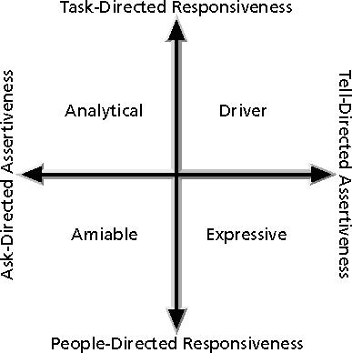
Information Technology Project Management, Sixth Edition
*

Slide 51
Also uses a four-dimensional model of normal behavior
Dominance
Influence
Steadiness
Compliance
People in opposite quadrants can have problems understanding each other
Information Technology Project Management, Sixth Edition
*

Slide 52
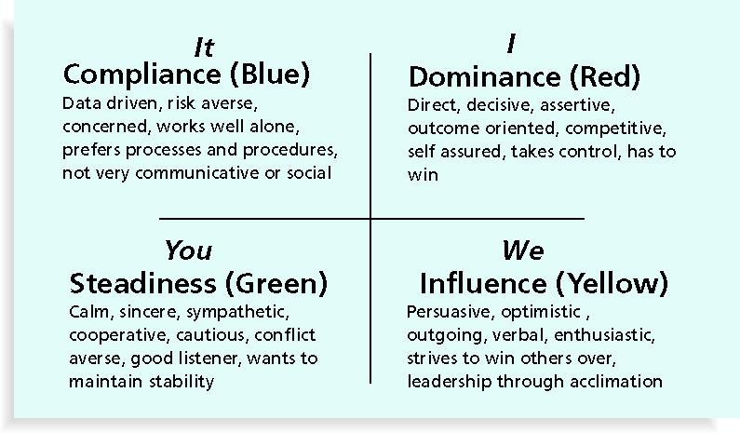
Information Technology Project Management, Sixth Edition
*

Slide 53
Team-based reward and recognition systems can promote teamwork
Focus on rewarding teams for achieving specific goals
Allow time for team members to mentor and help each other to meet project goals and develop human resources
Information Technology Project Management, Sixth Edition
*

Slide 54
Project managers must lead their teams in performing various project activities
After assessing team performance and related information, the project manager must decide:
If changes should be requested to the project
If corrective or preventive actions should be recommended
If updates are needed to the project management plan or organizational process assets
Information Technology Project Management, Sixth Edition
*

Slide 55
Observation and conversation
Project performance appraisals
Conflict management
Issue logs
Interpersonal skills
Information Technology Project Management, Sixth Edition
*

Slide 56
Be patient and kind with your team
Fix the problem instead of blaming people
Establish regular, effective meetings
Allow time for teams to go through the basic team-building stages
Limit the size of work teams to three to seven members
Information Technology Project Management, Sixth Edition
*

Slide 57
Patrick Lencioni, author of several books on teams, says that “Teamwork remains the one sustainable competitive advantage that has been largely untapped”*
The five dysfunctions of teams are:
Absence of trust
Fear of conflict
Lack of commitment
Avoidance of accountability
Inattention to results
*Lencioni, Patrick, “Overcoming the Five Dysfunctions of a Team,” Jossey-Bass: San Francisco, CA (2005), p. 3.
Information Technology Project Management, Sixth Edition
*

Slide 58
Plan some social activities to help project team members and other stakeholders get to know each other better
Stress team identity
Nurture team members and encourage them to help each other
Take additional actions to work with virtual team members
Information Technology Project Management, Sixth Edition
*

Slide 59
Software can help in producing RAMS and resource histograms
Project management software includes several features related to human resource management such as:
Assigning resources
Identifying potential resource shortages or underutilization
Leveling resources
Information Technology Project Management, Sixth Edition
*

Slide 60
Project managers must:
Treat people with consideration and respect
Understand what motivates them
Communicate carefully with them
Focus on your goal of enabling project team members to deliver their best work
Information Technology Project Management, Sixth Edition
*

Slide 61
Project human resource management includes the processes required to make the most effective use of the people involved with a project
Main processes include:
Develop human resource plan
Acquire project team
Develop project team
Manage project team
Information Technology Project Management, Sixth Edition
*

