Slide 1
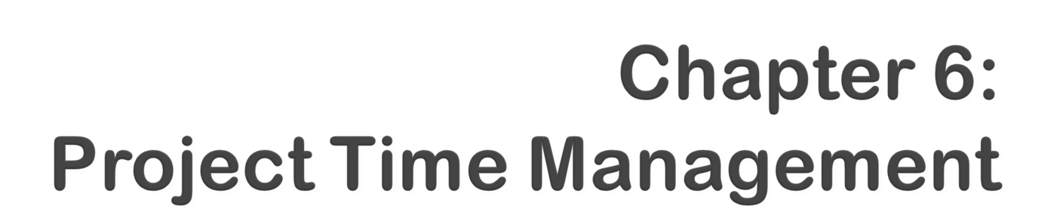

Information Technology Project Management, Sixth Edition
Note: See the text itself for full citations.
Notes:
*

Slide 2
Understand the importance of project schedules and good project time management
Define activities as the basis for developing project schedules
Describe how project managers use network diagrams and dependencies to assist in activity sequencing
Understand the relationship between estimating resources and project schedules
Explain how various tools and techniques help project managers perform activity duration estimating
*

Slide 3

Use a Gantt chart for planning and tracking schedule information, find the critical path for a project, and describe how critical chain scheduling and the Program Evaluation and Review Technique (PERT) affect schedule development
Discuss how reality checks and people issues are involved in controlling and managing changes to the project schedule
Describe how project management software can assist in project time management and review words of caution before using this software
*

Slide 4

Managers often cite delivering projects on time as one of their biggest challenges
Time has the least amount of flexibility; it passes no matter what happens on a project
Schedule issues are the main reason for conflicts on projects, especially during the second half of projects
*

Slide 5

One dimension of the Meyers-Briggs Type Indicator focuses on peoples’ attitudes toward structure and deadline
Some people prefer to follow schedules and meet deadlines while others do not (J vs. P)
Difference cultures and even entire countries have different attitudes about schedules
*

Slide 6

In contrast to the 2002 Salt Lake City Winter Olympic Games (see Chapter 4’s Media Snapshot), planning and scheduling was very different for the 2004 Summer Olympic Games held in Athens, Greece
Many articles were written before the opening ceremonies predicting that the facilities would not be ready in time; many people were pleasantly surprised by the amazing opening ceremonies, beautiful new buildings, and state-of-the-art security and transportation systems in Athens
The Greeks even made fun of critics by having construction workers pretend to still be working as the ceremonies began
*

Slide 7
Defining activities: identifying the specific activities that the project team members and stakeholders must perform to produce the project deliverables
Sequencing activities: identifying and documenting the relationships between project activities
Estimating activity resources: estimating how many resources a project team should use to perform project activities
Estimating activity durations: estimating the number of work periods that are needed to complete individual activities
Developing the schedule: analyzing activity sequences, activity resource estimates, and activity duration estimates to create the project schedule
Controlling the schedule: controlling and managing changes to the project schedule
*

Slide 8
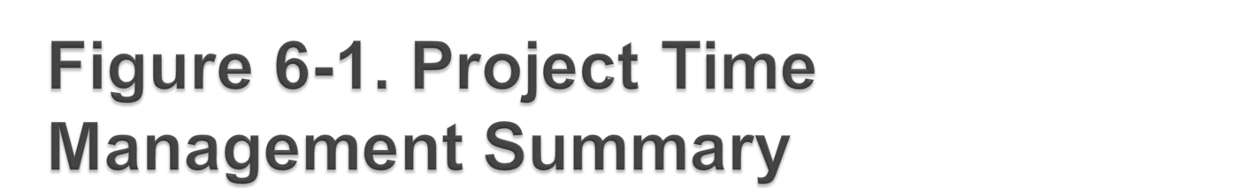
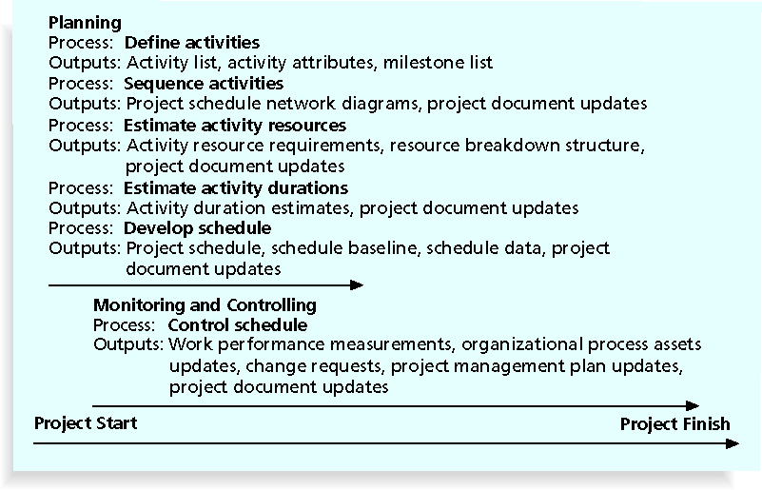
*

Slide 9

An activity or task is an element of work normally found on the work breakdown structure (WBS) that has an expected duration, a cost, and resource requirements
Activity definition involves developing a more detailed WBS and supporting explanations to understand all the work to be done so you can develop realistic cost and duration estimates
*

Slide 10

An activity list is a tabulation of activities to be included on a project schedule that includes:
  The activity name
  An activity identifier or number
  A brief description of the activity
Activity attributes provide more information such as predecessors, successors, logical relationships, leads and lags, resource requirements, constraints, imposed dates, and assumptions related to the activity
*

Slide 11

A milestone is a significant event that normally has no duration
It often takes several activities and a lot of work to complete a milestone
They’re useful tools for setting schedule goals and monitoring progress
Examples include obtaining customer sign-off on key documents or completion of specific products
*

Slide 12

At the U.S. Federal Bureau of Investigation (FBI), poor time management was one of the reasons behind the failure of Trilogy, a “disastrous, unbelievably expensive piece of vaporware, which was more than four years in the (un)making. The system was supposed to enable FBI agents to integrate intelligence from isolated information silos within the Bureau.”*
In May 2006, the Government Accounting Agency said that the Trilogy project failed at its core mission of improving the FBI’s investigative abilities and was plagued with missed milestones and escalating costs
*Roberts, Paul, “Frustrated contractor sentenced for hacking FBI to speed deployment,”
InfoWorld Tech Watch, (July 6, 2006).
*

Slide 13

Involves reviewing activities and determining dependencies
A dependency or relationship is the sequencing of project activities or tasks
You must determine dependencies in order to use critical path analysis
*

Slide 14

Mandatory dependencies: inherent in the nature of the work being performed on a project, sometimes referred to as hard logic
Discretionary dependencies: defined by the project team; sometimes referred to as soft logic and should be used with care since they may limit later scheduling options
External dependencies: involve relationships between project and non-project activities
*

Slide 15

Network diagrams are the preferred technique for showing activity sequencing
A network diagram is a schematic display of the logical relationships among, or sequencing of, project activities
Two main formats are the arrow and precedence diagramming methods
*

Slide 16
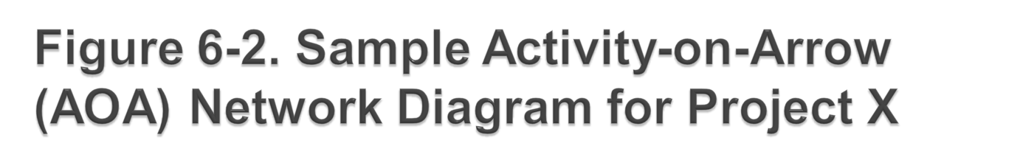
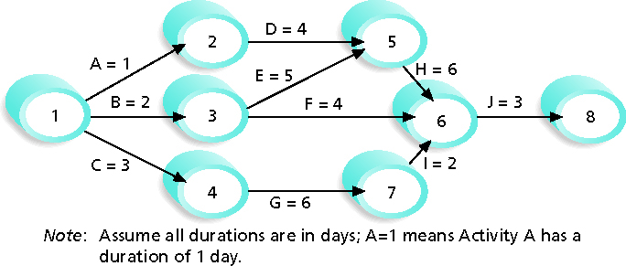
*
Notes:
*

Slide 17
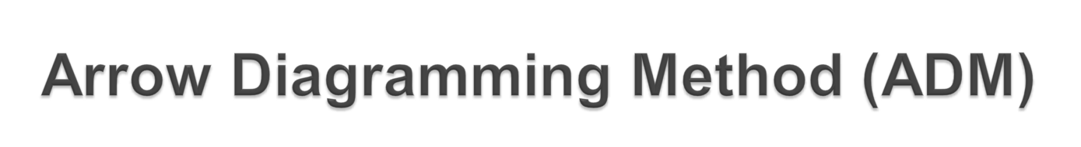
Also called activity-on-arrow (AOA) network diagrams
Activities are represented by arrows
Nodes or circles are the starting and ending points of activities
Can only show finish-to-start dependencies
*

Slide 18
1. Find all of the activities that start at node 1. Draw their finish nodes and draw arrows between node 1 and those finish nodes. Put the activity letter or name and duration estimate on the associated arrow.
2. Continue drawing the network diagram, working from left to right. Look for bursts and merges. Bursts occur when a single node is followed by two or more activities. A merge occurs when two or more nodes precede a single node.
3. Continue drawing the project network diagram until all activities are included on the diagram that have dependencies.
4. As a rule of thumb, all arrowheads should face toward the right, and no arrows should cross on an AOA network diagram.
*

Slide 19
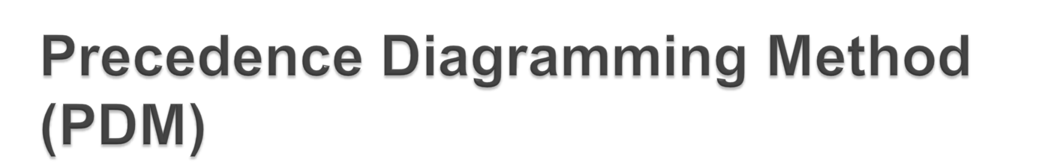
Activities are represented by boxes
Arrows show relationships between activities
More popular than ADM method and used by project management software
Better at showing different types of dependencies
*

Slide 20

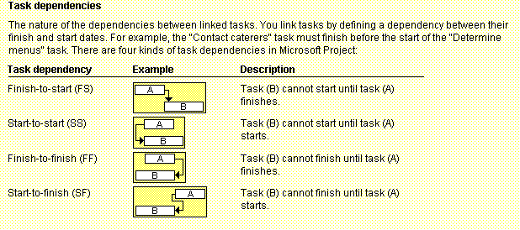
*

Slide 21

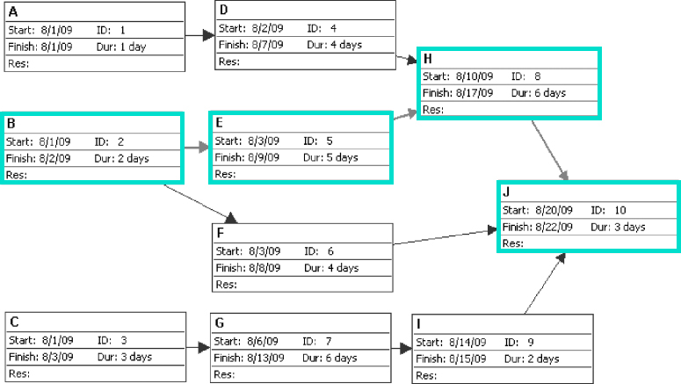
*

Slide 22
Before estimating activity durations, you must have a good idea of the quantity and type of resources that will be assigned to each activity; resources are people, equipment, and materials
Consider important issues in estimating resources
  How difficult will it be to do specific activities on this project?
  What is the organization’s history in doing similar activities?
  Are the required resources available?
A resource breakdown structure is a hierarchical structure that identifies the project’s resources by category and type
*

Slide 23

Duration includes the actual amount of time worked on an activity plus elapsed time
Effort is the number of workdays or work hours required to complete a task
Effort does not normally equal duration
People doing the work should help create estimates, and an expert should review them
*

Slide 24

Instead of providing activity estimates as a discrete number, such as four weeks, it’s often helpful to create a three-point estimate
  An estimate that includes an optimistic, most likely, and pessimistic estimate, such as three weeks for the optimistic, four weeks for the most likely, and five weeks for the pessimistic estimate
Three-point estimates are needed for PERT and Monte Carlo simulations
*

Slide 25

Uses results of the other time management processes to determine the start and end date of the project
Ultimate goal is to create a realistic project schedule that provides a basis for monitoring project progress for the time dimension of the project
Important tools and techniques include Gantt charts, critical path analysis, and critical chain scheduling, and PERT analysis
*

Slide 26

Gantt charts provide a standard format for displaying project schedule information by listing project activities and their corresponding start and finish dates in a calendar format
Symbols include:
  Black diamonds: milestones
  Thick black bars: summary tasks
  Lighter horizontal bars: durations of tasks
  Arrows: dependencies between tasks
*

Slide 27
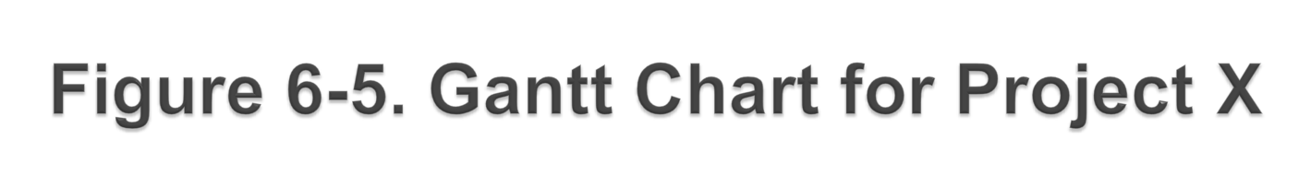
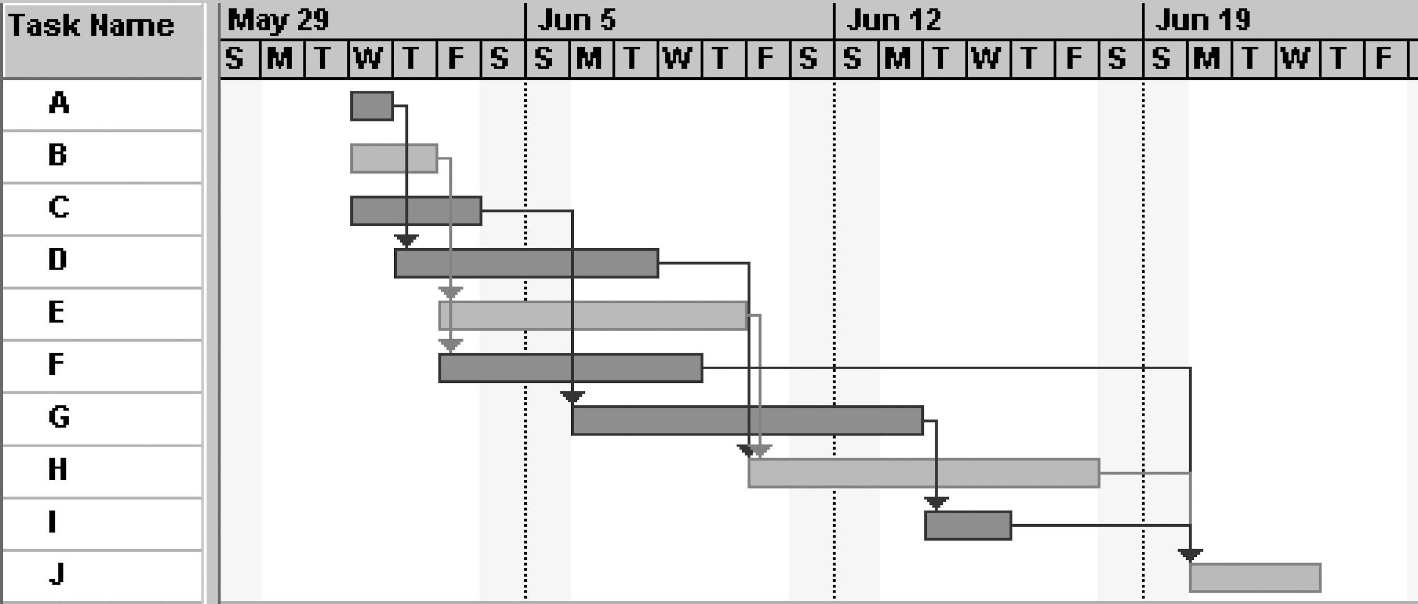
Note: Darker bars would be red in Project 2007 to represent critical tasks.
*

Slide 28

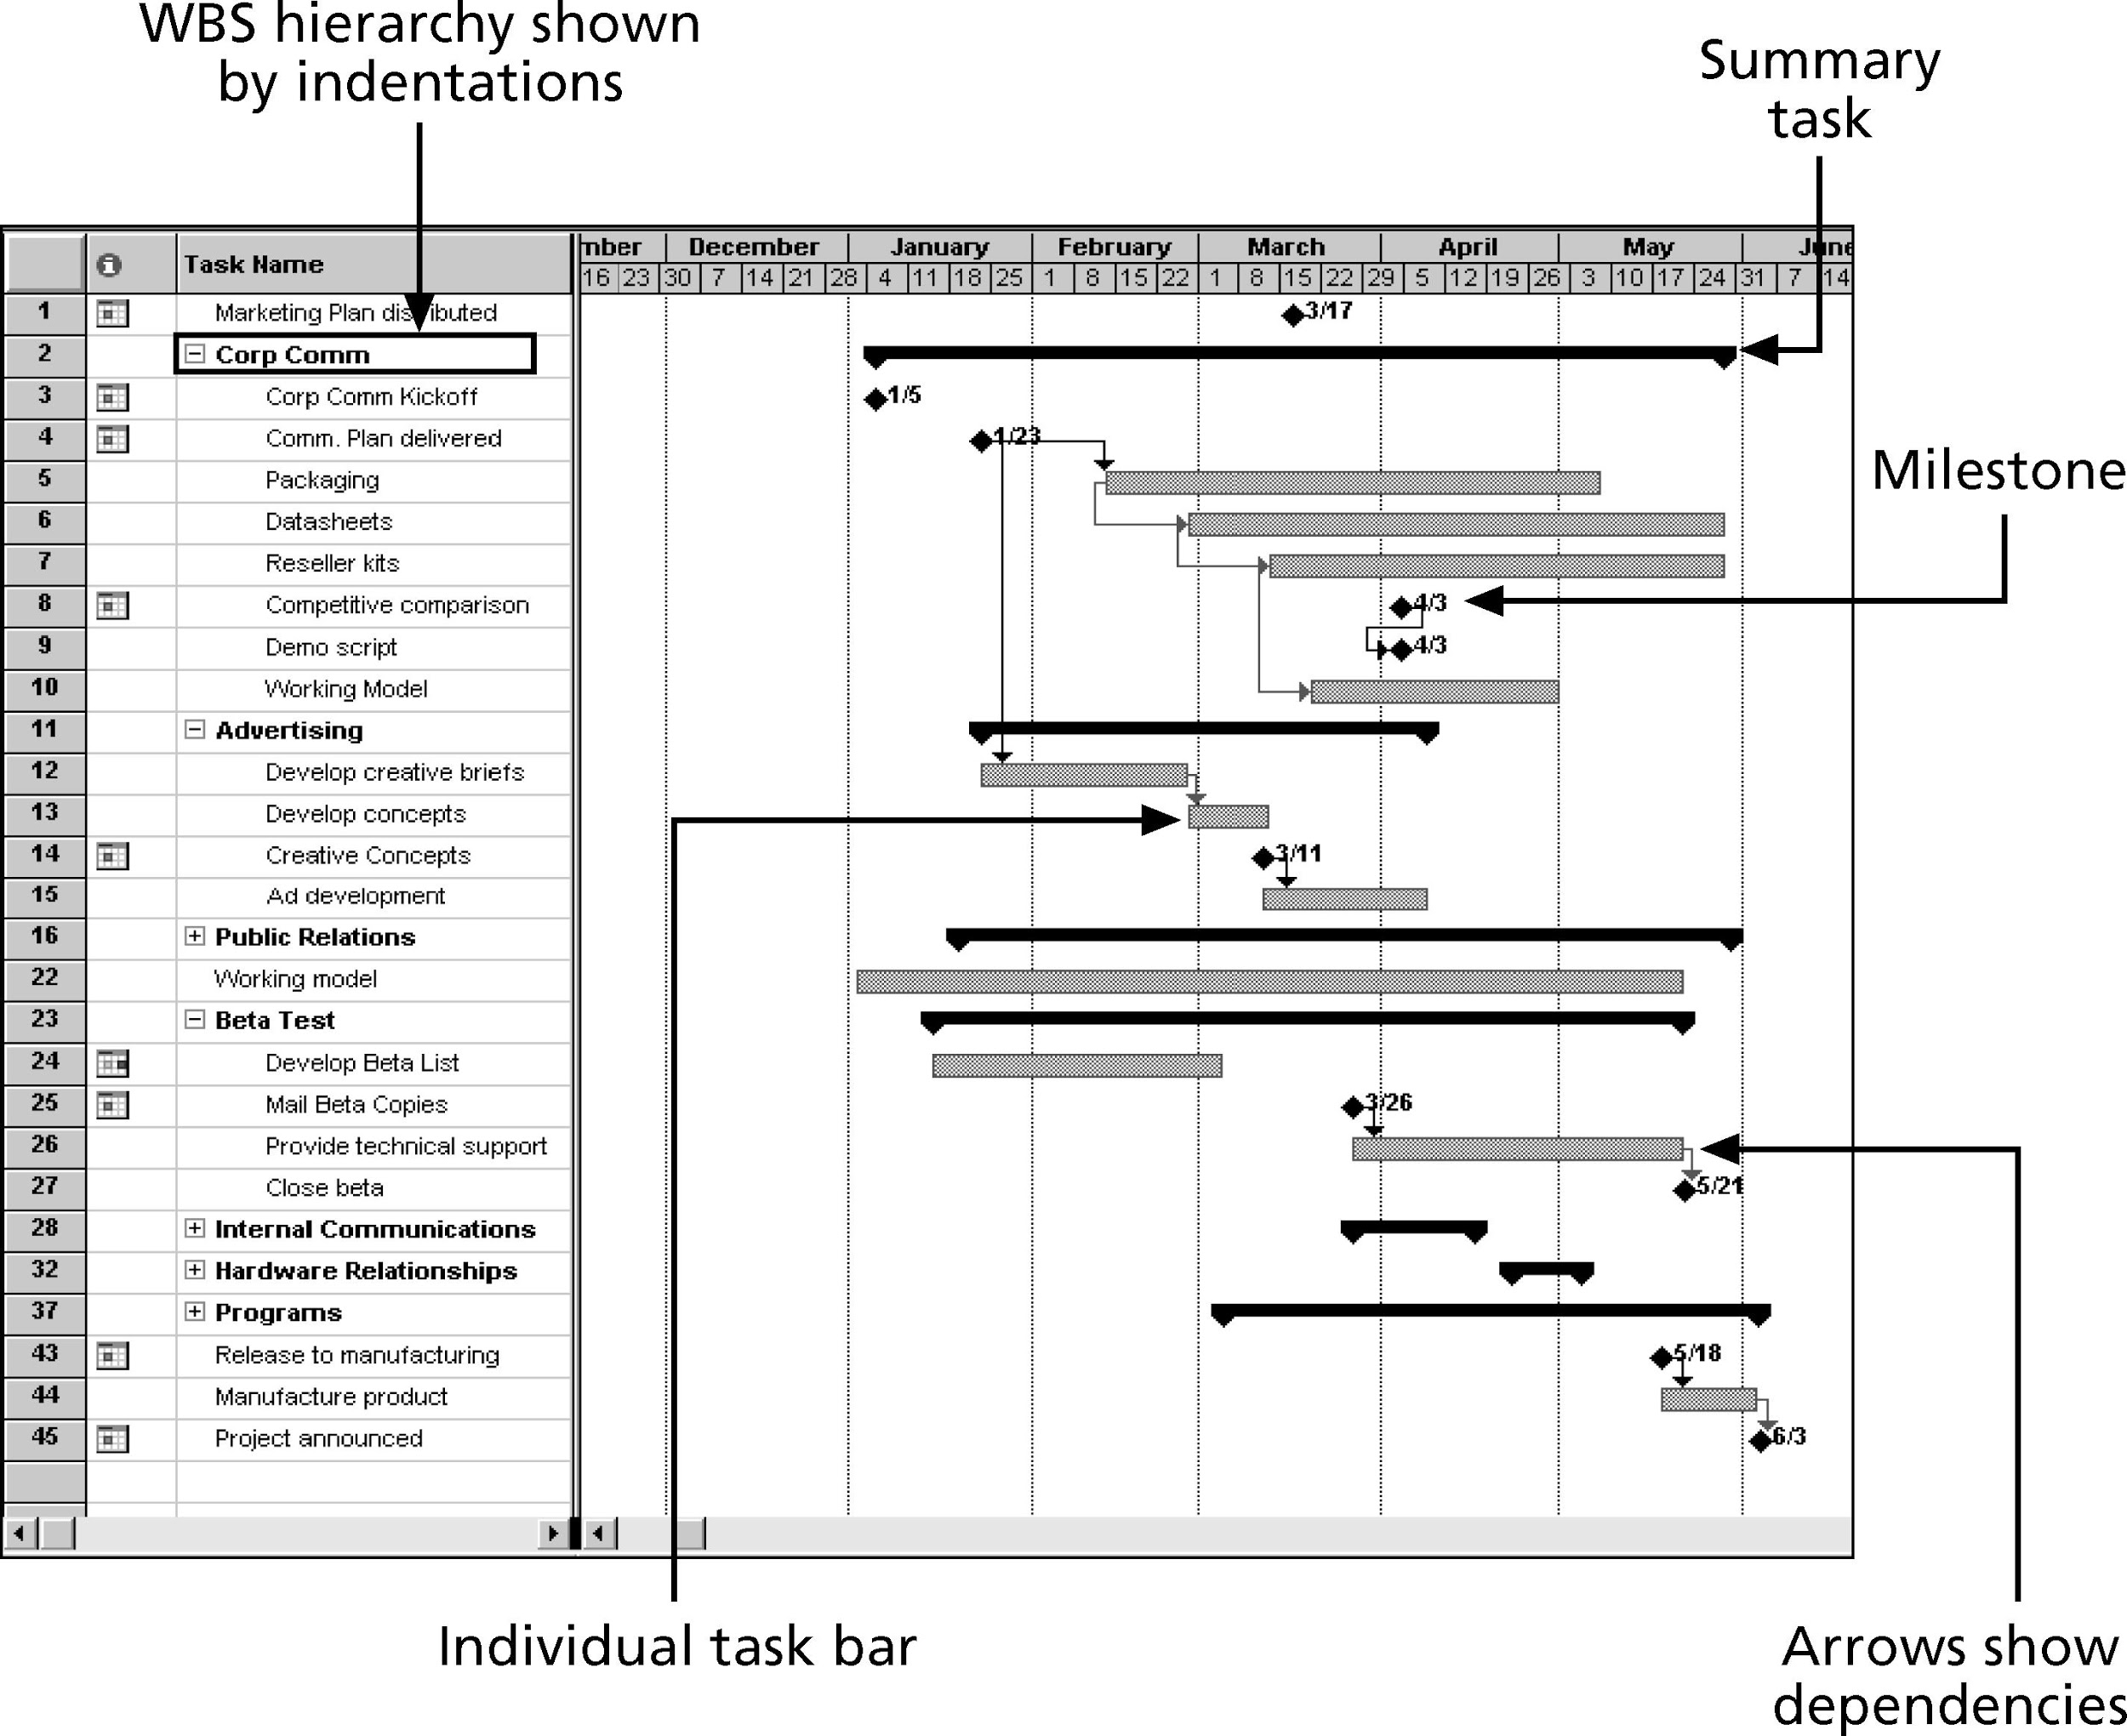
*

Slide 29

Many people like to focus on meeting milestones, especially for large projects
Milestones emphasize important events or accomplishments on projects
Normally create milestone by entering tasks with a zero duration, or you can mark any task as a milestone
*

Slide 30

Milestones should be:
  Specific
  Measurable
  Assignable
  Realistic
  Time-framed
*

Slide 31
Schedule risk is inherent in the development of complex systems. Luc Richard, the founder of www.projectmangler.com, suggests that project managers can reduce schedule risk through project milestones, a best practice that involves identifying and tracking significant points or achievements in the project. The five key points of using project milestones include the following:
  1. Define milestones early in the project and include them in the Gantt chart to provide a visual guide.
  2. Keep milestones small and frequent.
  3. The set of milestones must be all-encompassing.
  4. Each milestone must be binary, meaning it is either complete or incomplete.
  5. Carefully monitor the critical path.
*

Slide 32

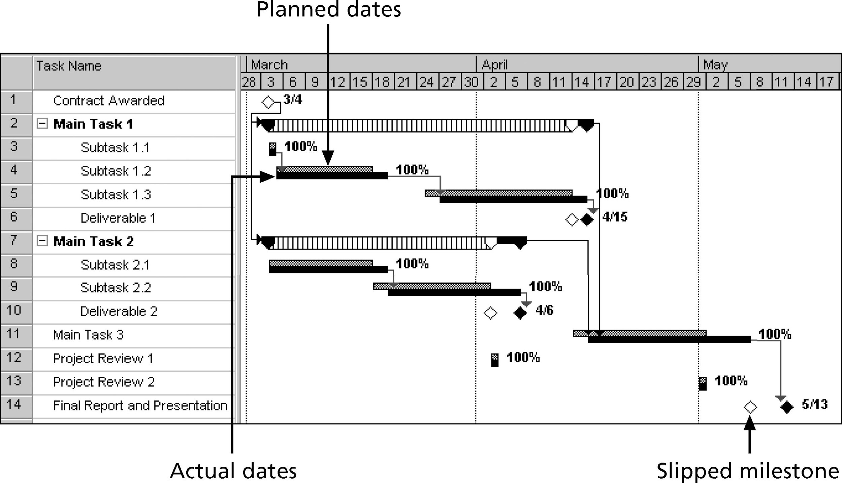
*

Slide 33
CPM is a network diagramming technique used to predict total project duration
A critical path for a project is the series of activities that determines the earliest time by which the project can be completed
The critical path is the longest path through the network diagram and has the least amount of slack or float
Slack or float is the amount of time an activity may be delayed without delaying a succeeding activity or the project finish date
*

Slide 34

First develop a good network diagram
Add the duration estimates for all activities on each path through the network diagram
The longest path is the critical path
If one or more of the activities on the critical path takes longer than planned, the whole project schedule will slip unless the project manager takes corrective action
*

Slide 35
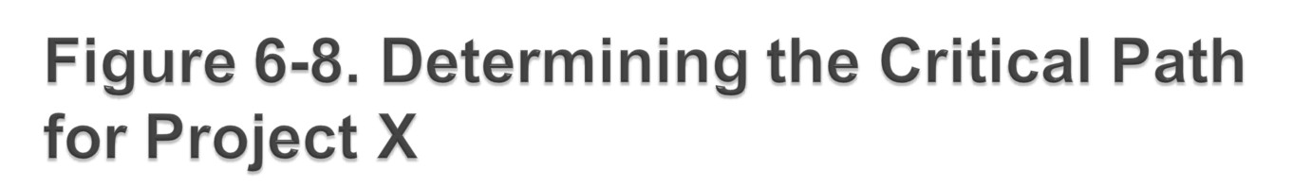
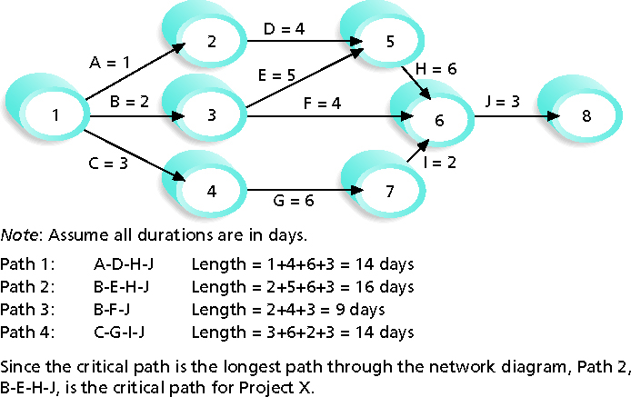
*

Slide 36
A project team at Apple computer put a stuffed gorilla on the top of the cubicle of the person currently managing critical task
The critical path is not the one with all the critical activities; it only accounts for time
  Remember the example of growing grass being on the critical path for Disney’s Animal Kingdom
There can be more than one critical path if the lengths of two or more paths are the same
The critical path can change as the project progresses
*

Slide 37

Free slack or free float is the amount of time an activity can be delayed without delaying the early start of any immediately following activities
Total slack or total float is the amount of time an activity may be delayed from its early start without delaying the planned project finish date
A forward pass through the network diagram determines the early start and finish dates
A backward pass determines the late start and finish dates
*

Slide 38
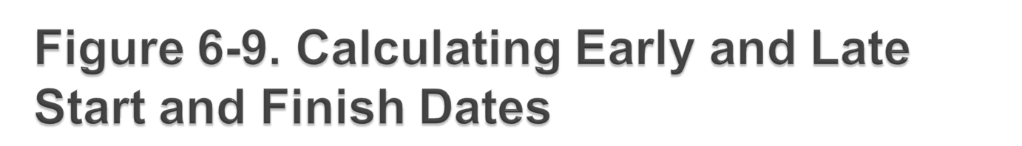
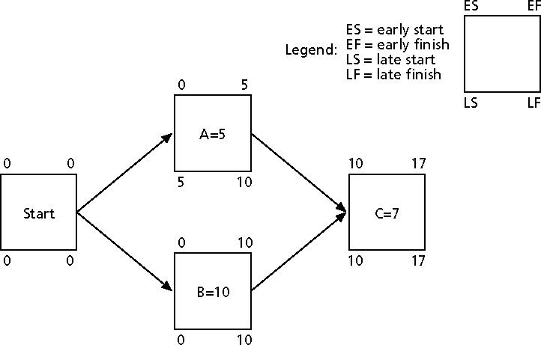
*

Slide 39
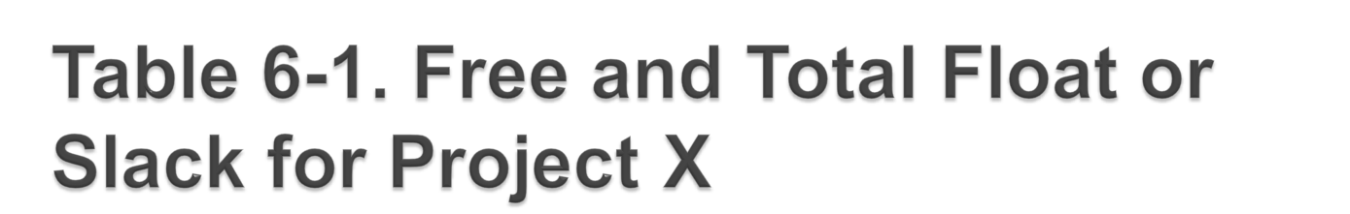
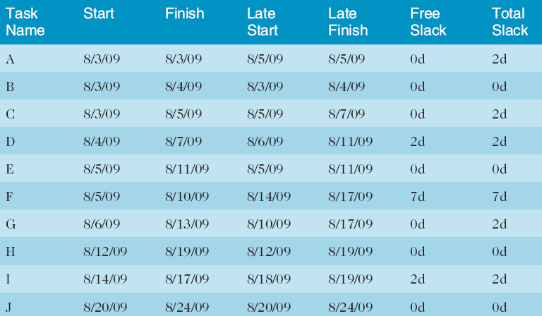
*

Slide 40
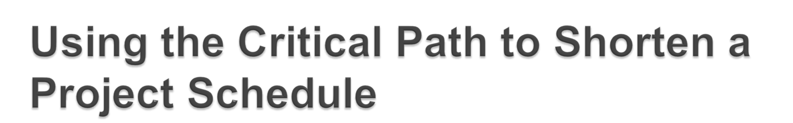
Three main techniques for shortening schedules
  Shortening durations of critical activities/tasks by adding more resources or changing their scope
  Crashing activities by obtaining the greatest amount of schedule compression for the least incremental cost
  Fast tracking activities by doing them in parallel or overlapping them
*

Slide 41
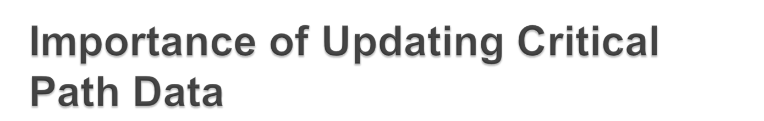
It is important to update project schedule information to meet time goals for a project
The critical path may change as you enter actual start and finish dates
If you know the project completion date will slip, negotiate with the project sponsor
*

Slide 42
Critical chain scheduling
  A method of scheduling that considers limited resources when creating a project schedule and includes buffers to protect the project completion date
Uses the Theory of Constraints (TOC)
  A management philosophy developed by Eliyahu M. Goldratt and introduced in his book The Goal
Attempts to minimize multitasking
  When a resource works on more than one task at a time
*

Slide 43
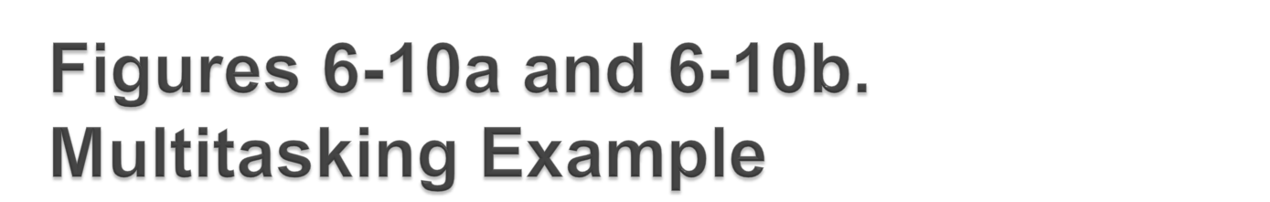
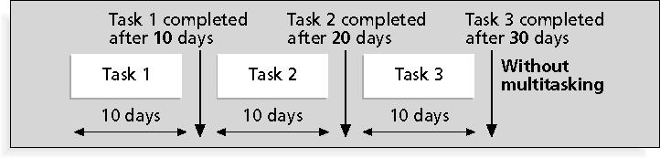
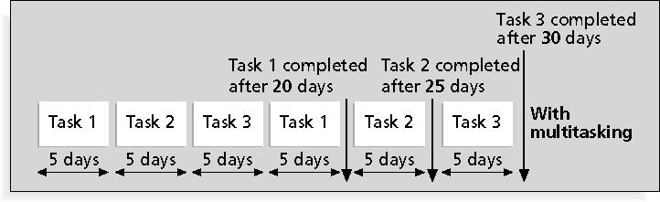
*

Slide 44
A buffer is additional time to complete a task
Murphy’s Law states that if something can go wrong, it will
Parkinson’s Law states that work expands to fill the time allowed
In traditional estimates, people often add a buffer to each task and use it if it’s needed or not
Critical chain scheduling removes buffers from individual tasks and instead creates:
  Project buffers or additional time added before the project’s due date
  Feeding buffers or additional time added before tasks on the critical path
*

Slide 45

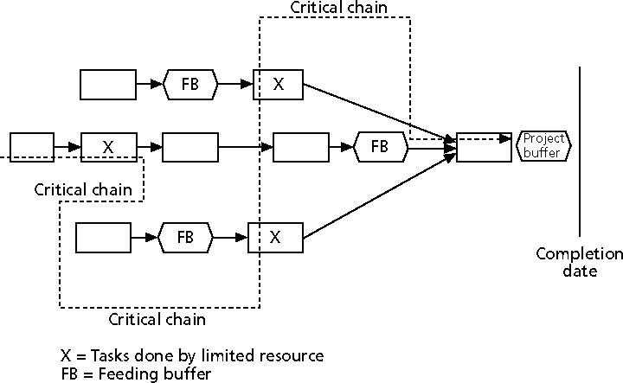
*

Slide 46

PERT is a network analysis technique used to estimate project duration when there is a high degree of uncertainty about the individual activity duration estimates
PERT uses probabilistic time estimates
  Duration estimates based on using optimistic, most likely, and pessimistic estimates of activity durations, or a three-point estimate
*

Slide 47
PERT weighted average =
optimistic time + 4X most likely time + pessimistic time
6
Example:
PERT weighted average =
8 workdays + 4 X 10 workdays + 24 workdays = 12 days 6
where optimistic time = 8 days
most likely time = 10 days, and
pessimistic time = 24 days
Therefore, you’d use 12 days on the network diagram instead of 10 when using PERT for the above example
*

Slide 48

Perform reality checks on schedules
Allow for contingencies
Don’t plan for everyone to work at 100% capacity all the time
Hold progress meetings with stakeholders and be clear and honest in communicating schedule issues
*

Slide 49

Goals are to know the status of the schedule, influence factors that cause schedule changes, determine that the schedule has changed, and manage changes when they occur
Tools and techniques include:
  Progress reports
  A schedule change control system
  Project management software, including schedule comparison charts like the tracking Gantt chart
  Variance analysis, such as analyzing float or slack
  Performance management, such as earned value (Chapter 7)
*

Slide 50

First review the draft schedule or estimated completion date in the project charter
Prepare a more detailed schedule with the project team
Make sure the schedule is realistic and followed
Alert top management well in advance if there are schedule problems
*

Slide 51

Strong leadership helps projects succeed more than good PERT charts
Project managers should use:
  Empowerment
  Incentives
  Discipline
  Negotiation
*

Slide 52
Mittal Steel Poland earned Poland’s Project Excellence Award in 2007 for implementing a SAP system
Derek Prior, research director at AMR Research, identified three things the most successful SAP implementation projects do to deliver business benefits:
  Form a global competence centre
  Identify super-users for each location
  Provide ongoing involvement of managers in business processes so they feel they own these processes
*

Slide 53
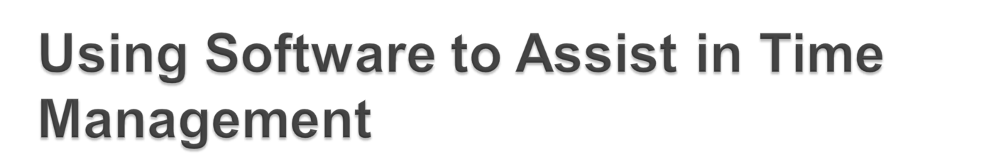
Software for facilitating communications helps people exchange schedule-related information
Decision support models help analyze trade-offs that can be made
Project management software can help in various time management areas
*

Slide 54
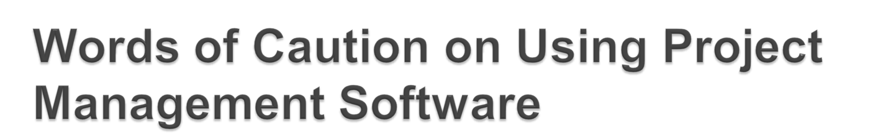
Many people misuse project management software because they don’t understand important concepts and have not had training
You must enter dependencies to have dates adjust automatically and to determine the critical path
You must enter actual schedule information to compare planned and actual progress
*

Slide 55

Project time management is often cited as the main source of conflict on projects, and most IT projects exceed time estimates
Main processes include:
  Define activities
  Sequence activities
  Estimate activity resources
  Estimate activity durations
  Develop schedule
  Control schedule
*

