Slide 1
Information Technology Project Management, Sixth Edition
Note: See the text itself for full citations.

Slide 2
Describe the five project management (PM) process groups, the typical level of activity for each, and the interactions among them
Understand how the PM process groups relate to the PM knowledge areas
Discuss how organizations develop information technology PM methodologies to meet their needs
Information Technology Project Management, Sixth Edition
*

Slide 3
Review a case study of an organization applying the project management process groups to manage an information technology project; describe outputs of each process group; and understand the contribution that effective project initiating, planning, executing, monitoring and controlling, and closing make to project success
Information Technology Project Management, Sixth Edition
*

Slide 4
A process is a series of actions directed toward a particular result
Project management can be viewed as a number of interlinked processes
The project management process groups include:
Initiating processes
Planning processes
Executing processes
Monitoring and controlling processes
Closing processes
Information Technology Project Management, Sixth Edition
*

Slide 5
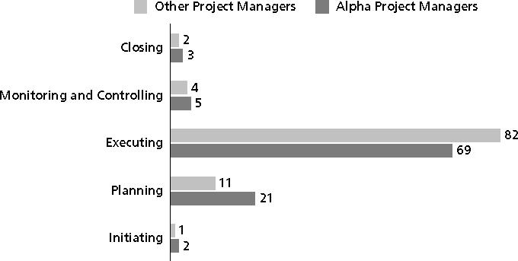
Information Technology Project Management, Sixth Edition
*

Slide 6
Philip A. Pell, PMP, commented on how the U.S. IRS needed to improve its project management process. “Pure and simple, good, methodology-centric, predictable, and repeatable project management is the SINGLE greatest factor in the success (or in this case failure) of any project… The project manager is ultimately responsible for the success or failure of the project.”*
In 2006, the IRS lost more than $320 million due to a botched fraud-detection system project
A 2008 U.S. Government Accountability Office (GAO) report stated that IRS had fixed just 29 of 98 information security weaknesses identified the previous year
*Comments posted on CIO Magazine Web site on article “For the IRS, There’s No EZ Fix,” (April 1, 2004).
Information Technology Project Management, Sixth Edition
*

Slide 7
Just as information technology projects need to follow the project management process groups, so do other projects, such as the production of a movie. Processes involved in making movies might include screenwriting (initiating), producing (planning), acting and directing (executing), editing (monitoring and controlling), and releasing the movie to theaters (closing). Many people enjoy watching the extra features on a DVD that describe how these processes lead to the creation of a movie… This acted “…not as promotional filler but as a serious and meticulously detailed examination of the entire filmmaking process.”* Project managers in any field know how important it is to follow a good process.
*Jacks, Brian, “Lord of the Rings: The Two Towers Extended Edition (New Line)”, Underground Online (accessed from www.ugo.com August 4, 2004).
Information Technology Project Management, Sixth Edition
*

Slide 8
You can map the main activities of each PM process group into the nine knowledge areas using the PMBOK® Guide 2008
Note that there are activities from each knowledge area under the planning and monitoring and controlling process groups
Two new processes were added in 2008: identify stakeholders and collect requirements
Information Technology Project Management, Sixth Edition
*

Slide 9
*Source: PMBOK® Guide, Fourth Edition, 2008.
Information Technology Project Management, Sixth Edition
*

Slide 10
Information Technology Project Management, Sixth Edition
*

Slide 11
Information Technology Project Management, Sixth Edition
*

Slide 12
Just as projects are unique, so are approaches to project management
Many organizations develop their own project management methodologies, especially for IT projects
A methodology describes how things should be done; a standard describes what should be done
PRINCE2, Agile, RUP, and Six Sigma provide different project management methodologies
Information Technology Project Management, Sixth Edition
*

Slide 13
AgênciaClick, an interactive advertising and online communications company based in São Paulo, Brazil, made PMI’s list of outstanding organizations in project management in 2007
Since 2002, the company saw revenues jump 132 percent, primarily due to their five-year emphasis on practicing good project management across the entire company
Information Technology Project Management, Sixth Edition
*

Slide 14
This case study provides an example of what’s involved in initiating, planning, executing, controlling, and closing an IT project
You can download templates for creating your own project management documents from the companion Web site for this text or the author’s site
Note: This case study provides a big picture view of managing a project; later chapters provide detailed information on each knowledge area
Information Technology Project Management, Sixth Edition
*

Slide 15
It is good practice to lay the groundwork for a project before it officially starts
Senior managers often perform several pre-initiation tasks, including the following:
Determine the scope, time, and cost constraints for the project
Identify the project sponsor
Select the project manager
Develop a business case for a project (see Table 3-2 for an example)
Meet with the project manager to review the process and expectations for managing the project
Determine if the project should be divided into two or more smaller projects
Information Technology Project Management, Sixth Edition
*

Slide 16
Initiating a project includes recognizing and starting a new project or project phase
The main goal is to formally select and start off projects
Information Technology Project Management, Sixth Edition
*

Slide 17
Information Technology Project Management, Sixth Edition
*

Slide 18
Contents are often sensitive, so do not publish this document.
Information Technology Project Management, Sixth Edition
*

Slide 19
See Table 3-6 for an example of a charter
Charters are normally short and include key project information and stakeholder signatures
It’s good practice to hold a kick-off meeting at the beginning of a project so that stakeholders can meet each other, review the goals of the project, and discuss future plans
Information Technology Project Management, Sixth Edition
*

Slide 20
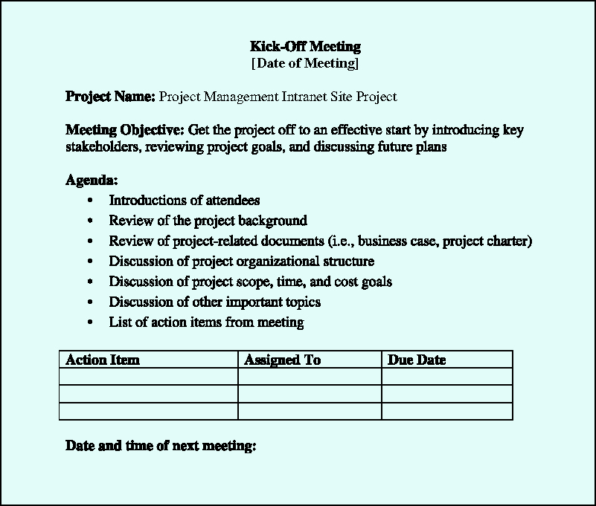
Information Technology Project Management, Sixth Edition
*

Slide 21
The main purpose of project planning is to guide execution
Every knowledge area includes planning information (see Table 3-7 on pages 97-98)
Key outputs included in the JWD project include:
A team contract
A project scope statement
A work breakdown structure (WBS)
A project schedule, in the form of a Gantt chart with all dependencies and resources entered
A list of prioritized risks (part of a risk register)
See sample documents on pages 100-107
Information Technology Project Management, Sixth Edition
*

Slide 22
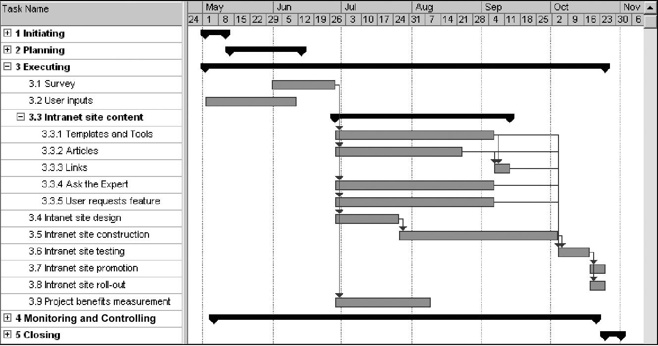
Information Technology Project Management, Sixth Edition
*

Slide 23
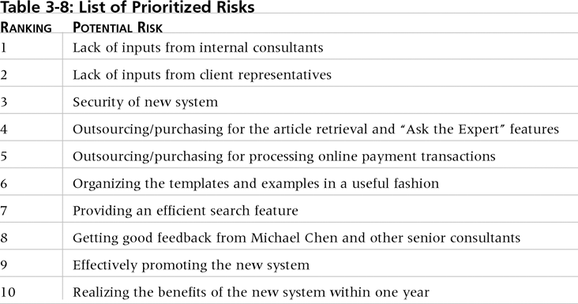
Information Technology Project Management, Sixth Edition
*

Slide 24
Usually takes the most time and resources to perform project execution
Project managers must use their leadership skills to handle the many challenges that occur during project execution
Table 3-11 on p. 108 lists the executing processes and outputs; many project sponsors and customers focus on deliverables related to providing the products, services, or results desired from the project
A milestone report (example on pp. 109-110) can help focus on completing major milestones
Information Technology Project Management, Sixth Edition
*

Slide 25
Information Technology Project Management, Sixth Edition
*

Slide 26
One way to learn about best practices in project management is by studying recipients of PMI’s Project of the Year award
The Quartier international de Montreal (QIM), Montreal’s international district, was a 66-acre urban revitalization project in the heart of downtown Montreal
This $90 million, five-year project turned a once unpopular area into a thriving section of the city with a booming real estate market and has generated $770 million in related construction
Information Technology Project Management, Sixth Edition
*

Slide 27
Involves measuring progress toward project objectives, monitoring deviation from the plan, and taking correction actions
Affects all other process groups and occurs during all phases of the project life cycle
Outputs include performance reports, change requests, and updates to various plans
See Table 3-13
Information Technology Project Management, Sixth Edition
*

Slide 28
Involves gaining stakeholder and customer acceptance of the final products and services
Even if projects are not completed, they should be closed out to learn from the past
Outputs include project archives and lessons learned, part of organizational process assets
Most projects also include a final report and presentation to the sponsor/senior management
Information Technology Project Management, Sixth Edition
*

Slide 29
Table 3-18 on pp. 118-121 lists the templates available on the companion Web site (www.cengage.com/mis/schwalbe) and the author’s site (www.kathyschwalbe.com)
Information Technology Project Management, Sixth Edition
*

Slide 30
The five project management process groups are initiating, planning, executing, monitoring and controlling, and closing
You can map the main activities of each process group to the nine knowledge areas
Some organizations develop their own information technology project management methodologies
The JWD Consulting case study provides an example of using the process groups and shows several important project documents
Information Technology Project Management, Sixth Edition
*

