Slide 1
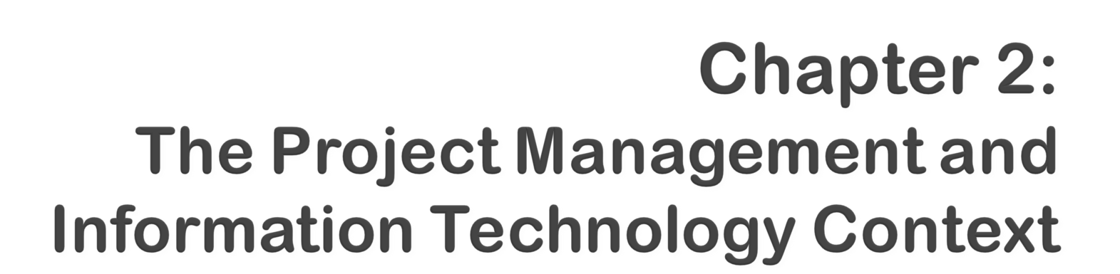

Information Technology Project Management, Sixth Edition
Note: See the text itself for full citations.
Notes:
*

Slide 2

Describe the systems view of project management and how it applies to information technology projects
Understand organizations, including the four frames, organizational structures, and organizational culture
Explain why stakeholder management and top management commitment are critical for a project’s success
Information Technology Project Management, Sixth Edition
*

Slide 3

Understand the concept of a project phase and the project life cycle and distinguish between project development and product development
Discuss the unique attributes and diverse nature of information technology projects
Describe recent trends affecting IT project management, including globalization, outsourcing, and virtual teams
Information Technology Project Management, Sixth Edition
*

Slide 4

Projects must operate in a broad organizational environment
Project managers need to use systems thinking:
  Taking a holistic view of carrying out projects within the context of the organization
Senior managers must make sure projects continue to support current business needs
Information Technology Project Management, Sixth Edition
*

Slide 5

A systems approach emerged in the 1950s to describe a more analytical approach to management and problem solving
Three parts include:
  Systems philosophy: an overall model for thinking about things as systems
  Systems analysis: problem-solving approach
  Systems management: address business, technological, and organizational issues before making changes to systems
Information Technology Project Management, Sixth Edition
*

Slide 6
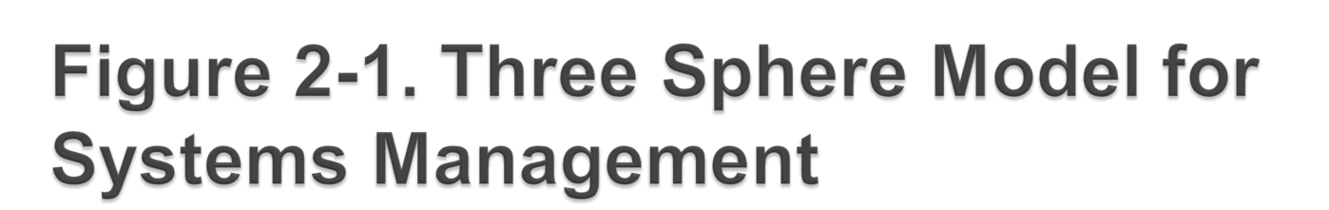
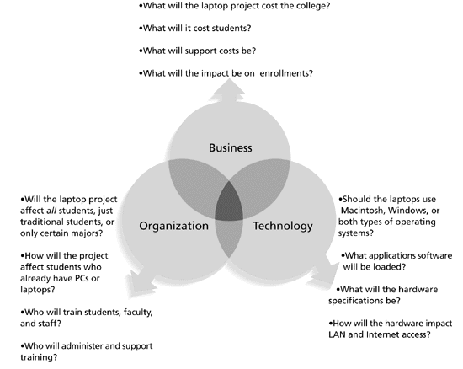
Information Technology Project Management, Sixth Edition
*

Slide 7
Structural frame: Focuses on roles and responsibilities, coordination and control. Organization charts help define this frame.
Human resources frame: Focuses on providing harmony between needs of the organization and needs of people.
Political frame: Assumes organizations are coalitions composed of varied individuals and interest groups. Conflict and power are key issues.
Symbolic frame: Focuses on symbols and meanings related to events. Culture is important.
Information Technology Project Management, Sixth Edition
*

Slide 8

Many enterprise resource planning (ERP) projects fail due to organizational issues, not technical issues. For example, Sobey’s Canadian grocery store chain abandoned its two-year, $90 million ERP system due to organizational problems.
As Dalhousie University Associate Professor Sunny Marche states, “The problem of building an integrated system that can accommodate different people is a very serious challenge. You can’t divorce technology from the sociocultural issues. They have an equal role.” Sobey’s ERP system shut down for five days, and employees were scrambling to stock potentially empty shelves in several stores for weeks. The system failure cost Sobey’s more than $90 million and caused shareholders to take an 82-cent after-tax hit per share.*
*Hoare, Eva. “Software hardships,” The Herald, Halifax, Nova Scotia (2001).
Information Technology Project Management, Sixth Edition
*

Slide 9

3 basic organization structures
  Functional: functional managers report to the CEO
  Project: program managers report to the CEO
  Matrix: middle ground between functional and project structures; personnel often report to two or more bosses; structure can be weak, balanced, or strong matrix
Information Technology Project Management, Sixth Edition
*

Slide 10

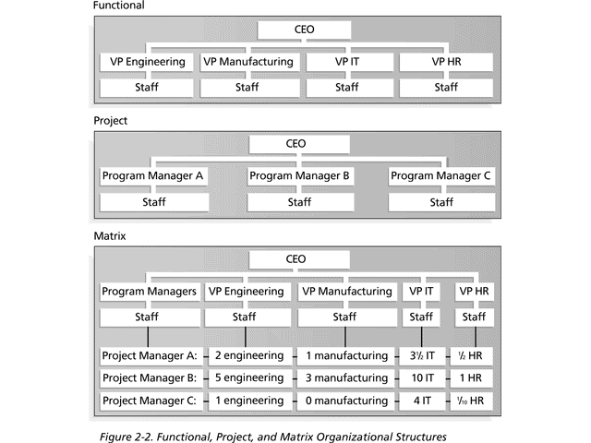
Information Technology Project Management, Sixth Edition
*

Slide 11

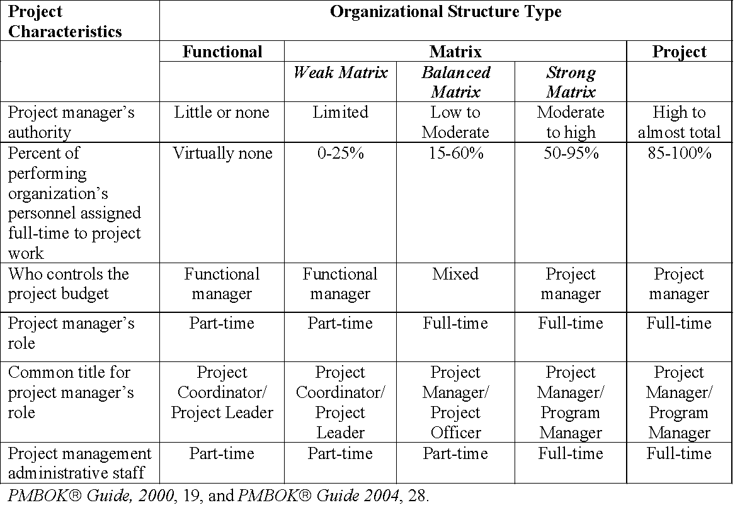
Information Technology Project Management, Sixth Edition
*

Slide 12

Organizational culture is a set of shared assumptions, values, and behaviors that characterize the functioning of an organization
Many experts believe the underlying causes of many companies’ problems are not the structure or staff, but the culture
Information Technology Project Management, Sixth Edition
*

Slide 13

Member identity*
Group emphasis*
People focus
Unit integration*
Control
Risk tolerance*
Reward criteria*
Conflict tolerance*
Means-ends orientation
Open-systems focus*
*Project work is most successful in an organizational culture where these items are strong/high and other items are balanced
Information Technology Project Management, Sixth Edition
*

Slide 14

Project managers must take time to identify, understand, and manage relationships with all project stakeholders
Using the four frames of organizations can help meet stakeholder needs and expectations
Senior executives/top management are very important stakeholders
Information Technology Project Management, Sixth Edition
*

Slide 15

The New York Times reported that the project to rebuild Ground Zero in New York City is having severe problems; imagine all of the stakeholders involved in this huge, highly emotional project
A 34-page report describes the many challenges faced in the reconstruction of the former World Trade Center site nearly seven years after the terrorist attack of September 11, 2001
The report identified the need for a steering to make final decisions on important matters
Information Technology Project Management, Sixth Edition
*

Slide 16

People in top management positions are key stakeholders in projects
A very important factor in helping project managers successfully lead projects is the level of commitment and support they receive from top management
Without top management commitment, many projects will fail
Some projects have a senior manager called a champion who acts as a key proponent for a project
Information Technology Project Management, Sixth Edition
*

Slide 17

Providing adequate resources
Approving unique project needs in a timely manner
Getting cooperation from other parts of the organization
Mentoring and coaching on leadership issues
Information Technology Project Management, Sixth Edition
*

Slide 18

IT governance addresses the authority and control for key IT activities in organizations, including IT infrastructure, IT use, and project management
A lack of IT governance can be dangerous, as evidenced by three well-publicized IT project failures in Australia (Sydney Water’s customer relationship management system, the Royal Melbourne Institute of Technology’s academic management system, and One.Tel’s billing system)
Information Technology Project Management, Sixth Edition
*

Slide 19

If the organization has a negative attitude toward IT, it will be difficult for an IT project to succeed
Having a Chief Information Officer (CIO) at a high level in the organization helps IT projects
Assigning non-IT people to IT projects also encourages more commitment
Information Technology Project Management, Sixth Edition
*

Slide 20

Standards and guidelines help project managers be more effective
Senior management can encourage:
  The use of standard forms and software for project management
  The development and use of guidelines for writing project plans or providing status information
  The creation of a project management office or center of excellence
Information Technology Project Management, Sixth Edition
*

Slide 21

A project life cycle is a collection of project phases that defines:
  What work will be performed in each phase
  What deliverables will be produced and when
  Who is involved in each phase
  How management will control and approve work produced in each phase
A deliverable is a product or service produced or provided as part of a project
Information Technology Project Management, Sixth Edition
*

Slide 22

In early phases of a project life cycle:
  Resource needs are usually lowest
  The level of uncertainty (risk) is highest
  Project stakeholders have the greatest opportunity to influence the project
In middle phases of a project life cycle:
  The certainty of completing a project improves
  More resources are needed
The final phase of a project life cycle focuses on:
  Ensuring that project requirements were met
  The sponsor approves completion of the project
Information Technology Project Management, Sixth Edition
*

Slide 23

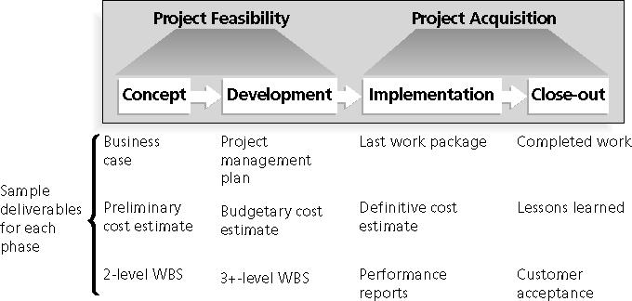
Information Technology Project Management, Sixth Edition
*

Slide 24
Products also have life cycles
The Systems Development Life Cycle (SDLC) is a framework for describing the phases involved in developing and maintaining information systems
Systems development projects can follow
  Predictive life cycle: the scope of the project can be clearly articulated and the schedule and cost can be predicted
  Adaptive Software Development (ASD) life cycle: requirements cannot be clearly expressed, projects are mission driven and component based, using time-based cycles to meet target dates
Information Technology Project Management, Sixth Edition
*

Slide 25

Waterfall model: has well-defined, linear stages of systems development and support
Spiral model: shows that software is developed using an iterative or spiral approach rather than a linear approach
Incremental build model: provides for progressive development of operational software
Prototyping model: used for developing prototypes to clarify user requirements
Rapid Application Development (RAD) model: used to produce systems quickly without sacrificing quality
Information Technology Project Management, Sixth Edition
*

Slide 26

Agile software development has become popular to describe new approaches that focus on close collaboration between programming teams and business experts
Visit www.agilealliance.org for information
See the companion Web site for Suggested Readings
Information Technology Project Management, Sixth Edition
*

Slide 27

A project should successfully pass through each of the project phases in order to continue on to the next
Management reviews, also called phase exits or kill points, should occur after each phase to evaluate the project’s progress, likely success, and continued compatibility with organizational goals
Information Technology Project Management, Sixth Edition
*

Slide 28
"The real improvement that I saw was in our ability to⎯in the words of Thomas Edison⎯know when to stop beating a dead horse.…Edison's key to success was that he failed fairly often; but as he said, he could recognize a dead horse before it started to smell...In information technology we ride dead horses⎯failing projects⎯a long time before we give up. But what we are seeing now is that we are able to get off them; able to reduce cost overrun and time overrun. That's where the major impact came on the success rate.”*
Many organizations, like Huntington Bancshares, Inc., use an executive steering committee to help keep projects on track.
*Cabanis, Jeannette, "'A Major Impact': The Standish Group's Jim Johnson On Project Management and IT Project Success," PM Network, PMI, Sep.1998, p. 7
Information Technology Project Management, Sixth Edition
*

Slide 29

IT projects can be very diverse in terms of size, complexity, products produced, application area, and resource requirements
IT project team members often have diverse backgrounds and skill sets
IT projects use diverse technologies that change rapidly; even within one technology area, people must be highly specialized
Information Technology Project Management, Sixth Edition
*

Slide 30

Globalization: lower trade and political barriers and the digital revolution have made it possible to interact almost instantaneously with billions of other people across the planet
Outsourcing: outsourcing is when an organization acquires goods and/or sources from an outside source; offshoring is sometimes used to describe outsourcing from another country
Virtual teams: a virtual team is a group of individuals who work across time and space using communication technologies
Information Technology Project Management, Sixth Edition
*

Slide 31

Issues
  Communications
  Trust
  Common work practices
  Tools
Suggestions
  Employ greater project discipline
  Think global but act local
  Keep project momentum going
  Use newer tools and technology
Information Technology Project Management, Sixth Edition
*

Slide 32

Organizations remain competitive by using outsourcing to their advantage, such as finding ways to reduce costs
Their next challenge is to make strategic IT investments with outsourcing by improving their enterprise architecture to ensure that IT infrastructure and business processes are integrated and standardized (see Suggested Readings)
Project managers should become more familiar with negotiating contracts and other outsourcing issues
Information Technology Project Management, Sixth Edition
*

Slide 33

Increasing competiveness and responsiveness by having a team of workers available 24/7
Lowering costs because many virtual workers do not require office space or support beyond their home offices
Providing more expertise and flexibility by having team members from across the globe working any time of day or night
Increasing the work/life balance for team members by eliminating fixed office hours and the need to travel to work
Information Technology Project Management, Sixth Edition
*

Slide 34

Isolating team members
Increasing the potential for communications problems
Reducing the ability for team members to network and transfer information informally
Increasing the dependence on technology to accomplish work
See text for a list of factors that help virtual teams succeed, including team processes, trust/relationships, leadership style, and team member selection
Information Technology Project Management, Sixth Edition
*

Slide 35
Project managers need to take a systems approach when working on projects
Organizations have four different frames: structural, human resources, political, and symbolic
The structure and culture of an organization have strong implications for project managers
Projects should successfully pass through each phase of the project life cycle
Project managers need to consider several factors due to the unique context of information technology projects
Recent trends affecting IT project management include globalization, outsourcing, and virtual teams
Information Technology Project Management, Sixth Edition
*

