Slide 1


Information Technology Project Management, Sixth Edition
Note: See the text itself for full citations.
Notes:
*

Slide 2
Understand the importance of good communications in projects
Discuss the process of identifying stakeholders and how to create a stakeholder register and stakeholder management strategy
Explain the elements of project communications planning and how to create a communications management plan
Describe various methods for distributing project information and the advantages and disadvantages of each, discuss the importance of addressing individual communication needs, and calculate the number of communications channels in a project
Information Technology Project Management, Sixth Edition
*

Slide 3
Recognize the importance of managing stakeholder expectations
Understand how performance reporting helps stakeholders stay informed about project resources
List various methods for improving project communications, such as managing conflicts, running effective meetings, using e-mail and other technologies effectively, and using templates
Describe how software can enhance project communications management
Information Technology Project Management, Sixth Edition
*

Slide 4
The greatest threat to many projects is a failure to communicate
Our culture does not portray IT professionals as being good communicators
Research shows that IT professionals must be able to communicate effectively to succeed in their positions
Strong verbal skills are a key factor in career advancement for IT professionals
Information Technology Project Management, Sixth Edition
*

Slide 5

Identifying stakeholders: identifying everyone involved in or affected by the project and determining the best ways to manage relationships with them
Planning communications: determining the information and communications needs of the stakeholders
Distributing information: making needed information available to project stakeholders in a timely manner
Managing stakeholder expectations: managing communications to satisfy the needs and expectations of project stakeholders and to resolve issues
Reporting performance: collecting and disseminating performance information, including status reports, progress measurement, and forecasting
Information Technology Project Management, Sixth Edition
*

Slide 6

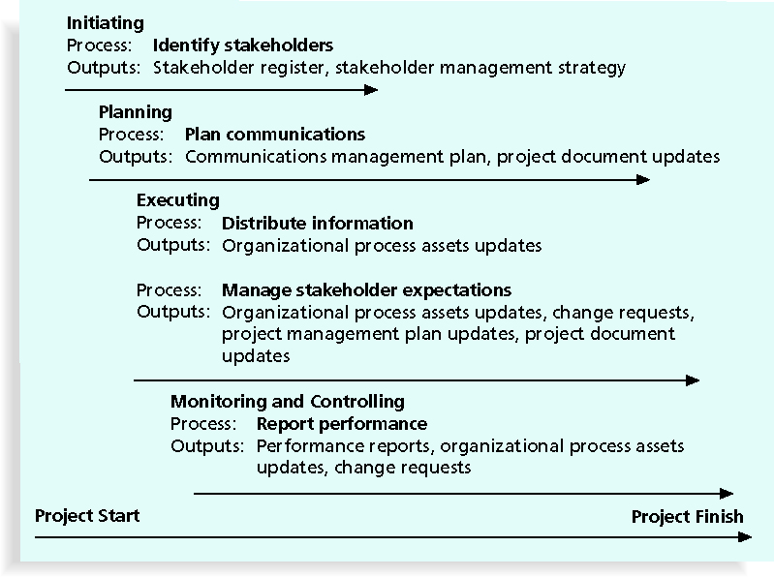
Information Technology Project Management, Sixth Edition
*

Slide 7

Recall that the ultimate goal of project management is to meet or exceed stakeholder needs and expectations from a project, so you must first identify who your particular project stakeholders are
Two key outputs of this process include:
  Stakeholder register: a public document that includes details related to the identified project stakeholders (see Table 3-4 for an example)
  Stakeholder management strategy: an approach to help increase the support of stakeholders throughout the project; often includes sensitive information
Information Technology Project Management, Sixth Edition
*

Slide 8
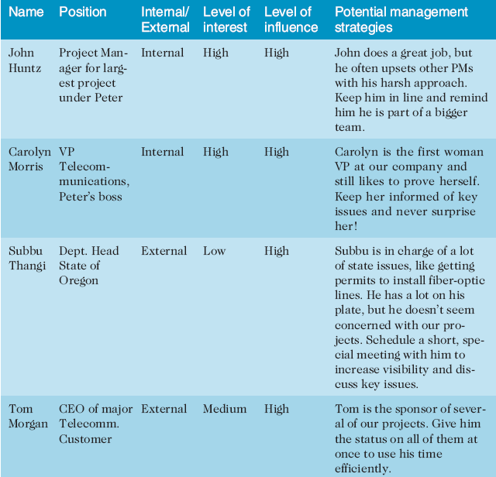
Information Technology Project Management, Sixth Edition
*

Slide 9

Every project should include some type of communications management plan, a document that guides project communications
Creating a stakeholder analysis for project communications also aids in communications planning (see Table 10-2 for an example)
Information Technology Project Management, Sixth Edition
*

Slide 10
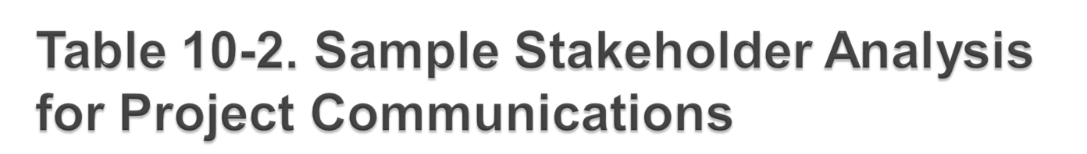
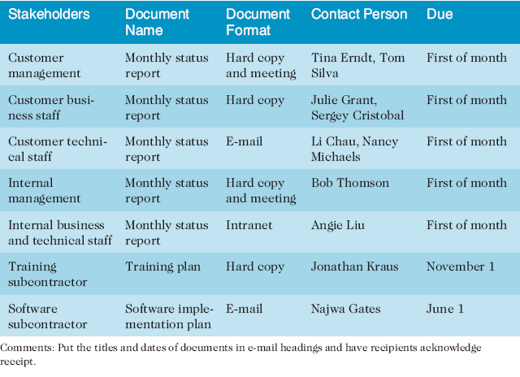
Information Technology Project Management, Sixth Edition
*

Slide 11

Stakeholder communications requirements
Information to be communicated, including format, content, and level of detail
The people who will receive the information and who will produce it
Suggested methods or technologies for conveying the information
Information Technology Project Management, Sixth Edition
*

Slide 12

Frequency of communication
Escalation procedures for resolving issues
Revision procedures for updating the communications management plan
A glossary of common terminology
Information Technology Project Management, Sixth Edition
*

Slide 13

Getting the right information to the right people at the right time and in a useful format is just as important as developing the information in the first place
Important considerations include:
  Using technology to enhance information distribution
  Formal and informal methods for distributing information
Information Technology Project Management, Sixth Edition
*

Slide 14

Telecommunications throughout Asia were severely disrupted on December 26, 2006, after earthquakes off Taiwan damaged undersea cables, slowing Internet services and hindering financial transactions, particularly in the currency market
International telephone traffic was restricted from some countries, and Internet access slowed to a crawl
Information Technology Project Management, Sixth Edition
*

Slide 15

Don’t bury crucial information
Don’t be afraid to report bad information
Oral communication via meetings and informal talks helps bring important information—good and bad—out into the open
Information Technology Project Management, Sixth Edition
*

Slide 16

Research says that in a face-to-face interaction:
  58 percent of communication is through body language
  35 percent of communication is through how the words are said
  7 percent of communication is through the content or words that are spoken
Pay attention to more than just the actual words someone is saying
A person’s tone of voice and body language say a lot about how he or she really feels
Information Technology Project Management, Sixth Edition
*

Slide 17

Short, frequent meetings are often very effective in IT projects
Stand-up meetings force people to focus on what they really need to communicate
Some companies have policies preventing the use of e-mail between certain hours or even entire days of the week
Information Technology Project Management, Sixth Edition
*

Slide 18

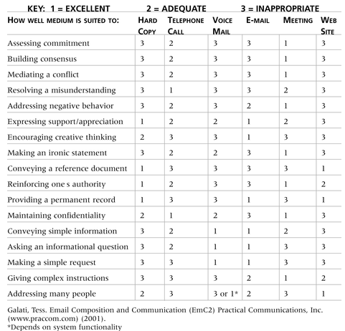
Information Technology Project Management, Sixth Edition
*

Slide 19
Collaboration is a key driver of overall performance of companies around the world
Of all the collaboration technologies that were studied, three were more commonly present in high-performing companies than in low-performing ones: Web conferencing, audio conferencing, and meeting-scheduler technologies
“This study reveals a powerful new metric business leaders can use to more successfully manage their companies and achieve competitive advantage,” said Brian Cotton, a vice president at Frost & Sullivan*
The study also showed that there are regional differences in how people in various countries prefer to communicate with one another
*Frost & Sullivan, “New Research Reveals Collaboration Is a Key Driver of Business Performance Around the World,” Microsoft PressPass (June 5, 2006).
Information Technology Project Management, Sixth Edition
*

Slide 20

People are not interchangeable parts
As illustrated in Brooks’ book The Mythical Man-Month, you cannot assume that a task originally scheduled to take two months of one person’s time can be done in one month by two people
Nine women cannot produce a baby in one month!
Information Technology Project Management, Sixth Edition
*

Slide 21

Introverts like more private communications, while extroverts like to discuss things in public
Intuitive people like to understand the big picture, while sensing people need step-by-step details
Thinkers want to know the logic behind decisions, while feeling people want to know how something affects them personally
Judging people are driven to meet deadlines while perceiving people need more help in developing and following plans
Information Technology Project Management, Sixth Edition
*

Slide 22

Rarely does the receiver interpret a message exactly as the sender intended
Geographic location and cultural background affect the complexity of project communications
  Different working hours
  Language barriers
  Different cultural norms
Information Technology Project Management, Sixth Edition
*

Slide 23

Dear Mom and Dad, or should I say Grandma & Grandpa,
Yes, I am pregnant. No, I’m not married yet since Larry, my boyfriend, is out of a job. Larry’s employers just don’t seem to appreciate the skills he has learned since he quit high school. Larry looks much younger than you, Dad, even though he is three years older. I’m quitting college and getting a job so we can get an apartment before the baby is born. I found a beautiful apartment above a 24-hour auto repair garage with good insulation so the exhaust fumes and noise won’t bother us.
I’m very happy. I thought you would be too.
Love, Ashley
P.S. There is no Larry. I’m not pregnant. I’m not getting married. I’m not quitting school, but I am getting a “D” in Chemistry. I just wanted you to have some perspective.
Information Technology Project Management, Sixth Edition
*

Slide 24

As the number of people involved increases, the complexity of communications increases because there are more communications channels or pathways through which people can communicate
Number of communications channels = n(n-1)
2
where n is the number of people involved
Information Technology Project Management, Sixth Edition
*

Slide 25

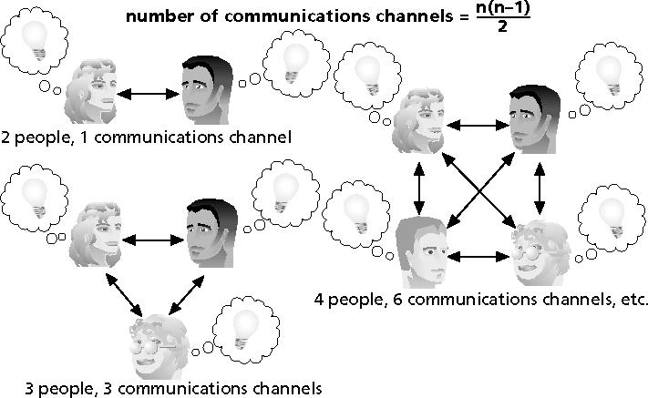
Information Technology Project Management, Sixth Edition
*

Slide 26

Project managers must understand and work with various stakeholders
Need to devise a way to identify and resolve issues
An expectations management matrix can help clarify expectations
Information Technology Project Management, Sixth Edition
*

Slide 27
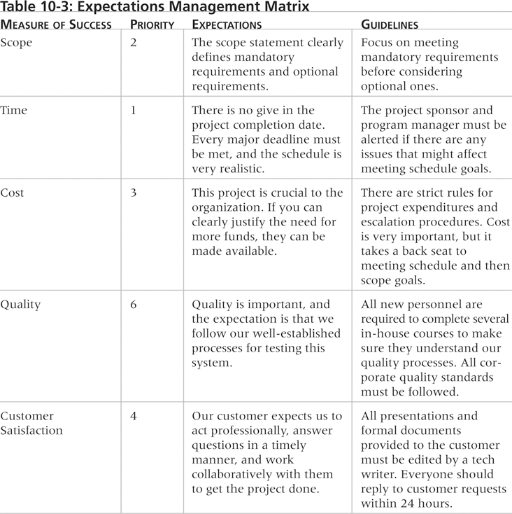
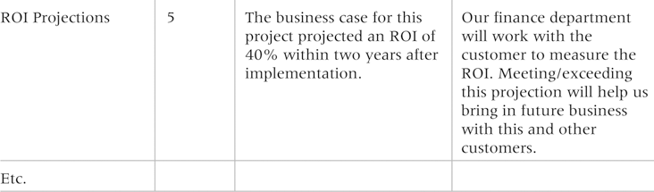
Information Technology Project Management, Sixth Edition
*

Slide 28

Performance reporting keeps stakeholders informed about how resources are being used to achieve project objectives:
  Status reports describe where the project stands at a specific point in time
  Progress reports describe what the project team has accomplished during a certain period of time
  Forecasts predict future project status and progress based on past information and trends
Information Technology Project Management, Sixth Edition
*

Slide 29

Manage conflicts effectively
Develop better communication skills
Run effective meetings
Use e-mail and other technologies effectively
Use templates for project communications
Information Technology Project Management, Sixth Edition
*

Slide 30

Confrontation: directly face a conflict using a problem-solving approach
Compromise: use a give-and-take approach
Smoothing: de-emphasize areas of difference and emphasize areas of agreement
Forcing: the win-lose approach
Withdrawal: retreat or withdraw from an actual or potential disagreement
Collaborating: decision makers incorporate different viewpoints and insights to develop consensus and commitment
Information Technology Project Management, Sixth Edition
*

Slide 31

Conflict often produces important results, such as new ideas, better alternatives, and motivation to work harder and more collaboratively
Groupthink: conformance to the values or ethical standards of a group; groupthink can develop if there are no conflicting viewpoints
Research suggests that task-related conflict often improves team performance, but emotional conflict often depresses team performance
Information Technology Project Management, Sixth Edition
*

Slide 32

Companies and formal degree programs for IT professionals often neglect the importance of speaking, writing, and listening skills
As organizations become more global, they realize they must invest in ways to improve communication with people from different countries and cultures
It takes leadership to improve communication
Information Technology Project Management, Sixth Edition
*

Slide 33
Communications technology, such as using e-mail and searching the Web, should help improve project communications, but it can also cause conflict
How? Cyberslackers are people who should be working, but instead spend their time online doing non-work-related activities, such as annoying friends or co-workers by sending unimportant e-mails
A recent study by Websense suggested that employees are using the Web more and more for personal reasons, and it is costing U.S. companies $178 billion annually, or $5,000 per employee
A 2008 survey found that more than a quarter of U.S. employers have fired workers for misusing e-mail and one-third have fired workers for misusing the Internet on the job
Information Technology Project Management, Sixth Edition
*

Slide 34

Determine if a meeting can be avoided
Define the purpose and intended outcome of the meeting
Determine who should attend the meeting
Provide an agenda to participants before the meeting
Prepare handouts and visual aids, and make logistical arrangements ahead of time
Run the meeting professionally
Build relationships
Information Technology Project Management, Sixth Edition
*

Slide 35

Make sure that e-mail, instant messaging, or collaborative tools are an appropriate medium for what you want to communicate
Be sure to send information to the right people
Use meaningful subject lines, limit the content of e-mails to one main subject, and be as clear and concise as possible
Be sure to authorize the right people to share and edit your collaborative documents
Information Technology Project Management, Sixth Edition
*

Slide 36

A SharePoint portal allows users to create custom Web sites to access documents and applications stored on shared devices
Google Docs allow users to create, share, and edit documents, spreadsheets, and presentations online
A wiki is a Web site designed to enable anyone who accesses it to contribute or modify Web page content
Information Technology Project Management, Sixth Edition
*

Slide 37
Alaska Airlines uses secure project wikis to facilitate project communications and collaborations
Benefits include:
  Better documentation
  Improved trust and information sharing
  Sustained growth
The Alaska Airlines IT department even created a “Mother of All Wikis” to serve as an index for all the known project wikis
Information Technology Project Management, Sixth Edition
*

Slide 38

Many technical people are afraid to ask for help
Providing examples and templates for project communications saves time and money
Organizations can develop their own templates, use some provided by outside organizations, or use samples from textbooks
Recall that research shows that companies that excel in project management make effective use of templates
Information Technology Project Management, Sixth Edition
*

Slide 39

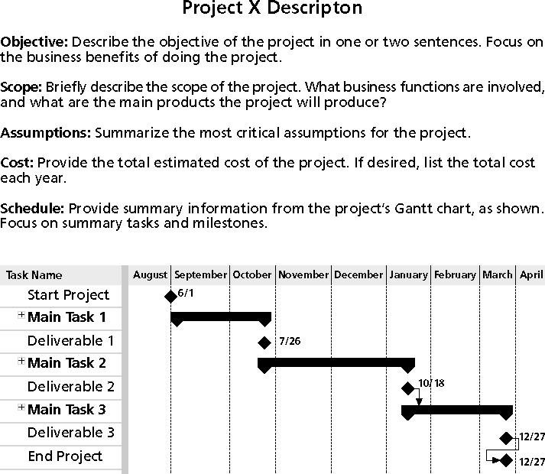
Information Technology Project Management, Sixth Edition
*

Slide 40

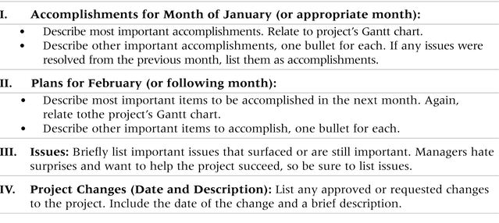
Information Technology Project Management, Sixth Edition
*

Slide 41

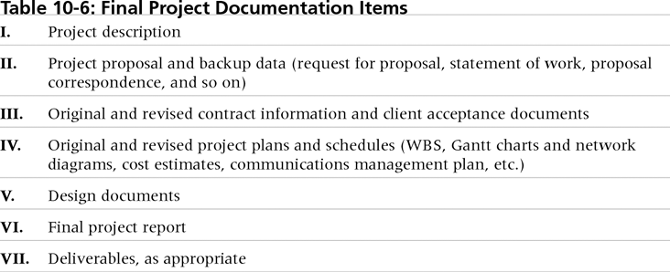
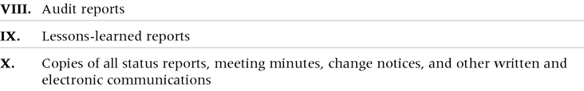
Information Technology Project Management, Sixth Edition
*

Slide 42

The project manager and project team members should each prepare a lessons-learned report
  A reflective statement that documents important things an individual learned from working on the project
The project manager often combines information from all of the lessons-learned reports into a project summary report
See template and sample in Chapter 3
Information Technology Project Management, Sixth Edition
*

Slide 43

It is also important to organize and prepare project archives
Project archives are a complete set of organized project records that provide an accurate history of the project
These archives can provide valuable information for future projects as well
Information Technology Project Management, Sixth Edition
*

Slide 44

Many project teams create a project Web site to store important product documents and other information
Can create the site using various types of software, such as enterprise project management software
Information Technology Project Management, Sixth Edition
*

Slide 45

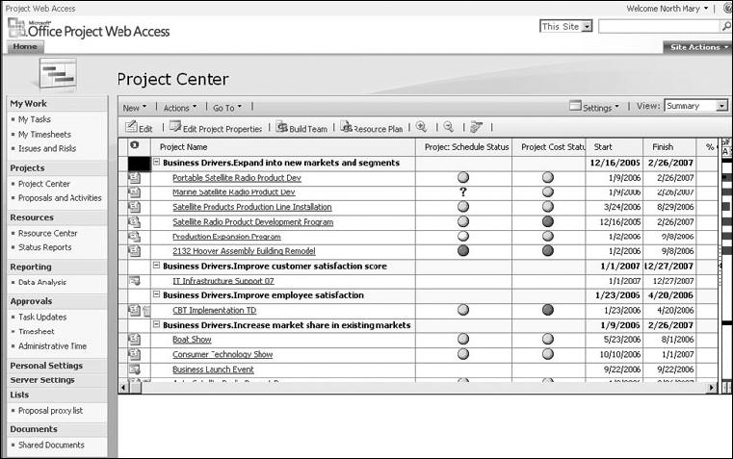
Information Technology Project Management, Sixth Edition
*

Slide 46

There are many software tools to aid in project communications
Today many people telecommute or work remotely at least part-time
Project management software includes new capabilities to enhance virtual communications
New tools, such as instant messaging and blogs, can enhance project communications
Information Technology Project Management, Sixth Edition
*

Slide 47

The goal of project communications management is to ensure timely and appropriate generation, collection, dissemination, storage, and disposition of project information
Main processes include:
  Identify stakeholders
  Plan communications
  Distribute information
  Manage stakeholder expectations
  Report performance
Information Technology Project Management, Sixth Edition
*

