Slide 1
Systems Analysis and Design
Alan Dennis, Barbara Haley Wixom, and Roberta Roth John Wiley & Sons, Inc.
Slides by Candace S. Garrod
Red Rocks Community College

Slide 2
Architecture Design
Chapter 8

Slide 3
Key Definitions
Architecture design
Plans for how the system will be distributed across computers and what the hardware and software will be used for each computer
Hardware and software specification
Describes the hardware/software components in detail to aid those responsible for purchasing those products.

Slide 4
ELEMENTS OF AN ARCHITECTURE DESIGN

Slide 5
Architectural Components (Functions) of Software
Data storage
Data access logic
Processing required to access stored data
Application logic
Processing logic of the application
Presentation logic
Information display and user command processing

Slide 6
Architectural Design Purpose
Determine what parts of the application software will be assigned to what hardware.
Hardware options:
Clients
Input/output devices employed by users
PCs, laptops, handheld devices, cell phones
Servers
Larger computers storing software
Accessible by many users

Slide 7
Server-Based Architectures
Mainframe
Minicomputer
Microcomputer (personal computer)

Slide 8
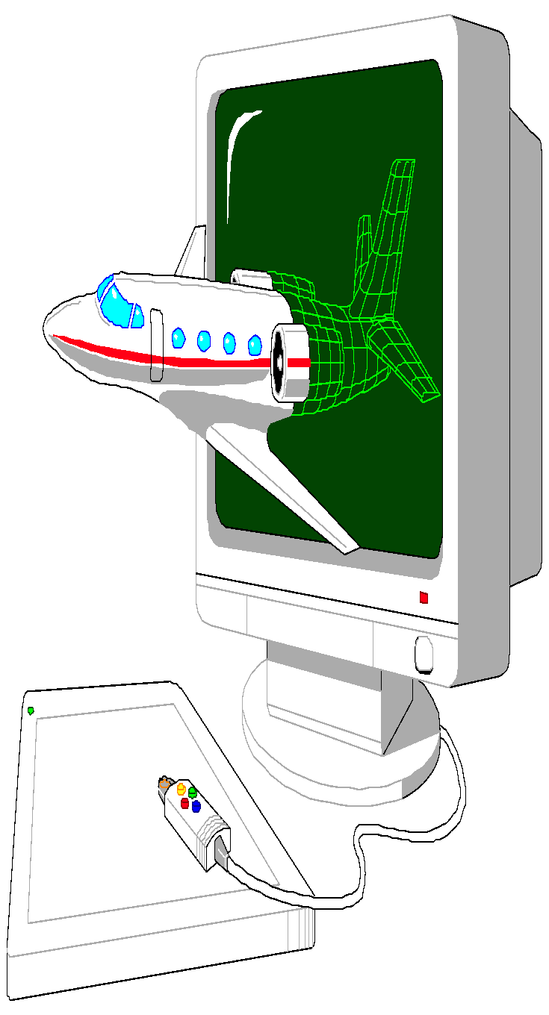
Client-Based Architectures
Terminals
Microcomputer (personal computer)
Special purpose terminals(ATMs, kiosks, Palm Pilots, and many others)

Slide 9
Client-Server Architectures
Server-based Architecture
Client-based Architecture
Client-server based Architecture

Slide 10
Server-Based Architecture

Slide 11
Client-Based Architecture

Slide 12
Client-Server Architecture (Two-Tiered)

Slide 13
Client-Server Attributes
Benefits
Scalable
Works with multiple vendors/products through middleware
Improved modularity of web-based systems
No central point of failure
Limitations
Complexity
New programming languages and techniques (adds stress for personnel)
More complex to update

Slide 14
Three-Tiered Client-Server Architecture

Slide 15
Four-Tiered Client-Server Architecture

Slide 16
N-Tiered versus 2-Tiered Client-Server Architectures
Benefits
Separates processing to better balance load on different servers
More scalable
Limitations
Greater load on the network
More difficult to program and test

Slide 17
Your Turn
Consider the course registration system at your university:
What computing architecture does it use?
What computing architecture would you use if you were replacing it today?

Slide 18
CREATING AN ARCHITECTURE DESIGN

Slide 19
Selecting an Architecture Design
Lower costs often used to justify choice of client-server
Recommended selection process:
Expand nonfunctional requirement details
Base architecture selection on the detailed nonfunctional requirements

Slide 20
Operational Requirements
Type of Requirement Definition Examples

Slide 21
Performance Requirements

Slide 22
Security Requirements

Slide 23
Cultural/Political Requirements
Type of Requirement Definition Examples

Slide 24
Designing the Architecture
Technical environment requirements, driven by business requirements, often define the application architecture
If not, other nonfunctional requirements become important

Slide 25
Nonfunctional Requirements and their Implications for Architecture Design

Slide 26
HARDWARE AND SOFTWARE SPECIFICATION

Slide 27
Hardware and Software Specification
Used if new hardware or software must be purchased
Communicates project needs
Actual acquisition of hardware and software usually left to a purchasing department -- especially in larger firms

Slide 28
Hardware and Software Specification
Determine software needs
OS, special purpose
Training, warranty, maintenance, licensing needs
Determine hardware needs
Server(s), clients, peripherals, backup devices, storage components
Minimum configuration needs

Slide 29
Sample Hardware and Software Specification
Standard Standard Standard Standard Client Web Server Application Server Database Server

Slide 30
Factors in Hardware and Software Selection

Slide 31
Summary
The three fundamental computing architectures are server-based, client-based, and client-server based.
Select architecture design based on detailed nonfunctional requirements
Hardware and software specification documents acquisition needs

Slide 32
Copyright © 2009 John Wiley & Sons, Inc.
All rights reserved. Reproduction or translation of this work beyond that permitted in Section 117 of the 1976 United States Copyright Act without the express written permission of the copyright owner is unlawful.
Request for further information should be addressed to the Permissions Department, John Wiley & Sons, Inc.
The purchaser may make back-up copies for his/her own use only and not for redistribution or resale.
The Publisher assumes no responsibility for errors, omissions, or damages, caused by the use of these programs or from the use of the information contained herein.

