Slide 1
Systems Analysis and Design
Alan Dennis, Barbara Haley Wixom, and Roberta Roth John Wiley & Sons, Inc.
Slides by Candace S. Garrod Red Rock Community College
PowerPoint Presentation for Dennis, Wixom, & Roth Systems Analysis and Design, 4th Edition
Copyright 2009 © John Wiley & Sons, Inc. All rights reserved.
7 - *

Slide 2
Moving into Design
Chapter 7
PowerPoint Presentation for Dennis, Wixom, & Roth Systems Analysis and Design, 4th Edition
Copyright 2009 © John Wiley & Sons, Inc. All rights reserved.
7 - *
Notes:
*

Slide 3
Key Definitions
Design phase
Decide how to build the system
Create system requirements that describe technical details for building the system
Architecture Design Document
Final deliverable from design phase
Conveys exactly what system the design team will implement during the implementation phase
PowerPoint Presentation for Dennis, Wixom, & Roth Systems Analysis and Design, 4th Edition
Copyright 2009 © John Wiley & Sons, Inc. All rights reserved.
7 - *

Slide 4
Transition from Requirement to Design
Influences on the Acquisition Strategy
Selecting a Design Strategy
Selecting a System Acquisition Strategy
Selecting a System Acquisition Strategy
Developing an Alternative Matrix
Developing an Alternative Matrix
Developing an Alternative Matrix
PowerPoint Presentation for Dennis, Wixom, & Roth Systems Analysis and Design, 4th Edition
Copyright 2009 © John Wiley & Sons, Inc. All rights reserved.
7 - *

Slide 5
Classical Design Mistakes
Reducing design time
Feature creep
Silver bullet syndrome
Switching tools in mid-project
PowerPoint Presentation for Dennis, Wixom, & Roth Systems Analysis and Design, 4th Edition
Copyright 2009 © John Wiley & Sons, Inc. All rights reserved.
7 - *

Slide 6
Design Strategies
Custom development (build from scratch) in-house
Purchase software package (and customize it)
Outsource development to third party
PowerPoint Presentation for Dennis, Wixom, & Roth Systems Analysis and Design, 4th Edition
Copyright 2009 © John Wiley & Sons, Inc. All rights reserved.
7 - *

Slide 7
Custom Development
PROS
CONS
Allows flexibility and creativity
Consistent with existing technology and standards
Builds technical skills and functional knowledge in- house
Requires significant time and effort
May exacerbate existing backlogs May require missing skills Often costs more Often takes more calendar time Risk of project failure
PowerPoint Presentation for Dennis, Wixom, & Roth Systems Analysis and Design, 4th Edition
Copyright 2009 © John Wiley & Sons, Inc. All rights reserved.
7 - *

Slide 8
Packaged Software
Available for many common business needs
Tested, proven; cost and time savings
Rarely a perfect fit with business needs
May allow for customization
Manipulation of system parameters
Changing way features work
Synchronizing with other application interfaces
May require workarounds
PowerPoint Presentation for Dennis, Wixom, & Roth Systems Analysis and Design, 4th Edition
Copyright 2009 © John Wiley & Sons, Inc. All rights reserved.
7 - *

Slide 9
Systems Integration
Building systems by combining packages, legacy systems, and custom pieces
Integrating data is the key
PowerPoint Presentation for Dennis, Wixom, & Roth Systems Analysis and Design, 4th Edition
Copyright 2009 © John Wiley & Sons, Inc. All rights reserved.
7 - *

Slide 10
Outsourcing
Hiring an external vendor, developer, or service provider
May reduce costs or add value
Risks include possibly
Losing confidential information
Losing control over future development
Losing learning opportunities
PowerPoint Presentation for Dennis, Wixom, & Roth Systems Analysis and Design, 4th Edition
Copyright 2009 © John Wiley & Sons, Inc. All rights reserved.
7 - *

Slide 11
Outsourcing Contracts
Time and arrangements
Fixed-price
Value-added
PowerPoint Presentation for Dennis, Wixom, & Roth Systems Analysis and Design, 4th Edition
Copyright 2009 © John Wiley & Sons, Inc. All rights reserved.
7 - *

Slide 12
Outsourcing Guidelines
PowerPoint Presentation for Dennis, Wixom, & Roth Systems Analysis and Design, 4th Edition
Copyright 2009 © John Wiley & Sons, Inc. All rights reserved.
7 - *

Slide 13
INFLUENCES ON THE ACQUISTION STRATEGY
PowerPoint Presentation for Dennis, Wixom, & Roth Systems Analysis and Design, 4th Edition
Copyright 2009 © John Wiley & Sons, Inc. All rights reserved.
7 - *
Notes:
*

Slide 14
Selecting a Design Strategy
Consider each of the following when deciding what strategy to use:
Business need
In-house experience
Project skills
Project management
Time frame
PowerPoint Presentation for Dennis, Wixom, & Roth Systems Analysis and Design, 4th Edition
Copyright 2009 © John Wiley & Sons, Inc. All rights reserved.
7 - *

Slide 15
Selecting a System Acquisition Strategy
PowerPoint Presentation for Dennis, Wixom, & Roth Systems Analysis and Design, 4th Edition
Copyright 2009 © John Wiley & Sons, Inc. All rights reserved.
7 - *

Slide 16
SELECTING AN ACQUISITION STRATEGY
PowerPoint Presentation for Dennis, Wixom, & Roth Systems Analysis and Design, 4th Edition
Copyright 2009 © John Wiley & Sons, Inc. All rights reserved.
7 - *
Notes:
*

Slide 17
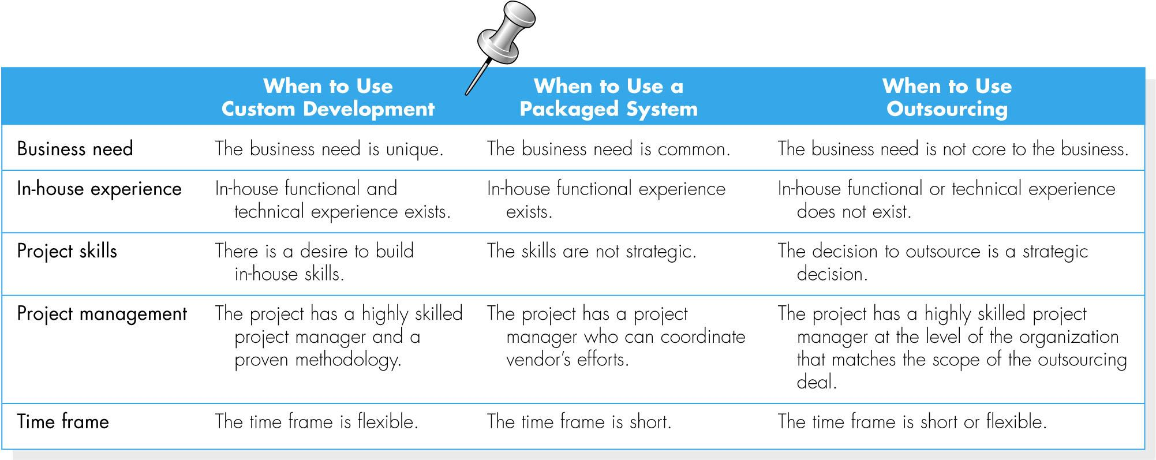
PowerPoint Presentation for Dennis, Wixom, & Roth Systems Analysis and Design, 4th Edition
Copyright 2009 © John Wiley & Sons, Inc. All rights reserved.
7 - *

Slide 18
In-House Experience
If in-house experience exists for all the functional and technical needs of the system, it will be easier to build a custom application.
A packaged system may be a better alternative for companies that do not have the technical skills to build the desired system.
PowerPoint Presentation for Dennis, Wixom, & Roth Systems Analysis and Design, 4th Edition
Copyright 2009 © John Wiley & Sons, Inc. All rights reserved.
7 - *

Slide 19
Project Skills
The skills that are applied during projects are either technical or functional.
Different design alternatives are more viable, depending on how important the skills are to the company’s strategy.
PowerPoint Presentation for Dennis, Wixom, & Roth Systems Analysis and Design, 4th Edition
Copyright 2009 © John Wiley & Sons, Inc. All rights reserved.
7 - *

Slide 20
Project Management
Custom applications require excellent project management and a proven methodology.
There are so many things that can push a project off track, such as funding obstacles, staffing, and overly demanding business users.
PowerPoint Presentation for Dennis, Wixom, & Roth Systems Analysis and Design, 4th Edition
Copyright 2009 © John Wiley & Sons, Inc. All rights reserved.
7 - *

Slide 21
Project Management - continued
The project team should choose to develop a custom application only if it is certain that the underlying coordination and control mechanisms will be in place.
Packaged and outsourcing alternatives also must be managed; however, they are more shielded from internal obstacles.
PowerPoint Presentation for Dennis, Wixom, & Roth Systems Analysis and Design, 4th Edition
Copyright 2009 © John Wiley & Sons, Inc. All rights reserved.
7 - *

Slide 22
Time Frame
When time is a factor, the project team should probably start looking for a system that is already built and tested.
If a custom alternative is chosen, and the time frame is very short, consider using techniques like timeboxing to manage the problem.
PowerPoint Presentation for Dennis, Wixom, & Roth Systems Analysis and Design, 4th Edition
Copyright 2009 © John Wiley & Sons, Inc. All rights reserved.
7 - *

Slide 23
Selecting an Acquisition Strategy
Once a project team has a good understanding of how well each acquisition strategy fits with the project’s needs, it must begin to understand exactly how to implement these strategies.
One helpful tool is the request for proposal (RFP), a document that solicits a formal proposal from a potential vendor, developer, or service provider
PowerPoint Presentation for Dennis, Wixom, & Roth Systems Analysis and Design, 4th Edition
Copyright 2009 © John Wiley & Sons, Inc. All rights reserved.
7 - *

Slide 24
Selecting an Acquisition Strategy - continued
For smaller projects with smaller budgets, the request for information (RFI) may be sufficient, as it is shorter and less detailed.
A request for quote (RGQ) may be used when a list of equipment is so complete that the vendor only need provide a price.
PowerPoint Presentation for Dennis, Wixom, & Roth Systems Analysis and Design, 4th Edition
Copyright 2009 © John Wiley & Sons, Inc. All rights reserved.
7 - *

Slide 25
Developing an Alternative Matrix
What tools and technologies are needed for a custom development project?
What vendors make products that address the project needs?
What service providers would be able to build this application if outsourced?
PowerPoint Presentation for Dennis, Wixom, & Roth Systems Analysis and Design, 4th Edition
Copyright 2009 © John Wiley & Sons, Inc. All rights reserved.
7 - *

Slide 26
Developing an Alternative Matrix
Combine several feasibility analyses into one matrix
Include technical, budget, and organizational feasibilities
Assign weights to indicate the relative importance of the criteria
Assign scores to indicate how well the alternative meets the criteria
PowerPoint Presentation for Dennis, Wixom, & Roth Systems Analysis and Design, 4th Edition
Copyright 2009 © John Wiley & Sons, Inc. All rights reserved.
7 - *

Slide 27
Developing an Alternative Matrix
PowerPoint Presentation for Dennis, Wixom, & Roth Systems Analysis and Design, 4th Edition
Copyright 2009 © John Wiley & Sons, Inc. All rights reserved.
7 - *

Slide 28
Summary Slide
System Design Phase – transitioning from requirements to design
Design all the elements of the system
First Task – determine the system acquisition strategy
Custom development
Purchase software package
Outsource
Use Alternatives Matrix to structure the system acquisition decision
PowerPoint Presentation for Dennis, Wixom, & Roth Systems Analysis and Design, 4th Edition
Copyright 2009 © John Wiley & Sons, Inc. All rights reserved.
7 - *

Slide 29
Copyright © 2009 John Wiley & Sons, Inc.
All rights reserved. Reproduction or translation of this work beyond that permitted in Section 117 of the 1976 United States Copyright Act without the express written permission of the copyright owner is unlawful.
Request for further information should be addressed to the Permissions Department, John Wiley & Sons, Inc.
The purchaser may make back-up copies for his/her own use only and not for redistribution or resale.
The Publisher assumes no responsibility for errors, omissions, or damages, caused by the use of these programs or from the use of the information contained herein.
PowerPoint Presentation for Dennis, Wixom, & Roth Systems Analysis and Design, 4th Edition
Copyright 2009 © John Wiley & Sons, Inc. All rights reserved.
7 - *
Notes:
*

