Slide 1
Systems Analysis and Design
Alan Dennis, Barbara Haley Wixom, and Roberta Roth John Wiley & Sons, Inc.
Slides by Candace S. Garrod
Red Rocks Community College

Slide 2
Process Modeling
Chapter 5

Slide 3
Key Definitions
Process model
A formal way of representing how a business system operates
Illustrates the activities that are performed and how data moves among them
Data flow diagramming
A common technique for creating process models

Slide 4
Key Definitions
Logical process models describe processes without suggesting how they are conducted
Physical process models provide information that is needed to build the system

Slide 5
DATA FLOW DIAGRAMS (DFD)

Slide 6
Reading a DFD

Slide 7
Elements of a DFD
Process
An activity or function performed for a specific business reason
Manual or computerized
Data flow
A single piece of data or a logical collection of data
Always starts or ends at a process

Slide 8
DFD Elements
Data Store
A collection of data that is stored in some way
Data flowing out is retrieved from the data store
Data flowing in updates or is added to the data store
External entity
A person, organization, or system that is external to the system but interacts with it.

Slide 9
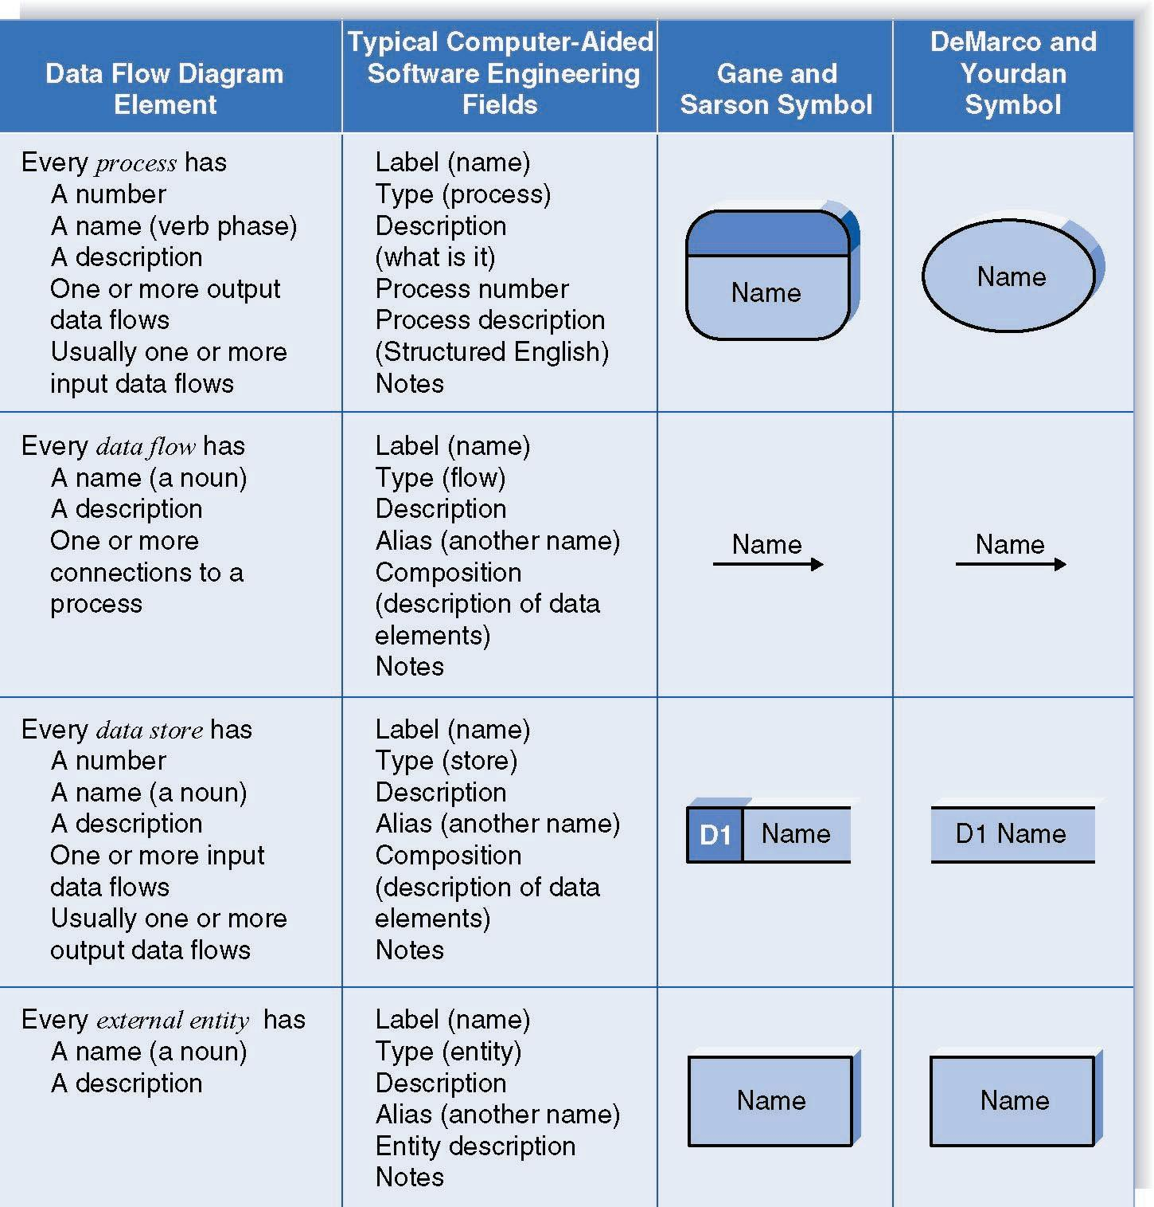
Naming and Drawing DFD Elements
Process
Data flow
Data store
External
entity

Slide 10
Using a DFD to Define Business Processes
Business processes are too complex to be shown on a single DFD
Decomposition is the process of representing the system in a hierarchy of DFD diagrams
Child diagrams show a portion of the parent diagram in greater detail

Slide 11
Key Definition
Balancing involves insuring that information presented at one level of a DFD is accurately represented in the next level DFD.

Slide 12
Relationship among Levels of DFDs
Context diagram
Level 0 diagram
Level 1 diagram
Level 2 diagram

Slide 13
Context Diagram
First DFD in every business process
Shows the context into which the business process fits
Shows the overall business process as just one process (process 0)
Shows all the external entities that receive information from or contribute information to the system

Slide 14
Level 0 Diagram
Shows all the major processes that comprise the overall system – the internal components of process 0
Shows how the major processes are interrelated by data flows
Shows external entities and the major processes with which they interact
Adds data stores

Slide 15
Level 1 Diagrams
Generally, one level 1 diagram is created for every major process on the level 0 diagram
Shows all the internal processes that comprise a single process on the level 0 diagram
Shows how information moves from and to each of these processes
If a parent process is decomposed into, for example, three child processes, these three child processes wholly and completely make up the parent process

Slide 16
Level 2 Diagrams
Shows all processes that comprise a single process on the level 1 diagram
Shows how information moves from and to each of these processes
Level 2 diagrams may not be needed for all level 1 processes
Correctly numbering each process helps the user understand where the process fits into the overall system

Slide 17
Alternative Data Flows
Where a process can produce different data flows given different conditions
We show both data flows and use the process description to explain why they are alternatives
Tip -- alternative data flows often accompany processes with IF statements

Slide 18
Your Turn
At this point in the process it is easy to lose track of the “big picture”.
Describe the difference between data flows, data stores, and processes.
Describe in your own words the relationship between the DFD and the ultimate new application being developed.

Slide 19
Process Descriptions
Text-based process descriptions provide more information about the process than the DFD alone
If the logic underlying the process is quite complex, more detail may be needed in the form of
Structured English
Decision trees
Decision tables

Slide 20
CREATING DATA FLOW DIAGRAMS

Slide 21
Integrating Scenario Descriptions
DFDs start with the use cases and requirements definition
Generally, the DFDs integrate the use cases
Names of use cases become processes
Inputs and outputs become data flows
“Small” data inputs and outputs are combined into a single flow

Slide 22
Steps in Building DFDs
Build the context diagram
Create DFD fragments for each use case
Organize DFD fragments into level 0 diagram
Decompose level 0 processes into level 1 diagrams as needed; decompose level 1 processes into level 2 diagrams as needed; etc.
Validate DFDs with user to ensure completeness and correctness

Slide 23
Creating the Context Diagram
Draw one process representing the entire system (process 0)
Find all inputs and outputs listed at the top of the use cases that come from or go to external entities; draw as data flows
Draw in external entities as the source or destination of the data flows

Slide 24
A Context Diagram Example

Slide 25
Creating DFD Fragments
Each use case is converted into one DFD fragment
Number the process the same as the use case number
Change process name into verb phrase
Design the processes from the viewpoint of the organization running the system

Slide 26
Creating DFD Fragments
Add data flows to show use of data stores as sources and destinations of data
Layouts typically place
processes in the center
inputs from the left
outputs to the right
stores beneath the processes

Slide 27
A DFD Fragment Example

Slide 28
Creating the Level 0 Diagram
Combine the set of DFD fragments into one diagram
Generally move from top to bottom, left to right
Minimize crossed lines
Iterate as needed
DFDs are often drawn many times before being finished, even with very experienced systems analysts

Slide 29
A Level 0 DFD Example

Slide 30
Creating Level 1 Diagrams (and Below)
Each use case is turned into its own DFD
Take the steps listed on the use case and depict each as a process on the level 1 DFD
Inputs and outputs listed on use case become data flows on DFD
Include sources and destinations of data flows to processes and stores within the DFD
May also include external entities for clarity

Slide 31
Creating Level 1 Diagrams (and Below)
When to stop decomposing DFDs?
Ideally, a DFD has at least three processes and no more than seven to nine.

Slide 32
Validating the DFD
Syntax errors – diagram follows the rules
Assure correct DFD structure
For each DFD: Check each process for: A unique name: action verb phrase; number; description
At least one input data flow
At least one output data flow
Output data flow names usually different than input data flow names
Between 3 and 7 processes per DFD

Slide 33
Validating the DFD
For each DFD: Check each data flow for: A unique name: noun; description
Connects to at least one process
Shown in only one direction (no two-headed arrows)
A minimum number of crossed lines
Check each data store for:
A unique name: noun; description
At least one input data flow
At least one output data flow
Check each external entity for:
A unique name: noun; description
At least one input or output data flow

Slide 34
Validating the DFD
Across DFDs:
Context Diagram: Every set of DFDs must have one Context Diagram
Viewpoint: There is a consistent viewpoint for the entire set of DFDs Decomposition: Every process is wholly and complete described by the processes on its children DFDs Balance: Every data flow, data store, and external entity on a higher level DFD is shown on the lower level DFD that decomposes it No data stores or data flows appear on lower-lever DFDs that do not appear on their parent DFD

Slide 35
Validating the DFD
Semantics errors – diagram conveys correct meaning
Assure accuracy of DFD relative to actual/desired business processes
To verify correct representation, use
User walkthroughs
Role-play processes
Examine lowest level DFDs to ensure consistent decomposition
Examine names carefully to ensure consistent use of terms

Slide 36
A Quick Review of Decomposition for CD Selections

Slide 37
Context Diagram for CD Selections Internet Sales System

Slide 38
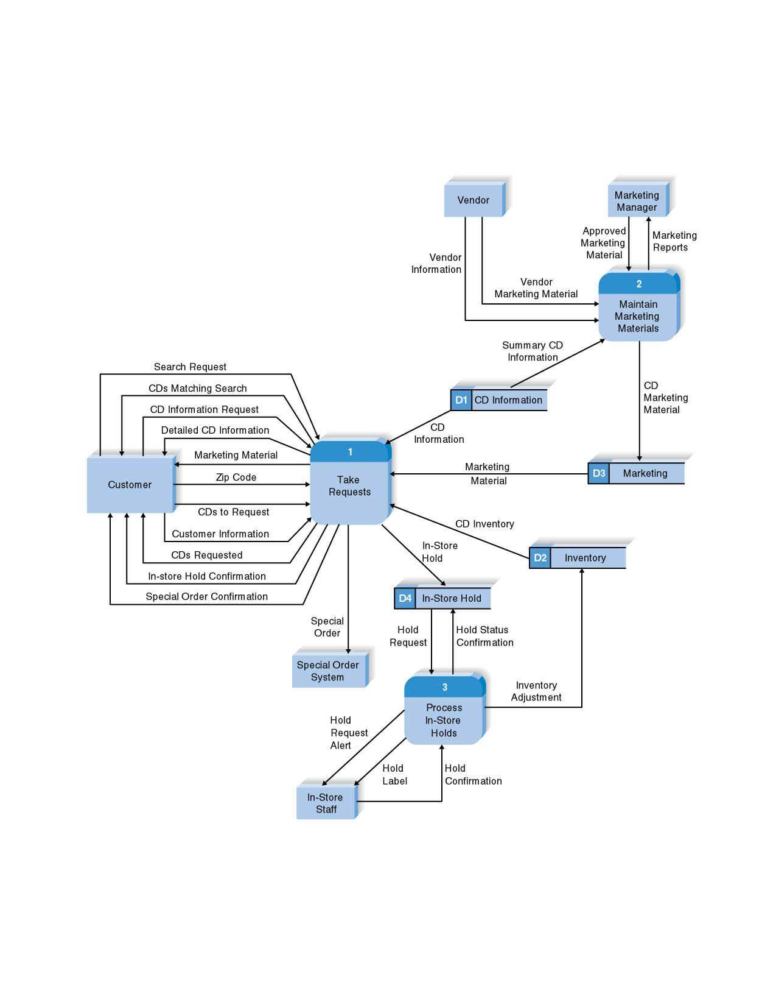
Level 0 DFD for CD Selections Internet System

Slide 39
Level 1 DFD for CD Selections Process 1: Take Requests

Slide 40
Summary
The Data Flow Diagram (DFD) is an essential tool for creating formal descriptions of business processes.
Use cases record the input, transformation, and output of business processes and are the basis for process models.
Eliciting use cases and modeling business processes are critically important skills for the systems analyst to master.

Slide 41
Copyright © 2009 John Wiley & Sons, Inc.
All rights reserved. Reproduction or translation of this work beyond that permitted in Section 117 of the 1976 United States Copyright Act without the express written permission of the copyright owner is unlawful.
Request for further information should be addressed to the Permissions Department, John Wiley & Sons, Inc.
The purchaser may make back-up copies for his/her own use only and not for redistribution or resale.
The Publisher assumes no responsibility for errors, omissions, or damages, caused by the use of these programs or from the use of the information contained herein.

