Slide 1
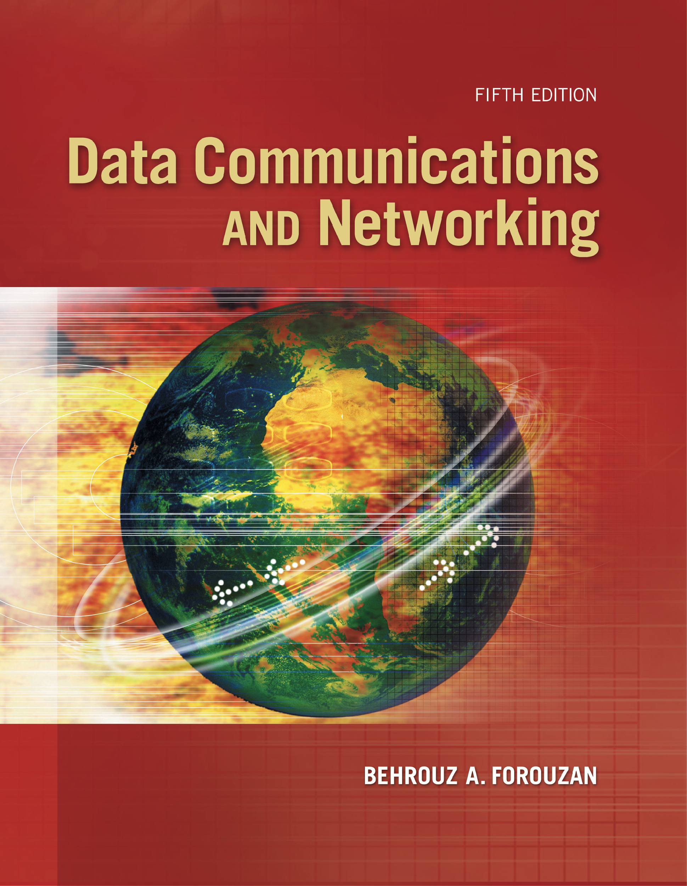
Chapter 1
Introduction
Copyright © The McGraw-Hill Companies, Inc. Permission required for reproduction or display.

Slide 2
Chapter 1: Outline
1.1 Data Communications
1.2 Networks
1.3 Network Types
1.4 Internet History
1.5 Standards and Administration

Slide 3

Chapter 1: Objective
The first section introduces data communications and defines their components and the types of data exchanged. It also shows how different types of data are represented and how data is flowed through the network.
The second section introduces networks and defines their criteria and structures. It introduces four different network topologies.
The third section discusses different types of networks: LANs, WANs, and internetworks (internets). It also introduces the Internet, the largest internet in the world. The concept of switching is also introduced in this section to show how small networks can be combined to create larger ones.

Slide 4
Chapter 1: Objective (continued)
The fourth section covers a brief history of the Internet: early history, the birth of the Internet, and the issues related to the Internet today.
The fifth section covers Internet standards and organizations.

Slide 5
    1-1 DATA COMMUNICATIONS
When we communicate, we are sharing information. This sharing can be local or remote.
The term Data refers to the information.
Telecommunication means communication at a distance. It includes telephony, telegraph, and television,
Data communications are the exchange of data between two devices via some form of transmission media, such as a wire cable.
1.5

Slide 6
    1-1 DATA COMMUNICATIONS
The effectiveness of a data communications system depends on four characteristics:
Delivery: The system must deliver data to the correct destination.
Accuracy: The system must deliver the data accurately (not altered).
Timeliness: The system must deliver data in a timely manner (not late).
Jitter: variation in the delay of received packets. Because of network congestion or improper queuing, the delay between packets can vary instead of remaining constant.
1.6
Notes:
Real-time transmission Real-time transmission are used in delivering video and audio. means delivering data as they are produced, in the same order that they are produced, and without significant delay.
Jitter: The sending side transmits packets in a continuous stream and spaces them evenly apart. Because of network congestion, improper queuing, or configuration errors, the delay between packets can vary instead of remaining constant, as shown in the figure. This variation causes problems for audio playback at the receiving end. Playback may experience gaps while waiting for the arrival of variable delayed packets.
This variation causes problems for audio playback at the receiving end. Playback may experience gaps while waiting for the arrival of variable delayed packets.

Slide 7
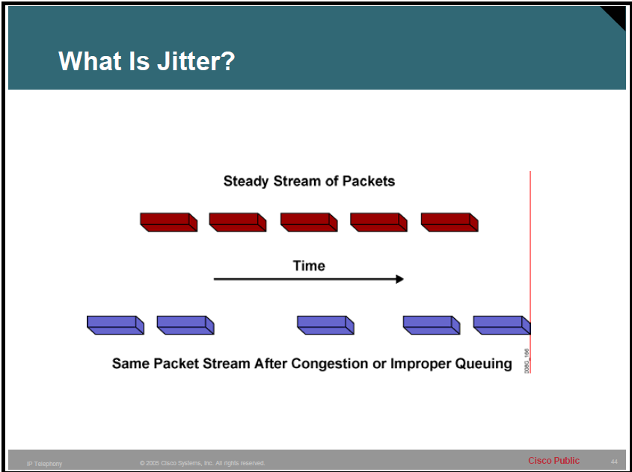
Jitter is the variation in the delay of received packets

Slide 8
    1-1 DATA COMMUNICATIONS
Real-time transmission:
Used in delivering video and audio.
it means delivering data as they are produced, in the same order that they are produced, and without significant delay.
1.8
Notes:
Jitter: The sending side transmits packets in a continuous stream and spaces them evenly apart. Because of network congestion, improper queuing, or configuration errors, the delay between packets can vary instead of remaining constant, as shown in the figure. This variation causes problems for audio playback at the receiving end. Playback may experience gaps while waiting for the arrival of variable delayed packets.
This variation causes problems for audio playback at the receiving end. Playback may experience gaps while waiting for the arrival of variable delayed packets.

Slide 9
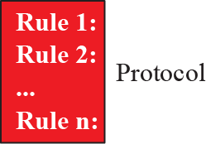
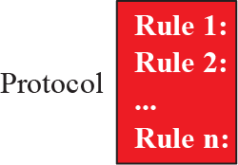
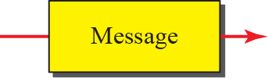


1.1.1 Components
A data communications system has five components (see Figure 1.1).
Figure 1.1: Five components of data communication
1.9
Notes:
A protocol is a set of rules that govern data communications. It represents
an agreement between the communicating devices. Without a protocol, two
devices may be connected but not communicating, just as a person speaking French
cannot be understood by a person who speaks only Japanese.

Slide 10
1.1.2 Data Representation
Information today comes in different forms such as:
Text: represented as sets of bits (0s or 1s) (Unicode).
Numbers: also represented by sets of bits . (The number is directly converted to a binary number).
Images: also represented by sets of bits. In its simplest form, an image is composed of a matrix of pixels, where each pixel is a small dot. Each pixel is assigned a bit pattern. The size and the value of the pattern depend on the image (black/white or Gray scale) colored images are represented by RGB or YCM (The intensity of each color is measured, and a bit pattern is assigned to it).
Audio &Video: represented by sampling rate (Chapter 26).
1.10
Notes:
Text: Such as Unicode system: uses up to 32 bits to represent a symbol or a Character, and it covers mostly all the languages letters.
For example, an image can be divided into 1000 pixels or 10,000 pixels. In the second case, there is a better representation of the image (better resolution), but more memory is needed to store the image.
For an image made of only black and white dots,1-bit pattern is enough to represent a pixel. If an image is not made of pure white and pure black pixels, we can increase the size of the bit pattern to include gray scale. For example, to show four levels of gray scale, we can use 2-bit patterns. A black pixel can be represented by 00, a dark gray pixel by 01, a light gray pixel by 10, and a white pixel by 11.

Slide 11
1.1.3 Data Flow
Communication between two devices can be:
Simplex: unidirectional (Keyboards, monitors).
Half-duplex: each station can both transmit and receive, but not at the same time. (Walkie-talkies). The entire capacity of a channel is taken over by the sending station.
Full-duplex: both stations can transmit and receive at the same time. (Telephone Network). The capacity of the link is shared. Either the link contain two physically separate transmission paths, or the capacity of the channel is divided
1.11

Slide 12
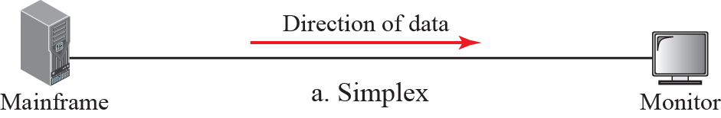
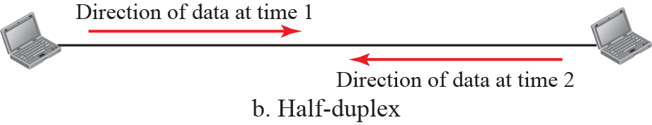
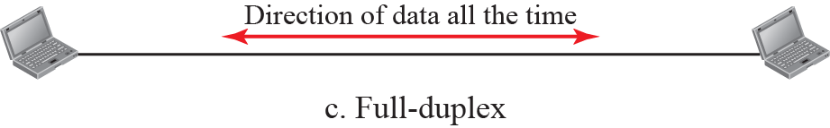
Figure 1.2: Data flow
1.12

Slide 13
    1-2 NETWORKS
A network is the interconnection of a set of devices capable of communication.
In this definition, a device can be:
A host: laptop, desktop, workstation, cellular phone, or security system.
A connecting device: router, switch, a
modem that changes the form of data.
These devices are connected using wired or wireless transmission media.
1.13

Slide 14
1.2.1 Network Criteria
A network must be able to meet a certain number of criteria. The most important of these are:
performance: measured by transit time or response time. evaluated by throughput and delay.
Reliability: measured by the frequency of failure, the time it takes a link to recover from a failure, and the network’s robustness in a catastrophe.
Security: protecting data from damage or unauthorized access, and implementing procedures for recovery from breaches and data losses.
1.14
Notes:
Transit time is the amount of time required for a message to travel from one device to
another. Response time is the elapsed time between an inquiry and a response.
throughput : is the amount of material or items passing through
We often need more throughput and less delay.

Slide 15
1.2.2 Physical Structures
Before discussing networks, we need to define some network attributes.
Type of Connection
There are two types of connections:
Point-to-Point
Multipoint.
1.15

Slide 16
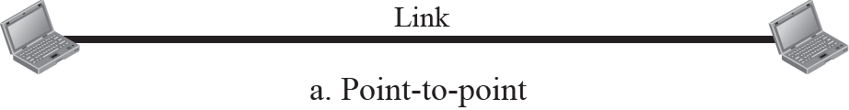
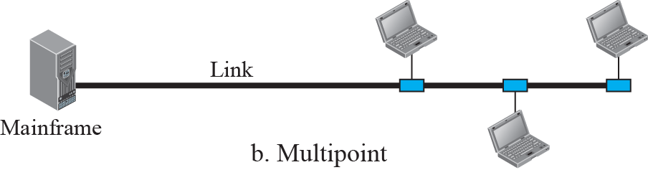
Figure 1.3: Types of connection
Point-to-Point: The entire capacity of the link is reserved for transmission between two devices.
(remote control and TV control system)
Multipoint: More than two devices share a single link.
Spatially shared: If several devices can use the link at the same time.
timeshared connection: if users must take turns,.
1.16
Notes:
When we change television channels by infrared remote control, we are establishing a point-to-point connection between the remote control and the television’s control system.

Slide 17
Physical Topology
There are four basic topologies possible:
Mesh.
Star.
Bus.
Ring.
1.17

Slide 18
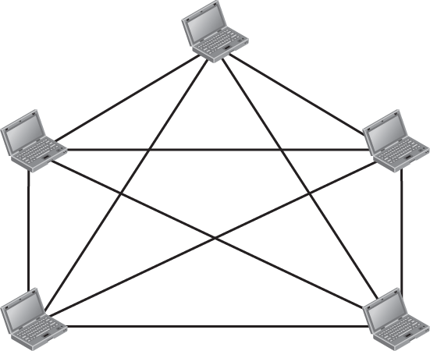


Figure 1.4: A fully-connected mesh topology
Every device has a dedicated point-to-point link to every other device
(the link carries traffic only between the two devices it connects)
1.18
Notes:
Node 1 must be connected to n – 1 nodes, node 2 must be connected to n – 1
nodes, and finally node n must be connected to n – 1 nodes. We need n (n – 1) physical
links. However, if each physical link allows communication in both directions (duplex
mode), we can divide the number of links by 2. In other words, we can say that in a mesh
topology, we need n (n – 1) / 2 duplex-mode links.

Slide 19
mesh advantages
dedicated links guarantees that each connection can carry its own data load (less traffic problems than shared link).
dedicated links guarantees security. When every message travels along a dedicated line, only the intended recipient sees it. Physical boundaries prevent other users from gaining access to messages.
If one link becomes unusable, it does not ruin the entire system.
point-to-point links make fault identification and fault isolation easy. Traffic can be routed to avoid links with suspected problems.
1.19
Notes:
Disadvantages: costly and take too much cable and work to install.

Slide 20
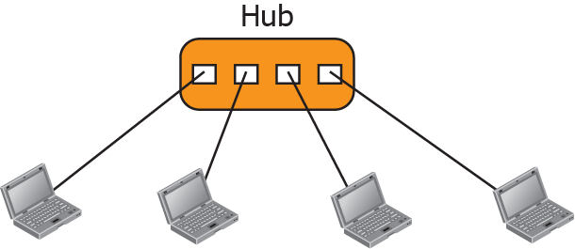
Figure 1.5: A star topology
Each device has a dedicated point-to-point link to a central controller, usually called a hub, used in local-area networks (LANs),
Advantages:
Less expensive than a mesh topology.
Easy to install
If one link fails, only that link is affected. All
easy fault identification as long as the hub is working.
Disadvantages :
If the hub goes down, the whole system is dead.
1.20
Notes:
The devices are not directly linked to one another. Unlike a
mesh topology, a star topology does not allow direct traffic between devices. The controller
acts as an exchange: If one device wants to send data to another, it sends the
data to the controller, which then relays the data to the other connected device.

Slide 21
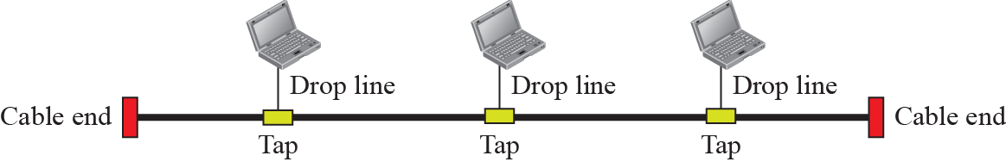
Figure 1.6: A bus topology
multipoint. One long cable acts as a backbone to link all the devices in a network
A drop line is a connection between the device and the main cable.
A tap is a connector that either splices into the main cable or punctures the sheathing of a cable to create a contact with the metallic core.
There is a limit on the number of taps a bus can support and on the distance between those taps. . Why?
Advantages :
Easy to install. Less cables than star and mesh.
Disadvantages :
difficult reconnection and fault isolation.
1.21
Notes:
As a signal travels along the backbone, some of its energy is transformed into heat. Therefore, it becomes weaker and weaker as it travels farther and farther.
In a bus, this redundancy is eliminated. Only the backbone cable
stretches through the entire facility. Each drop line has to reach only as far as the nearest
point on the backbone.

Slide 22
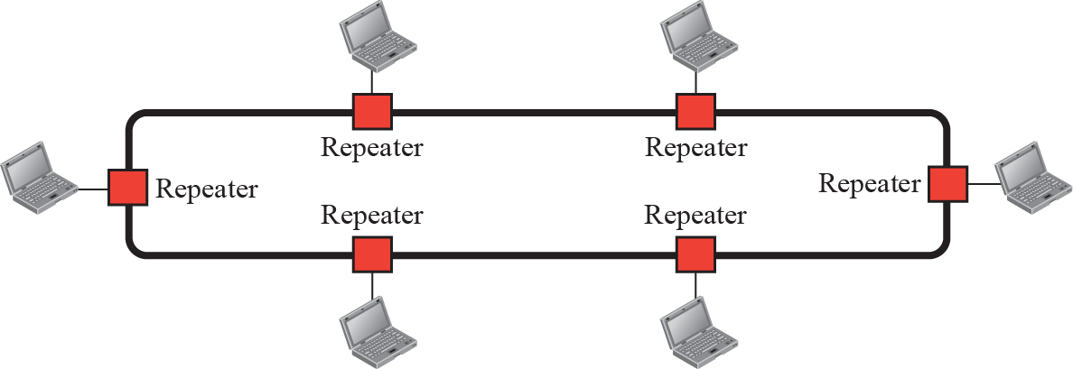
Figure 1.7: A ring topology
Each device is linked to only its immediate neighbors
Advantages:
easy to install. To add or delete a device requires changing only two connections.
fault isolation is simple. HOW?
Disadvantages:
a break in the ring can disable the entire network.
1.22
Notes:
a signal is circulating at all times. If one device does not receive a signal it can issue an alarm. The alarm alerts the network operator to the problem and its location.

Slide 23
    1-3 NETWORKS TYPES
There are different types of networks we encounter in the world today.
The criteria of distinguishing one type of network from another is difficult and sometimes confusing.
We use a few criteria to make a distinction such as:
Size.
Geographical coverage.
Ownership.
1.23

Slide 24
1.3.1 Local Area Network
A local area network (LAN) is usually:
privately owned.
connects some hosts in a single office, building, or campus. Depending on the needs of an organization, a LAN can be as simple as two PCs and a printer in someone’s home office, or it can extend throughout a company and include audio and video devices.
Each host in a LAN has an identifier, an address, that uniquely defines the host in the LAN.
A packet sent by a host to another host carries both the source host’s and the destination host’s addresses.
1.24

Slide 25
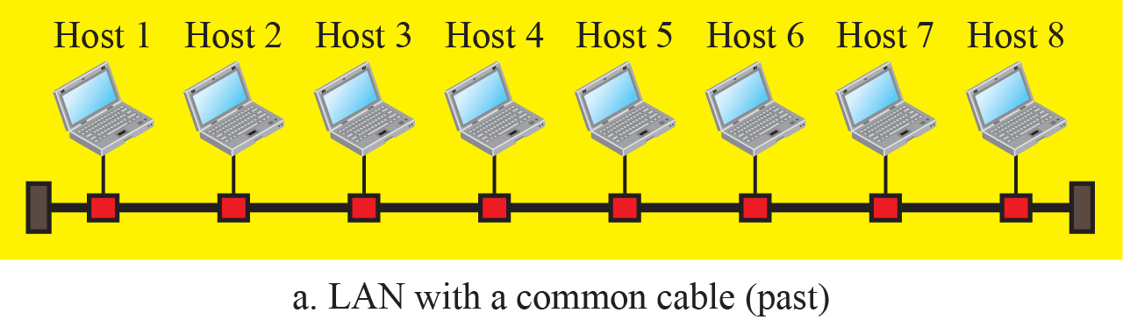
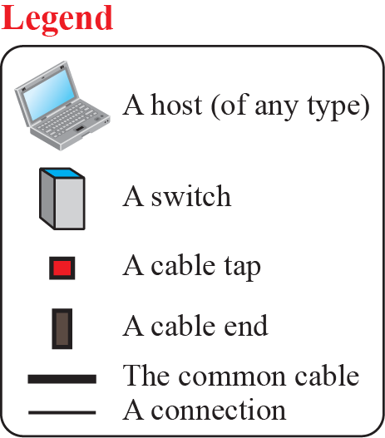
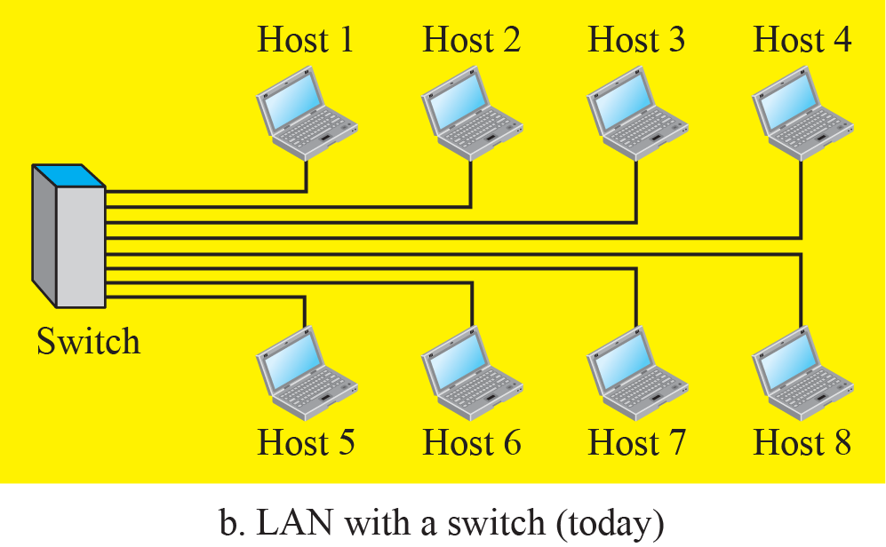
Figure 1.8: An Isolated LAN in the past and today
all hosts in a network were connected through a common cable. A packet sent from one host to another was received by all hosts. The intended
recipient kept the packet; the others dropped the packet.
use a smart connecting switch, able to recognize the destination address of the packet and guide the packet to its destination without sending it to all other hosts.
1.25

Slide 26
1.3.2 Wide Area Network
A wide area network (WAN) is also a connection of devices capable of communication.
However, there are some differences between a LAN and a WAN:
LAN is normally limited in size; a WAN has a wider geographical span, spanning a town, a state, a country, or even the world.
LAN interconnects hosts; a WAN interconnects connecting devices such as switches, routers, or modems.
LAN is normally privately owned by the organization that uses it; a WAN is normally created and run by communication companies and leased by an organization that uses it.
1.26

Slide 27
1.3.2 Wide Area Network
A wide area network (WAN) is also a connection of devices capable of communication.
We see two distinct examples of WANs today:
point-to-point WANs
switched WANs.
1.27

Slide 28
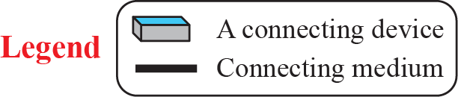
Figure 1.9: A Point-to-Point WAN
a network that connects two communicating devices through a transmission media (cable or air).
1.28

Slide 29
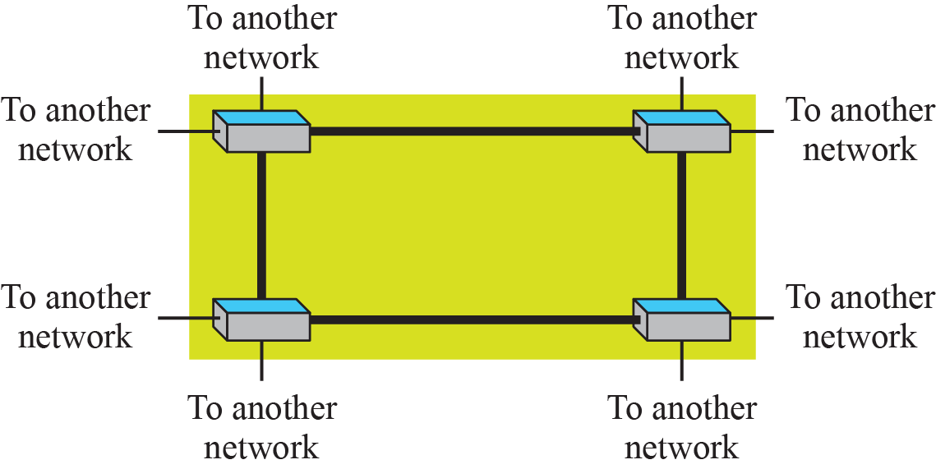
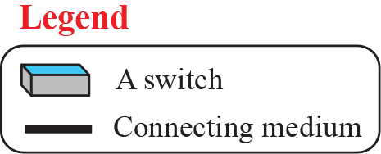
Figure 1.10: A Switched WAN
A switched WAN is a network with more than two ends.
is a combination of several point-to-point WANs that are connected by switches.
A switched WAN is used in the backbone of global communication today
1.29

Slide 30
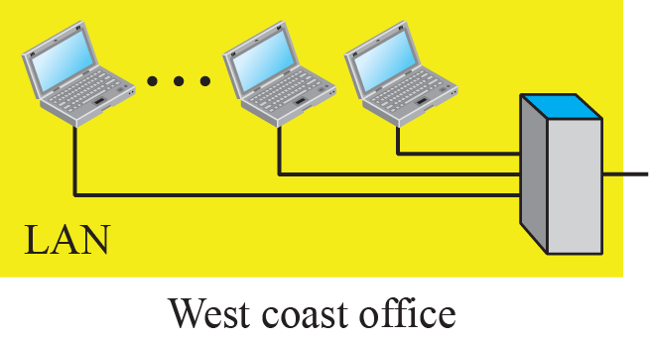
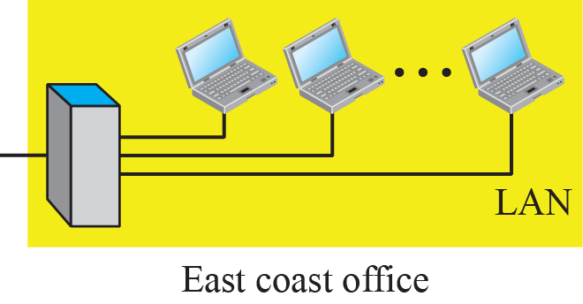
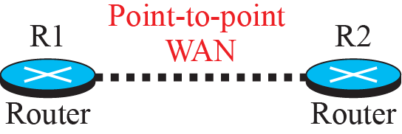
Figure 1.11: An internetwork made of two LANs and one WAN
When two or more networks are connected, they make an internetwork, or internet.
1.30

Slide 31

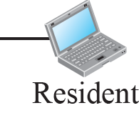
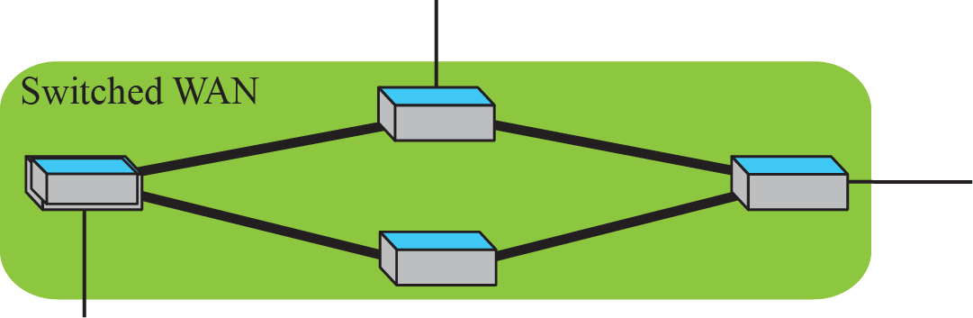
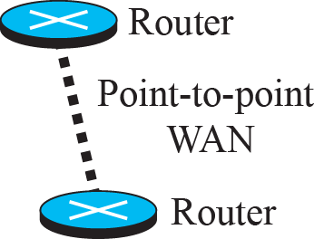
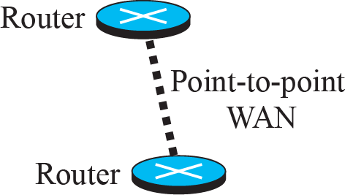
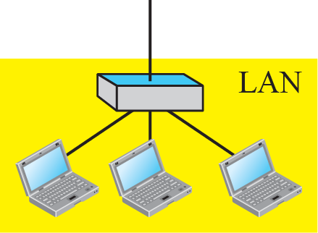
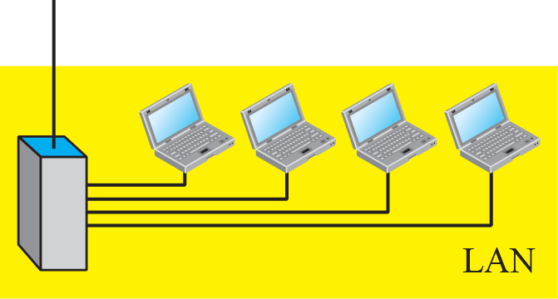
Figure 1.12: A heterogeneous network made of WANs and LANs
1.31

Slide 32
1.3.3 Switching
An internet is a switched network in which a switch connects at least two links together. A switch needs to forward data from a network to another network when required. The two most common types of switched networks are circuit-switched and packet-switched networks. We discuss both next.
1.32

Slide 33

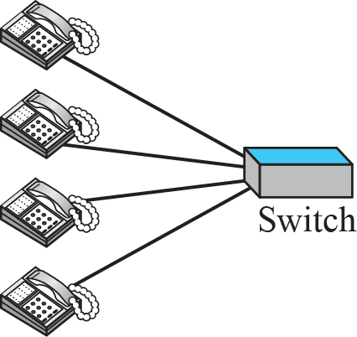
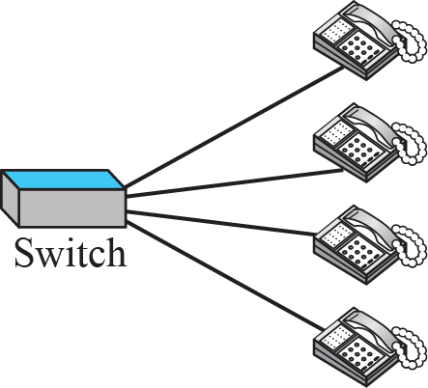
Figure 1.13: A circuit-switched network
1.33

Slide 34

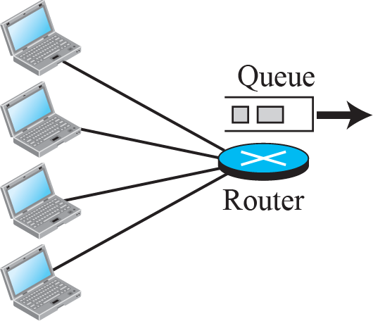
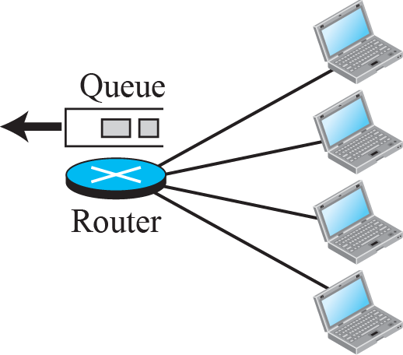
Figure 1.14: A packet-switched network
1.34

Slide 35
1.3.4 The Internet
As we discussed before, an internet (note the lowercase i) is two or more networks that can communicate with each other. The most notable internet is called the Internet (uppercase I ), and is composed of thousands of interconnected networks. Figure 1.15 shows a conceptual (not geographical) view of the Internet.
1.35

Slide 36
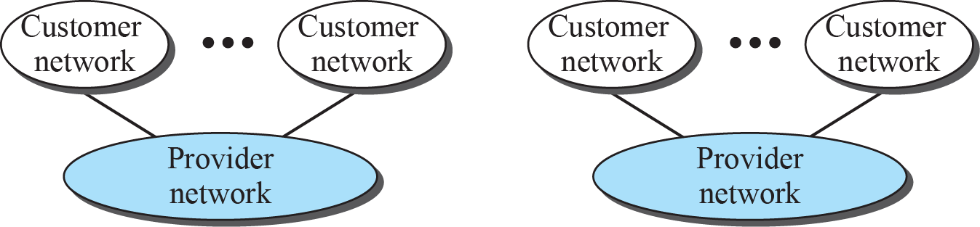
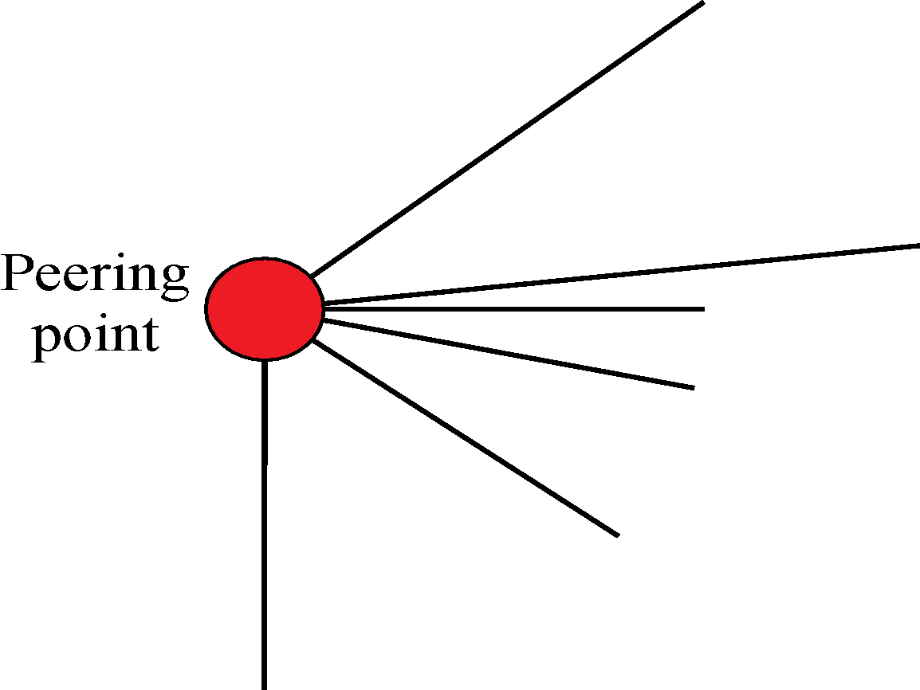

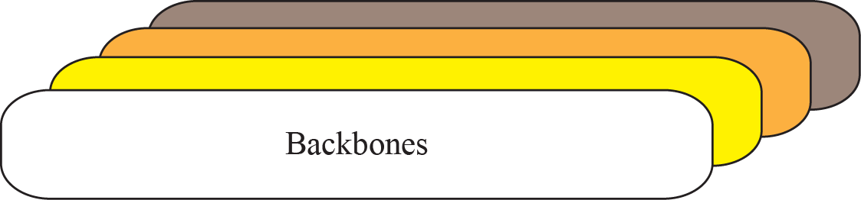
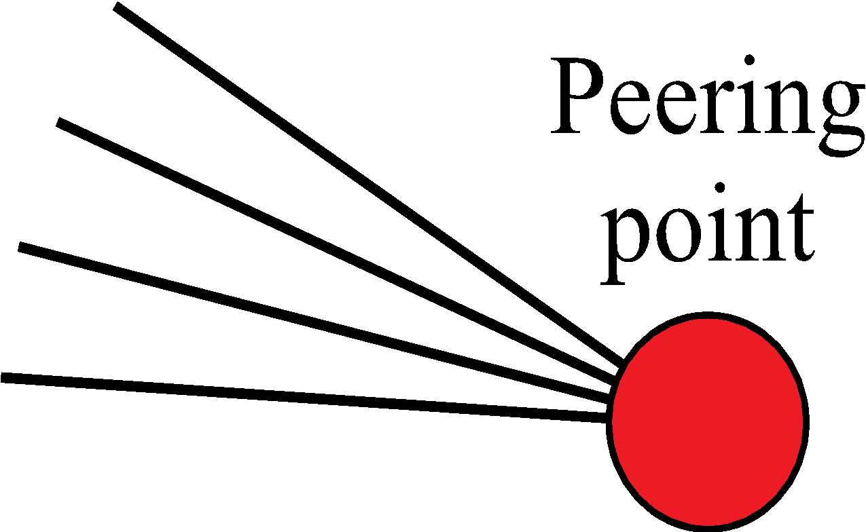

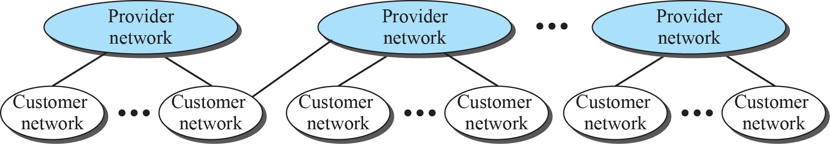
Figure 1.15: The Internet today
1.36

Slide 37
1.3.5 Accessing the Internet
The Internet today is an internetwork that allows any user to become part of it. The user, however, needs to be physically connected to an ISP. The physical connection is normally done through a point-to-point WAN. In this section, we briefly describe how this can happen, but we postpone the technical details of the connection until Chapters 14 and 16.
1.37

Slide 38
    1-4 INTERNET HISTORY
Now that we have given an overview of the Internet and its protocol, let us give a brief history of the Internet. This brief history makes it clear how the Internet has evolved from a private network to a global one in less than forty years.
1.38

Slide 39
1.4.1 Early History
There were some communication networks, such as telegraph and telephone networks, before 1960. These networks were suitable for constant-rate communication at that time, which means that after a connection was made between two users, the encoded message (telegraphy) or voice (telephony) could be exchanged. A computer network, on the other hand, should be able to handle bursty data, which means data received at variable rates at different times. The world needed to wait for the packet-switched network to be invented.
1.39

Slide 40
1.4.2 Birth of the Internet
In 1972, Vint Cerf and Bob Kahn, both of whom were part of the core ARPANET group, collaborated on what they called the Internetting Project. They wanted to link dissimilar networks so that a host on one network could communicate with a host on another. There were many problems to overcome: diverse packet sizes, diverse interfaces, and diverse transmission rates, as well as differing reliability requirements. Cerf and Kahn devised the idea of a device called a gateway to serve as the intermediary hardware to transfer data from one network to another.
1.40

Slide 41
1.4.3 Internet Today
Today, we witness a rapid growth both in the infrastructure and new applications. The Internet today is a set of pier networks that provide services to the whole world. What has made the Internet so popular is the invention of new applications.
1.41

Slide 42
    1-5 STANDARDS AND ADMINISTRATION
In the discussion of the Internet and its protocol, we often see a reference to a standard or an administration entity. In this section, we introduce these standards and administration entities for those readers that are not familiar with them; the section can be skipped if the reader is familiar with them.
1.42

Slide 43
1.5.1 Internet Standards
An Internet standard is a thoroughly tested specification that is useful to and adhered to by those who work with the Internet. It is a formalized regulation that must be followed. There is a strict procedure by which a specification attains Internet standard status. A specification begins as an Internet draft. An Internet draft is a working document (a work in progress) with no official status and a six-month lifetime.
1.43

Slide 44
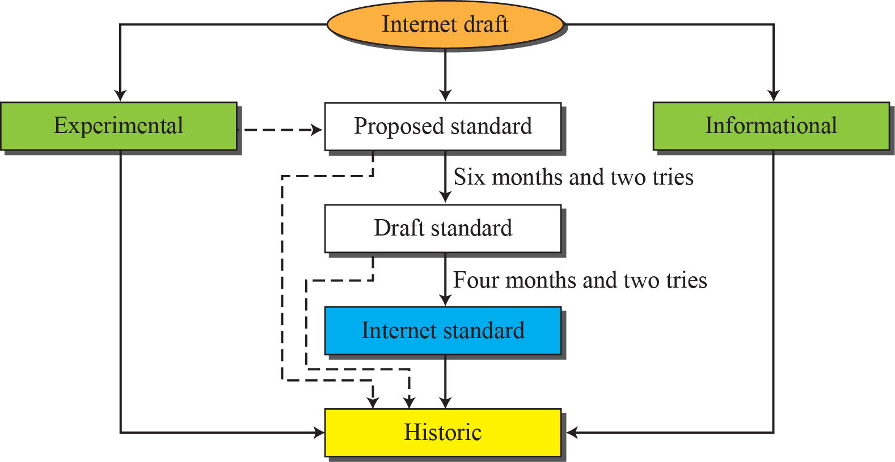
Figure 1.16: Maturity levels of an RFC
1.44

Slide 45
1.5.2 Internet Administration
The Internet, with its roots primarily in the research domain, has evolved and gained a broader user base with significant commercial activity. Various groups that coordinate Internet issues have guided this growth and development. Appendix G gives the addresses, e-mail addresses, and telephone numbers for some of these groups. Figure 1.17 shows the general organization of Internet administration.
1.45

Slide 46
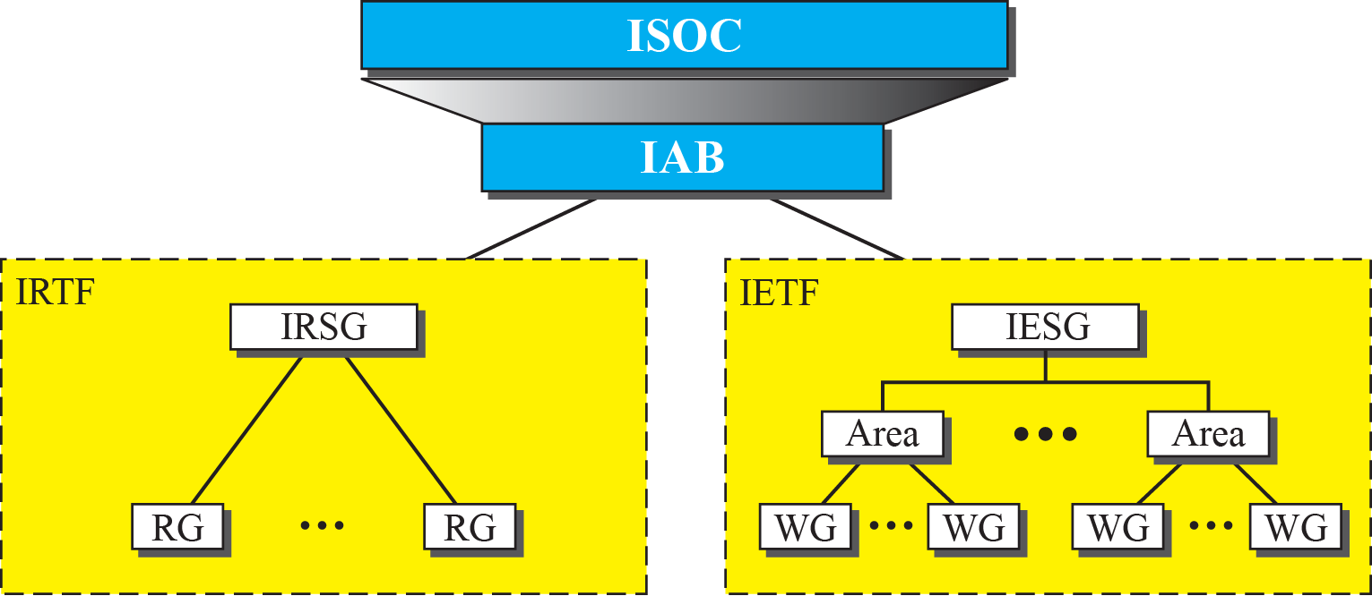
Figure 1.17: Internet administration
1.46

