Slide 1
Chapter 6
Human Aspects of Software Engineering
Slide Set to accompany Software Engineering: A Practitioner’s Approach, 8/e
by Roger S. Pressman and Bruce R. Maxim
Slides copyright © 1996, 2001, 2005, 2009, 2014 by Roger S. Pressman
For non-profit educational use only
May be reproduced ONLY for student use at the university level when used in conjunction with Software Engineering: A Practitioner's Approach, 8/e. Any other reproduction or use is prohibited without the express written permission of the author.
All copyright information MUST appear if these slides are posted on a website for student use.
These slides are designed to accompany Software Engineering: A Practitioner’s Approach, 8/e (McGraw-Hill, 2014) Slides copyright 2014 by Roger Pressman.
‹#›

Slide 2
Traits of Successful Software Engineers
Sense of individual responsibility
Acutely aware of the needs of team members and stakeholders
Brutally honest about design flaws and offers constructive criticism
Resilient under pressure
Heightened sense of fairness
Attention to detail
Pragmatic
These slides are designed to accompany Software Engineering: A Practitioner’s Approach, 8/e (McGraw-Hill, 2014) Slides copyright 2014 by Roger Pressman.
‹#›

Slide 3
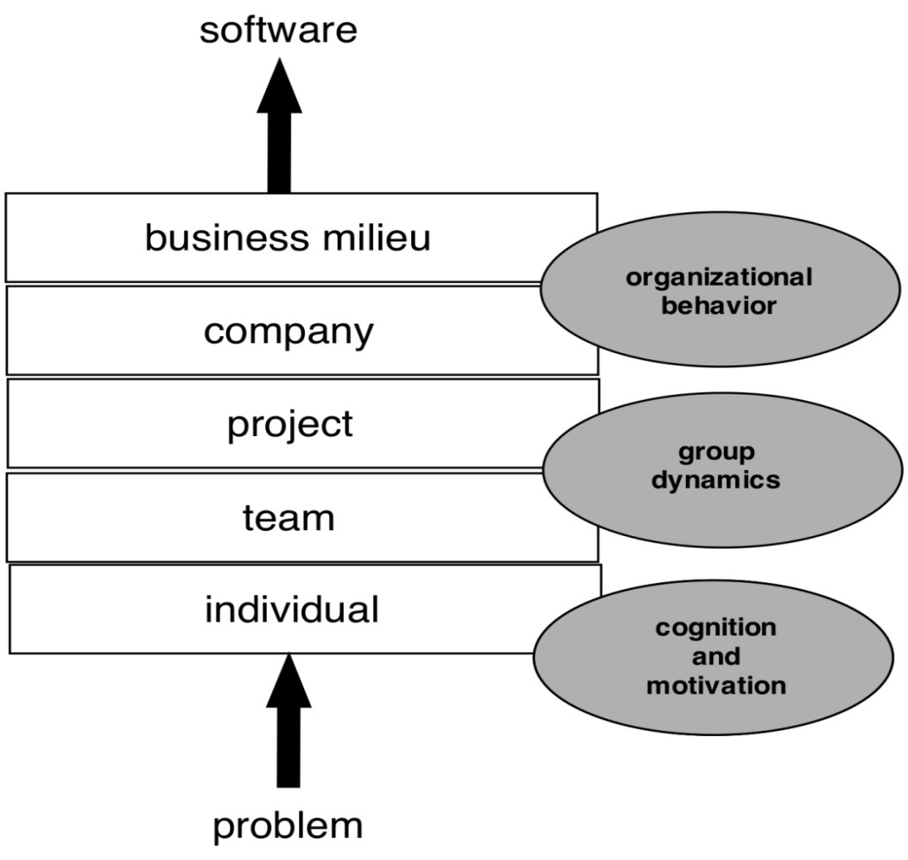
Behavioral Model for Software Engineering
These slides are designed to accompany Software Engineering: A Practitioner’s Approach, 8/e (McGraw-Hill, 2014) Slides copyright 2014 by Roger Pressman.
‹#›

Slide 4
Boundary Spanning Team Roles
Ambassador – represents team to outside constituencies
Scout – crosses team boundaries to collect information
Guard – protects access to team work products
Sentry – controls information sent by stakeholders
Coordinator – communicates across the team and organization
These slides are designed to accompany Software Engineering: A Practitioner’s Approach, 8/e (McGraw-Hill, 2014) Slides copyright 2014 by Roger Pressman.
‹#›

Slide 5
Effective Software Team Attributes
Sense of purpose
Sense of involvement
Sense of trust
Sense of improvement
Diversity of team member skill sets
These slides are designed to accompany Software Engineering: A Practitioner’s Approach, 8/e (McGraw-Hill, 2014) Slides copyright 2014 by Roger Pressman.
‹#›

Slide 6
Avoid Team “Toxicity”
A frenzied work atmosphere in which team members waste energy and lose focus on the objectives of the work to be performed.
High frustration caused by personal, business, or technological factors that cause friction among team members.
“Fragmented or poorly coordinated procedures” or a poorly defined or improperly chosen process model that becomes a roadblock to accomplishment.
Unclear definition of roles resulting in a lack of accountability and resultant finger-pointing.
“Continuous and repeated exposure to failure” that leads to a loss of confidence and a lowering of morale.
These slides are designed to accompany Software Engineering: A Practitioner’s Approach, 8/e (McGraw-Hill, 2014) Slides copyright 2014 by Roger Pressman.
‹#›

Slide 7
Factors Affecting Team Structure
The following factors must be considered when selecting a software project team structure ...
the difficulty of the problem to be solved
the size of the resultant program(s) in lines of code or function points
the time that the team will stay together (team lifetime)
the degree to which the problem can be modularized
the required quality and reliability of the system to be built
the rigidity of the delivery date
the degree of sociability (communication) required for the project
These slides are designed to accompany Software Engineering: A Practitioner’s Approach, 8/e (McGraw-Hill, 2014) Slides copyright 2014 by Roger Pressman.
‹#›

Slide 8
Organizational Paradigms
closed paradigm—structures a team along a traditional hierarchy of authority
random paradigm—structures a team loosely and depends on individual initiative of the team members
open paradigm—attempts to structure a team in a manner that achieves some of the controls associated with the closed paradigm but also much of the innovation that occurs when using the random paradigm
synchronous paradigm—relies on the natural compartmentalization of a problem and organizes team members to work on pieces of the problem with little active communication among themselves
suggested by Constantine [Con93]
These slides are designed to accompany Software Engineering: A Practitioner’s Approach, 8/e (McGraw-Hill, 2014) Slides copyright 2014 by Roger Pressman.
‹#›

Slide 9
Generic Agile Teams
Stress individual competency coupled with group collaboration as critical success factors
People trump process and politics can trump people
Agile teams as self-organizing and have many structures
An adaptive team structure
Uses elements of Constantine’s random, open, and synchronous structures
Significant autonomy
Planning is kept to a minimum and constrained only by business requirements and organizational standards
These slides are designed to accompany Software Engineering: A Practitioner’s Approach, 8/e (McGraw-Hill, 2014) Slides copyright 2014 by Roger Pressman.
‹#›

Slide 10
XP Team Values
Communication – close informal verbal communication among team members and stakeholders and establishing meaning for metaphors as part of continuous feedback
Simplicity – design for immediate needs nor future needs
Feedback – derives from the implemented software, the customer, and other team members
Courage – the discipline to resist pressure to design for unspecified future requirements
Respect – among team members and stakeholders
These slides are designed to accompany Software Engineering: A Practitioner’s Approach, 8/e (McGraw-Hill, 2014) Slides copyright 2014 by Roger Pressman.
‹#›

Slide 11
Impact of Social Media
Blogs – can be used share information with team members and customers
Microblogs (e.g. Twitter) – allow posting of real-time messages to individuals following the poster
Targeted on-line forums – allow participants to post questions or opinions and collect answers
Social networking sites (e.g. Facebook, LinkedIn) – allows connections among software developers for the purpose of sharing information
Social book marking (e.g. Delicious, Stumble, CiteULike) – allow developers to keep track of and share web-based resources
These slides are designed to accompany Software Engineering: A Practitioner’s Approach, 8/e (McGraw-Hill, 2014) Slides copyright 2014 by Roger Pressman.
‹#›

Slide 12
Software Engineering using the Cloud
Benefits
Provides access to all software engineering work products
Removes device dependencies and available every where
Provides avenues for distributing and testing software
Allows software engineering information developed by one member to be available to all team members
Concerns
Dispersing cloud services outside the control of the software team may present reliability and security risks
Potential for interoperability problems becomes high with large number of services distributed on the cloud
Cloud services stress usability and performance which often conflicts with security, privacy, and reliability
These slides are designed to accompany Software Engineering: A Practitioner’s Approach, 8/e (McGraw-Hill, 2014) Slides copyright 2014 by Roger Pressman.
‹#›

Slide 13
Collaboration Tools
Namespace that allows secure, private storage or work products
Calendar for coordinating project events
Templates that allow team members to create artifacts that have common look and feel
Metrics support to allow quantitative assessment of each team member’s contributions
Communication analysis to track messages and isolates patterns that may imply issues to resolve
Artifact clustering showing work product dependencies
These slides are designed to accompany Software Engineering: A Practitioner’s Approach, 8/e (McGraw-Hill, 2014) Slides copyright 2014 by Roger Pressman.
‹#›

Slide 14
Team Decisions Making Complications
Problem complexity
Uncertainty and risk associated with the decision
Work associated with decision has unintended effect on another project object (law of unintended consequences)
Different views of the problem lead to different conclusions about the way forward
Global software teams face additional challenges associated with collaboration, coordination, and coordination difficulties
These slides are designed to accompany Software Engineering: A Practitioner’s Approach, 8/e (McGraw-Hill, 2014) Slides copyright 2014 by Roger Pressman.
‹#›

Slide 15
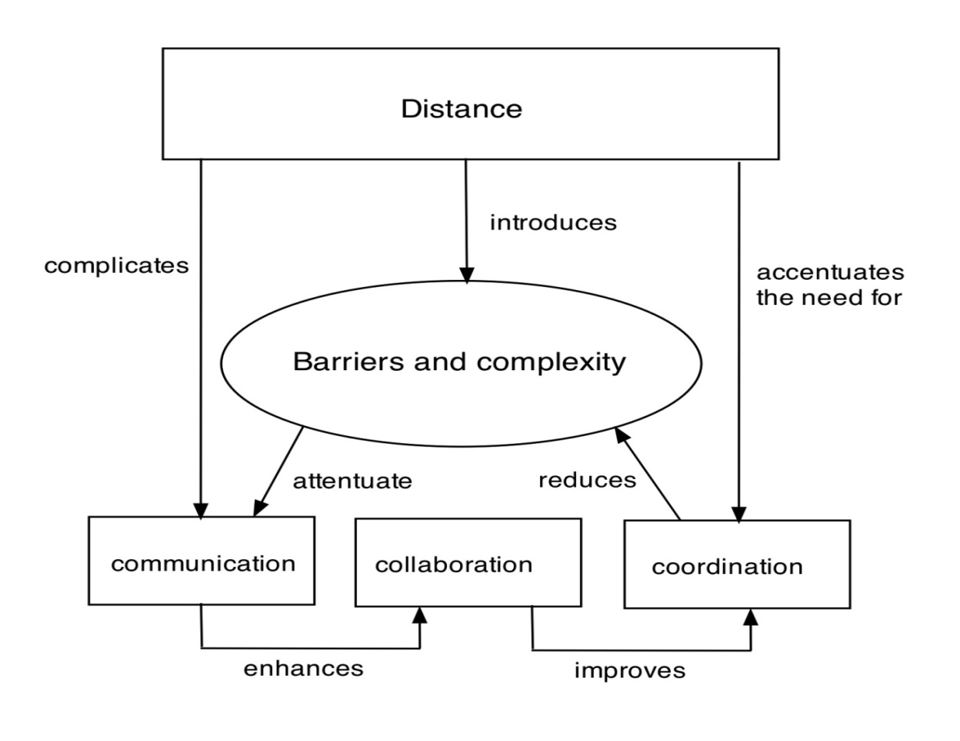
Factors Affecting Global Software Development Team
These slides are designed to accompany Software Engineering: A Practitioner’s Approach, 8/e (McGraw-Hill, 2014) Slides copyright 2014 by Roger Pressman.
‹#›

