Slide 1
Chapter 12
Design Concepts
Slide Set to accompany Software Engineering: A Practitioner’s Approach, 8/e
by Roger S. Pressman and Bruce R. Maxim
Slides copyright © 1996, 2001, 2005, 2009, 2014 by Roger S. Pressman
For non-profit educational use only
May be reproduced ONLY for student use at the university level when used in conjunction with Software Engineering: A Practitioner's Approach, 8/e. Any other reproduction or use is prohibited without the express written permission of the author.
All copyright information MUST appear if these slides are posted on a website for student use.
These slides are designed to accompany Software Engineering: A Practitioner’s Approach, 8/e (McGraw-Hill, 2014) Slides copyright 2014 by Roger Pressman.
‹#›

Slide 2
Design
Mitch Kapor, the creator of Lotus 1-2-3, presented a “software design manifesto” in Dr. Dobbs Journal. He said:
Good software design should exhibit:
Firmness: A program should not have any bugs that inhibit its function.
Commodity: A program should be suitable for the purposes for which it was intended.
Delight: The experience of using the program should be pleasurable one.
These slides are designed to accompany Software Engineering: A Practitioner’s Approach, 8/e (McGraw-Hill, 2014) Slides copyright 2014 by Roger Pressman.
‹#›

Slide 3
Software Design
Encompasses the set of principles, concepts, and practices that lead to the development of a high quality system or product
Design principles establish and overriding philosophy that guides the designer as the work is performed
Design concepts must be understood before the mechanics of design practice are applied
Software design practices change continuously as new methods, better analysis, and broader understanding evolve
.
These slides are designed to accompany Software Engineering: A Practitioner’s Approach, 8/e (McGraw-Hill, 2014) Slides copyright 2014 by Roger Pressman.
‹#›

Slide 4
Software Engineering Design
Data/Class design – transforms analysis classes into implementation classes and data structures
Architectural design – defines relationships among the major software structural elements
Interface design – defines how software elements, hardware elements, and end-users communicate
Component-level design – transforms structural elements into procedural descriptions of software components
These slides are designed to accompany Software Engineering: A Practitioner’s Approach, 8/e (McGraw-Hill, 2014) Slides copyright 2014 by Roger Pressman.
‹#›

Slide 5
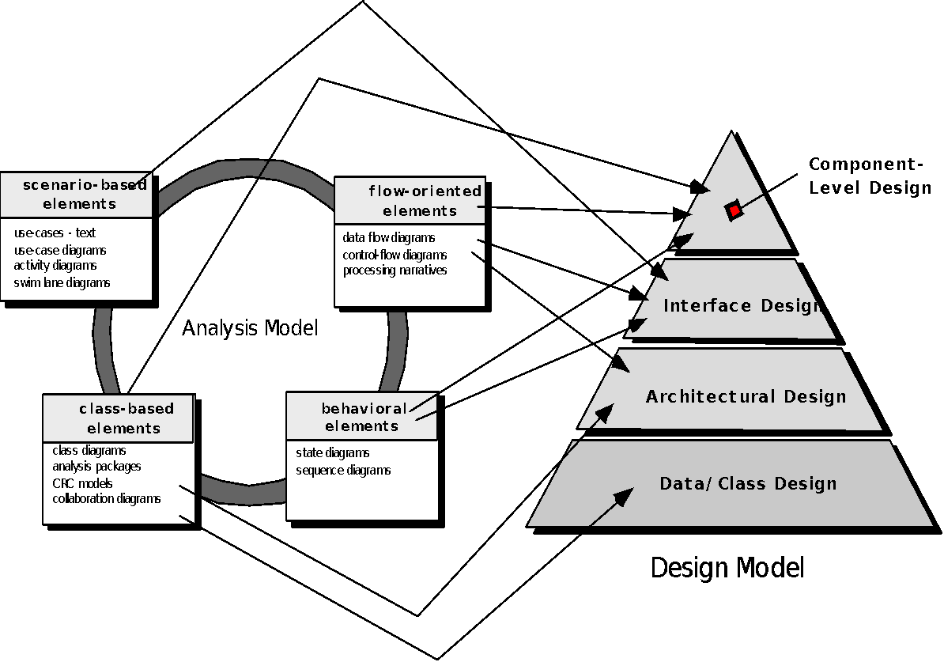
Analysis Model -> Design Model
These slides are designed to accompany Software Engineering: A Practitioner’s Approach, 8/e (McGraw-Hill, 2014) Slides copyright 2014 by Roger Pressman.
‹#›
Notes:
‹#›

Slide 6
Design and Quality
the design must implement all of the explicit requirements contained in the analysis model, and it must accommodate all of the implicit requirements desired by the customer.
the design must be a readable, understandable guide for those who generate code and for those who test and subsequently support the software.
the design should provide a complete picture of the software, addressing the data, functional, and behavioral domains from an implementation perspective.
These slides are designed to accompany Software Engineering: A Practitioner’s Approach, 8/e (McGraw-Hill, 2014) Slides copyright 2014 by Roger Pressman.
‹#›

Slide 7
Quality Guidelines
A design should exhibit an architecture that (1) has been created using recognizable architectural styles or patterns, (2) is composed of components that exhibit good design characteristics and (3) can be implemented in an evolutionary fashion
A design should be modular; that is, the software should be logically partitioned into elements or subsystems
A design should contain distinct representations of data, architecture, interfaces, and components.
A design should lead to data structures that are appropriate for the classes to be implemented and are drawn from recognizable data patterns.
A design should lead to components that exhibit independent functional characteristics.
A design should lead to interfaces that reduce the complexity of connections between components and with the external environment.
A design should be derived using a repeatable method that is driven by information obtained during software requirements analysis.
A design should be represented using a notation that effectively communicates its meaning.
These slides are designed to accompany Software Engineering: A Practitioner’s Approach, 8/e (McGraw-Hill, 2014) Slides copyright 2014 by Roger Pressman.
‹#›

Slide 8
Design Principles
The design process should not suffer from ‘tunnel vision.’
The design should be traceable to the analysis model.
The design should not reinvent the wheel.
The design should “minimize the intellectual distance” [DAV95] between the software and the problem as it exists in the real world.
The design should exhibit uniformity and integration.
The design should be structured to accommodate change.
The design should be structured to degrade gently, even when aberrant data, events, or operating conditions are encountered.
Design is not coding, coding is not design.
The design should be assessed for quality as it is being created, not after the fact.
The design should be reviewed to minimize conceptual (semantic) errors.
From Davis [DAV95]
These slides are designed to accompany Software Engineering: A Practitioner’s Approach, 8/e (McGraw-Hill, 2014) Slides copyright 2014 by Roger Pressman.
‹#›

Slide 9
Fundamental Concepts
Abstraction—data, procedure, control
Architecture—the overall structure of the software
Patterns—”conveys the essence” of a proven design solution
Separation of concerns—any complex problem can be more easily handled if it is subdivided into pieces
Modularity—compartmentalization of data and function
Hiding—controlled interfaces
Functional independence—single-minded function and low coupling
Refinement—elaboration of detail for all abstractions
Aspects—a mechanism for understanding how global requirements affect design
Refactoring—a reorganization technique that simplifies the design
OO design concepts—Appendix II
Design Classes—provide design detail that will enable analysis classes to be implemented
These slides are designed to accompany Software Engineering: A Practitioner’s Approach, 8/e (McGraw-Hill, 2014) Slides copyright 2014 by Roger Pressman.
‹#›

Slide 10
Data Abstraction
door
manufacturer
model number
type
swing direction
inserts
lights
type
number
weight
opening mechanism
implemented as a data structure
These slides are designed to accompany Software Engineering: A Practitioner’s Approach, 8/e (McGraw-Hill, 2014) Slides copyright 2014 by Roger Pressman.
‹#›

Slide 11
Procedural Abstraction
open
details of enter
algorithm
implemented with a "knowledge" of the
object that is associated with enter
These slides are designed to accompany Software Engineering: A Practitioner’s Approach, 8/e (McGraw-Hill, 2014) Slides copyright 2014 by Roger Pressman.
‹#›

Slide 12
Architecture
“The overall structure of the software and the ways in which that structure provides conceptual integrity for a system.” [SHA95a]
Structural properties. This aspect of the architectural design representation defines the components of a system (e.g., modules, objects, filters) and the manner in which those components are packaged and interact with one another. For example, objects are packaged to encapsulate both data and the processing that manipulates the data and interact via the invocation of methods
Extra-functional properties. The architectural design description should address how the design architecture achieves requirements for performance, capacity, reliability, security, adaptability, and other system characteristics.
Families of related systems. The architectural design should draw upon repeatable patterns that are commonly encountered in the design of families of similar systems. In essence, the design should have the ability to reuse architectural building blocks.
These slides are designed to accompany Software Engineering: A Practitioner’s Approach, 8/e (McGraw-Hill, 2014) Slides copyright 2014 by Roger Pressman.
‹#›

Slide 13
Patterns
Design Pattern Template
Pattern name—describes the essence of the pattern in a short but expressive name
Intent—describes the pattern and what it does
Also-known-as—lists any synonyms for the pattern
Motivation—provides an example of the problem
Applicability—notes specific design situations in which the pattern is applicable
Structure—describes the classes that are required to implement the pattern
Participants—describes the responsibilities of the classes that are required to implement the pattern
Collaborations—describes how the participants collaborate to carry out their responsibilities
Consequences—describes the “design forces” that affect the pattern and the potential trade-offs that must be considered when the pattern is implemented
Related patterns—cross-references related design patterns
These slides are designed to accompany Software Engineering: A Practitioner’s Approach, 8/e (McGraw-Hill, 2014) Slides copyright 2014 by Roger Pressman.
‹#›

Slide 14
Separation of Concerns
Any complex problem can be more easily handled if it is subdivided into pieces that can each be solved and/or optimized independently
A concern is a feature or behavior that is specified as part of the requirements model for the software
By separating concerns into smaller, and therefore more manageable pieces, a problem takes less effort and time to solve.
These slides are designed to accompany Software Engineering: A Practitioner’s Approach, 8/e (McGraw-Hill, 2014) Slides copyright 2014 by Roger Pressman.
‹#›

Slide 15
Modularity
"modularity is the single attribute of software that allows a program to be intellectually manageable" [Mye78].
Monolithic software (i.e., a large program composed of a single module) cannot be easily grasped by a software engineer.
The number of control paths, span of reference, number of variables, and overall complexity would make understanding close to impossible.
In almost all instances, you should break the design into many modules, hoping to make understanding easier and as a consequence, reduce the cost required to build the software.
These slides are designed to accompany Software Engineering: A Practitioner’s Approach, 8/e (McGraw-Hill, 2014) Slides copyright 2014 by Roger Pressman.
‹#›

Slide 16
Modularity: Trade-offs
What is the "right" number of modules
for a specific software design?
module development cost
cost of
software
module
integration
cost
optimal number
number of modules
of modules
These slides are designed to accompany Software Engineering: A Practitioner’s Approach, 8/e (McGraw-Hill, 2014) Slides copyright 2014 by Roger Pressman.
‹#›

Slide 17
Information Hiding
module
• algorithm
controlled
interface
• data structure
• details of external interface
• resource allocation policy
clients
"secret"
a specific design decision
These slides are designed to accompany Software Engineering: A Practitioner’s Approach, 8/e (McGraw-Hill, 2014) Slides copyright 2014 by Roger Pressman.
‹#›

Slide 18
Why Information Hiding?
reduces the likelihood of “side effects”
limits the global impact of local design decisions
emphasizes communication through controlled interfaces
discourages the use of global data
leads to encapsulation—an attribute of high quality design
results in higher quality software
These slides are designed to accompany Software Engineering: A Practitioner’s Approach, 8/e (McGraw-Hill, 2014) Slides copyright 2014 by Roger Pressman.
‹#›

Slide 19
Stepwise Refinement
open
walk to door;
reach for knob;
open door;
repeat until door opens
turn knob clockwise;
walk through;
if knob doesn't turn, then
close door.
take key out;
find correct key;
insert in lock;
endif
pull/push door
move out of way;
end repeat
These slides are designed to accompany Software Engineering: A Practitioner’s Approach, 8/e (McGraw-Hill, 2014) Slides copyright 2014 by Roger Pressman.
‹#›

Slide 20
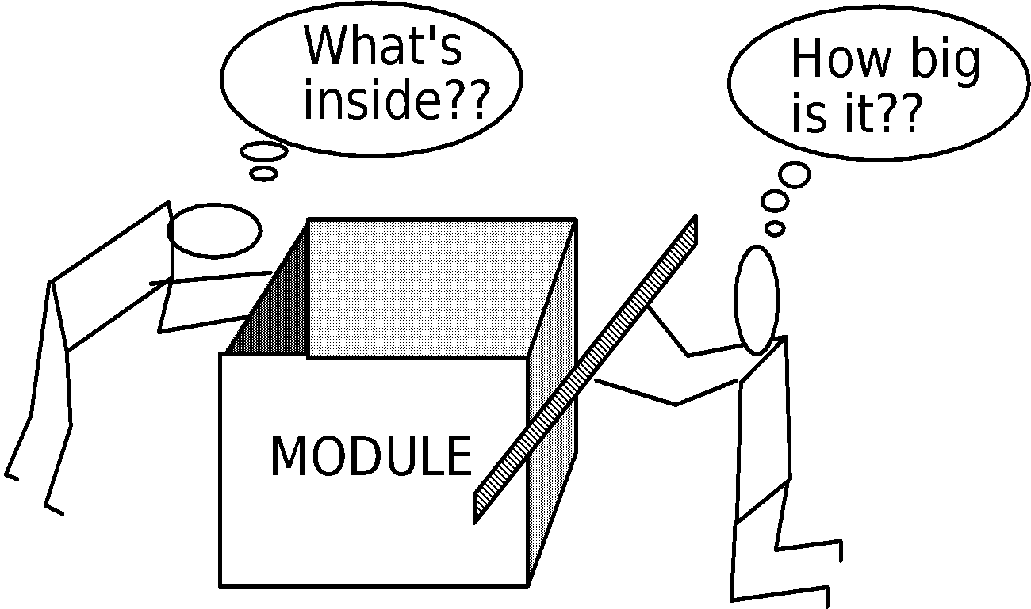
Sizing Modules: Two Views
These slides are designed to accompany Software Engineering: A Practitioner’s Approach, 8/e (McGraw-Hill, 2014) Slides copyright 2014 by Roger Pressman.
‹#›

Slide 21
Functional Independence
Functional independence is achieved by developing modules with "single-minded" function and an "aversion" to excessive interaction with other modules.
Cohesion is an indication of the relative functional strength of a module.
A cohesive module performs a single task, requiring little interaction with other components in other parts of a program. Stated simply, a cohesive module should (ideally) do just one thing.
Coupling is an indication of the relative interdependence among modules.
Coupling depends on the interface complexity between modules, the point at which entry or reference is made to a module, and what data pass across the interface.
These slides are designed to accompany Software Engineering: A Practitioner’s Approach, 8/e (McGraw-Hill, 2014) Slides copyright 2014 by Roger Pressman.
‹#›

Slide 22
Aspects
Consider two requirements, A and B. Requirement A crosscuts requirement B “if a software decomposition [refinement] has been chosen in which B cannot be satisfied without taking A into account. [Ros04]
An aspect is a representation of a cross-cutting concern.
These slides are designed to accompany Software Engineering: A Practitioner’s Approach, 8/e (McGraw-Hill, 2014) Slides copyright 2014 by Roger Pressman.
‹#›

Slide 23
Aspects—An Example
Consider two requirements for the SafeHomeAssured.com WebApp. Requirement A is described via the use-case Access camera surveillance via the Internet. A design refinement would focus on those modules that would enable a registered user to access video from cameras placed throughout a space. Requirement B is a generic security requirement that states that a registered user must be validated prior to using SafeHomeAssured.com. This requirement is applicable for all functions that are available to registered SafeHome users. As design refinement occurs, A* is a design representation for requirement A and B* is a design representation for requirement B. Therefore, A* and B* are representations of concerns, and B* cross-cuts A*.
An aspect is a representation of a cross-cutting concern. Therefore, the design representation, B*, of the requirement, a registered user must be validated prior to using SafeHomeAssured.com, is an aspect of the SafeHome WebApp.
These slides are designed to accompany Software Engineering: A Practitioner’s Approach, 8/e (McGraw-Hill, 2014) Slides copyright 2014 by Roger Pressman.
‹#›

Slide 24
Refactoring
Fowler [FOW99] defines refactoring in the following manner:
"Refactoring is the process of changing a software system in such a way that it does not alter the external behavior of the code [design] yet improves its internal structure.”
When software is refactored, the existing design is examined for
redundancy
unused design elements
inefficient or unnecessary algorithms
poorly constructed or inappropriate data structures
or any other design failure that can be corrected to yield a better design.
These slides are designed to accompany Software Engineering: A Practitioner’s Approach, 8/e (McGraw-Hill, 2014) Slides copyright 2014 by Roger Pressman.
‹#›

Slide 25
OO Design Concepts
Design classes
Entity classes
Boundary classes
Controller classes
Inheritance—all responsibilities of a superclass is immediately inherited by all subclasses
Messages—stimulate some behavior to occur in the receiving object
Polymorphism—a characteristic that greatly reduces the effort required to extend the design
These slides are designed to accompany Software Engineering: A Practitioner’s Approach, 8/e (McGraw-Hill, 2014) Slides copyright 2014 by Roger Pressman.
‹#›

Slide 26
Design Classes
Analysis classes are refined during design to become entity classes
Boundary classes are developed during design to create the interface (e.g., interactive screen or printed reports) that the user sees and interacts with as the software is used.
Boundary classes are designed with the responsibility of managing the way entity objects are represented to users.
Controller classes are designed to manage
the creation or update of entity objects;
the instantiation of boundary objects as they obtain information from entity objects;
complex communication between sets of objects;
validation of data communicated between objects or between the user and the application.
These slides are designed to accompany Software Engineering: A Practitioner’s Approach, 8/e (McGraw-Hill, 2014) Slides copyright 2014 by Roger Pressman.
‹#›

Slide 27
Design Class Characteristics
Complete - includes all necessary attributes and methods) and sufficient (contains only those methods needed to achieve class intent)
Primitiveness – each class method focuses on providing one service
High cohesion – small, focused, single-minded classes
Low coupling – class collaboration kept to minimum
These slides are designed to accompany Software Engineering: A Practitioner’s Approach, 8/e (McGraw-Hill, 2014) Slides copyright 2014 by Roger Pressman.
‹#›

Slide 28
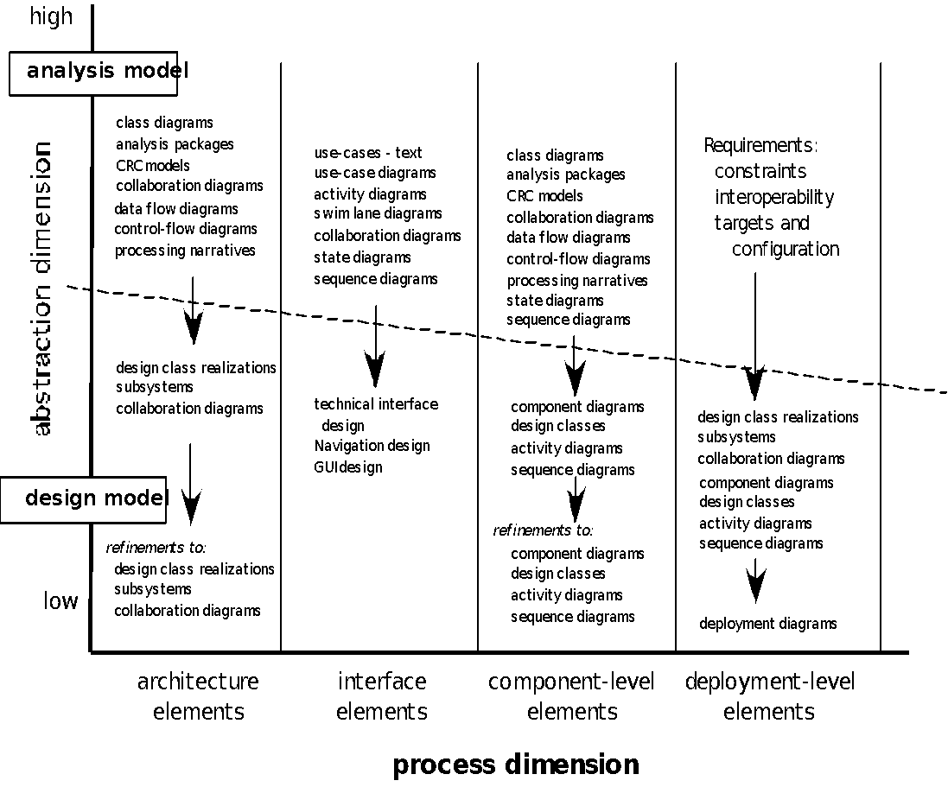
The Design Model
These slides are designed to accompany Software Engineering: A Practitioner’s Approach, 8/e (McGraw-Hill, 2014) Slides copyright 2014 by Roger Pressman.
‹#›

Slide 29
Design Model Elements
Data elements
Data model --> data structures
Data model --> database architecture
Architectural elements
Application domain
Analysis classes, their relationships, collaborations and behaviors are transformed into design realizations
Patterns and “styles” (Chapters 9 and 12)
Interface elements
the user interface (UI)
external interfaces to other systems, devices, networks or other producers or consumers of information
internal interfaces between various design components.
Component elements
Deployment elements
These slides are designed to accompany Software Engineering: A Practitioner’s Approach, 8/e (McGraw-Hill, 2014) Slides copyright 2014 by Roger Pressman.
‹#›

Slide 30
Data Modeling
examines data objects independently of processing
focuses attention on the data domain
creates a model at the customer’s level of abstraction
indicates how data objects relate to one another
These slides are designed to accompany Software Engineering: A Practitioner’s Approach, 8/e (McGraw-Hill, 2014). Slides copyright 2014 by Roger Pressman.
‹#›

Slide 31
What is a Data Object?
a representation of almost any composite information that must be understood by software.
composite information—something that has a number of different properties or attributes
can be an external entity (e.g., anything that produces or consumes information), a thing (e.g., a report or a display), an occurrence (e.g., a telephone call) or event (e.g., an alarm), a role (e.g., salesperson), an organizational unit (e.g., accounting department), a place (e.g., a warehouse), or a structure (e.g., a file).
The description of the data object incorporates the data object and all of its attributes.
A data object encapsulates data only—there is no reference within a data object to operations that act on the data.
These slides are designed to accompany Software Engineering: A Practitioner’s Approach, 8/e (McGraw-Hill, 2014). Slides copyright 2014 by Roger Pressman.
‹#›

Slide 32
Data Objects and Attributes
A data object contains a set of attributes that act as an aspect, quality, characteristic, or descriptor of the object
object: automobile
attributes:
make
model
body type
price
options code
These slides are designed to accompany Software Engineering: A Practitioner’s Approach, 8/e (McGraw-Hill, 2014). Slides copyright 2014 by Roger Pressman.
‹#›

Slide 33
What is a Relationship?
Data objects are connected to one another in different ways.
A connection is established between person and car because the two objects are related.
A person owns a car
A person is insured to drive a car
The relationships owns and insured to drive define the relevant connections between person and car.
Several instances of a relationship can exist
Objects can be related in many different ways
These slides are designed to accompany Software Engineering: A Practitioner’s Approach, 8/e (McGraw-Hill, 2014). Slides copyright 2014 by Roger Pressman.
‹#›

Slide 34
Architectural Elements
The architectural model [Sha96] is derived from three sources:
information about the application domain for the software to be built;
specific requirements model elements such as data flow diagrams or analysis classes, their relationships and collaborations for the problem at hand, and
the availability of architectural patterns (Chapter 16) and styles (Chapter 13).
These slides are designed to accompany Software Engineering: A Practitioner’s Approach, 8/e (McGraw-Hill, 2014) Slides copyright 2014 by Roger Pressman.
‹#›

Slide 35
Interface Elements
Interface is a set of operations that describes the externally observable behavior of a class and provides access to its public operations
Important elements
User interface (UI)
External interfaces to other systems
Internal interfaces between various design components
Modeled using UML communication diagrams (called collaboration diagrams in UML 1.x)
These slides are designed to accompany Software Engineering: A Practitioner’s Approach, 8/e (McGraw-Hill, 2014) Slides copyright 2014 by Roger Pressman.
‹#›
Notes:
‹#›

Slide 36
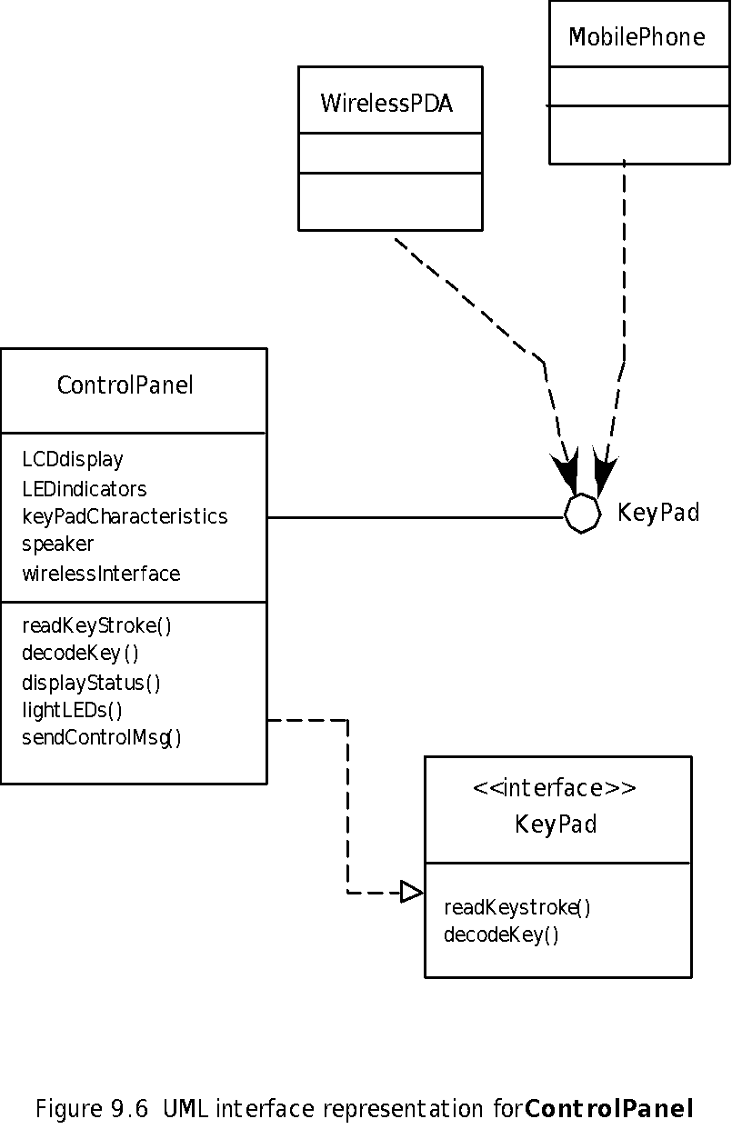
Interface Elements
These slides are designed to accompany Software Engineering: A Practitioner’s Approach, 8/e (McGraw-Hill, 2014) Slides copyright 2014 by Roger Pressman.
‹#›

Slide 37
Component Elements
Describes the internal detail of each software component
Defines
Data structures for all local data objects
Algorithmic detail for all component processing functions
Interface that allows access to all component operations
Modeled using UML component diagrams, UML activity diagrams, pseudocode (PDL), and sometimes flowcharts
These slides are designed to accompany Software Engineering: A Practitioner’s Approach, 8/e (McGraw-Hill, 2014) Slides copyright 2014 by Roger Pressman.
‹#›

Slide 38
Component Elements
These slides are designed to accompany Software Engineering: A Practitioner’s Approach, 8/e (McGraw-Hill, 2014) Slides copyright 2014 by Roger Pressman.
‹#›

Slide 39
Deployment Elements
Indicates how software functionality and subsystems will be allocated within the physical computing environment
Modeled using UML deployment diagrams
Descriptor form deployment diagrams show the computing environment but does not indicate configuration details
Instance form deployment diagrams identifying specific named hardware configurations are developed during the latter stages of design
These slides are designed to accompany Software Engineering: A Practitioner’s Approach, 8/e (McGraw-Hill, 2014) Slides copyright 2014 by Roger Pressman.
‹#›

Slide 40
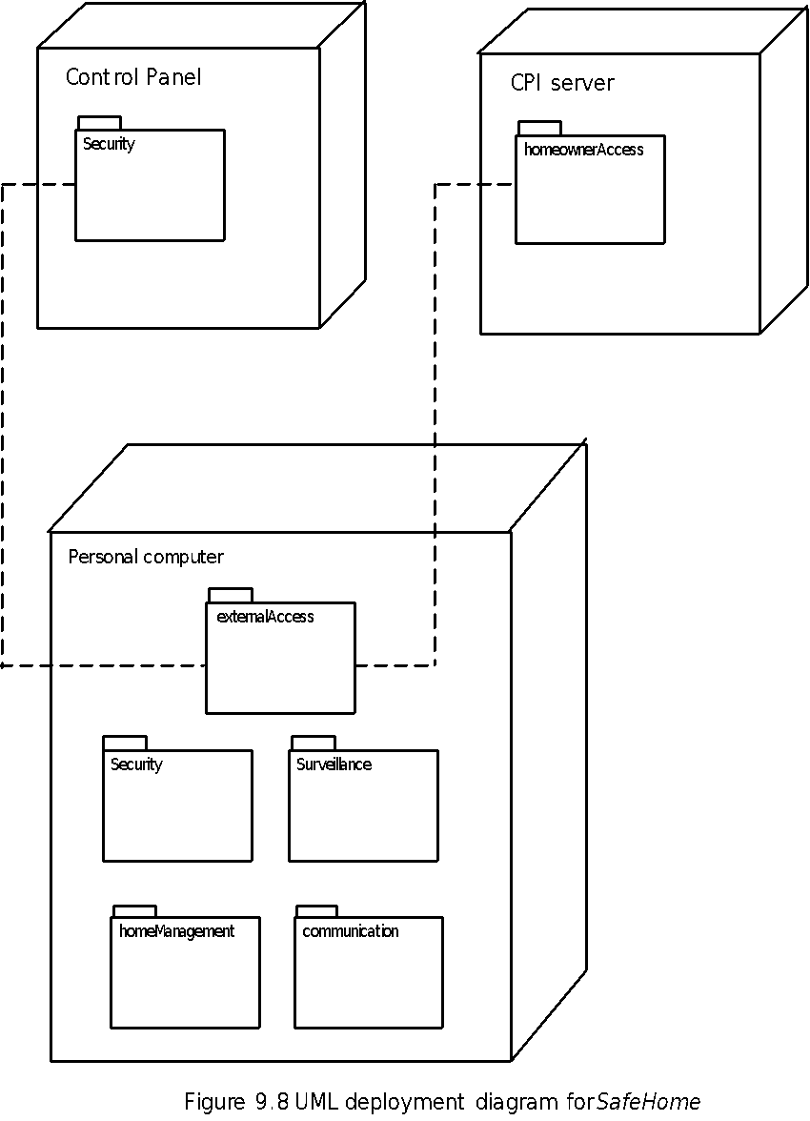
Deployment Elements
These slides are designed to accompany Software Engineering: A Practitioner’s Approach, 8/e (McGraw-Hill, 2014) Slides copyright 2014 by Roger Pressman.
‹#›

