Slide 1
Chapter 1
The Nature of Software
Slide Set to accompany Software Engineering: A Practitioner’s Approach, 8/e
by Roger S. Pressman and Bruce R. Maxim
Slides copyright © 1996, 2001, 2005, 2009, 2014 by Roger S. Pressman
For non-profit educational use only
May be reproduced ONLY for student use at the university level when used in conjunction with Software Engineering: A Practitioner's Approach, 8/e. Any other reproduction or use is prohibited without the express written permission of the author.
All copyright information MUST appear if these slides are posted on a website for student use.
These slides are designed to accompany Software Engineering: A Practitioner’s Approach, 8/e (McGraw-Hill 2014). Slides copyright 2014 by Roger Pressman.
‹#›
Notes:
‹#›

Slide 2
What is Software?
Software is: (1) instructions (computer programs) that when executed provide desired features, function, and performance; (2) data structures that enable the programs to adequately manipulate information and (3) documentation that describes the operation and use of the programs.
These slides are designed to accompany Software Engineering: A Practitioner’s Approach, 8/e (McGraw-Hill 2014). Slides copyright 2014 by Roger Pressman.
‹#›
Notes:
‹#›

Slide 3
What is Software?
Software is developed or engineered, it is not manufactured in the classical sense.
Software doesn't "wear out."
Although the industry is moving toward component-based construction, most software continues to be custom-built.
These slides are designed to accompany Software Engineering: A Practitioner’s Approach, 8/e (McGraw-Hill 2014). Slides copyright 2014 by Roger Pressman.
‹#›

Slide 4
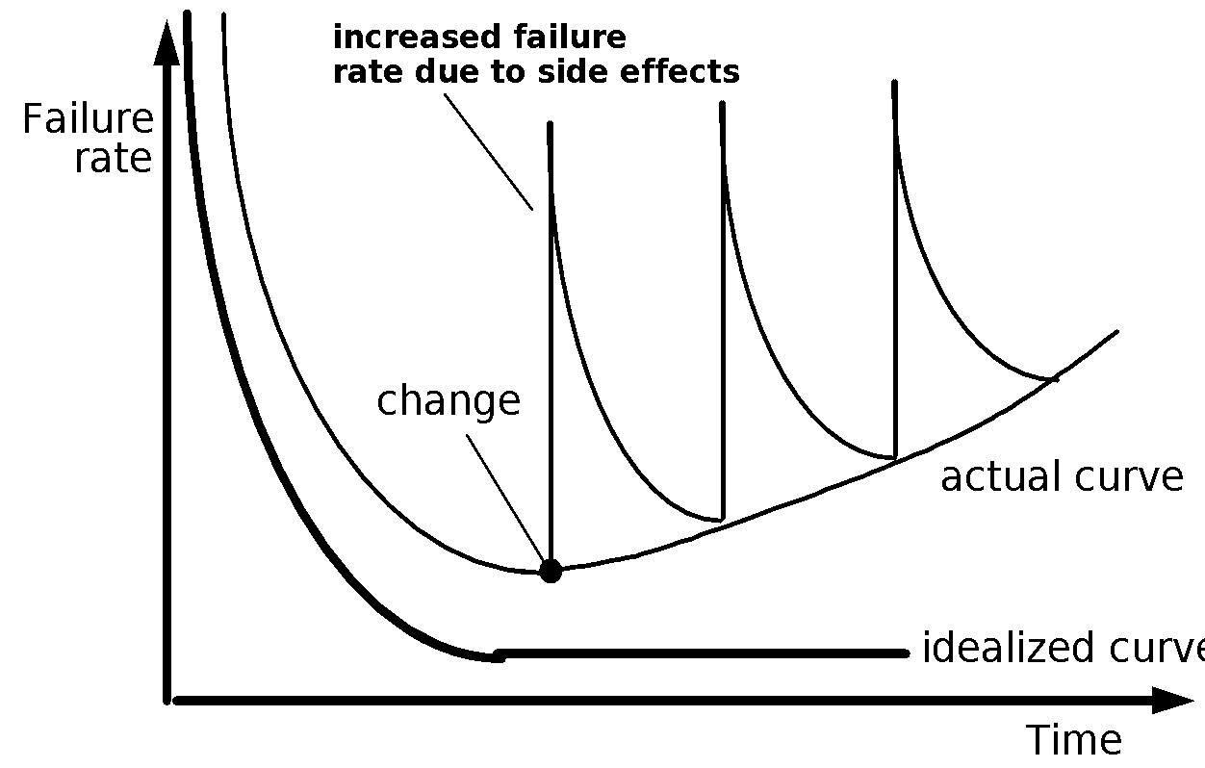
Wear vs. Deterioration
These slides are designed to accompany Software Engineering: A Practitioner’s Approach, 8/e (McGraw-Hill 2014). Slides copyright 2014 by Roger Pressman.
‹#›
Notes:
‹#›

Slide 5
Software Applications
System software
Application software
Engineering/Scientific software
Embedded software
Product-line software
Web/Mobile applications)
AI software (robotics, neural nets, game playing)
These slides are designed to accompany Software Engineering: A Practitioner’s Approach, 8/e (McGraw-Hill 2014). Slides copyright 2014 by Roger Pressman.
‹#›
Notes:
‹#›

Slide 6
Legacy Software
Why must it change?
software must be adapted to meet the needs of new computing environments or technology.
software must be enhanced to implement new business requirements.
software must be extended to make it interoperable with other more modern systems or databases.
software must be re-architected to make it viable within a network environment.
These slides are designed to accompany Software Engineering: A Practitioner’s Approach, 8/e (McGraw-Hill 2014). Slides copyright 2014 by Roger Pressman.
‹#›
Notes:
‹#›

Slide 7
WebApps
Modern WebApps are much more than hypertext files with a few pictures
WebApps are augmented with tools like XML and Java to allow Web engineers including interactive computing capability
WebApps may standalone capability to end users or may be integrated with corporate databases and business applications
Semantic web technologies (Web 3.0) have evolved into sophisticated corporate and consumer applications that encompass semantic databases that require web linking, flexible data representation, and application programmer interfaces (API’s) for access
The aesthetic nature of the content remains an important determinant of the quality of a WebApp.
These slides are designed to accompany Software Engineering: A Practitioner’s Approach, 8/e (McGraw-Hill 2014). Slides copyright 2014 by Roger Pressman.
‹#›

Slide 8
Mobile Apps
Reside on mobile platforms such as cell phones or tablets
Contain user interfaces that take both device characteristics and location attributes
Often provide access to a combination of web-based resources and local device processing and storage capabilities
Provide persistent storage capabilities within the platform
A mobile web application allows a mobile device to access to web-based content using a browser designed to accommodate the strengths and weaknesses of the mobile platform
A mobile app can gain direct access to the hardware found on the device to provide local processing and storage capabilities
As time passes these differences will become blurred
These slides are designed to accompany Software Engineering: A Practitioner’s Approach, 8/e (McGraw-Hill 2014). Slides copyright 2014 by Roger Pressman.
‹#›

Slide 9
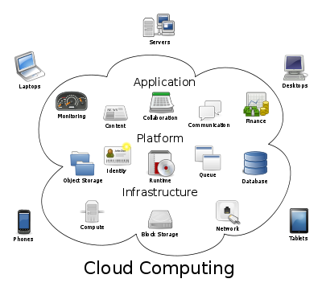
Cloud Computing
These slides are designed to accompany Software Engineering: A Practitioner’s Approach, 8/e (McGraw-Hill 2014). Slides copyright 2014 by Roger Pressman.
‹#›

Slide 10
Cloud Computing
Cloud computing provides distributed data storage and processing resources to networked computing devices
Computing resources reside outside the cloud and have access to a variety of resources inside the cloud
Cloud computing requires developing an architecture containing both frontend and backend services
Frontend services include the client devices and application software to allow access
Backend services include servers, data storage, and server-resident applications
Cloud architectures can be segmented to restrict access to private data
These slides are designed to accompany Software Engineering: A Practitioner’s Approach, 8/e (McGraw-Hill 2014). Slides copyright 2014 by Roger Pressman.
‹#›

Slide 11
Product Line Software
Product line software is a set of software-intensive systems that share a common set of features and satisfy the needs of a particular market
These software products are developed using the same application and data architectures using a common core of reusable software components
A software product line shares a set of assets that include requirements, architecture, design patterns, reusable components, test cases, and other work products
A software product line allow in the development of many products that are engineered by capitalizing on the commonality among all products with in the product lin
These slides are designed to accompany Software Engineering: A Practitioner’s Approach, 8/e (McGraw-Hill 2014). Slides copyright 2014 by Roger Pressman.
‹#›

Slide 12
Characteristics of WebApps - II
Data driven. The primary function of many WebApps is to use hypermedia to present text, graphics, audio, and video content to the end-user.
Content sensitive. The quality and aesthetic nature of content remains an important determinant of the quality of a WebApp.
Continuous evolution. Unlike conventional application software that evolves over a series of planned, chronologically-spaced releases, Web applications evolve continuously.
Immediacy. Although immediacy—the compelling need to get software to market quickly—is a characteristic of many application domains, WebApps often exhibit a time to market that can be a matter of a few days or weeks.
Security. Because WebApps are available via network access, it is difficult, if not impossible, to limit the population of end-users who may access the application.
Aesthetics. An undeniable part of the appeal of a WebApp is its look and feel.
These slides are designed to accompany Software Engineering: A Practitioner’s Approach, 8/e (McGraw-Hill 2014). Slides copyright 2014 by Roger Pressman.
‹#›

