Slide 1
Chapter 11
Requirements Modeling: Behavior, Patterns, and Web/Mobile Apps
Slide Set to accompany Software Engineering: A Practitioner’s Approach, 8/e
by Roger S. Pressman and Bruce R. Maxim
Slides copyright © 1996, 2001, 2005, 2009, 2014 by Roger S. Pressman
For non-profit educational use only
May be reproduced ONLY for student use at the university level when used in conjunction with Software Engineering: A Practitioner's Approach, 8/e. Any other reproduction or use is prohibited without the express written permission of the author.
All copyright information MUST appear if these slides are posted on a website for student use.
These slides are designed to accompany Software Engineering: A Practitioner’s Approach, 8/e (McGraw-Hill 2014). Slides copyright 2014 by Roger Pressman.
‹#›

Slide 2
Behavioral Modeling
The behavioral model indicates how software will respond to external events or stimuli. To create the model, the analyst must perform the following steps:
Evaluate all use-cases to fully understand the sequence of interaction within the system.
Identify events that drive the interaction sequence and understand how these events relate to specific objects.
Create a sequence for each use-case.
Build a state diagram for the system.
Review the behavioral model to verify accuracy and consistency.
These slides are designed to accompany Software Engineering: A Practitioner’s Approach, 8/e (McGraw-Hill 2014). Slides copyright 2014 by Roger Pressman.
‹#›

Slide 3
State Representations
In the context of behavioral modeling, two different characterizations of states must be considered:
the state of each class as the system performs its function and
the state of the system as observed from the outside as the system performs its function
The state of a class takes on both passive and active characteristics [CHA93].
A passive state is simply the current status of all of an object’s attributes.
The active state of an object indicates the current status of the object as it undergoes a continuing transformation or processing.
These slides are designed to accompany Software Engineering: A Practitioner’s Approach, 8/e (McGraw-Hill 2014). Slides copyright 2014 by Roger Pressman.
‹#›

Slide 4
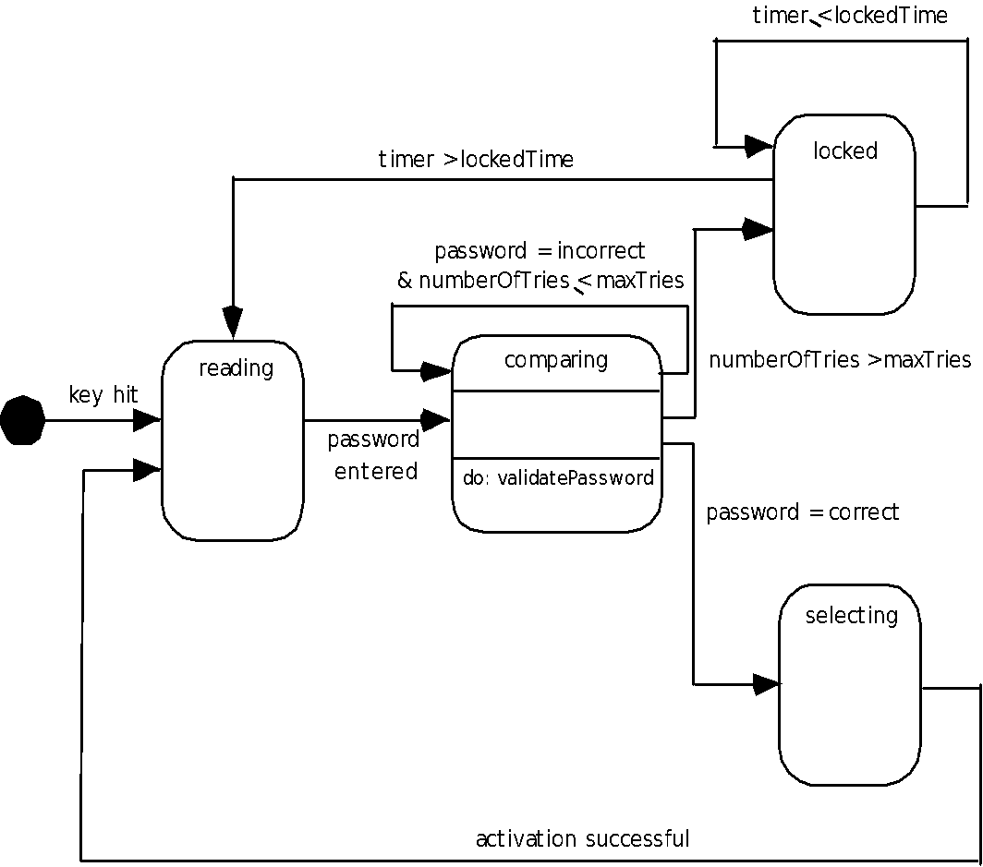
State Diagram for the ControlPanel Class
These slides are designed to accompany Software Engineering: A Practitioner’s Approach, 8/e (McGraw-Hill 2014). Slides copyright 2014 by Roger Pressman.
‹#›

Slide 5
The States of a System
state—a set of observable circum-stances that characterizes the behavior of a system at a given time
state transition—the movement from one state to another
event—an occurrence that causes the system to exhibit some predictable form of behavior
action—process that occurs as a consequence of making a transition
These slides are designed to accompany Software Engineering: A Practitioner’s Approach, 8/e (McGraw-Hill 2014). Slides copyright 2014 by Roger Pressman.
‹#›

Slide 6
Behavioral Modeling
make a list of the different states of a system (How does the system behave?)
indicate how the system makes a transition from one state to another (How does the system change state?)
indicate event
indicate action
draw a state diagram or a sequence diagram
These slides are designed to accompany Software Engineering: A Practitioner’s Approach, 8/e (McGraw-Hill 2014). Slides copyright 2014 by Roger Pressman.
‹#›

Slide 7
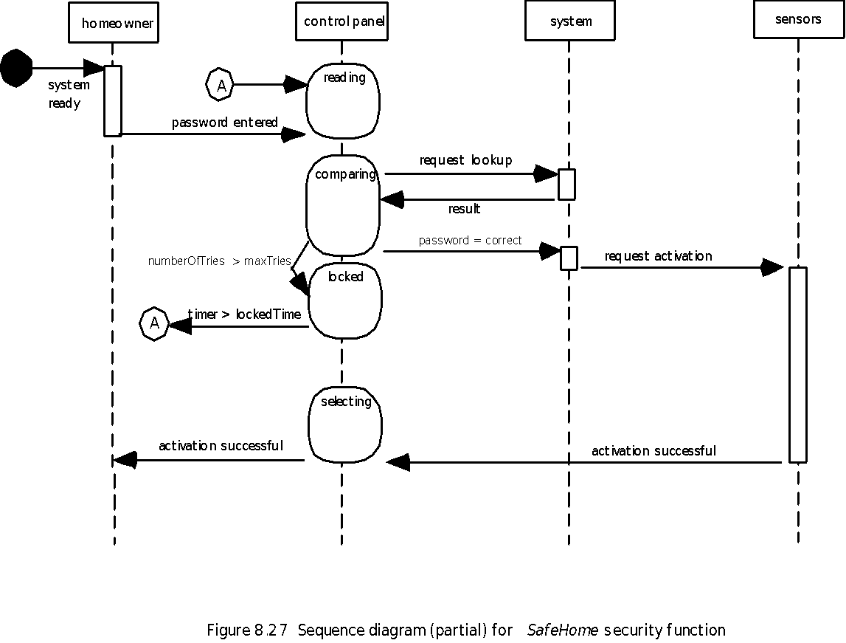
Sequence Diagram
These slides are designed to accompany Software Engineering: A Practitioner’s Approach, 8/e (McGraw-Hill 2014). Slides copyright 2014 by Roger Pressman.
‹#›

Slide 8
Writing the Software Specification
Everyone knew exactly what had to be done until someone wrote it down!
These slides are designed to accompany Software Engineering: A Practitioner’s Approach, 8/e (McGraw-Hill 2014). Slides copyright 2014 by Roger Pressman.
‹#›

Slide 9
Patterns for Requirements Modeling
Software patterns are a mechanism for capturing domain knowledge in a way that allows it to be reapplied when a new problem is encountered
domain knowledge can be applied to a new problem within the same application domain
the domain knowledge captured by a pattern can be applied by analogy to a completely different application domain.
The original author of an analysis pattern does not “create” the pattern, but rather, discovers it as requirements engineering work is being conducted.
Once the pattern has been discovered, it is documented
These slides are designed to accompany Software Engineering: A Practitioner’s Approach, 8/e (McGraw-Hill 2014). Slides copyright 2014 by Roger Pressman.
‹#›

Slide 10
Discovering Analysis Patterns
The most basic element in the description of a requirements model is the use case.
A coherent set of use cases may serve as the basis for discovering one or more analysis patterns.
A semantic analysis pattern (SAP) “is a pattern that describes a small set of coherent use cases that together describe a basic generic application.” [Fer00]
These slides are designed to accompany Software Engineering: A Practitioner’s Approach, 8/e (McGraw-Hill 2014). Slides copyright 2014 by Roger Pressman.
‹#›

Slide 11
An Example
Consider the following preliminary use case for software required to control and monitor a real-view camera and proximity sensor for an automobile:
Use case: Monitor reverse motion
Description: When the vehicle is placed in reverse gear, the control software enables a video feed from a rear-placed video camera to the dashboard display. The control software superimposes a variety of distance and orientation lines on the dashboard display so that the vehicle operator can maintain orientation as the vehicle moves in reverse. The control software also monitors a proximity sensor to determine whether an object is inside 10 feet of the rear of the vehicle. It will automatically break the vehicle if the proximity sensor indicates an object within 3 feet of the rear of the vehicle.
These slides are designed to accompany Software Engineering: A Practitioner’s Approach, 8/e (McGraw-Hill 2014). Slides copyright 2014 by Roger Pressman.
‹#›

Slide 12
An Example
This use case implies a variety of functionality that would be refined and elaborated (into a coherent set of use cases) during requirements gathering and modeling.
Regardless of how much elaboration is accomplished, the use case(s) suggest(s) a simple, yet widely applicable SAP—the software-based monitoring and control of sensors and actuators in a physical system.
In this case, the “sensors” provide information about proximity and video information. The “actuator” is the breaking system of the vehicle (invoked if an object is very close to the vehicle.
But in a more general case, a widely applicable pattern is discovered --> Actuator-Sensor
These slides are designed to accompany Software Engineering: A Practitioner’s Approach, 8/e (McGraw-Hill 2014). Slides copyright 2014 by Roger Pressman.
‹#›

Slide 13
Actuator-Sensor Pattern—I
Pattern Name: Actuator-Sensor
Intent: Specify various kinds of sensors and actuators in an embedded system.
Motivation: Embedded systems usually have various kinds of sensors and actuators. These sensors and actuators are all either directly or indirectly connected to a control unit. Although many of the sensors and actuators look quite different, their behavior is similar enough to structure them into a pattern. The pattern shows how to specify the sensors and actuators for a system, including attributes and operations. The Actuator-Sensor pattern uses a pull mechanism (explicit request for information) for PassiveSensors and a push mechanism (broadcast of information) for the ActiveSensors.
Constraints:
Each passive sensor must have some method to read sensor input and attributes that represent the sensor value.
Each active sensor must have capabilities to broadcast update messages when its value changes.
Each active sensor should send a life tick, a status message issued within a specified time frame, to detect malfunctions.
Each actuator must have some method to invoke the appropriate response determined by the ComputingComponent.
Each sensor and actuator should have a function implemented to check its own operation state.
Each sensor and actuator should be able to test the validity of the values received or sent and set its operation state if the values are outside of the specifications.
These slides are designed to accompany Software Engineering: A Practitioner’s Approach, 8/e (McGraw-Hill 2014). Slides copyright 2014 by Roger Pressman.
‹#›

Slide 14
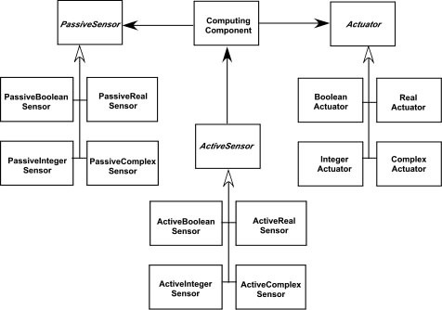
Actuator-Sensor Pattern—II
Applicability: Useful in any system in which multiple sensors and actuators are present.
Structure: A UML class diagram for the Actuator-Sensor Pattern is shown in Figure 7.8. Actuator, PassiveSensor and ActiveSensor are abstract classes and denoted in italics. There are four different types of sensors and actuators in this pattern. The Boolean, integer, and real classes represent the most common types of sensors and actuators. The complex classes are sensors or actuators that use values that cannot be easily represented in terms of primitive data types, such as a radar device. Nonetheless, these devices should still inherit the interface from the abstract classes since they should have basic functionalities such as querying the operation states.
These slides are designed to accompany Software Engineering: A Practitioner’s Approach, 8/e (McGraw-Hill 2014). Slides copyright 2014 by Roger Pressman.
‹#›

Slide 15
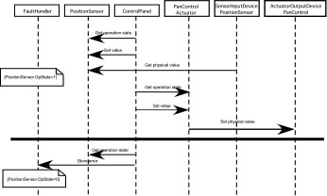
Actuator-Sensor Pattern—III
Behavior: Figure 7.9 presents a UML sequence diagram for an example of the Actuator-Sensor Pattern as it might be applied for the SafeHome function that controls the positioning (e.g., pan, zoom) of a security camera. Here, the ControlPanel queries a sensor (a passive position sensor) and an actuator (pan control) to check the operation state for diagnostic purposes before reading or setting a value. The messages Set Physical Value and Get Physical Value are not messages between objects. Instead, they describe the interaction between the physical devices of the system and their software counterparts. In the lower part of the diagram, below the horizontal line, the PositionSensor reports that the operation state is zero. The ComputingComponent then sends the error code for a position sensor failure to the FaultHandler that will decide how this error affects the system and what actions are required. it gets the data from the sensors and computes the required response for the actuators.
These slides are designed to accompany Software Engineering: A Practitioner’s Approach, 8/e (McGraw-Hill 2014). Slides copyright 2014 by Roger Pressman.
‹#›

Slide 16
Actuator-Sensor Pattern—III
See SEPA, 8/e for additional information on:
Participants
Collaborations
Consequences
These slides are designed to accompany Software Engineering: A Practitioner’s Approach, 8/e (McGraw-Hill 2014). Slides copyright 2014 by Roger Pressman.
‹#›

Slide 17
Requirements Modeling for WebApps
Content Analysis. The full spectrum of content to be provided by the WebApp is identified, including text, graphics and images, video, and audio data. Data modeling can be used to identify and describe each of the data objects.
Interaction Analysis. The manner in which the user interacts with the WebApp is described in detail. Use-cases can be developed to provide detailed descriptions of this interaction.
Functional Analysis. The usage scenarios (use-cases) created as part of interaction analysis define the operations that will be applied to WebApp content and imply other processing functions. All operations and functions are described in detail.
Configuration Analysis. The environment and infrastructure in which the WebApp resides are described in detail.
These slides are designed to accompany Software Engineering: A Practitioner’s Approach, 8/e (McGraw-Hill 2014). Slides copyright 2014 by Roger Pressman.
‹#›

Slide 18
When Do We Perform Analysis?
In some Web/Mobile App situations, analysis and design merge. However, an explicit analysis activity occurs when …
the Web or Mobile App to be built is large and/or complex
the number of stakeholders is large
the number of developers is large
the development team members have not worked together before
the success of the app will have a strong bearing on the success of the business
These slides are designed to accompany Software Engineering: A Practitioner’s Approach, 8/e (McGraw-Hill 2014). Slides copyright 2014 by Roger Pressman.
‹#›

Slide 19
The Content Model
Content objects are extracted from use-cases
examine the scenario description for direct and indirect references to content
Attributes of each content object are identified
The relationships among content objects and/or the hierarchy of content maintained by a WebApp
Relationships—entity-relationship diagram or UML
Hierarchy—data tree or UML
These slides are designed to accompany Software Engineering: A Practitioner’s Approach, 8/e (McGraw-Hill 2014). Slides copyright 2014 by Roger Pressman.
‹#›

Slide 20
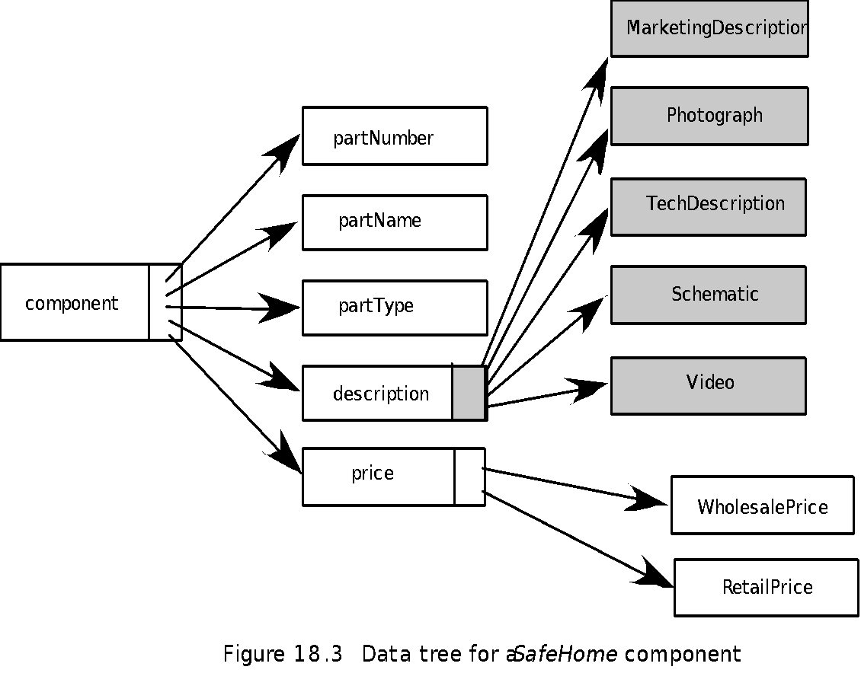
Data Tree
These slides are designed to accompany Software Engineering: A Practitioner’s Approach, 8/e (McGraw-Hill 2014). Slides copyright 2014 by Roger Pressman.
‹#›

Slide 21
The Interaction Model
Composed of four elements:
use-cases
sequence diagrams
state diagrams
a user interface prototype
Each of these is an important UML notation and is described in Appendix I
These slides are designed to accompany Software Engineering: A Practitioner’s Approach, 8/e (McGraw-Hill 2014). Slides copyright 2014 by Roger Pressman.
‹#›

Slide 22
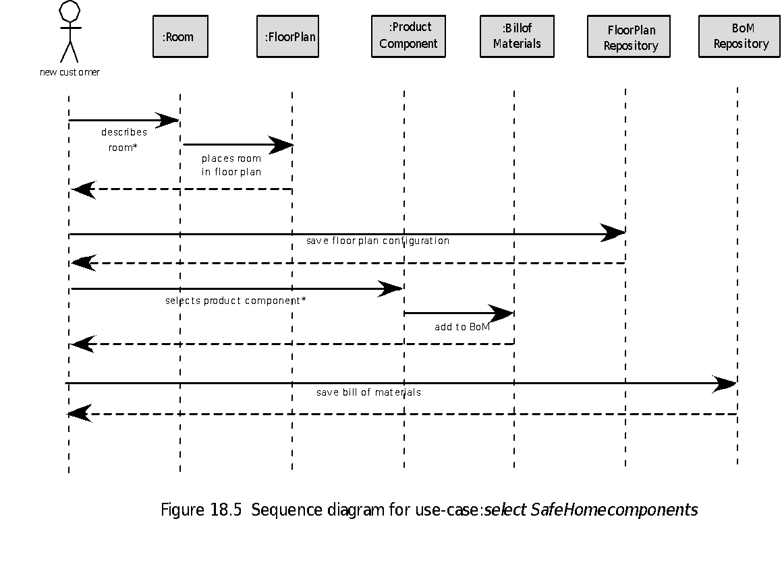
Sequence Diagram
These slides are designed to accompany Software Engineering: A Practitioner’s Approach, 8/e (McGraw-Hill 2014). Slides copyright 2014 by Roger Pressman.
‹#›

Slide 23
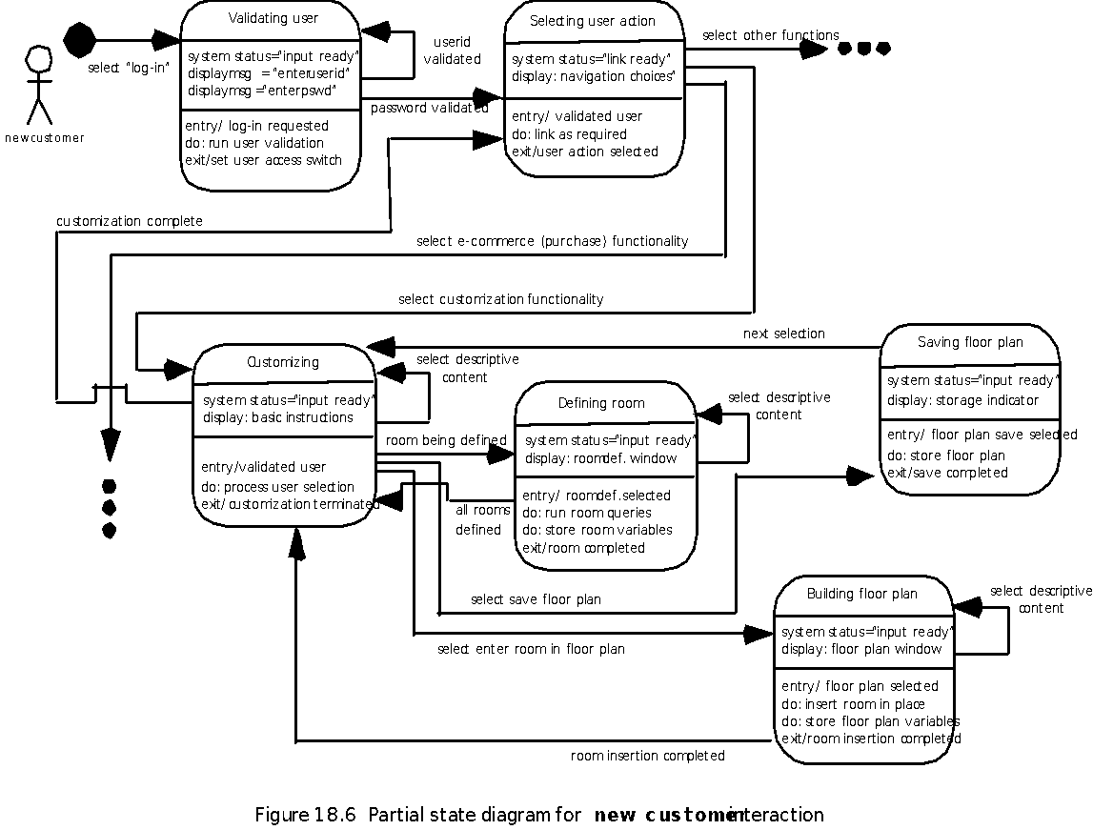
State Diagram
These slides are designed to accompany Software Engineering: A Practitioner’s Approach, 8/e (McGraw-Hill 2014). Slides copyright 2014 by Roger Pressman.
‹#›

Slide 24
The Functional Model
The functional model addresses two processing elements of the WebApp
user observable functionality that is delivered by the WebApp to end-users
the operations contained within analysis classes that implement behaviors associated with the class.
An activity diagram can be used to represent processing flow
These slides are designed to accompany Software Engineering: A Practitioner’s Approach, 8/e (McGraw-Hill 2014). Slides copyright 2014 by Roger Pressman.
‹#›

Slide 25
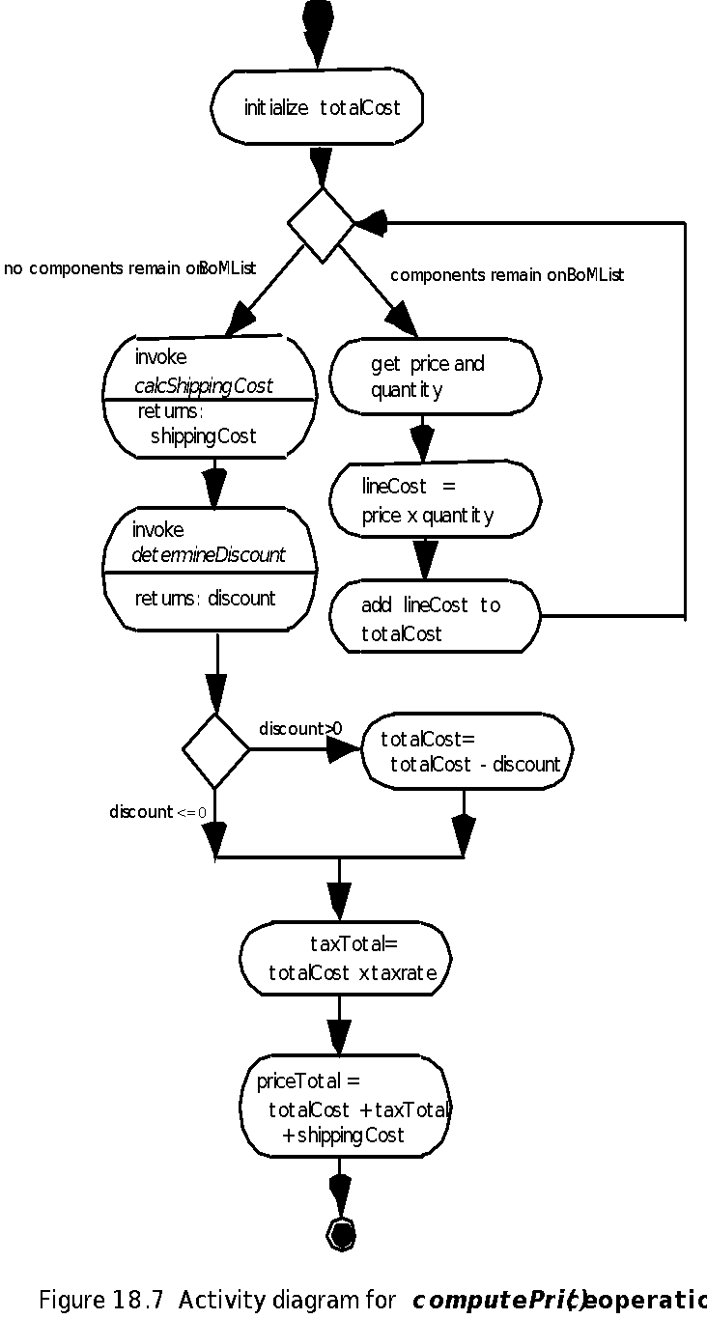
Activity Diagram
These slides are designed to accompany Software Engineering: A Practitioner’s Approach, 8/e (McGraw-Hill 2014). Slides copyright 2014 by Roger Pressman.
‹#›

Slide 26
The Configuration Model
Server-side
Server hardware and operating system environment must be specified
Interoperability considerations on the server-side must be considered
Appropriate interfaces, communication protocols and related collaborative information must be specified
Client-side
Browser configuration issues must be identified
Testing requirements should be defined
These slides are designed to accompany Software Engineering: A Practitioner’s Approach, 8/e (McGraw-Hill 2014). Slides copyright 2014 by Roger Pressman.
‹#›

Slide 27
Navigation Modeling-I
Should certain elements be easier to reach (require fewer navigation steps) than others? What is the priority for presentation?
Should certain elements be emphasized to force users to navigate in their direction?
How should navigation errors be handled?
Should navigation to related groups of elements be given priority over navigation to a specific element.
Should navigation be accomplished via links, via search-based access, or by some other means?
Should certain elements be presented to users based on the context of previous navigation actions?
Should a navigation log be maintained for users?
These slides are designed to accompany Software Engineering: A Practitioner’s Approach, 8/e (McGraw-Hill 2014). Slides copyright 2014 by Roger Pressman.
‹#›

Slide 28
Navigation Modeling-II
Should a full navigation map or menu (as opposed to a single “back” link or directed pointer) be available at every point in a user’s interaction?
Should navigation design be driven by the most commonly expected user behaviors or by the perceived importance of the defined WebApp elements?
Can a user “store” his previous navigation through the WebApp to expedite future usage?
For which user category should optimal navigation be designed?
How should links external to the WebApp be handled? overlaying the existing browser window? as a new browser window? as a separate frame?
These slides are designed to accompany Software Engineering: A Practitioner’s Approach, 8/e (McGraw-Hill 2014). Slides copyright 2014 by Roger Pressman.
‹#›

