Slide 1
Chapter 15
User Interface Design
Slide Set to accompany Software Engineering: A Practitioner’s Approach, 8/e
by Roger S. Pressman and Bruce R. Maxim
Slides copyright © 1996, 2001, 2005, 2009, 2014 by Roger S. Pressman
For non-profit educational use only
May be reproduced ONLY for student use at the university level when used in conjunction with Software Engineering: A Practitioner's Approach, 8/e. Any other reproduction or use is prohibited without the express written permission of the author.
All copyright information MUST appear if these slides are posted on a website for student use.
These slides are designed to accompany Software Engineering: A Practitioner’s Approach, 8/e (McGraw-Hill, 2014) Slides copyright 2014 by Roger Pressman.
‹#›

Slide 2

Interface Design
Easy to learn?
Easy to use?
Easy to understand?
These slides are designed to accompany Software Engineering: A Practitioner’s Approach, 8/e (McGraw-Hill, 2014) Slides copyright 2014 by Roger Pressman.
‹#›

Slide 3

Interface Design
Typical Design Errors
lack of consistency
too much memorization
no guidance / help
no context sensitivity
poor response
Arcane/unfriendly
These slides are designed to accompany Software Engineering: A Practitioner’s Approach, 8/e (McGraw-Hill, 2014) Slides copyright 2014 by Roger Pressman.
‹#›

Slide 4
Golden Rules
Place the user in control
Reduce the user’s memory load
Make the interface consistent
These slides are designed to accompany Software Engineering: A Practitioner’s Approach, 8/e (McGraw-Hill, 2014) Slides copyright 2014 by Roger Pressman.
‹#›

Slide 5
Place the User in Control
Define interaction modes in a way that does not force a user into unnecessary or undesired actions.
Provide for flexible interaction.
Allow user interaction to be interruptible and undoable.
Streamline interaction as skill levels advance and allow the interaction to be customized.
Hide technical internals from the casual user.
Design for direct interaction with objects that appear on the screen.
These slides are designed to accompany Software Engineering: A Practitioner’s Approach, 8/e (McGraw-Hill, 2014) Slides copyright 2014 by Roger Pressman.
‹#›

Slide 6
Reduce the User’s Memory Load
Reduce demand on short-term memory.
Establish meaningful defaults.
Define shortcuts that are intuitive.
The visual layout of the interface should be based on a real world metaphor.
Disclose information in a progressive fashion.
These slides are designed to accompany Software Engineering: A Practitioner’s Approach, 8/e (McGraw-Hill, 2014) Slides copyright 2014 by Roger Pressman.
‹#›

Slide 7
Make the Interface Consistent
Allow the user to put the current task into a meaningful context.
Maintain consistency across a family of applications.
If past interactive models have created user expectations, do not make changes unless there is a compelling reason to do so.
These slides are designed to accompany Software Engineering: A Practitioner’s Approach, 8/e (McGraw-Hill, 2014) Slides copyright 2014 by Roger Pressman.
‹#›

Slide 8
User Interface Design Models
User model — a profile of all end users of the system
Design model — a design realization of the user model
Mental model (system perception) — the user’s mental image of what the interface is
Implementation model — the interface “look and feel” coupled with supporting information that describe interface syntax and semantics
These slides are designed to accompany Software Engineering: A Practitioner’s Approach, 8/e (McGraw-Hill, 2014) Slides copyright 2014 by Roger Pressman.
‹#›

Slide 9
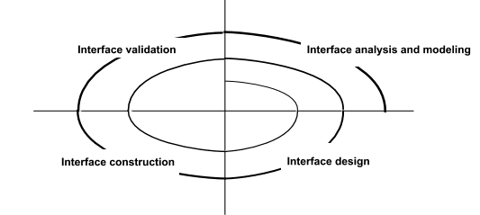
User Interface Design Process
These slides are designed to accompany Software Engineering: A Practitioner’s Approach, 8/e (McGraw-Hill, 2014) Slides copyright 2014 by Roger Pressman.
‹#›

Slide 10
Interface Analysis
Interface analysis means understanding
(1) the people (end-users) who will interact with the system through the interface;
(2) the tasks that end-users must perform to do their work,
(3) the content that is presented as part of the interface
(4) the environment in which these tasks will be conducted.
These slides are designed to accompany Software Engineering: A Practitioner’s Approach, 8/e (McGraw-Hill, 2014) Slides copyright 2014 by Roger Pressman.
‹#›

Slide 11
User Analysis
Are users trained professionals, technician, clerical, or manufacturing workers?
What level of formal education does the average user have?
Are the users capable of learning from written materials or have they expressed a desire for classroom training?
Are users expert typists or keyboard phobic?
What is the age range of the user community?
Will the users be represented predominately by one gender?
How are users compensated for the work they perform?
Do users work normal office hours or do they work until the job is done?
Is the software to be an integral part of the work users do or will it be used only occasionally?
What is the primary spoken language among users?
What are the consequences if a user makes a mistake using the system?
Are users experts in the subject matter that is addressed by the system?
Do users want to know about the technology the sits behind the interface?
These slides are designed to accompany Software Engineering: A Practitioner’s Approach, 8/e (McGraw-Hill, 2014) Slides copyright 2014 by Roger Pressman.
‹#›

Slide 12
Task Analysis and Modeling
Answers the following questions …
What work will the user perform in specific circumstances?
What tasks and subtasks will be performed as the user does the work?
What specific problem domain objects will the user manipulate as work is performed?
What is the sequence of work tasks—the workflow?
What is the hierarchy of tasks?
Use-cases define basic interaction
Task elaboration refines interactive tasks
Object elaboration identifies interface objects (classes)
Workflow analysis defines how a work process is completed when several people (and roles) are involved
These slides are designed to accompany Software Engineering: A Practitioner’s Approach, 8/e (McGraw-Hill, 2014) Slides copyright 2014 by Roger Pressman.
‹#›

Slide 13
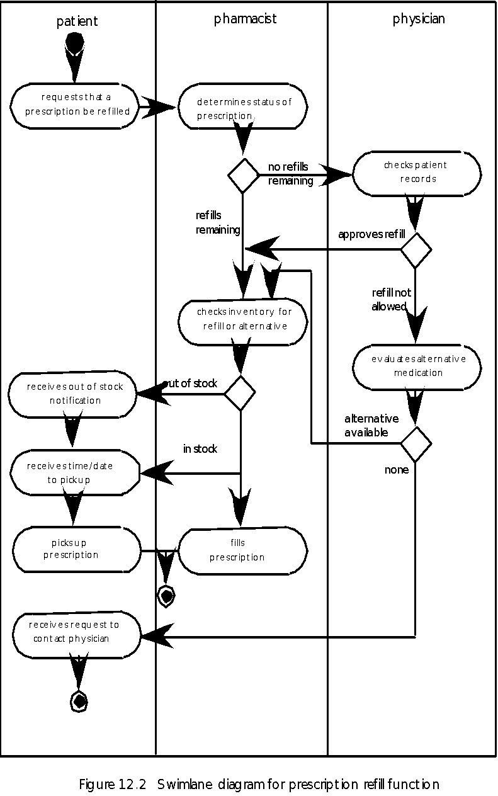
Swimlane Diagram
These slides are designed to accompany Software Engineering: A Practitioner’s Approach, 8/e (McGraw-Hill, 2014) Slides copyright 2014 by Roger Pressman.
‹#›

Slide 14
Analysis of Display Content
Are different types of data assigned to consistent geographic locations on the screen (e.g., photos always appear in the upper right hand corner)?
Can the user customize the screen location for content?
Is proper on-screen identification assigned to all content?
If a large report is to be presented, how should it be partitioned for ease of understanding?
Will mechanisms be available for moving directly to summary information for large collections of data.
Will graphical output be scaled to fit within the bounds of the display device that is used?
How will color to be used to enhance understanding?
How will error messages and warning be presented to the user?
These slides are designed to accompany Software Engineering: A Practitioner’s Approach, 8/e (McGraw-Hill, 2014) Slides copyright 2014 by Roger Pressman.
‹#›

Slide 15
Interface Design Steps
Using information developed during interface analysis, define interface objects and actions (operations).
Define events (user actions) that will cause the state of the user interface to change. Model this behavior.
Depict each interface state as it will actually look to the end-user.
Indicate how the user interprets the state of the system from information provided through the interface.
These slides are designed to accompany Software Engineering: A Practitioner’s Approach, 8/e (McGraw-Hill, 2014) Slides copyright 2014 by Roger Pressman.
‹#›

Slide 16
Design Issues
Response time
Help facilities
Error handling
Menu and command labeling
Application accessibility
Internationalization
These slides are designed to accompany Software Engineering: A Practitioner’s Approach, 8/e (McGraw-Hill, 2014) Slides copyright 2014 by Roger Pressman.
‹#›

Slide 17
Web and Mobile App Interface Design
Where am I? The interface should
provide an indication of the Web or Mobie App that has been accessed
inform the user of her location in the content hierarchy.
What can I do now? The interface should always help the user understand his current options
what functions are available?
what links are live?
what content is relevant?
Where have I been, where am I going? The interface must facilitate navigation.
Provide a “map” (implemented in a way that is easy to understand) of where the user has been and what paths may be taken to move elsewhere within the Web or Mobile App.
These slides are designed to accompany Software Engineering: A Practitioner’s Approach, 8/e (McGraw-Hill, 2014) Slides copyright 2014 by Roger Pressman.
‹#›

Slide 18
Effective Web and Mobile App Interfaces
Bruce Tognozzi [TOG01] suggests…
Effective interfaces are visually apparent and forgiving, instilling in their users a sense of control. Users quickly see the breadth of their options, grasp how to achieve their goals, and do their work.
Effective interfaces do not concern the user with the inner workings of the system. Work is carefully and continuously saved, with full option for the user to undo any activity at any time.
Effective applications and services perform a maximum of work, while requiring a minimum of information from users.
These slides are designed to accompany Software Engineering: A Practitioner’s Approach, 8/e (McGraw-Hill, 2014) Slides copyright 2014 by Roger Pressman.
‹#›

Slide 19
Interface Design Principles-I
Anticipation—A Web or Mobile App should be designed so that it anticipates the use’s next move.
Communication—The interface should communicate the status of any activity initiated by the user
Consistency—The use of navigation controls, menus, icons, and aesthetics (e.g., color, shape, layout)
Controlled autonomy—The interface should facilitate user movement throughout the Web or Mobile App, but it should do so in a manner that enforces navigation conventions that have been established for the application.
Efficiency—The design of the Web or Mobile App and its interface should optimize the user’s work efficiency, not the efficiency of the software engineer who designs and builds it or the client-server environment that executes it.
These slides are designed to accompany Software Engineering: A Practitioner’s Approach, 8/e (McGraw-Hill, 2014) Slides copyright 2014 by Roger Pressman.
‹#›

Slide 20
Interface Design Principles-II
Focus—The Web or Mobile App interface (and the content it presents) should stay focused on the user task(s) at hand.
Fitt’s Law—“The time to acquire a target is a function of the distance to and size of the target.”
Human interface objects—A vast library of reusable human interface objects has been developed for Web or Mobile Apps.
Latency reduction—The Web or Mobile App should use multi-tasking in a way that lets the user proceed with work as if the operation has been completed.
Learnability— A Web or Mobile App interface should be designed to minimize learning time, and once learned, to minimize relearning required when the App is revisited.
These slides are designed to accompany Software Engineering: A Practitioner’s Approach, 8/e (McGraw-Hill, 2014) Slides copyright 2014 by Roger Pressman.
‹#›

Slide 21
Interface Design Principles-III
Maintain work product integrity—A work product (e.g., a form completed by the user, a user specified list) must be automatically saved so that it will not be lost if an error occurs.
Readability—All information presented through the interface should be readable by young and old.
Track state—When appropriate, the state of the user interaction should be tracked and stored so that a user can logoff and return later to pick up where she left off.
Visible navigation—A well-designed Web or Mobile App interface provides “the illusion that users are in the same place, with the work brought to them.”
These slides are designed to accompany Software Engineering: A Practitioner’s Approach, 8/e (McGraw-Hill, 2014) Slides copyright 2014 by Roger Pressman.
‹#›

Slide 22
Interface Design Workflow-I
Review information contained in the analysis model and refine as required.
Develop a rough sketch of the Web or Mobile App interface layout.
Map user objectives into specific interface actions.
Define a set of user tasks that are associated with each action.
Storyboard screen images for each interface action.
Refine interface layout and storyboards using input from aesthetic design.
These slides are designed to accompany Software Engineering: A Practitioner’s Approach, 8/e (McGraw-Hill, 2014) Slides copyright 2014 by Roger Pressman.
‹#›

Slide 23
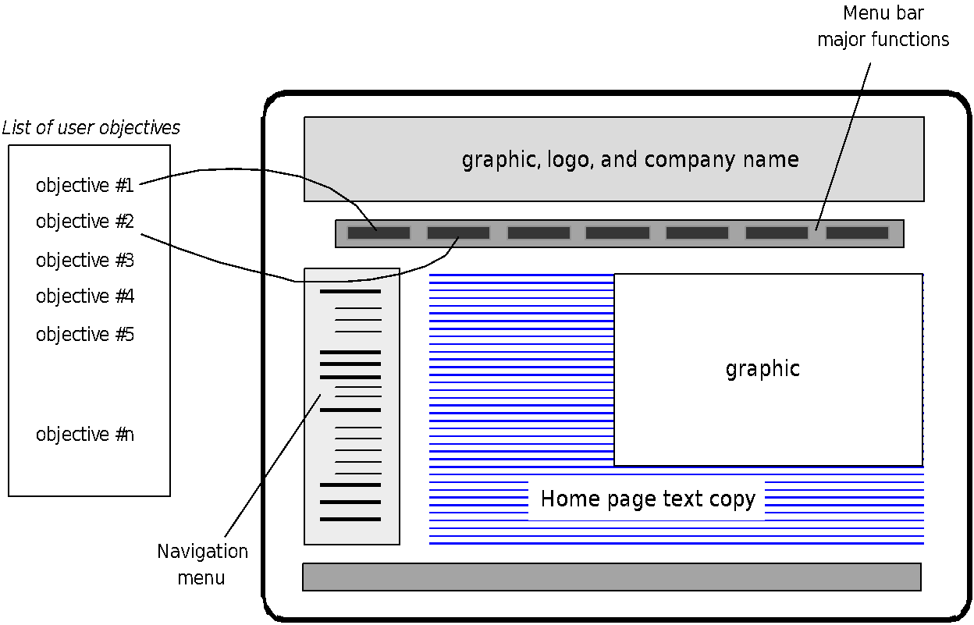
Mapping User Objectives
These slides are designed to accompany Software Engineering: A Practitioner’s Approach, 8/e (McGraw-Hill, 2014) Slides copyright 2014 by Roger Pressman.
‹#›

Slide 24
Interface Design Workflow-II
Identify user interface objects that are required to implement the interface.
Develop a procedural representation of the user’s interaction with the interface.
Develop a behavioral representation of the interface.
Describe the interface layout for each state.
Refine and review the interface design model.
These slides are designed to accompany Software Engineering: A Practitioner’s Approach, 8/e (McGraw-Hill, 2014) Slides copyright 2014 by Roger Pressman.
‹#›

Slide 25
Aesthetic Design
Don’t be afraid of white space.
Emphasize content.
Organize layout elements from top-left to bottom right.
Group navigation, content, and function geographically within the page.
Don’t extend your real estate with the scrolling bar.
Consider resolution and browser window size when designing layout.
These slides are designed to accompany Software Engineering: A Practitioner’s Approach, 8/e (McGraw-Hill, 2014) Slides copyright 2014 by Roger Pressman.
‹#›

Slide 26
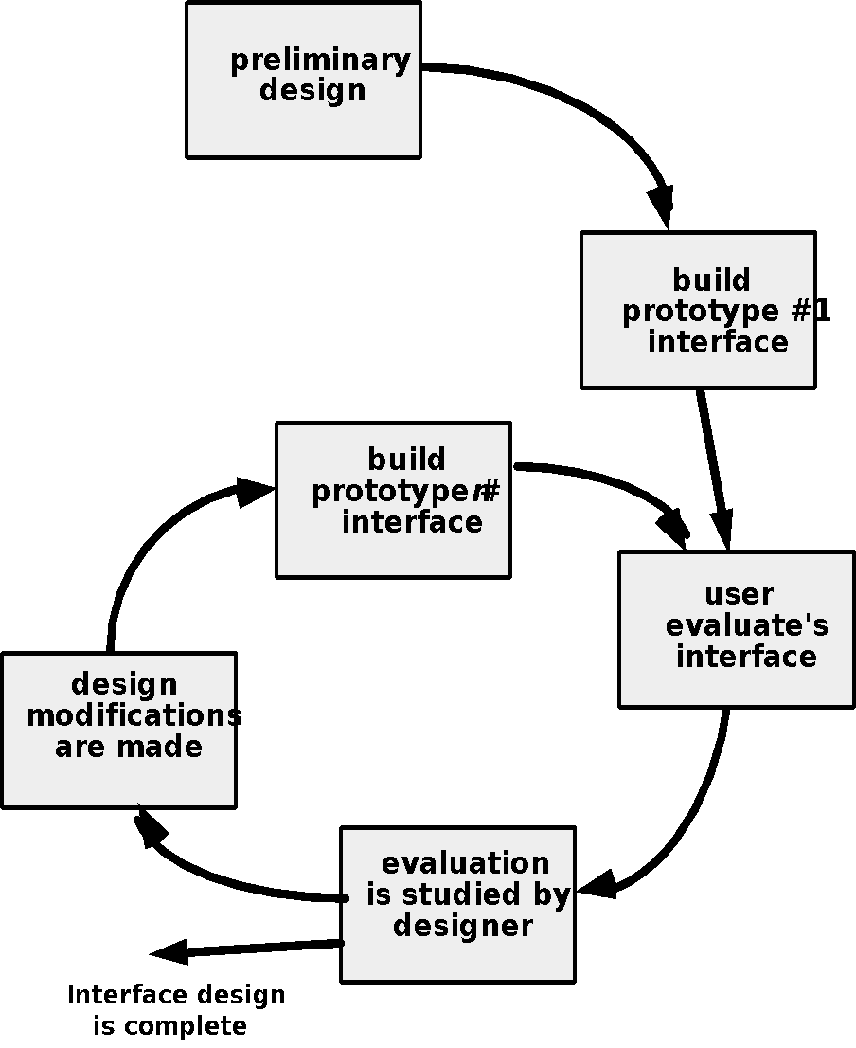
Design Evaluation Cycle
These slides are designed to accompany Software Engineering: A Practitioner’s Approach, 8/e (McGraw-Hill, 2014) Slides copyright 2014 by Roger Pressman.
‹#›

