Slide 1
Chapter 4: Multithreaded Programming
Notes:
*

Slide 2
Multicore Programming
Multicore or multiprocessor systems putting pressure on programmers, challenges include:
  Dividing activities
  Balance
  Data splitting
  Data dependency
  Testing and debugging
Parallelism implies a system can perform more than one task simultaneously
Concurrency supports more than one task making progress
  Single processor / core, scheduler providing concurrency
Types of parallelism
  Data parallelism – distributes subsets of the same data across multiple cores, same operation on each
  Task parallelism – distributing threads across cores, each thread performing unique operation
As # of threads grows, so does architectural support for threading
  CPUs have cores as well as hardware threads
  Consider Oracle SPARC T4 with 8 cores, and 8 hardware threads per core

Slide 3
Multithreading Models
Many-to-One
One-to-One
Many-to-Many
Notes:
*

Slide 4
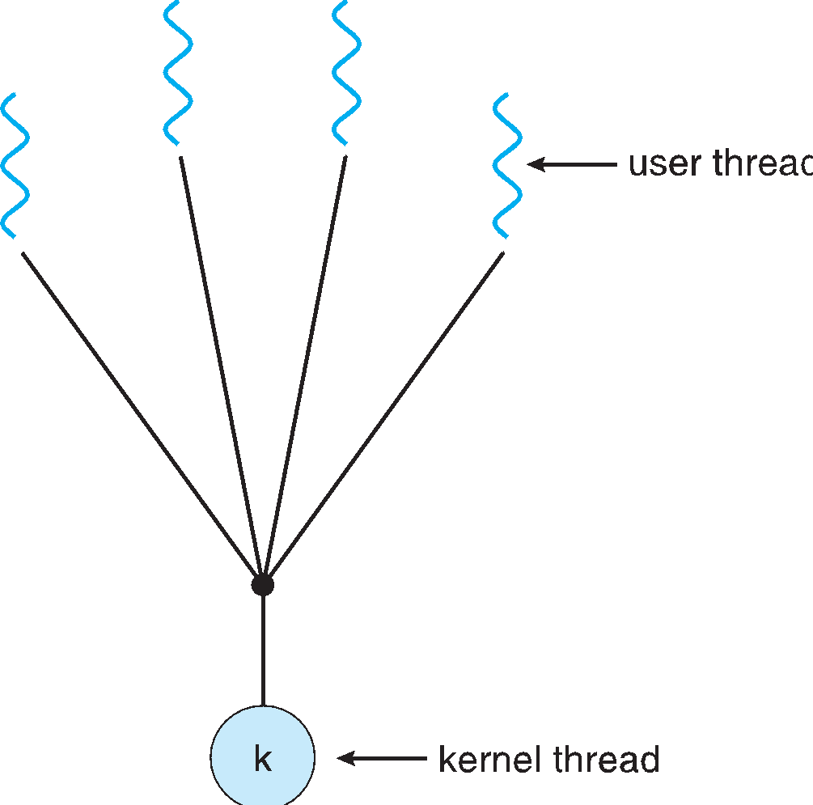
Many-to-One
Many user-level threads mapped to single kernel thread
One thread blocking causes all to block
Multiple threads may not run in parallel on muticore system because only one may be in kernel at a time
Few systems currently use this model
Examples:
  Solaris Green Threads
  GNU Portable Threads
Notes:
*

Slide 5
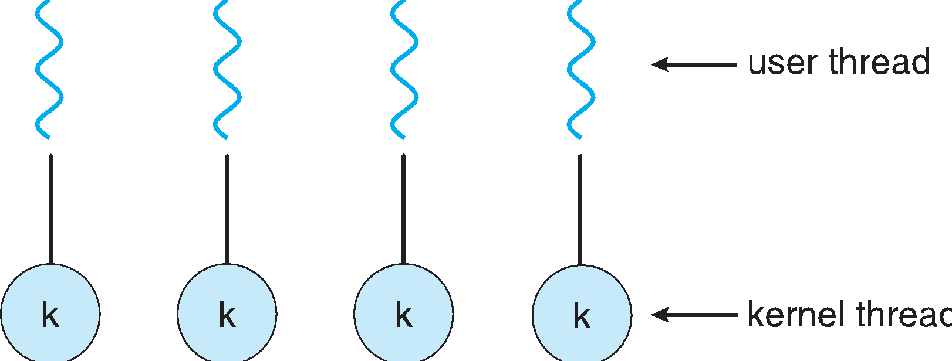
One-to-One
Each user-level thread maps to kernel thread
Creating a user-level thread creates a kernel thread
More concurrency than many-to-one
Number of threads per process sometimes restricted due to overhead
Examples
  Windows NT/XP/2000
  Linux
  Solaris 9 and later
Notes:
*

Slide 6
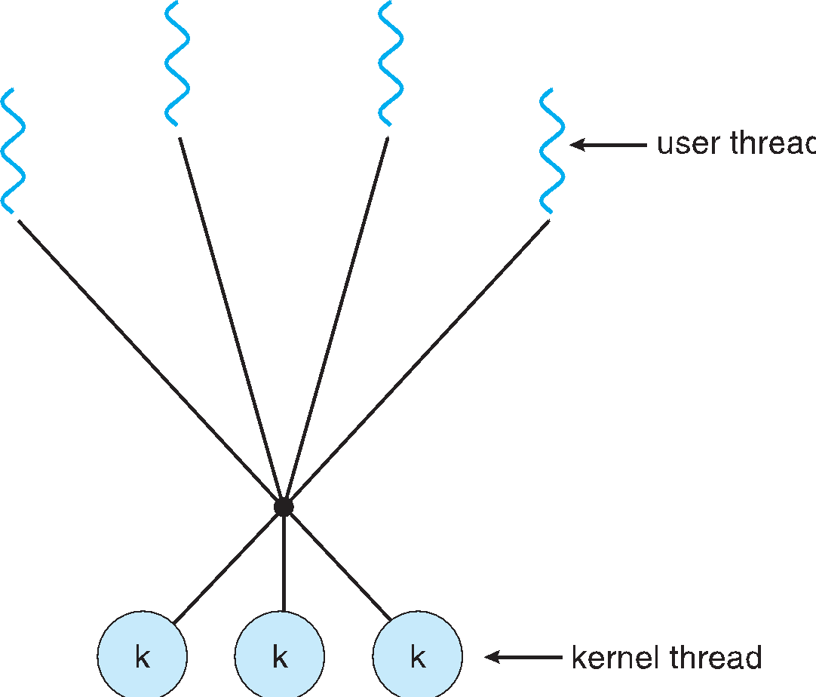
Many-to-Many Model
Allows many user level threads to be mapped to many kernel threads
Allows the operating system to create a sufficient number of kernel threads
Solaris prior to version 9
Windows NT/2000 with the ThreadFiber package
Notes:
*

Slide 7
Pthreads
May be provided either as user-level or kernel-level
A POSIX standard (IEEE 1003.1c) API for thread creation and synchronization
Specification, not implementation
API specifies behavior of the thread library, implementation is up to development of the library
Common in UNIX operating systems (Solaris, Linux, Mac OS X)
Notes:
*

Slide 8
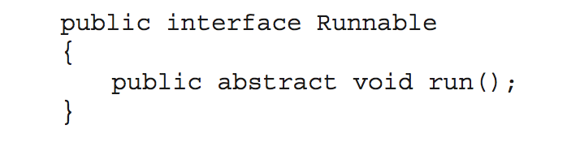
Java Threads
Java threads are managed by the JVM
Typically implemented using the threads model provided by underlying OS
Java threads may be created by:
  Extending Thread class
  Implementing the Runnable interface
Notes:
*

Slide 9
Implicit Threading
Growing in popularity as numbers of threads increase, program correctness more difficult with explicit threads
Creation and management of threads done by compilers and run-time libraries rather than programmers
Three methods explored
  Thread Pools
  OpenMP
  Grand Central Dispatch
Other methods include Microsoft Threading Building Blocks (TBB), java.util.concurrent package
Notes:
*

