Slide 1
Practical TCP/IP and Ethernet

Slide 2
Practical TCP/IP and Ethernet
Recall the TCP/IP Model
Each layer speaks its own protocol, e.g. for Web
Layer 7: HTTP
Layer 4: TCP
Layer 3: IP
Layer 2: Ethernet
Layer 1: Voltage
Data is encapsulated as it moves from higher to lower layers and decapsulated as it moves from lower to higher layers.
Application
Transport
Network
Data Link
Physical

Slide 3
Practical TCP/IP and Ethernet
Recall the TCP/IP Model
Each layer speaks its own protocol, e.g. for Web
Layer 7: HTTP
Layer 4: TCP
Layer 3: IP
Layer 2: Ethernet
Layer 1: Voltage
Data is encapsulated as it moves from higher to lower layers and decapsulated as it moves from lower to higher layers.
Application
Transport
Network
Key idea: each layer has its own component of an address identifying a unique endpoint of communication.
Data Link
Physical

Slide 4
Practical TCP/IP and Ethernet
Protocol Data Units
Layer 7: HTTP Example
GET / HTTP/1.1
Host: example.iana.org
Plain text request
HTTP/1.1 200 OK
Content-Type: text/html
Content-Length: 136
Server: Apache/2.2.3
<!doctype html>
<html><head>...
Plain text response

Slide 5
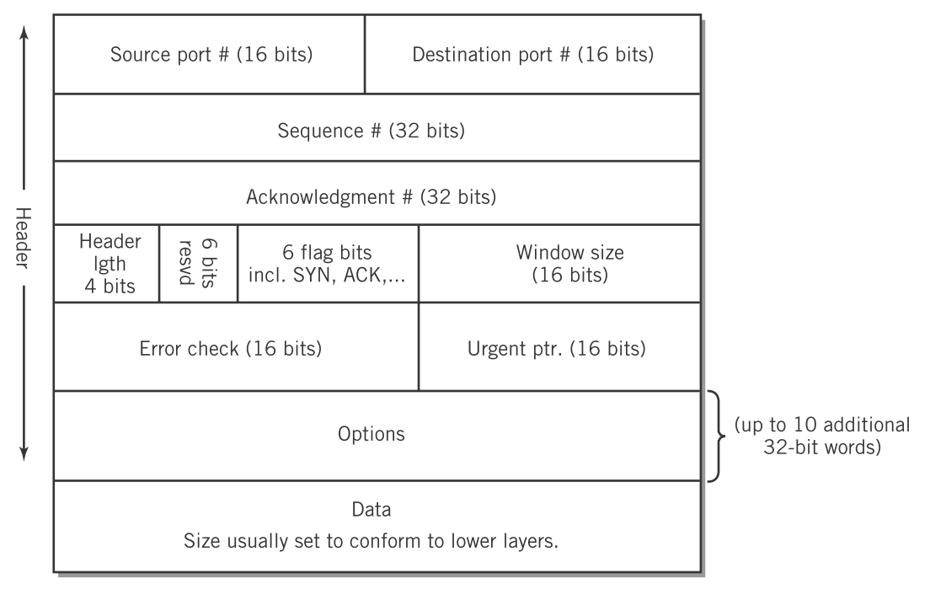
Practical TCP/IP and Ethernet
Protocol Data Units
Layer 4: TCP
Englander, 2009, p. 430

Slide 6
Practical TCP/IP and Ethernet
Protocol Data Units
Layer 4: TCP
Ports are the address of the application on the host. Web servers listen on port 80. Web browsers send from ephemeral ports in the range 49152 to 65535.
Englander, 2009, p. 430

Slide 7
Practical TCP/IP and Ethernet
Protocol Data Units
Layer 4: TCP
Sequence and acknowledgement numbers allow the stream to be reconstructed in order and dropped packets to be retransmitted.
Englander, 2009, p. 430

Slide 8
Practical TCP/IP and Ethernet
Protocol Data Units
Layer 4: TCP
Flags allow for initiating and closing connections and synchronizing sequence and acknowledgement numbers.
Englander, 2009, p. 430

Slide 9
Practical TCP/IP and Ethernet
Protocol Data Units
Layer 4: TCP
The widow size allows for congestion and flow control.
Englander, 2009, p. 430

Slide 10
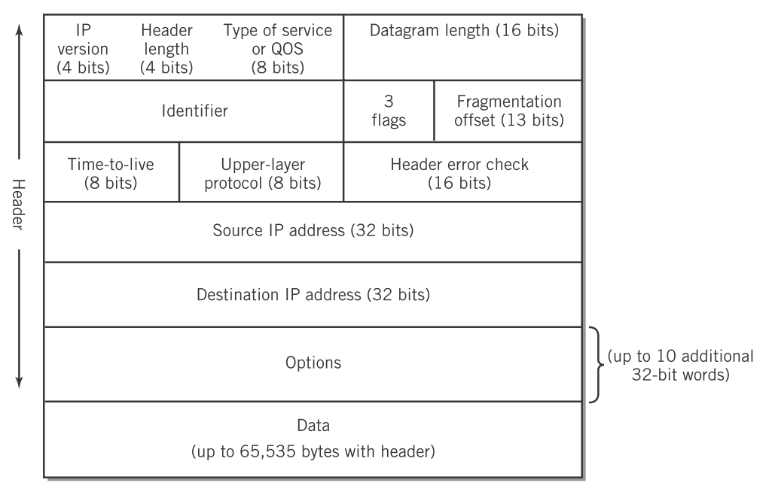
Practical TCP/IP and Ethernet
Protocol Data Units
Layer 3: IP
Englander, 2009, p. 430

Slide 11
Practical TCP/IP and Ethernet
Protocol Data Units
Layer 3: IP
The globally unique address of the source and destination hosts on the Internet
Englander, 2009, p. 430

Slide 12
Practical TCP/IP and Ethernet
Protocol Data Units
Layer 2: Ethernet
Englander, 2009, p. 436

Slide 13
Practical TCP/IP and Ethernet
Protocol Data Units
Layer 2: Ethernet
The unique hardware address of the network card source and next hop destination

Slide 14
Practical TCP/IP and Ethernet
PDU Summary
Layer | PDU name | Address
7 | Data | URL
4 | Segment | Port
3 | Packet | IP address
2 | Frame | MAC address
Proxies work at layer 7 and 4
Routers and firewalls work at layer 3
Switches work at layer 2

Slide 15
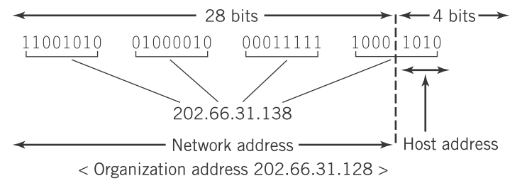
Practical TCP/IP and Ethernet
IP addressing
32-bits, typically divided into 4 octets
An arbitrary dividing line (a netmask or VLSM—variable length subnet mask) separates the network portion from the host portion.
202.66.31.138/28 or a netmask of 255.255.255.240

Slide 16
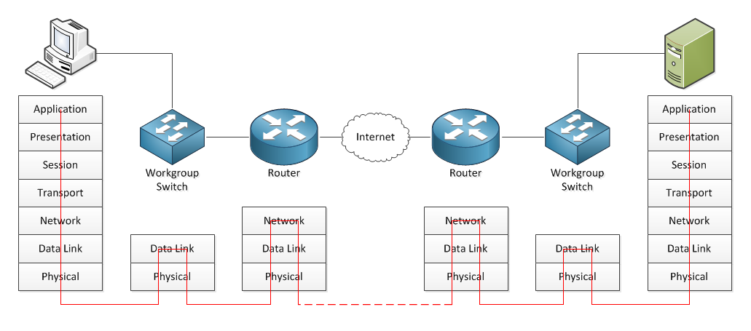
Practical TCP/IP and Ethernet
Delivery
How does data move through the network?
Step 1: PC sends a web request to 65.215.65.132. Comparing destination IP against the network portion of the PC’s IP indicates they are on different networks.

Slide 17
Practical TCP/IP and Ethernet
Delivery
How does data move through the network?
Step 2: PC uses it’s configured default gateway and sends an ARP request to get a MAC address for the router. The router responds with it’s MAC address.

Slide 18
Practical TCP/IP and Ethernet
Delivery
How does data move through the network?
Step 3: PC takes the HTTP data and encapsulates it in a TCP segment in an IP packet (with the web server’s IP address) in an Ethernet frame using the gateway’s MAC address. Send.

Slide 19
Practical TCP/IP and Ethernet
Delivery
How does data move through the network?
Step 4: Switch receives frame, examines destination MAC and looks up the right port to send it back out. Forward to router.

Slide 20
Practical TCP/IP and Ethernet
Delivery
How does data move through the network?
Step 5: Router receives frame, strips it, and examines the destination IP address. It’s on a different network, and so it forwards to its gateway.

Slide 21
Practical TCP/IP and Ethernet
Delivery
How does data move through the network?
Step 6: The packet is routed to a to the web server’s ISP.

Slide 22
Practical TCP/IP and Ethernet
Delivery
How does data move through the network?
Step 7: The border router receives the packet and recognizes the destination is on it’s local network. It ARPs for the MAC address of the server and frames it. Send.

Slide 23
Practical TCP/IP and Ethernet
Delivery
How does data move through the network?
Step 8: The switch receives the frame, looks up the MAC address of the server in its switching table, and forwards it out the appropriate port.

Slide 24
Practical TCP/IP and Ethernet
Delivery
How does data move through the network?
Step 9: The server receives and strips the frame, packet, and segment to receive the data. Process is reversed to send the reply back to the PC.

Slide 25
Practical TCP/IP and Ethernet
Summary
Each protocol data unit contains addressing information: segments have ports, packets have IP addresses, and frames have MAC addresses.
IP addresses are divided into a network address and a host address within that network.
MAC addresses form the basis for a single hop between directly connected devices; IP addresses connect between hosts on different networks; segments connect between applications on each host.
Switching happens at layer 2 while routing happens at layer 3.

Slide 26
References
Englander, I. (2009). The architecture of computer hardware and systems software: an information technology approach. Wiley.

