Slide 1
CHAPTER 10: Computer Peripherals
The Architecture of Computer Hardware, Systems Software & Networking: An Information Technology Approach
4th Edition, Irv Englander
John Wiley and Sons ©2010
PowerPoint slides authored by Wilson Wong, Bentley University
PowerPoint slides for the 3rd edition were co-authored with Lynne Senne, Bentley College

Slide 2
Peripherals
Devices that are separate from the basic computer
Not the CPU, memory, or power supply
Classified as input, output, and storage
Connect via
Ports
Interface to systems bus
Copyright 2010 John Wiley & Sons, Inc.
10-*

Slide 3
Storage Devices
Primary memory
Secondary storage
Data and programs must be copied to primary memory for CPU access
Permanence of data - nonvolatile
Direct access storage devices (DASDs)
Online storage
Offline storage – loaded when needed
Network file storage
File servers, web servers, database servers
Copyright 2010 John Wiley & Sons, Inc.
10-*

Slide 4
Speed
Measured by access time and data transfer rate
Access time: average time it takes a computer to locate data and read it
millisecond = one-thousandth of a second
Data transfer rate: amount of data that moves per second
Copyright 2010 John Wiley & Sons, Inc.
10-*

Slide 5
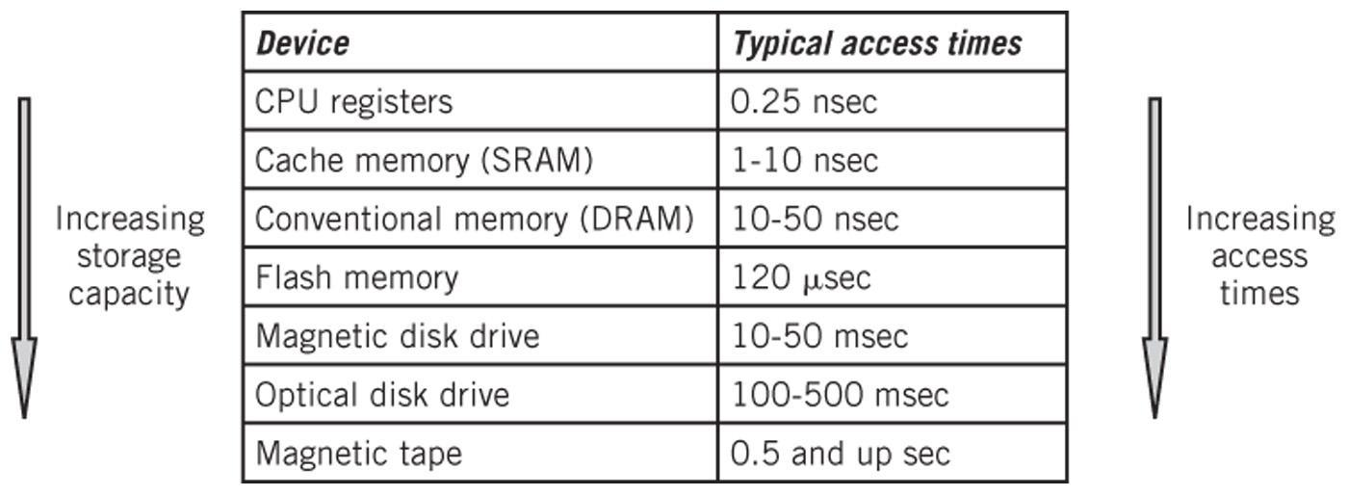
Storage Hierarchy
Copyright 2010 John Wiley & Sons, Inc.
10-*

Slide 6
Secondary Storage Devices
Solid state memory
Magnetic disks
Optical disk storage
Magnetic tape
Network storage
Characteristics
Rotation vs. Linear
Direct access vs. Sequential access
Copyright 2010 John Wiley & Sons, Inc.
10-*

Slide 7
Flash Memory
Nonvolatile electronic integrated circuit memory
Similar to other read-only memory but uses a different technology
Permits reading and writing individual bytes or small blocks of data
Small size makes it useful in portable devices such as USB “thumb drives”, digital cameras, cell phones, music players
Relatively immune to physical shocks
Generates little heat or noise
Copyright 2010 John Wiley & Sons, Inc.
10-*

Slide 8
Disk Layouts – CAV vs. CLV
CAV – Constant Angular Velocity
Number of bits on each track is the same! Denser towards the center.
Spins the same speed for every track
CLV – Constant Linear Velocity
All tracks have the same physical length and number of bits
Constant speed reading data off a track
Drive has to speed up when accessing close to the center of the drive and slow down when accessing towards the edge of the drive
Copyright 2010 John Wiley & Sons, Inc.
10-*

Slide 9
Disk Layout – Multiple Zone
Multiple zone recording
Also known as zone bit recording (ZBR) or zone-CAV recording (Z-CAV)
Compromise between CAV and CLV
Disk divided into zones
Cylinders in different zones have a different number of sectors
Number of sectors in a particular zone is constant
Data is buffered so the data rate to the I/O interface is constant
Copyright 2010 John Wiley & Sons, Inc.
10-*

Slide 10
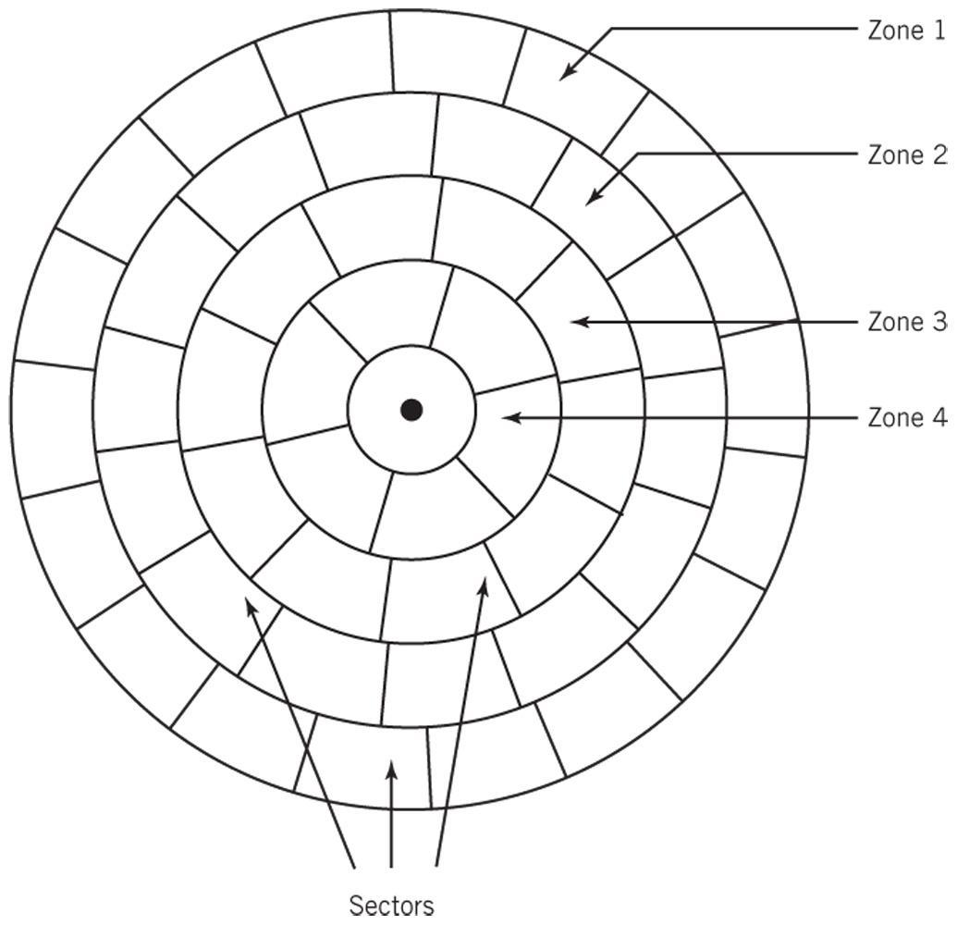
Multiple-Zone Disk Configuration
Copyright 2010 John Wiley & Sons, Inc.
10-*

Slide 11
Magnetic Disks
Track – circle
Cylinder – same track on all platters
Block – small arc of a track
Sector – pie-shaped part of a platter
Head – reads data off the disk as disk rotates at high speed (4200-14000 RPM)
Head crash
Disk damaged if head touches disk surface
Parked heads
Copyright 2010 John Wiley & Sons, Inc.
10-*

Slide 12
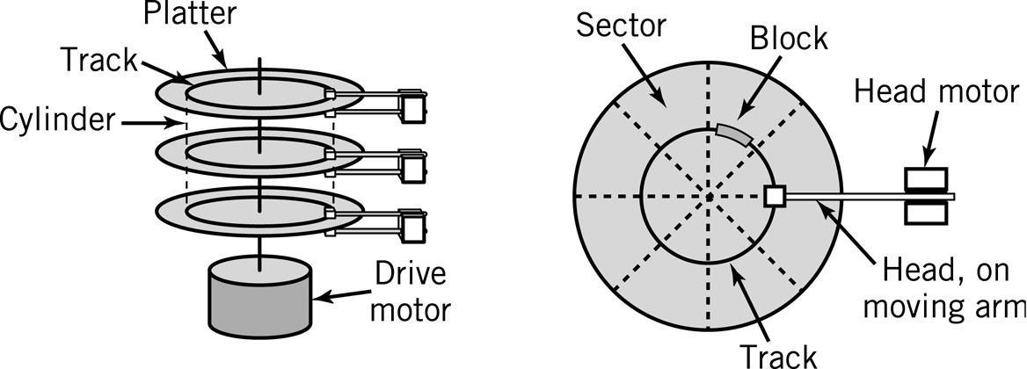
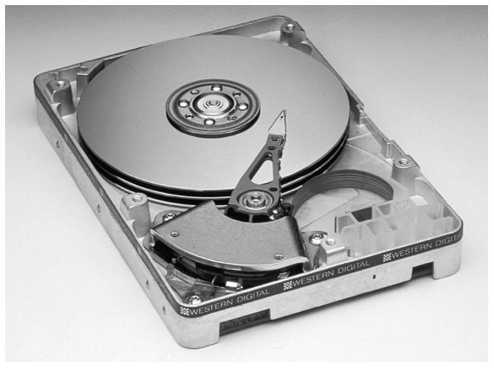
A Hard Disk Layout
Copyright 2010 John Wiley & Sons, Inc.
10-*
Notes:
*

Slide 13
Locating a Block of Data
Average seek time: time required to move from one track to another
Latency: time required for disk to rotate to beginning of correct sector
Transfer time: time required to transfer a block of data to the disk controller buffer
Copyright 2010 John Wiley & Sons, Inc.
10-*
Notes:
*

Slide 14
Disk Access Times
Average Seek time
average time to move from one track to another
Average Latency time
average time to rotate to the beginning of the sector
Average Latency time = ½ * 1/rotational speed
Transfer time
1/(# of sectors * rotational speed)
Total Time to access a disk block
Avg. seek time + avg. latency time + avg. transfer time
Copyright 2010 John Wiley & Sons, Inc.
10-*

Slide 15
Magnetic Disks
Data Block Format
Interblock gap
Header
Data
Formatting disk
Establishes the track positions, blocks and headers needed before use of the disk
Copyright 2010 John Wiley & Sons, Inc.
10-*

Slide 16
Disk Block Formats
Single Data Block
Header for Windows disk
Copyright 2010 John Wiley & Sons, Inc.
10-*

Slide 17
Disk Arrays
Grouping of multiple disks together
RAID – Redundant Array of Inexpensive Disks
Mirrored array
Striped array
RAID 0 to RAID 5
Copyright 2010 John Wiley & Sons, Inc.
10-*

Slide 18
RAID – Mirrored
Pair of disks contain the exact same stores of data
Reading data – alternate blocks of data are read from hard drives and combined
Access time is reduced by approximately a factor equal to the number of disk drives in array
Read failure – block is marked and then read from the mirrored drive
When using three or more mirrored drives, majority logic is used in the event of a failure. Fault-tolerant computers use this technique.
Copyright 2010 John Wiley & Sons, Inc.
10-*

Slide 19
RAID - Striped
A file segment is stored divided into blocks on different disks
Minimum of three drives needed because one disk drive is reserved for error checking
Writes – block of parity words from each block of data is created and put on the reserved error checking disk
Reads – parity data is used to check original data
Copyright 2010 John Wiley & Sons, Inc.
10-*

Slide 20
RAID Levels
RAID 0 – not true RAID, no error checking or redundancy, but data is placed across all drives for increased speed
RAID 1 – mirrored array
RAID 2, 3, 4 – arrays that are striped in different ways
RAID 5 – error checking blocks are spread across all drives
Copyright 2010 John Wiley & Sons, Inc.
10-*

Slide 21
Optical Storage
Reflected light off a mirrored or pitted surface
CD-ROM
650 MB of data, approximately 550 MB after formatting and error checking
Spiral 3 miles long, containing 15 billion bits!
CLV – all blocks are same physical length
Block – 2352 bytes
2k of data (2048 bytes)
16 bytes for header (12 start, 4 id)
288 bytes for advanced error control
DVD – similar technology to CD-ROM
WORM – write-once read-many
Copyright 2010 John Wiley & Sons, Inc.
10-*

Slide 22
Optical Storage
Laser strikes land: light reflected into detector
Laser strikes a pit: light scattered
Copyright 2010 John Wiley & Sons, Inc.
10-*
Notes:
*

Slide 23
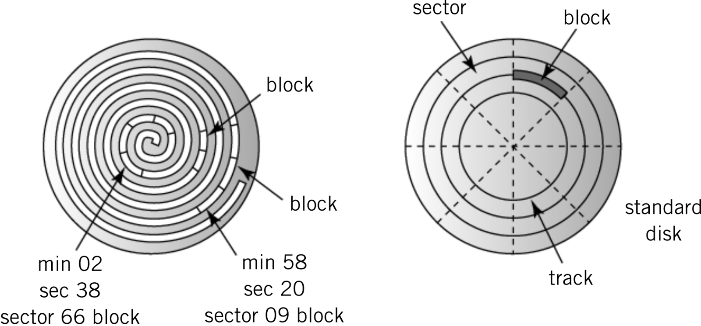
Layout: CD-ROM vs. Standard Disk
CD-ROM
Hard Disk
Copyright 2010 John Wiley & Sons, Inc.
10-*
Notes:
*

Slide 24
Types of Optical Storage
WORM Disks
Write-once-read-many times
Medium can be altered by using a medium-powered laser to blister the surface
Medium-powered laser blister technology also used for
CD-R, DVD-R, DVD-R, DVD+R
CD-RW, DVD-RW, DVD+RW, DVD-RAM, DVD+RAMBD-RE
File compatibility issues between the different CD, DVD and WORM formats
Copyright 2010 John Wiley & Sons, Inc.
10-*

Slide 25
Magnetic Tape
Offline storage
Archival purposes
Disaster recovery
Tape Cartridges
Linear tape open format vs. helical scan tape format
Copyright 2010 John Wiley & Sons, Inc.
10-*

Slide 26
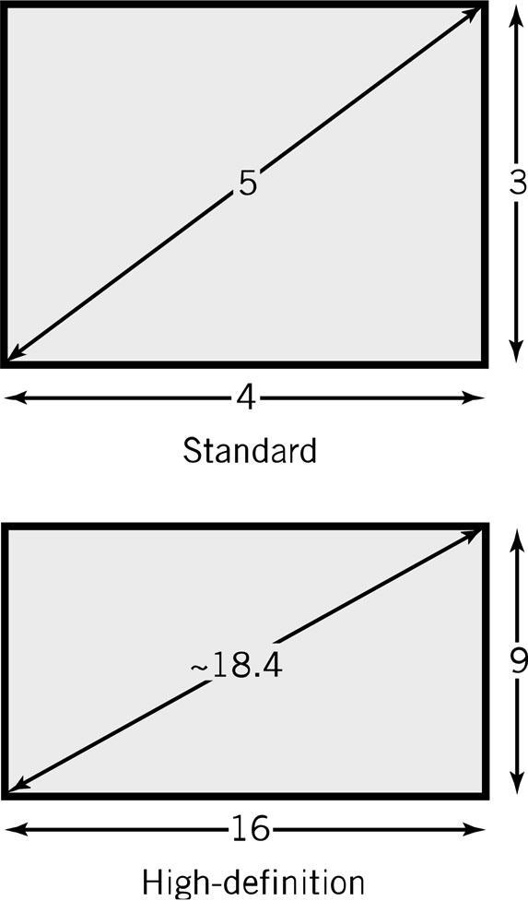
Displays
Pixel – picture element
Screen Size: diagonal length of screen
Aspect ratio – X pixels to Y pixels
4:3 – older displays
16:9 – widescreen displays
Pixel color is determined by intensity of 3 colors – Red, Green and Blue (RGB)
True Color – 8 bits for each color
256 levels of intensity for each color
256 * 256 * 256 = 16.7 million colors
Copyright 2010 John Wiley & Sons, Inc.
10-*

Slide 27
Resolution and Picture Size
Resolution
Measured as either number of pixels per inch or size of an individual pixel
Screen resolution examples:
768 x 1024
1440 x 900
1920 x 1080
Picture size calculation
Resolution * bits required to represent number of colors in picture
Example: resolution is 100 pixels by 50 pixels, 4 bits required for a 16 color image
100 * 50 * 4 bits = 20,000 bits
Video memory requirements are significant!
Copyright 2010 John Wiley & Sons, Inc.
10-*

Slide 28
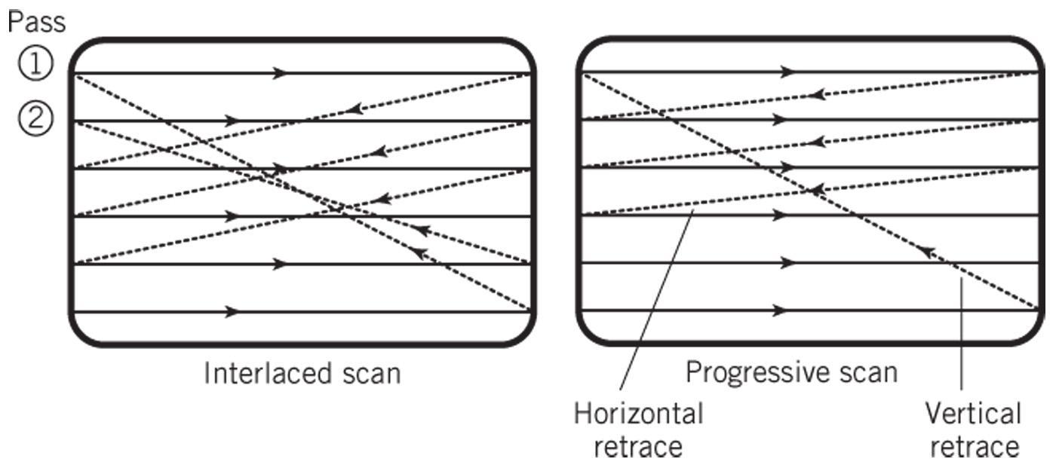
Interlaced vs. Progressive Scan
Copyright 2010 John Wiley & Sons, Inc.
10-*

Slide 29
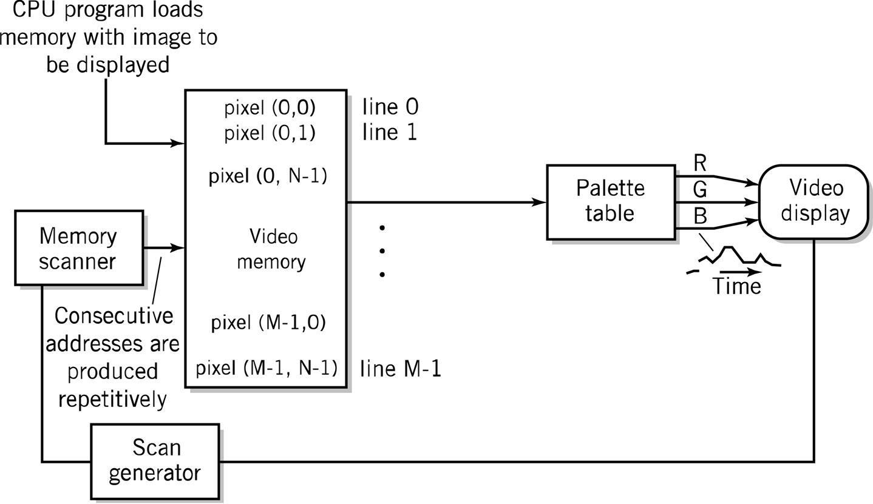
Diagram of Raster Screen Generation Process
Copyright 2010 John Wiley & Sons, Inc.
10-*

Slide 30
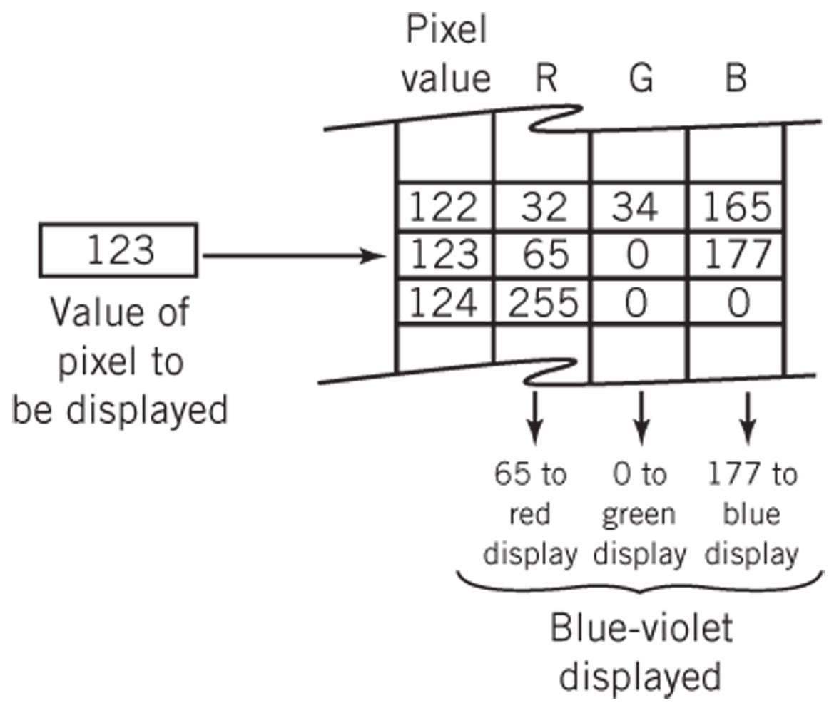
Color Transformation Table
Copyright 2010 John Wiley & Sons, Inc.
10-*

Slide 31
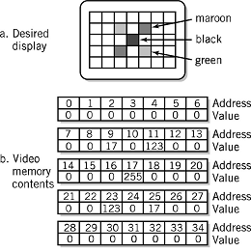
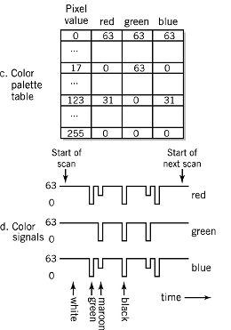
Display Example
Copyright 2010 John Wiley & Sons, Inc.
10-*

Slide 32
LCD – Liquid Crystal Display
Fluorescent light or LED panel
3 color cells per pixel
Operation
1st filter polarizes light in a specific direction
Electric charge rotates molecules in liquid crystal cells proportional to the strength of colors
Color filters only let through red, green, and blue light
Final filter lets through the brightness of light proportional to the polarization twist
Copyright 2010 John Wiley & Sons, Inc.
10-*

Slide 33
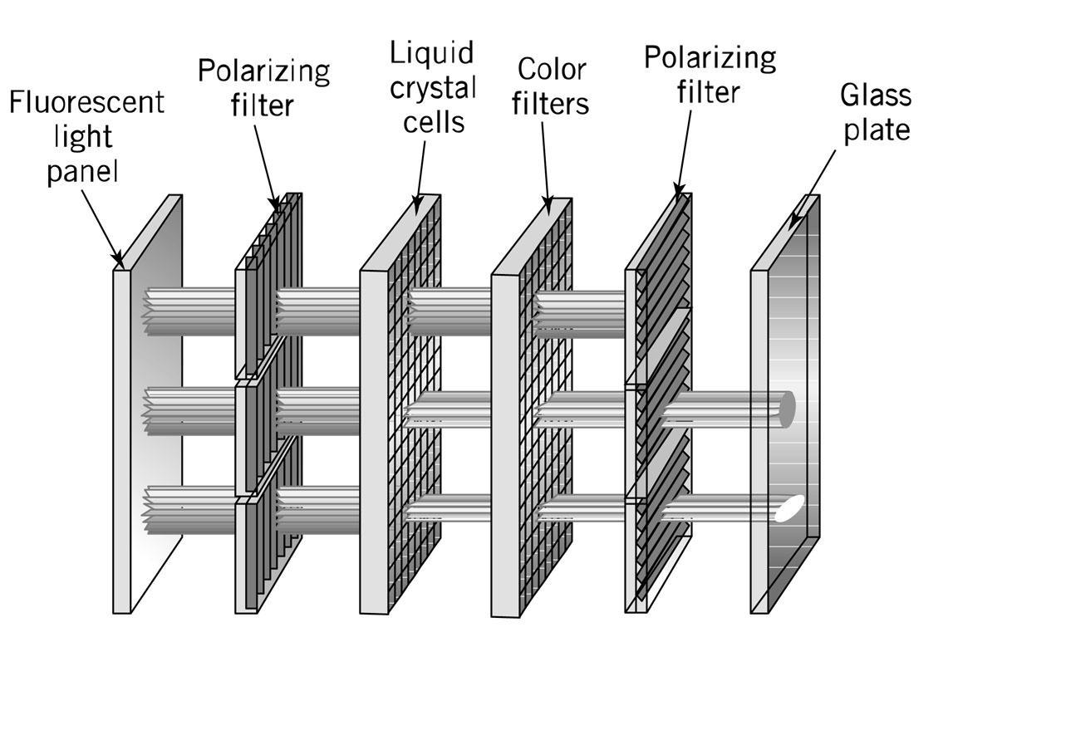
Liquid Crystal Display
Copyright 2010 John Wiley & Sons, Inc.
10-*

Slide 34
LCDs (continued)
Active matrix
One transistor per cell
More expensive
Brighter picture
Passive matrix
One transistor per row or column
Each cell is lit in succession
Display is dimmer since pixels are lit less frequently
Copyright 2010 John Wiley & Sons, Inc.
10-*

Slide 35
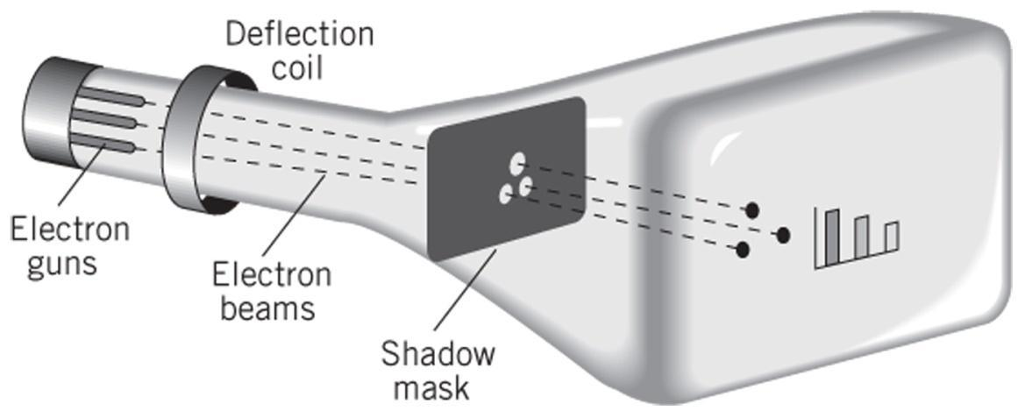
CRT Display Technology
CRTs (similar to TVs)
3 stripes of phosphors for each color
3 separate electron guns for each color
Strength of beam → brightness of color
Raster scan
30x per second
Interlaced vs. non-interlaced (progressive scan)
Copyright 2010 John Wiley & Sons, Inc.
10-*

Slide 36
OLED Display Technology
No backlight
Consists of red, green and blue LEDs
Each LED lights up individually
Very thin displays with panels less than 3mm thick!
Copyright 2010 John Wiley & Sons, Inc.
10-*

Slide 37
Printers
Dots vs. pixels
300-2400 dpi vs. 70-100 pixels per inch
Dots are on or off, pixels have intensities
Types
Typewriter / Daisy wheels – obsolete
Impact printing - dot matrix – mostly obsolete
Inkjet – squirts heated droplets of ink
Laser printer
Thermal wax transfer
Dye Sublimation
Copyright 2010 John Wiley & Sons, Inc.
10-*

Slide 38
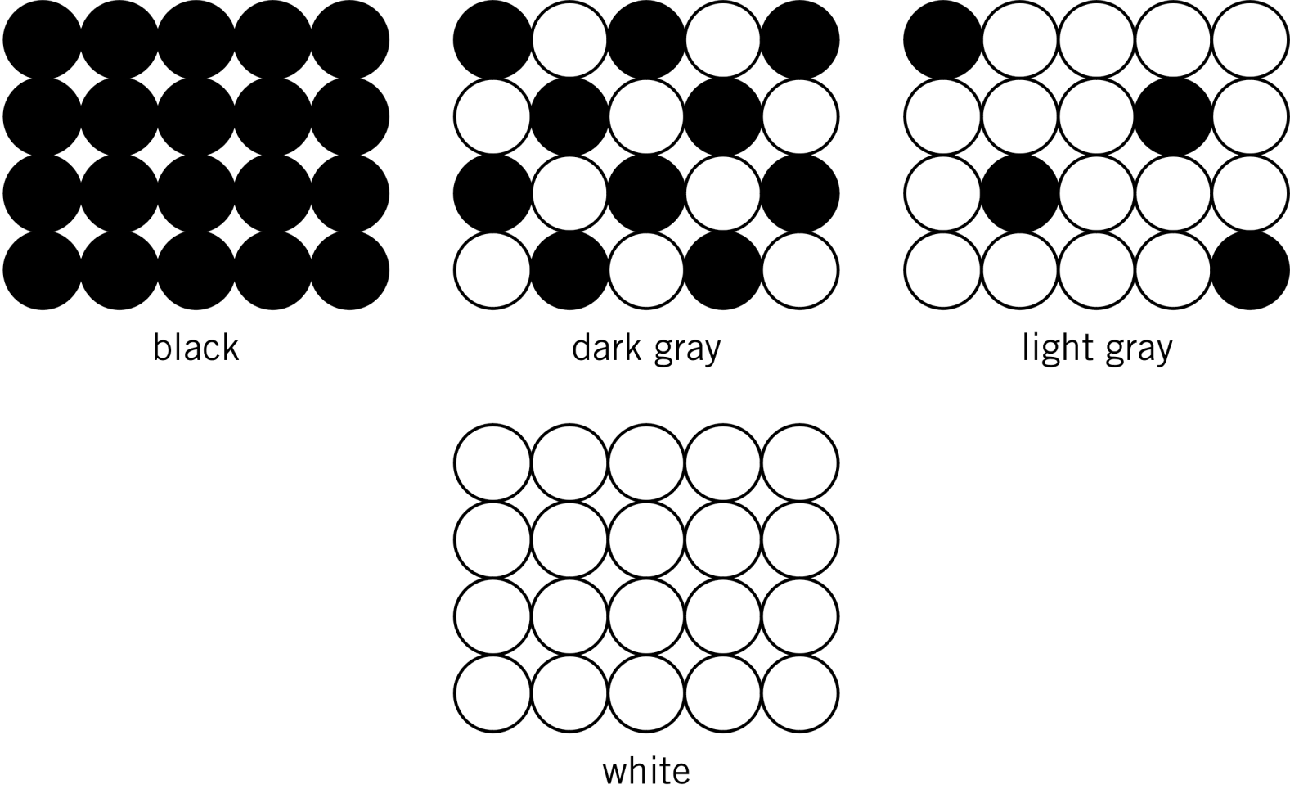
Creating a Gray Scale
Copyright 2010 John Wiley & Sons, Inc.
10-*
Notes:
*

Slide 39
Laser Printer Operation
Dots of laser light are beamed onto a drum
Drum becomes electrically charged
Drum passes through toner which then sticks to the electrically charged places
Electrically charged paper is fed toward the drum
Toner is transferred from the drum to the paper
The fusing system heats and melts the toner onto the paper
A corona wire resets the electrical charge on the drum
Copyright 2010 John Wiley & Sons, Inc.
10-*

Slide 40
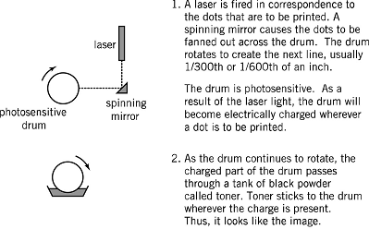
Laser Printer Operation
Copyright 2010 John Wiley & Sons, Inc.
10-*

Slide 41
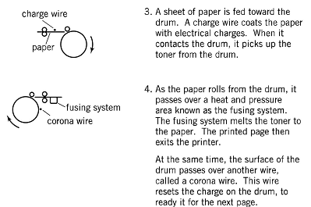
Laser Printer Operation
Copyright 2010 John Wiley & Sons, Inc.
10-*

Slide 42
Other Computer Peripherals
Scanners
Flatbed, sheet-fed, hand-held
Light is reflected off the sheet of paper
User Input Devices
Keyboard, mouse, light pens, graphics tablets
Communication Devices
Telephone modems
Network devices
Copyright 2010 John Wiley & Sons, Inc.
10-*

Slide 43
Network Communication Devices
Network is just another I/O device
Network I/O controller is the network interface card (NIC)
Types of network connections
Ethernet, FDDI fiber, token-ring
Medium access control (MAC) protocols
Define the specific rules of communication for the network
Copyright 2010 John Wiley & Sons, Inc.
10-*

Slide 44
Copyright 2010 John Wiley & Sons
All rights reserved. Reproduction or translation of this work beyond that permitted in section 117 of the 1976 United States Copyright Act without express permission of the copyright owner is unlawful. Request for further information should be addressed to the Permissions Department, John Wiley & Sons, Inc. The purchaser may make back-up copies for his/her own use only and not for distribution or resale. The Publisher assumes no responsibility for errors, omissions, or damages caused by the use of these programs or from the use of the information contained herein.”
Copyright 2010 John Wiley & Sons, Inc.
10-*

