Slide 1
Programmed I/O, Interrupts, and DMA

Slide 2
Programmed I/O, Interrupts, and DMA
Input/Output Characteristics
Many orders of magnitude slower than memory
Character vs. block based
Burst vs. steady transfers
Three approaches to I/O
Programmed
Interrupt-driven
Direct memory access

Slide 3
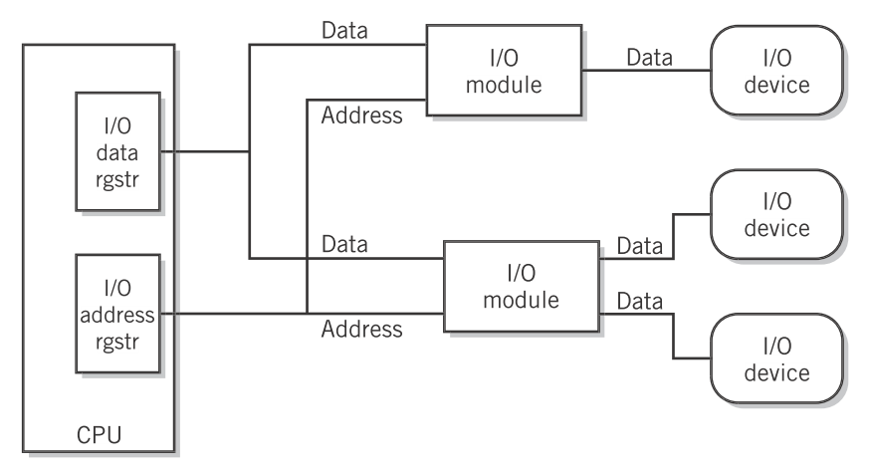
Programmed I/O, Interrupts, and DMA
Programmed I/O
CPU is responsible for reading/writing to devices
Special “input” instruction on CPU
I/O data register and I/O address register
Each device is assigned a unique address.
Englander, 2009, p. 283

Slide 4
Programmed I/O, Interrupts, and DMA
Programmed I/O
Memory mapped I/O alternative
Treat the I/O device as a memory address for reads and writes. Simplifies programmer interface; slightly more complicated control circuitry.
Problems with all programmed I/O
Must check status bits to see if I/O is “ready.”
Use a polling loop (busy-wait) to send and receive data to devices.

Slide 5
Programmed I/O, Interrupts, and DMA
SET kbdStatus, r1 ; addr of status
wait: LOAD [r1], r2 ; load status data
AND r2, 1, r2 ; check ready flag
BRZ wait ;
SET kbdBuff, r1 ; addr of data
LOAD [r1], r2 ; r2 has keypress
Programmed I/O
Memory mapped I/O alternative
Treat the I/O device as a memory address for reads and writes. Simplifies programmer interface; slightly more complicated control circuitry.
Problems with all programmed I/O
Must check status bits to see if I/O is “ready.”
Use a polling loop (busy-wait) to send and receive data to devices.

Slide 6
Programmed I/O, Interrupts, and DMA
Interrupts
Busy-waits (polling) wastes resources but has simpler hardware.
Alternative: After an I/O request from the CPU, let the I/O device notify the CPU when data is ready to be read (called an interrupt).
Each device is assigned an IRQ line (signal).
I/O controller sets IRQ line status high.
CPU detects IRQ at beginning of fetch/execute.
CPU saves state of running program and switches to an IRQ handler routine.
Routine services the request.
Control is returned to the previously running code.

Slide 7
Programmed I/O, Interrupts, and DMA
Interrupts
Changes to fetch/execute cycle

Slide 8
Programmed I/O, Interrupts, and DMA
Issues:
Additional control hardware
Queuing of interrupts
Masking interrupts
Registering handlers (part of the OS)
Interrupts
Changes to fetch/execute cycle

Slide 9
Programmed I/O, Interrupts, and DMA
Interrupts
Problems with interrupt driven I/O
CPU still involved with each interrupt
Only transfers a single byte/word

Slide 10
Programmed I/O, Interrupts, and DMA
Interrupts
Problems with interrupt driven I/O
CPU still involved with each interrupt
Only transfers a single byte/word
Disk or network transfers may be hundreds or thousands of bytes. IRQ handler code may be hundreds of instructions. Still too much overhead.

Slide 11
Programmed I/O, Interrupts, and DMA
DMA
Direct Memory Access (DMA)
Add a specialized kind of CPU that can directly transfer data from device to memory.

Slide 12
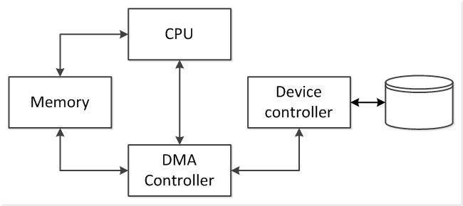
Programmed I/O, Interrupts, and DMA
DMA
Direct Memory Access (DMA)
Add a specialized kind of CPU that can directly transfer data from device to memory.

Slide 13
Programmed I/O, Interrupts, and DMA
DMA
Direct Memory Access (DMA)
Add a specialized kind of CPU that can directly transfer data from device to memory.
CPU uses PIO to specify memory address, operation (read/write), byte count, and block location on disk.

Slide 14
Programmed I/O, Interrupts, and DMA
DMA
Direct Memory Access (DMA)
Add a specialized kind of CPU that can directly transfer data from device to memory.
DMA controller initiates I/O with the device controller.

Slide 15
Programmed I/O, Interrupts, and DMA
DMA
Direct Memory Access (DMA)
Add a specialized kind of CPU that can directly transfer data from device to memory.
DMA controller receives data and transfers it to memory.

Slide 16
Programmed I/O, Interrupts, and DMA
DMA
Direct Memory Access (DMA)
Add a specialized kind of CPU that can directly transfer data from device to memory.
DMA controller interrupts CPU to notify data transfer is complete.

Slide 17
Programmed I/O, Interrupts, and DMA
DMA
Direct Memory Access (DMA)
Add a specialized kind of CPU that can directly transfer data from device to memory.
CPU handles interrupt. All bytes are in memory for processing.

Slide 18
Programmed I/O, Interrupts, and DMA
DMA
Direct Memory Access (DMA)
Add a specialized kind of CPU that can directly transfer data from device to memory.

Slide 19
Programmed I/O, Interrupts, and DMA
Summary
Purely programmed I/O requires special I/O instructions, I/O data and address registers, and polling loops that waste CPU resources.
Interrupt-driven I/O avoids busy-waiting but is unsuitable for large block transfers due to interrupt handler execution overhead.
DMA combines PIO and IRQ handlers with a special controller to transfer large amounts of block data efficiently directly to memory.

Slide 20
References
Englander, I. (2009). The architecture of computer hardware and systems software: an information technology approach. Wiley.

