Slide 1
CHAPTER 8: CPU and Memory Design, Enhancement, and Implementation
The Architecture of Computer Hardware, Systems Software & Networking: An Information Technology Approach
4th Edition, Irv Englander
John Wiley and Sons ©2010
PowerPoint slides authored by Wilson Wong, Bentley University
PowerPoint slides for the 3rd edition were co-authored with Lynne Senne, Bentley College

Slide 2
Current CPU Architectures
Current CPU Architecture Designs
Traditional modern architectures
VLIW (Transmeta) – Very Long Instruction Word
EPIC (Intel) – Explicitly Parallel Instruction Computer
Current CPU Architectures
IBM Mainframe series
Intel x86 family
IBM POWER/PowerPC family
Sun SPARC family
Copyright 2010 John Wiley & Sons, Inc.
8-*

Slide 3
Traditional Modern Architectures
Problems with early CPU Architectures and solutions:
Large number of specialized instructions were rarely used but added hardware complexity and slowed down other instructions
Slow data memory accesses could be reduced by increasing the number of general purpose registers
Using general registers to hold addresses could reduce the number of addressing modes and simplify architecture design
Fixed-length, fixed format instruction words would allow instructions to be fetched and decoded independently and in parallel
Copyright 2010 John Wiley & Sons, Inc.
8-*

Slide 4
VLIW Architecture
Transmeta Crusoe CPU
128-bit instruction bundle = molecule
Four 32-bit atoms (atom = instruction)
Parallel processing of 4 instructions
64 general purpose registers
Code morphing layer
Translates instructions written for other CPUs into molecules
Instructions are not written directly for the Crusoe CPU
Copyright 2010 John Wiley & Sons, Inc.
8-*

Slide 5
EPIC Architecture
128-bit instruction bundle
3 41-bit instructions
5 bits to identify type of instructions in bundle
128 64-bit general purpose registers
128 82-bit floating point registers
Intel X86 instruction set included
Programmers and compilers follow guidelines to ensure parallel execution of instructions
Copyright 2010 John Wiley & Sons, Inc.
8-*

Slide 6
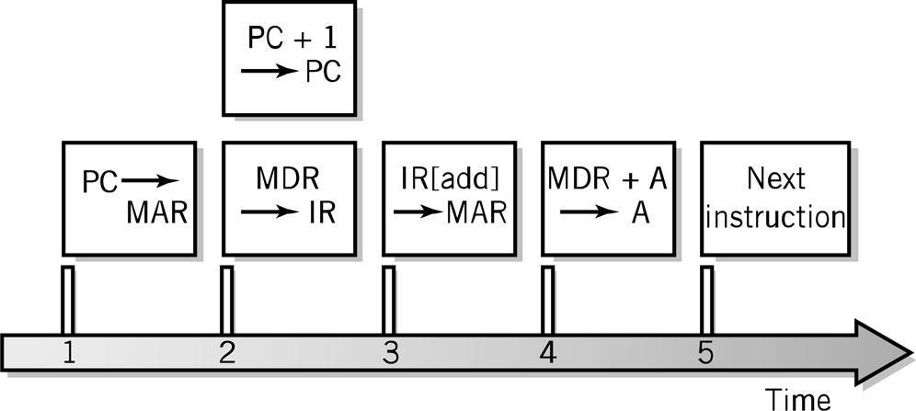
Fetch-Execute Cycle Timing Issues
Computer clock is used for timing purposes for each step of the instruction cycle
GHz (gighertz) – billion steps per second
Instructions can (and often) take more than one step
Data word width can require multiple steps
Fetch-execute timing diagram
Copyright 2010 John Wiley & Sons, Inc.
8-*

Slide 7
CPU Features and Enhancements
Separate Fetch/Execute Units
Pipelining
Multiple, Parallel Execution Units
Scalar Processing
Superscalar Processing
Branch Instruction Processing
Copyright 2010 John Wiley & Sons, Inc.
8-*

Slide 8
Separate Fetch-Execute Units
Fetch Unit
Instruction fetch unit
Instruction decode unit
Determine opcode
Identify type of instruction and operands
Several instructions are fetched in parallel and held in a buffer until decoded and executed
IP – Instruction Pointer register holds instruction location of current being processed
Execute Unit
Receives instructions from the decode unit
Appropriate execution unit services the instruction
Copyright 2010 John Wiley & Sons, Inc.
8-*

Slide 9
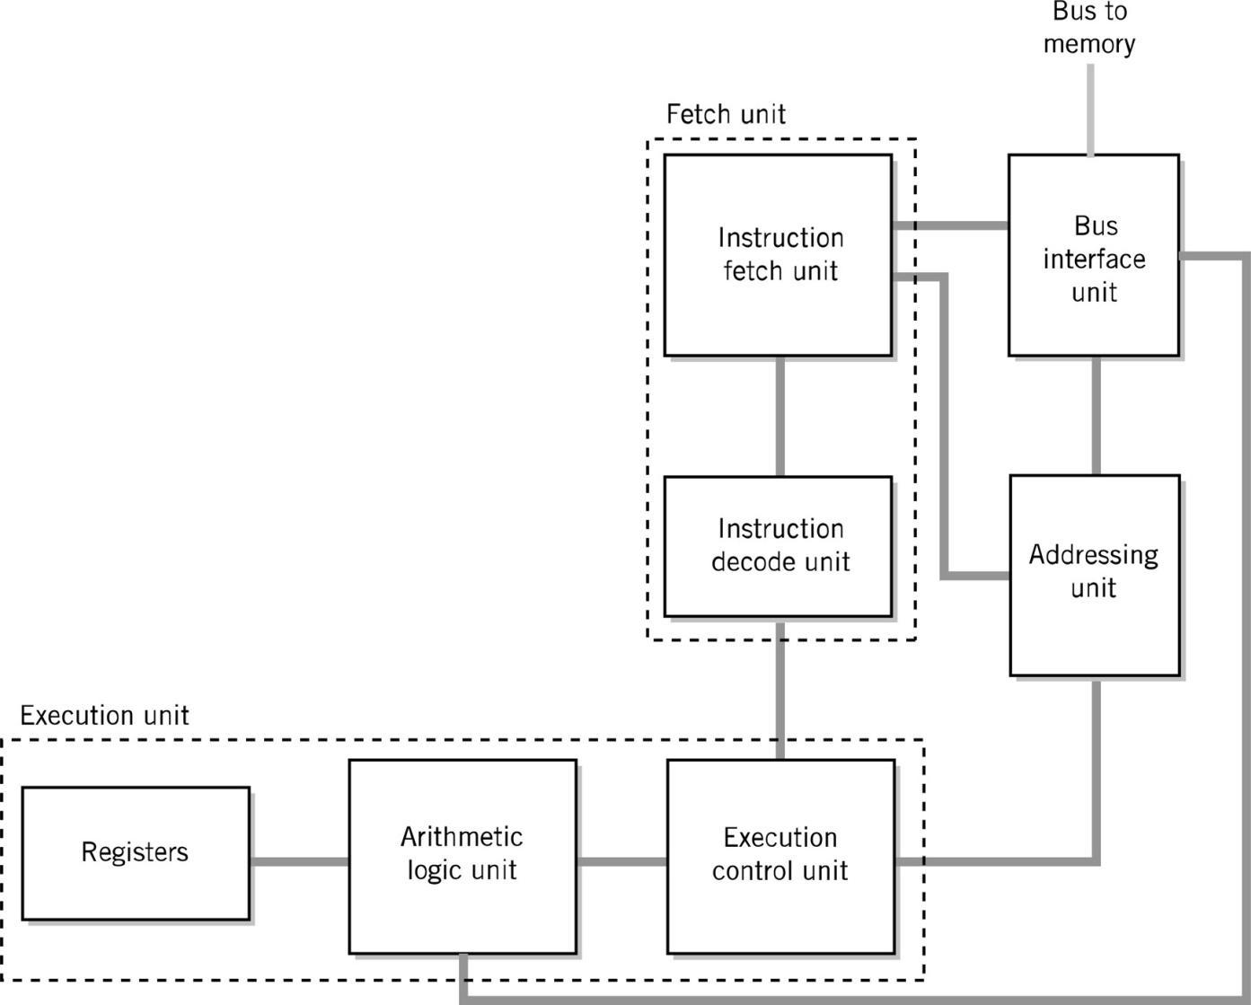
Alternative CPU Organization
Copyright 2010 John Wiley & Sons, Inc.
8-*

Slide 10
Instruction Pipelining
Assembly-line technique to allow overlapping between fetch-execute cycles of sequences of instructions
Scalar processing
Average instruction execution is approximately equal to the clock speed of the CPU
Problems from stalling
Instructions have different numbers of steps
Problems from branching
Copyright 2010 John Wiley & Sons, Inc.
8-*

Slide 11
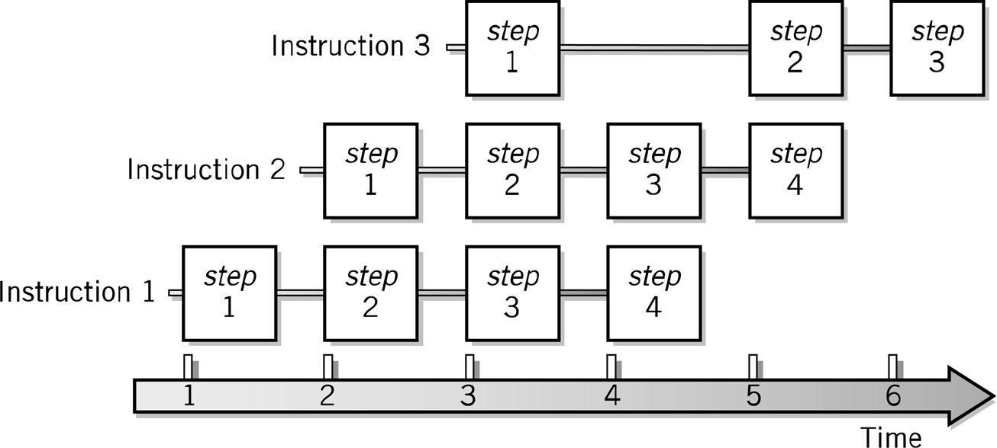
Pipelining Example
Copyright 2010 John Wiley & Sons, Inc.
8-*

Slide 12
Branch Problem Solutions
Separate pipelines for both possibilities
Probabilistic approach
Requiring the following instruction to not be dependent on the branch
Instruction Reordering (superscalar processing)
Copyright 2010 John Wiley & Sons, Inc.
8-*

Slide 13
Multiple, Parallel Execution Units
Different instructions have different numbers of steps in their cycle
Differences in each step
Each execution unit is optimized for one general type of instruction
Multiple execution units permit simultaneous execution of several instructions
Copyright 2010 John Wiley & Sons, Inc.
8-*

Slide 14
Superscalar Processing
Process more than one instruction per clock cycle
Separate fetch and execute cycles as much as possible
Buffers for fetch and decode phases
Parallel execution units
Copyright 2010 John Wiley & Sons, Inc.
8-*

Slide 15
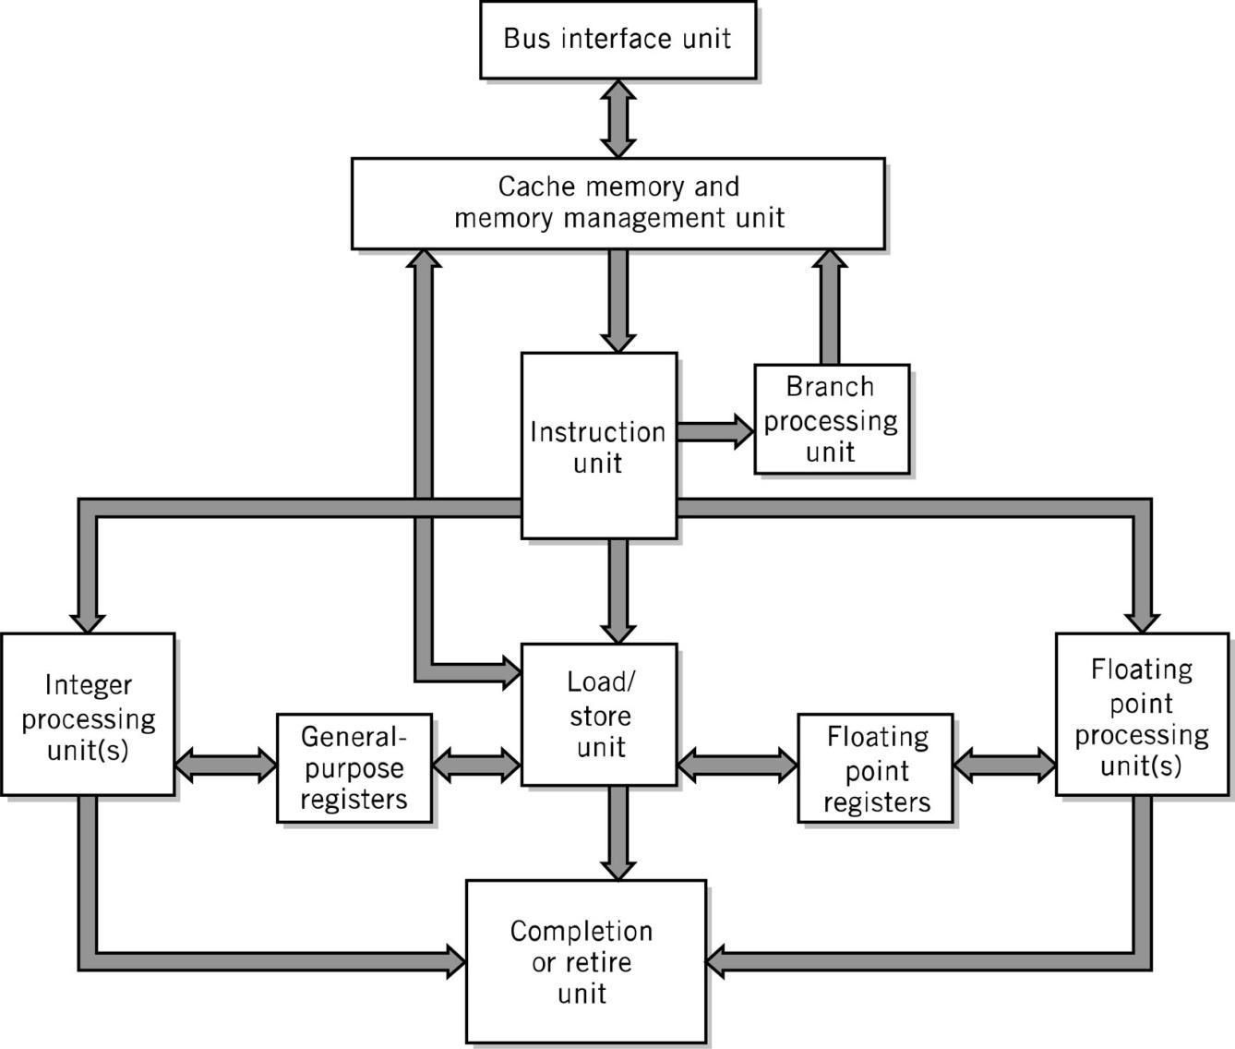
Superscalar CPU Block Diagram
Copyright 2010 John Wiley & Sons, Inc.
8-*

Slide 16
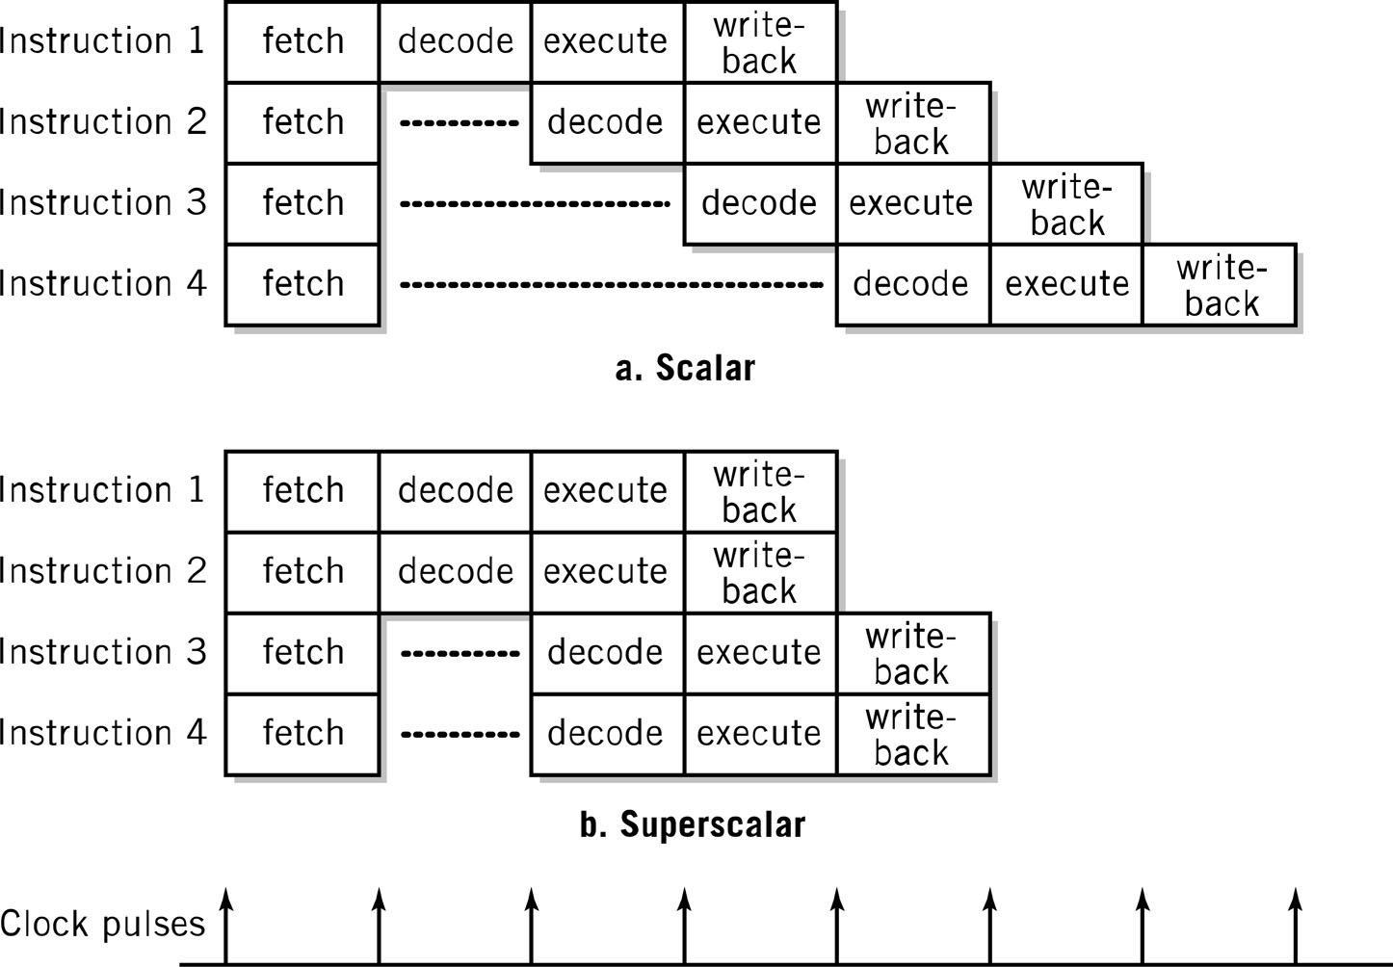
Scalar vs. Superscalar Processing
Copyright 2010 John Wiley & Sons, Inc.
8-*

Slide 17
Superscalar Issues
Out-of-order processing – dependencies (hazards)
Data dependencies
Branch (flow) dependencies and speculative execution
Parallel speculative execution or branch prediction
Branch History Table
Register access conflicts
Rename or logical registers
Copyright 2010 John Wiley & Sons, Inc.
8-*

Slide 18
Memory Enhancements
Memory is slow compared to CPU processing speeds!
2Ghz CPU = 1 cycle in ½ of a billionth of a second
70ns DRAM = 1 access in 70 millionth of a second
Methods to improvement memory accesses
Wide Path Memory Access
Retrieve multiple bytes instead of 1 byte at a time
Memory Interleaving
Partition memory into subsections, each with its own address register and data register
Cache Memory
Copyright 2010 John Wiley & Sons, Inc.
8-*

Slide 19
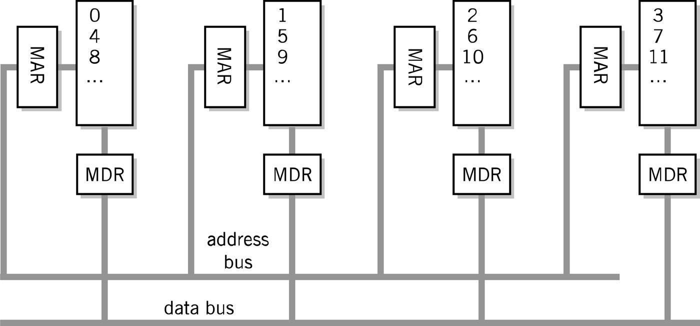
Memory Interleaving
Copyright 2010 John Wiley & Sons, Inc.
8-*

Slide 20
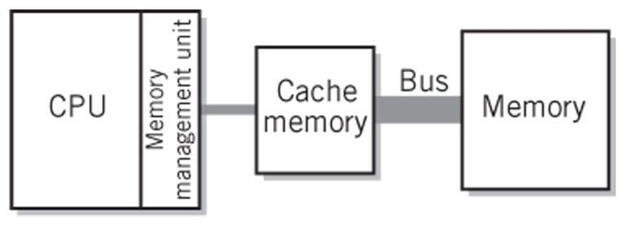
Cache Memory
Blocks: 8 or 16 bytes
Tags: pointer to location in main memory
Cache controller
hardware that checks tags
Cache Line
Unit of transfer between storage and cache memory
Hit Ratio: ratio of hits out of total requests
Synchronizing cache and memory
Write through
Write back
Copyright 2010 John Wiley & Sons, Inc.
8-*
Notes:
*

Slide 21
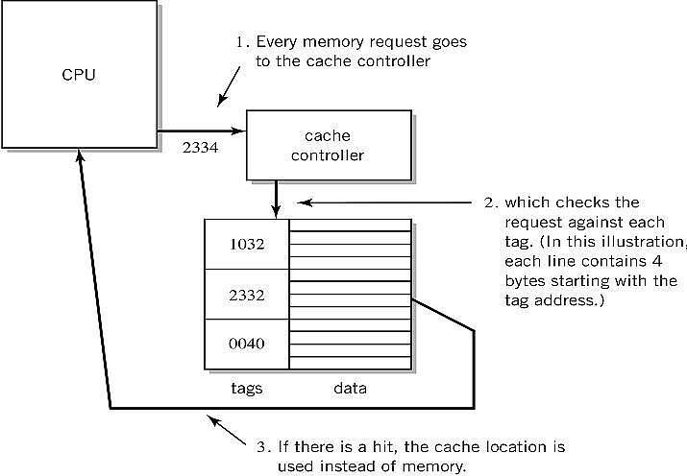
Step-by-Step Use of Cache
Copyright 2010 John Wiley & Sons, Inc.
8-*

Slide 22
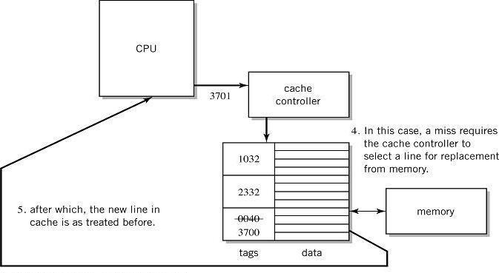
Step-by-Step Use of Cache
Copyright 2010 John Wiley & Sons, Inc.
8-*

Slide 23
Performance Advantages
Hit ratios of 90% common
50%+ improved execution speed
Locality of reference is why caching works
Most memory references confined to small region of memory at any given time
Well-written program in small loop, procedure or function
Data likely in array
Variables stored together
Copyright 2010 John Wiley & Sons, Inc.
8-*
Notes:
*

Slide 24
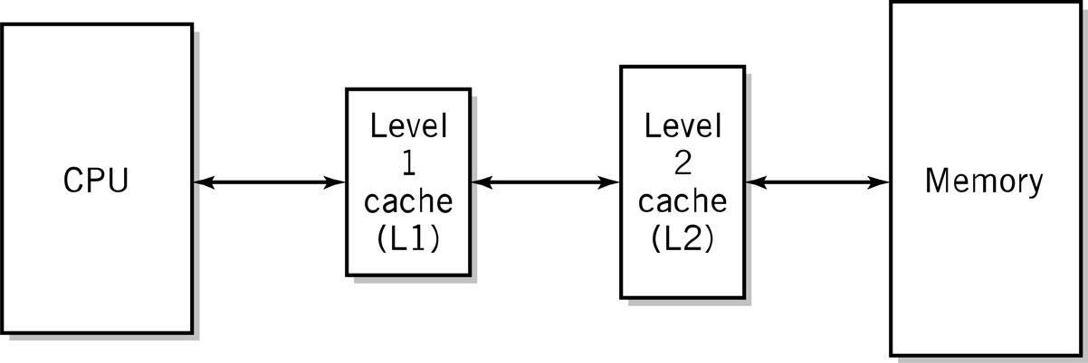
Two-level Caches
Why do the sizes of the caches have to be different?
Copyright 2010 John Wiley & Sons, Inc.
8-*

Slide 25
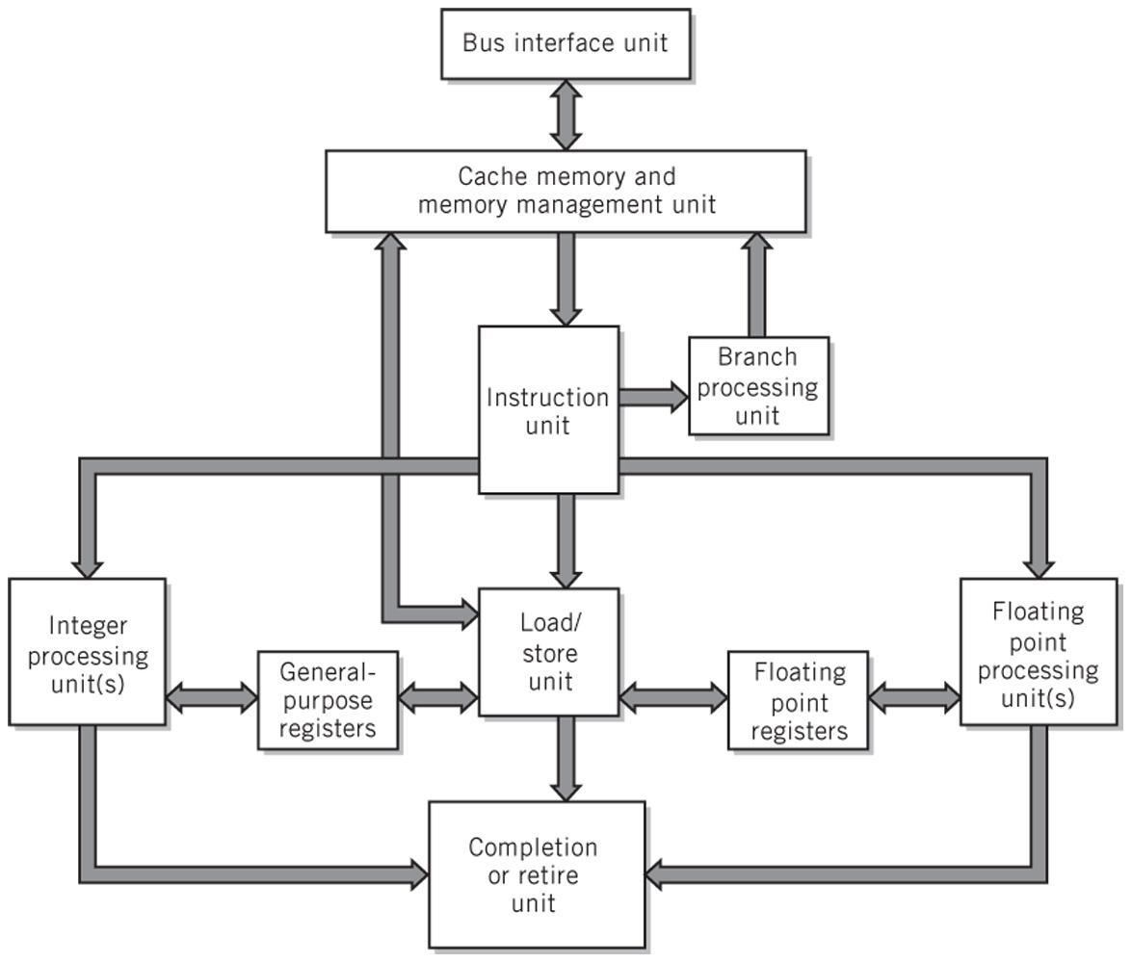
Modern CPU Block Diagram
Copyright 2010 John Wiley & Sons, Inc.
8-*

Slide 26
Multiprocessing
Reasons
Increase the processing power of a system
Parallel processing
Multiprocessor system
Tightly coupled
Multicore processors - when CPUs are on a single integrated circuit
Copyright 2010 John Wiley & Sons, Inc.
8-*

Slide 27
Multiprocessor Systems
Identical access to programs, data, shared memory, I/O, etc.
Easily extends multi-tasking, and redundant program execution
Two ways to configure
Master-slave multiprocessing
Symmetrical multiprocessing (SMP)
Copyright 2010 John Wiley & Sons, Inc.
8-*

Slide 28
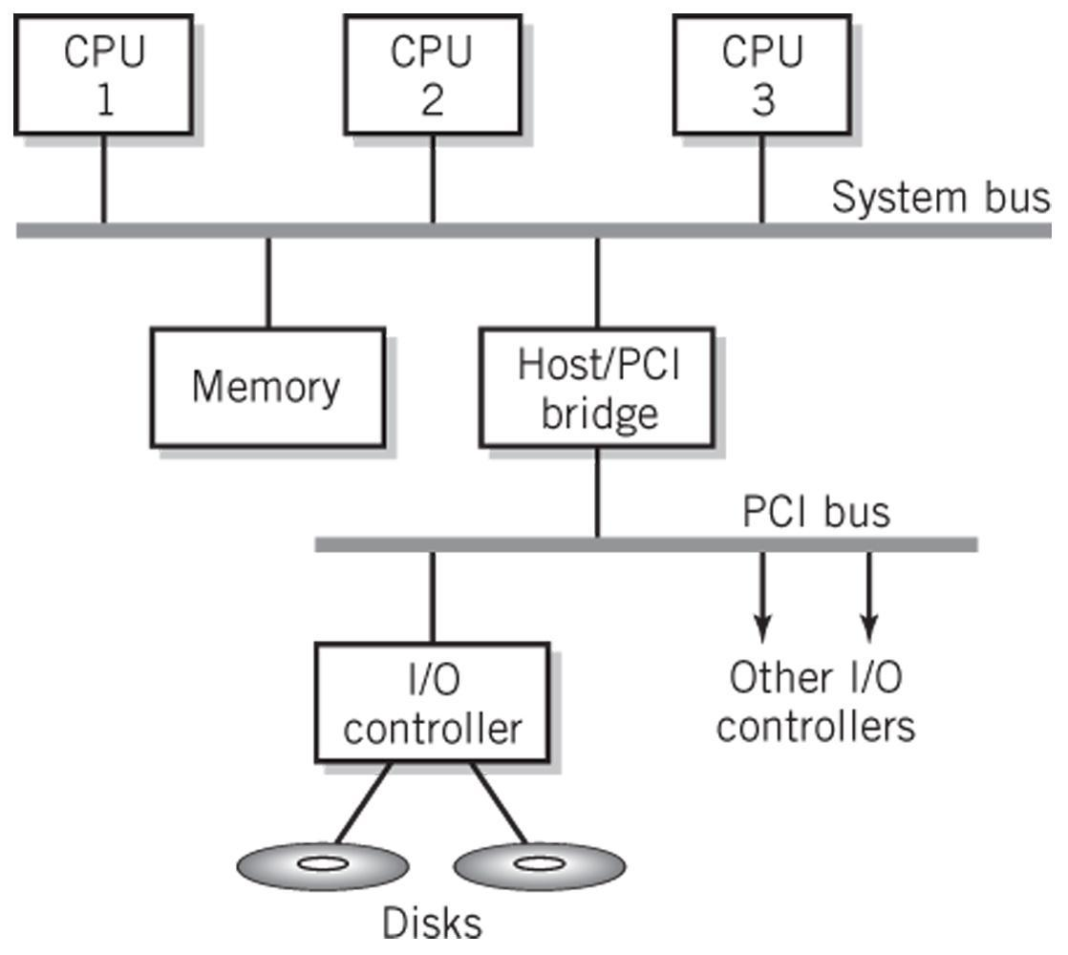
Typical Multiprocessing System Configuration
Copyright 2010 John Wiley & Sons, Inc.
8-*

Slide 29
Master-Slave Multiprocessing
Master CPU
Manages the system
Controls all resources and scheduling
Assigns tasks to slave CPUs
Advantages
Simplicity
Protection of system and data
Disadvantages
Master CPU becomes a bottleneck
Reliability issues – if master CPU fails entire system fails
Copyright 2010 John Wiley & Sons, Inc.
8-*

Slide 30
Symmetrical Multiprocessing
Each CPU has equal access to resources
Each CPU determines what to run using a standard algorithm
Disadvantages
Resource conflicts – memory, i/o, etc.
Complex implementation
Advantages
High reliability
Fault tolerant support is straightforward
Balanced workload
Copyright 2010 John Wiley & Sons, Inc.
8-*

Slide 31
Copyright 2010 John Wiley & Sons
All rights reserved. Reproduction or translation of this work beyond that permitted in section 117 of the 1976 United States Copyright Act without express permission of the copyright owner is unlawful. Request for further information should be addressed to the Permissions Department, John Wiley & Sons, Inc. The purchaser may make back-up copies for his/her own use only and not for distribution or resale. The Publisher assumes no responsibility for errors, omissions, or damages caused by the use of these programs or from the use of the information contained herein.”
Copyright 2010 John Wiley & Sons, Inc.
8-*

