Slide 1
Busses

Slide 2
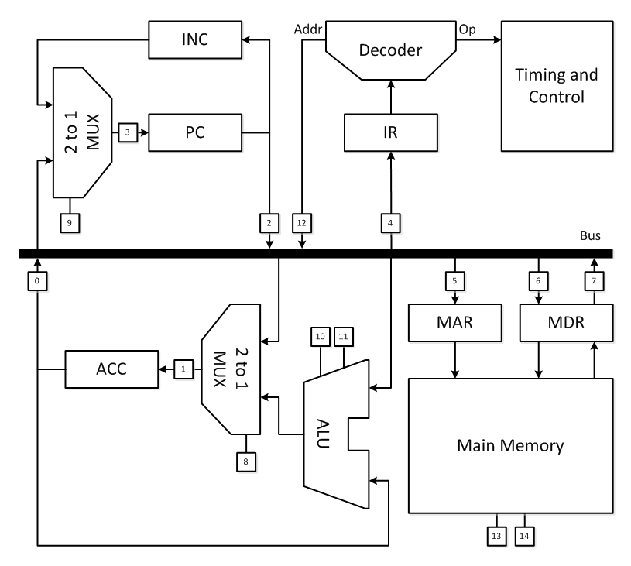
Busses
Recall detailed architecture

Slide 3
Busses
Recall detailed architecture
What is a bus?

Slide 4
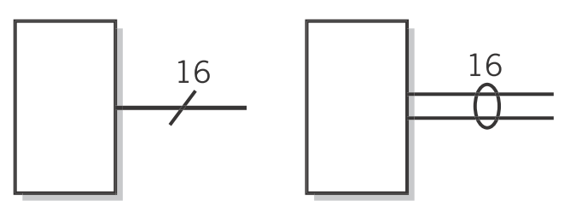
Busses
A collection of lines
A line is a single conductor carrying an electrical signal between components. It carries one bit of information.
A bus is a collection of lines used to transfer multiple bits of information at a time.
The width of a bus is the number of lines
(Englander, 2009, p. 218)

Slide 5
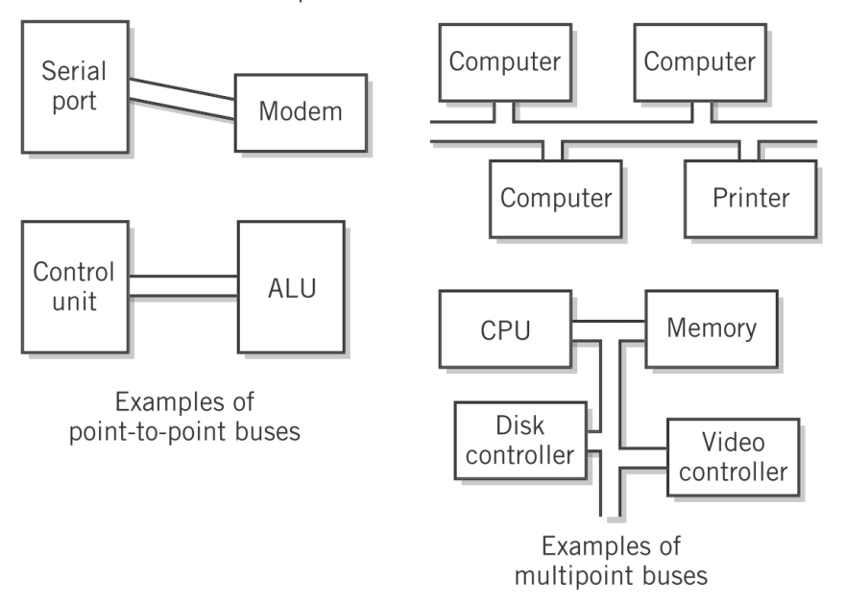
Busses
Point-to-point vs. multipoint
Point-to-point busses connect two components
Multipoint busses connect more than two components

Slide 6
Busses
Contention
Simplex busses transmit only in one direction.
Half-duplex busses transmit in both directions but not simultaneously.
Full-duplex busses transmit in both directions at the same time.
If busses are not full duplex, then a protocol must control access to prevent collisions on the bus
CSMA/CD on Thinnet Ethernet (IEEE 802.3)
CSMA/CA on WiFi (IEEE 802.11)

Slide 7
Busses
Summary
Busses carry data from one component to another.
The width of the bus determines the number of bits at a time that can be transmitted.
When the bus is half duplex or is multipoint, then an algorithm is needed to control access to the bus to prevent collisions.

Slide 8
References
Englander, I. (2009). The architecture of computer hardware and systems software: an information technology approach. Wiley.

