Slide 1
Fetch/Execute Cycle and Microcode

Slide 2
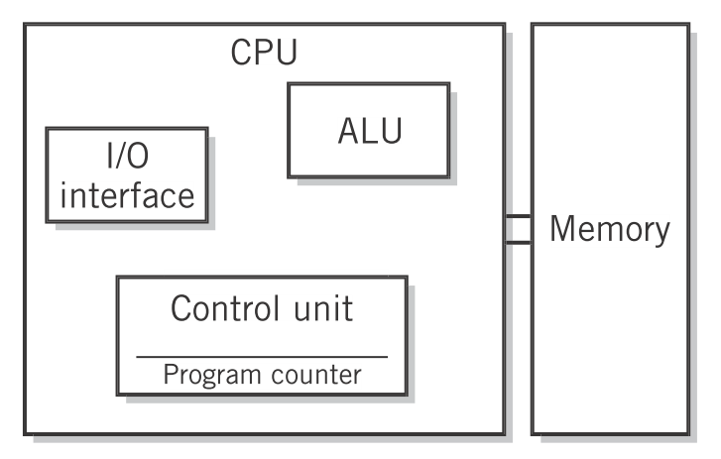
Fetch/Execute Cycle
Von Neumann Architecture
Englander, 2009, p. 200

Slide 3
Fetch/Execute Cycle
Von Neumann Architecture
Memory stores both program and data. Path to memory can become a bottleneck.
Englander, 2009, p. 200

Slide 4
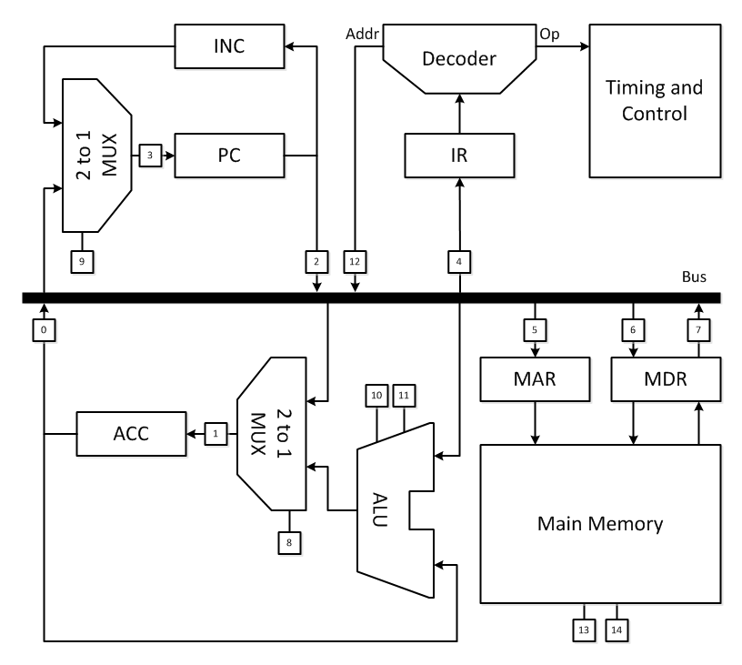
Fetch/Execute Cycle
Detailed Architecture

Slide 5
Fetch/Execute Cycle
Detailed Architecture
Control signals: determine order of operations, access to bus, loading of registers, etc.

Slide 6
Fetch/Execute Cycle
Detailed Architecture
Bus Access: Signals 0, 2, 7, and 12 control which data gets written to the bus.

Slide 7
Fetch/Execute Cycle
Detailed Architecture
Selection: Signals 8 and 9 control which of two inputs get sent to output.

Slide 8
Fetch/Execute Cycle
Detailed Architecture
ALU Operations: Signals 10 and 11 choose among addition, subtraction, multiplication and division performed by the ALU.

Slide 9
Fetch/Execute Cycle
Detailed Architecture
Number | Operation | Number | Operation
0 | ACCbus | 8 | ALUACC
1 | Load ACC | 9 | INCPC
2 | PCbus | 10 | ALU operation
3 | Load PC | 11 | ALU operation
4 | Load IR | 12 | Addrbus
5 | Load MAR | 13 | CS
6 | MDRbus | 14 | R/W
7 | Load MDR

Slide 10
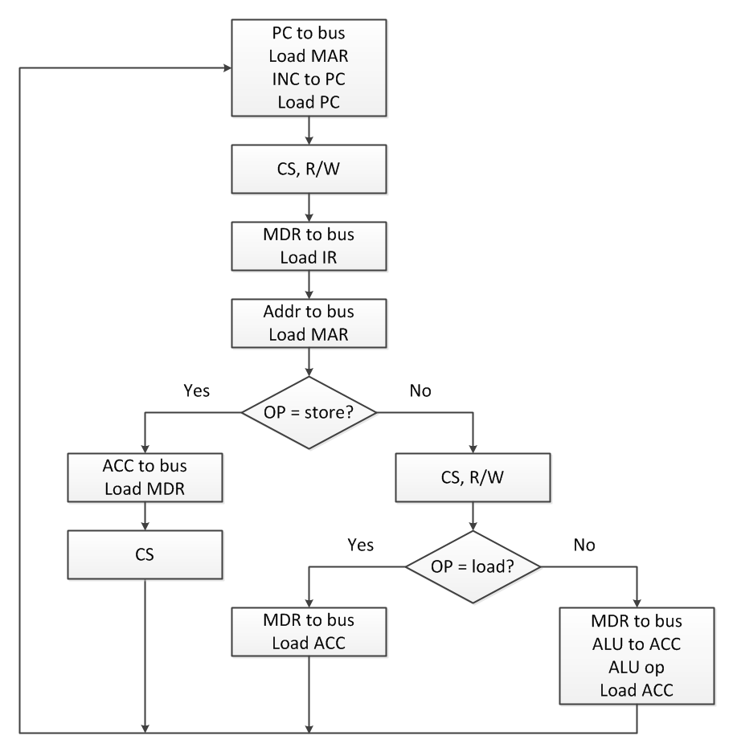
Fetch/Execute Cycle
Detailed Fetch/Execute Cycle

Slide 11
Fetch/Execute Cycle
Detailed Fetch/Execute Cycle
Fetch
Execute

Slide 12
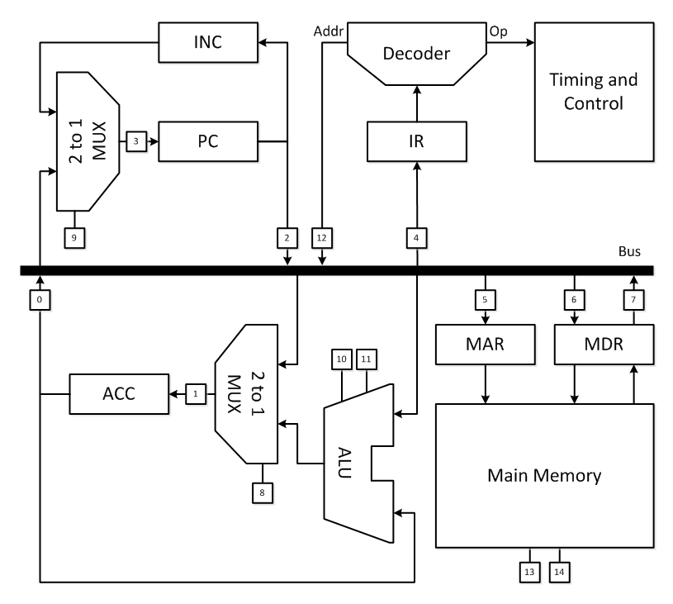
Fetch/Execute Cycle
Detailed Fetch/Execute Cycle

Slide 13
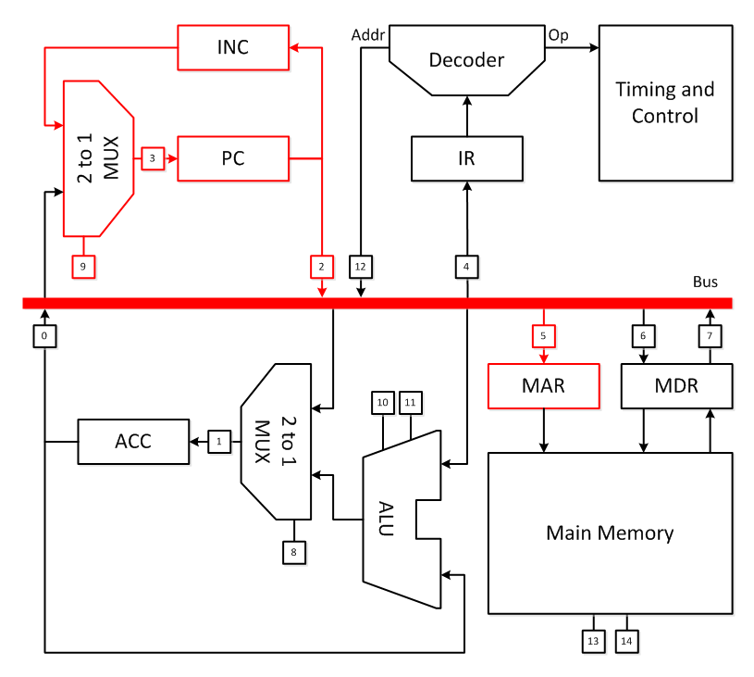
Fetch/Execute Cycle
PC  bus
Load MAR
INC  PC
Load PC
Detailed Fetch/Execute Cycle

Slide 14
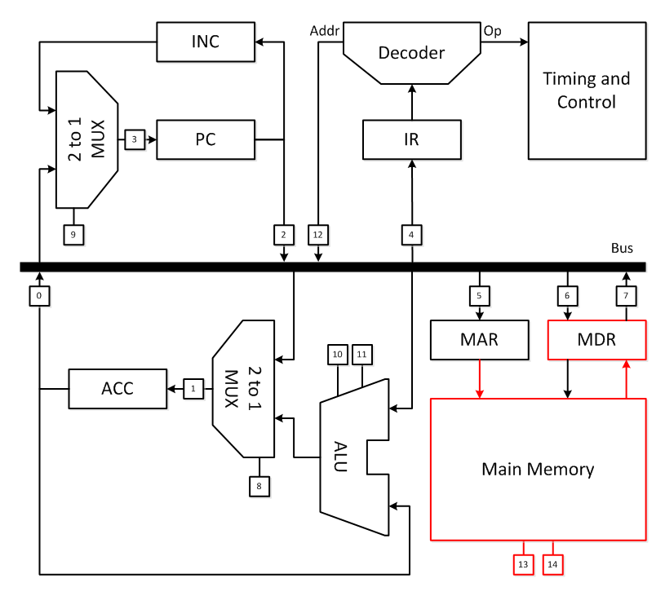
Fetch/Execute Cycle
CS, R/W
Detailed Fetch/Execute Cycle

Slide 15
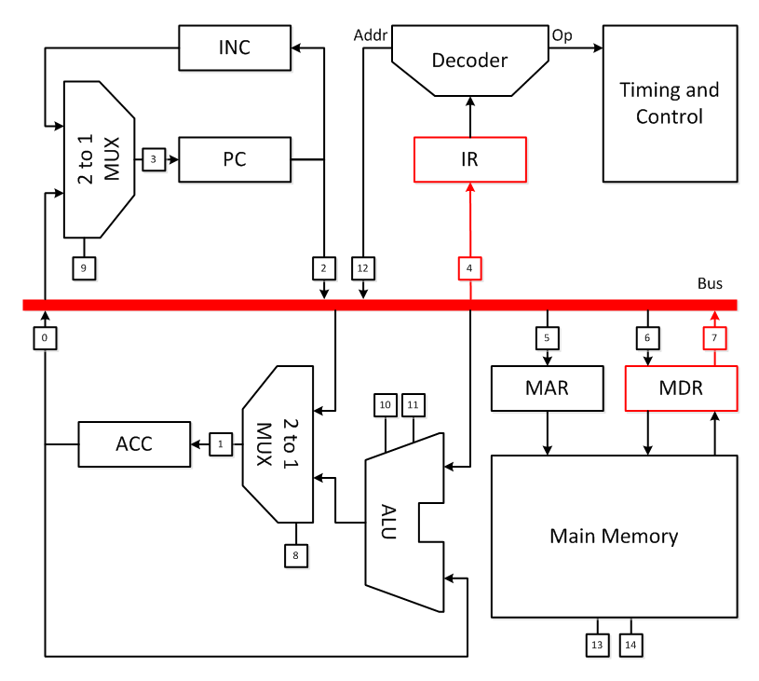
Fetch/Execute Cycle
MDR  bus
Load IR
Detailed Fetch/Execute Cycle

Slide 16
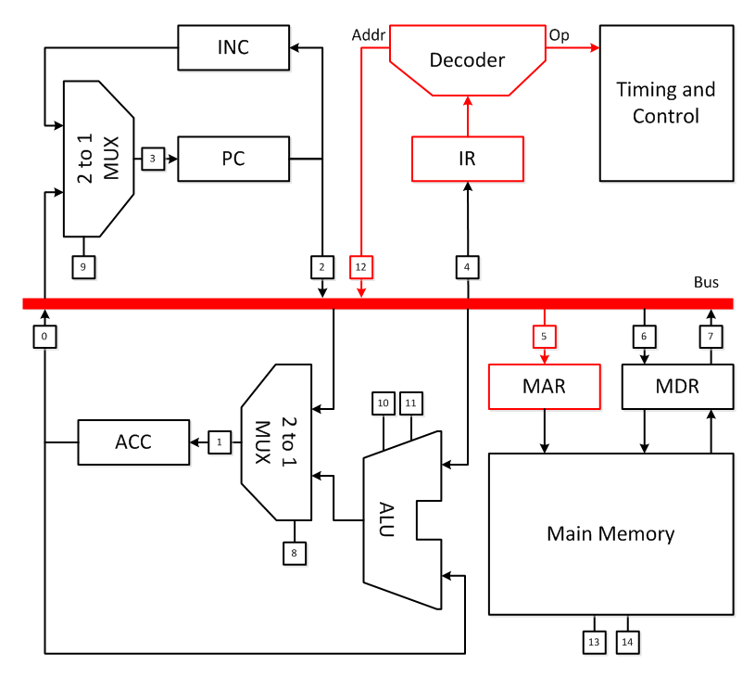
Fetch/Execute Cycle
Addr  bus
Load MAR
Detailed Fetch/Execute Cycle
Assume the instruction is LOAD

Slide 17
Fetch/Execute Cycle
Detailed Fetch/Execute Cycle
CS, R/W

Slide 18
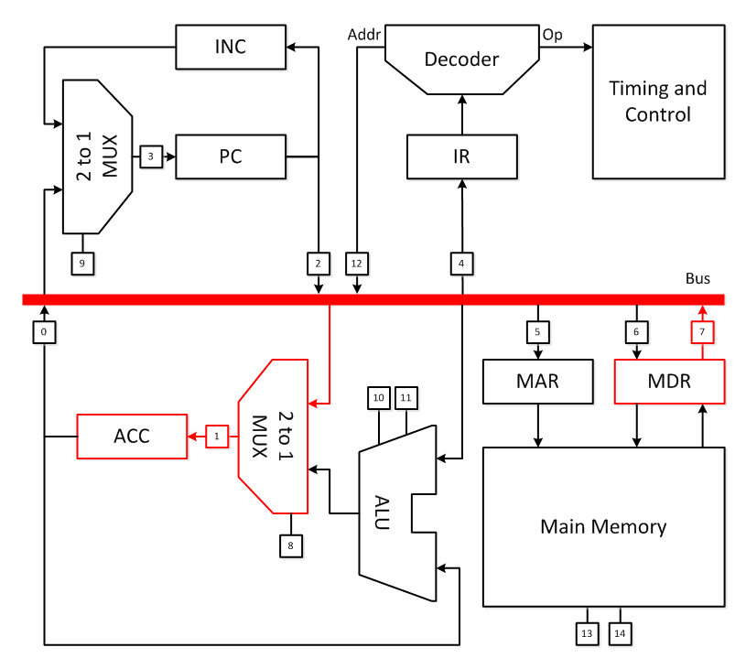
Fetch/Execute Cycle
MDR  bus
Load ACC
Detailed Fetch/Execute Cycle

Slide 19
Fetch/Execute Cycle
Detailed Fetch/Execute Cycle
This fetch/execute cycle can’t handle branching. How would it need to be modified?

Slide 20
Fetch/Execute Cycle
Detailed Fetch/Execute Cycle

Slide 21
Fetch/Execute Cycle
Summary
The fetch/execute cycle consists of many steps and is implemented in the control unit as microcode.
Control signals select operations, control access to the bus, and allow data to flow from component to component.
Adding new instructions means modifying the microprogram in the control unit.

Slide 22
References
Englander, I. (2009). The architecture of computer hardware and systems software: an information technology approach. Wiley.

