Slide 1
Memory Operation

Slide 2
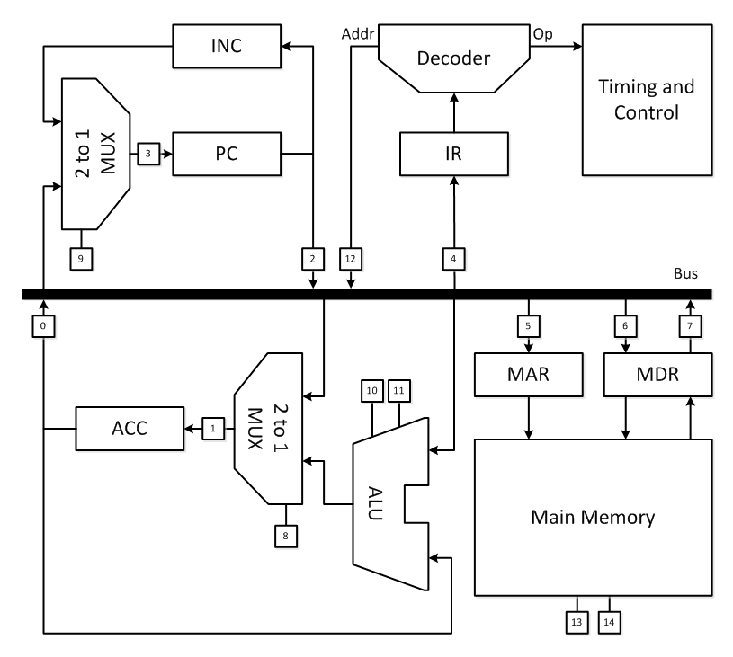
Memory Operation
Recall detailed architecture

Slide 3
Memory Operation
Recall detailed architecture
How is memory accessed?

Slide 4
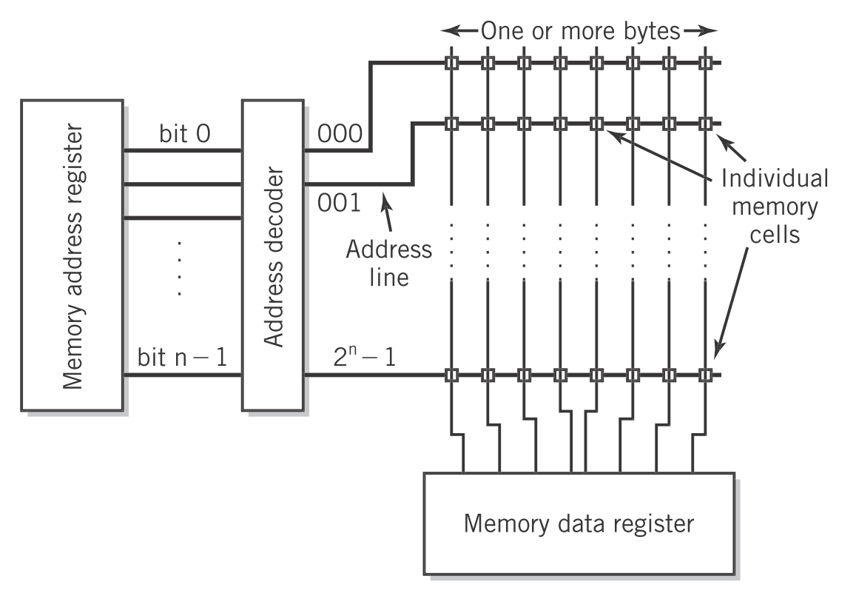
Memory Operation
MAR and MDR

Slide 5
Memory Operation
n-bit address
CS signal selects a single line
MAR and MDR
n to 2^{n} decoder
R/W signal 1 for read, 0 for write

Slide 6
Memory Operation
MAR and MDR
Width of the MAR determines the number of addressable lines. 32-bit machine = 2³² ≈ 4 billion addresses.
Width of the MDR determines the word size.
word size × addresses = total memory size

Slide 7
Memory Operation
Summary
MAR determines which line of memory to access.
CS signal activates memory.
R/W signal selects either to read (1) or write (0) memory.
MDR sends (write) or receives (read) data to and from memory.

Slide 8
References
Englander, I. (2009). The architecture of computer hardware and systems software: an information technology approach. Wiley.

