Slide 1
Little Man Computer and Instruction Cycle

Slide 2
A Model for Computation
Little Man Computer
Developed by Dr. Stuart Madnick of MIT in 1965
A model for how computers execute programs

Slide 3
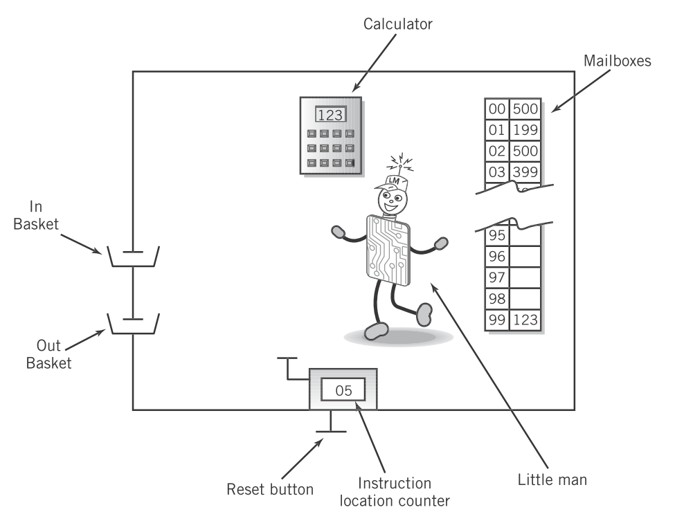
A Model for Computation
Little Man Computer
Developed by Dr. Stuart Madnick of MIT in 1965
A model for how computers execute programs
Englander, 2009, p. 182

Slide 4
A Model for Computation
Little Man Computer
Developed by Dr. Stuart Madnick of MIT in 1965
A model for how computers execute programs
Input and output from and to the user
Englander, 2009, p. 182

Slide 5
A Model for Computation
Little Man Computer
Developed by Dr. Stuart Madnick of MIT in 1965
A model for how computers execute programs
Add, subtract, multiply and divide numbers.
Englander, 2009, p. 182

Slide 6
A Model for Computation
Little Man Computer
Developed by Dr. Stuart Madnick of MIT in 1965
A model for how computers execute programs
Memory holding both programs and data
Englander, 2009, p. 182

Slide 7
A Model for Computation
Little Man Computer
Developed by Dr. Stuart Madnick of MIT in 1965
A model for how computers execute programs
Address (mailbox) of the next instruction to be executed
Englander, 2009, p. 182

Slide 8
A Model for Computation
Little Man Computer
Developed by Dr. Stuart Madnick of MIT in 1965
A model for how computers execute programs
Control unit coordinating the other components
Englander, 2009, p. 182

Slide 9
A Model for Computation
Little Man Computer
The Little Man executes instructions that are stored in memory. Like everything else, these are encoded.
Just numbers in each field representing something to do, and what to do it on.

Slide 10
A Model for Computation
Mnemonic | Code | Description
LDA | 5XX | Load calculator with data from box XX
STO | 3XX | Store calculator value in box XX
ADD | 1XX | Add data in box XX to calculator
SUB | 2XX | Subtract data in box XX from calculator
IN | 901 | Get input from inbox, put in calculator
OUT | 902 | Write calculator total to outbox
HLT | 000 | Stop executing
BRZ | 7XX | Zero? Next instruction is in box XX
BRP | 8XX | Positive? Next instruction is in box XX
BR | 6XX | Next instruction is in box XX
DAT |  | Data storage reserved

Slide 11
Executing Instructions
Execute cycle
Fetch
Little Man looks at the instruction counter.
Little Man retrieves the instruction from the mailbox indicated by the counter.
Little Man increments the instruction counter.
Execute
Little Man performs the instruction retrieved from the previous step.

Slide 12
Executing Instructions
Execute cycle
Example program: Read two numbers, add them, output the result.
Box | Assembly | Code
01 | IN | 901
02 | STO 07 | 307
03 | IN | 901
04 | ADD 07 | 107
05 | OUT | 902
06 | HLT | 000
07 | DAT | 000

Slide 13
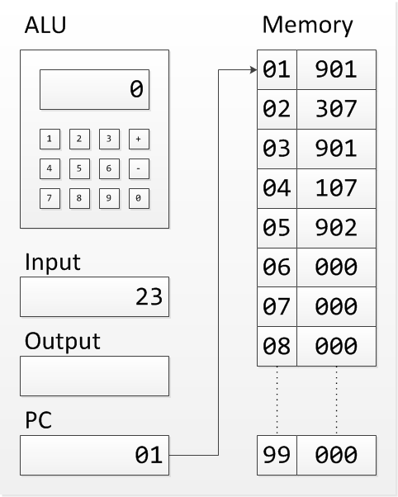
Executing Instructions
Execute cycle
Example program: read two numbers, add them, output the result
Box | Assembly | Code
01 | IN | 901
02 | STO 07 | 307
03 | IN | 901
04 | ADD 07 | 107
05 | OUT | 902
06 | HLT | 000
07 | DAT | 000

Slide 14
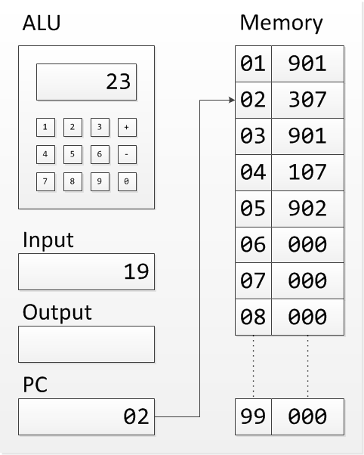
Executing Instructions
Execute cycle
Example program: read two numbers, add them, output the result
Box | Assembly | Code
01 | IN | 901
02 | STO 07 | 307
03 | IN | 901
04 | ADD 07 | 107
05 | OUT | 902
06 | HLT | 000
07 | DAT | 000

Slide 15
Executing Instructions
Execute cycle
Example program: read two numbers, add them, output the result
Box | Assembly | Code
01 | IN | 901
02 | STO 07 | 307
03 | IN | 901
04 | ADD 07 | 107
05 | OUT | 902
06 | HLT | 000
07 | DAT | 000

Slide 16
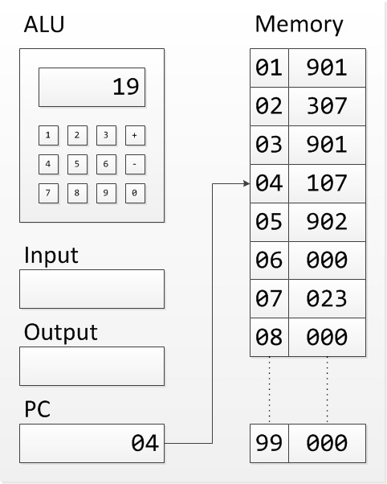
Executing Instructions
Execute cycle
Example program: read two numbers, add them, output the result
Box | Assembly | Code
01 | IN | 901
02 | STO 07 | 307
03 | IN | 901
04 | ADD 07 | 107
05 | OUT | 902
06 | HLT | 000
07 | DAT | 000

Slide 17
Executing Instructions
Execute cycle
Example program: read two numbers, add them, output the result
Box | Assembly | Code
01 | IN | 901
02 | STO 07 | 307
03 | IN | 901
04 | ADD 07 | 107
05 | OUT | 902
06 | HLT | 000
07 | DAT | 000

Slide 18
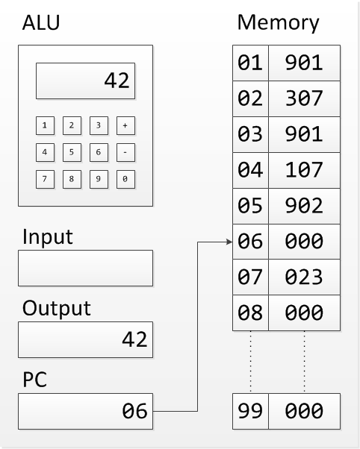
Executing Instructions
Execute cycle
Example program: read two numbers, add them, output the result
Box | Assembly | Code
01 | IN | 901
02 | STO 07 | 307
03 | IN | 901
04 | ADD 07 | 107
05 | OUT | 902
06 | HLT | 000
07 | DAT | 000

Slide 19
Little Man Computer and Instruction Cycle
Summary
LMC is a model for computation based on real principles.
Instructions consist of an operation and, optionally, an operand on which to act.
Fetch/execute cycle (simple):
Retrieve instruction indicated by PC.
Increment program counter.
Execute instruction.
Operations of load, store, add, subtract, input, output, and branching are the simplest possible instruction set.

Slide 20
References
Englander, I. (2009). The architecture of computer hardware and systems software: an information technology approach. Wiley.

