Slide 1
CHAPTER 6: The Little Man Computer
The Architecture of Computer Hardware, Systems Software & Networking: An Information Technology Approach
4th Edition, Irv Englander
John Wiley and Sons ©2010
PowerPoint slides authored by Wilson Wong, Bentley University
PowerPoint slides for the 3rd edition were co-authored with Lynne Senne, Bentley University

Slide 2
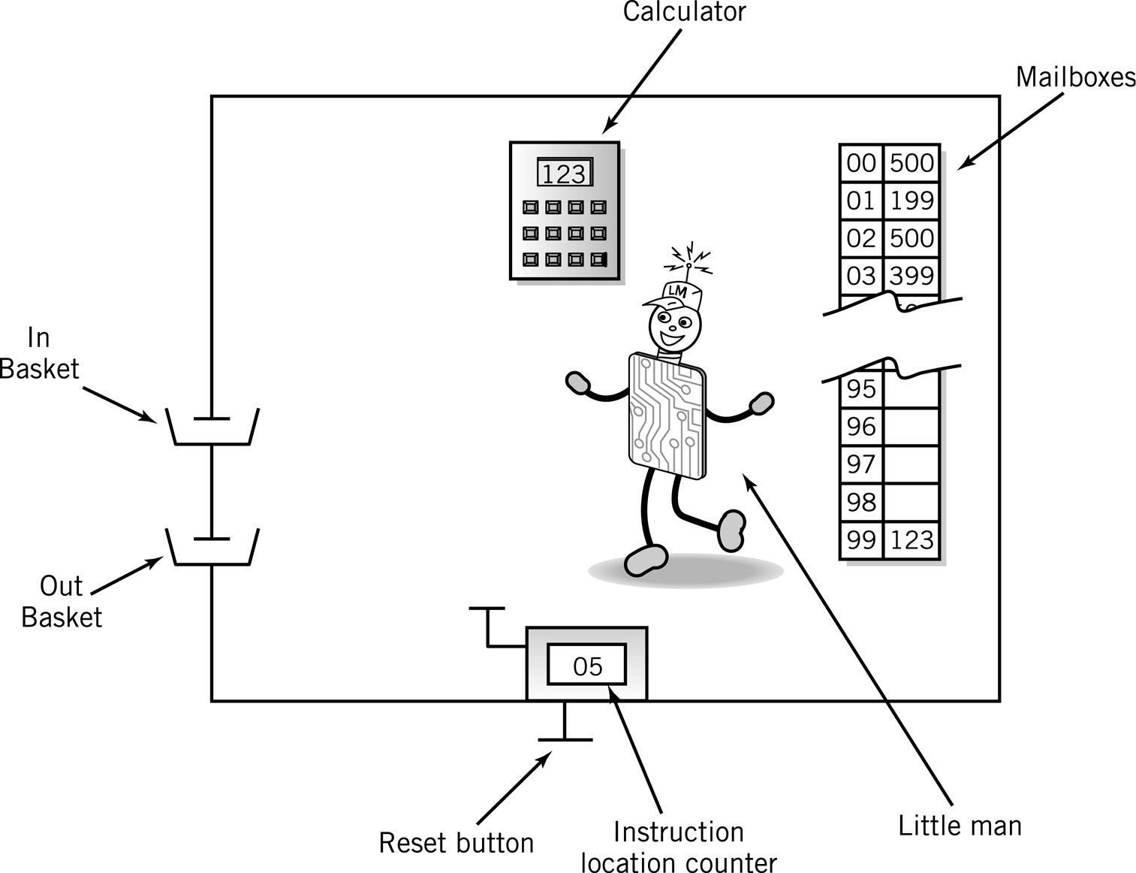
The Little Man Computer
Copyright 2010 John Wiley & Sons, Inc.
6-*
Notes:
*

Slide 3
Mailboxes: Address vs. Content
Addresses are consecutive starting at 00 and ending at 99
Content may be
Data, a three digit number, or
Instructions
Address | Content
Copyright 2010 John Wiley & Sons, Inc.
6-*

Slide 4
Content: Instructions
Op code
In LMC, represented by a single digit
Operation code
Arbitrary mnemonic
Operand
In LMC, represented by two digits following the op code
Object to be manipulated
Data or
Address of data
Address | Content
 | Op code | Operand
Copyright 2010 John Wiley & Sons, Inc.
6-*

Slide 5
Magic!
Load program into memory
Put data into In Basket
Copyright 2010 John Wiley & Sons, Inc.
6-*

Slide 6
Assembly Language
Specific to a CPU
1 to 1 correspondence between assembly language instruction and binary (machine) language instruction
Mnemonics (short character sequence) represent instructions
Used when programmer needs precise control over hardware, e.g., device drivers
Copyright 2010 John Wiley & Sons, Inc.
6-*

Slide 7
Instruction Set
Arithmetic | 1xx | ADD
 | 2xx | SUB
Data Movement | 3xx | STORE
 | 5xx | LOAD
Input/Output | 901 | INPUT
 | 902 | Output
Machine Control (coffee break) | 000 | HALT COB
Copyright 2010 John Wiley & Sons, Inc.
6-*

Slide 8
Input/Output
Move data between calculator and in/out baskets
 |  | Content
 |  | Op Code | Operand (address)
IN (input) |  | 9 | 01
OUT (output) |  | 9 | 02
Copyright 2010 John Wiley & Sons, Inc.
6-*

Slide 9
LMC Input/Output
IN
OUT
Copyright 2010 John Wiley & Sons, Inc.
6-*
Notes:
*

Slide 10
Internal Data Movement
Between mailbox and calculator
 |  | Content
 |  | Op Code | Operand (address)
STO (store) |  | 3 | xx
LDA (load) |  | 5 | xx
Copyright 2010 John Wiley & Sons, Inc.
6-*

Slide 11
LMC Internal Data
LDA
STO
Copyright 2010 John Wiley & Sons, Inc.
6-*
Notes:
*

Slide 12
Arithmetic Instructions
Read mailbox
Perform operation in the calculator
 |  | Content
 |  | Op Code | Operand (address)
ADD |  | 1 | xx
SUB |  | 2 | xx
Copyright 2010 John Wiley & Sons, Inc.
6-*

Slide 13
LMC Arithmetic Instructions
ADD
SUB
Copyright 2010 John Wiley & Sons, Inc.
6-*
Notes:
*

Slide 14
Data storage location
Physically identical to instruction mailbox
Not located in instruction sequence
Identified by DAT mnemonic
Copyright 2010 John Wiley & Sons, Inc.
6-*

Slide 15
Simple Program: Add 2 Numbers
Input a #
Assume data is stored in mailboxes with addresses >90
Write instructions
Store the #
Input a #
Add
Output the
number
Copyright 2010 John Wiley & Sons, Inc.
6-*

Slide 16
Program to Add 2 Numbers
Mailbox | Code | Instruction Description
00 | 901 | ;input 1st Number
01 | 399 | ;store data
02 | 901 | ;input 2nd Number
03 | 199 | ;add 1st # to 2nd #
04 | 902 | ;output result
05 | 000 | ;stop
99 | 000 | ;data
Copyright 2010 John Wiley & Sons, Inc.
6-*

Slide 17
Program to Add 2 Numbers: Using Mnemonics
Mailbox | Mnemonic | Instruction Description
00 | IN | ;input 1st Number
01 | STO 99 | ;store data
02 | IN | ;input 2nd Number
03 | ADD 99 | ;add 1st # to 2nd #
04 | OUT | ;output result
05 | COB | ;stop
99 | DAT 00 | ;data
Copyright 2010 John Wiley & Sons, Inc.
6-*

Slide 18
Program Control
Branching (executing an instruction out of sequence)
Changes the address in the counter
Halt
 |  | Content
 |  | Op Code | Operand (address)
BR (Jump) |  | 6 | xx
BRZ (Branch on 0) |  | 7 | xx
BRP (Branch on +) |  | 8 | xx
COB (stop) |  | 0 | (ignore)
Copyright 2010 John Wiley & Sons, Inc.
6-*

Slide 19
LMC Instruction Set
Arithmetic | 1xx | ADD
 | 2xx | SUB
Data Movement | 3xx | STORE
 | 5xx | LOAD
BR | 6xx | JUMP
BRZ | 7xx | BRANC ON 0
BRP | 8xx | BRANCH ON +
Input/Output | 901 | INPUT
 | 902 | OUTPUT
Machine Control (coffee break) | 000 | HALT COB
Copyright 2010 John Wiley & Sons, Inc.
6-*

Slide 20
Find Positive Difference of 2 Numbers
00 | IN | 901
01 | STO 10 | 310
02 | IN | 901
03 | STO 11 | 311
04 | SUB 10 | 210
05 | BRP 08 | 808 | ;test
06 | LDA 10 | 510 | ;if negative, reverse order
07 | SUB 11 | 211
08 | OUT | 902 | ;print result and
09 | COB | 000 | ;stop
10 | DAT 00 | 000 | ;used for data
11 | DAT 00 | 000 | ;used for data
Copyright 2010 John Wiley & Sons, Inc.
6-*

Slide 21
Instruction Cycle
Fetch: Little Man finds out what instruction he is to execute
Execute: Little Man performs the work.
Copyright 2010 John Wiley & Sons, Inc.
6-*

Slide 22
Fetch Portion of Fetch and Execute Cycle
1. Little Man reads the address from the location counter
2. He walks over to the mailbox that corresponds to the location counter
Copyright 2010 John Wiley & Sons, Inc.
6-*

Slide 23
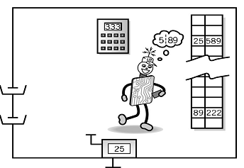
Fetch, cont.
3. And reads the number on the slip of paper (he puts the slip back in case he needs to read it again later)
Copyright 2010 John Wiley & Sons, Inc.
6-*

Slide 24
Execute Portion
1. The Little Man goes to the mailbox address specified in the instruction he just fetched.
2. He reads the number in that mailbox (he remembers to replace it in case he needs it later).
Copyright 2010 John Wiley & Sons, Inc.
6-*
Notes:
*

Slide 25
Execute, cont.
3. He walks over to the calculator and punches the number in.
4. He walks over to the location counter and clicks it, which gets him ready to fetch the next instruction.
Copyright 2010 John Wiley & Sons, Inc.
6-*

Slide 26
von Neumann Architecture (1945)
Stored program concept
Memory is addressed linearly
Memory is addressed without regard to content
Copyright 2010 John Wiley & Sons, Inc.
6-*

Slide 27
Copyright 2010 John Wiley & Sons
All rights reserved. Reproduction or translation of this work beyond that permitted in section 117 of the 1976 United States Copyright Act without express permission of the copyright owner is unlawful. Request for further information should be addressed to the Permissions Department, John Wiley & Sons, Inc. The purchaser may make back-up copies for his/her own use only and not for distribution or resale. The Publisher assumes no responsibility for errors, omissions, or damages caused by the use of these programs or from the use of the information contained herein.”
Copyright 2010 John Wiley & Sons, Inc.
6-*

