Slide 1
CHAPTER 5: Representing Numerical Data
The Architecture of Computer Hardware and Systems Software & Networking:
An Information Technology Approach
4th Edition, Irv Englander
John Wiley and Sons ©2010
PowerPoint slides authored by Wilson Wong, Bentley University
PowerPoint slides for the 3rd edition were co-authored with Lynne Senne, Bentley University

Slide 2
Number Representation
Numbers can be represented as a combination of
Value or magnitude
Sign (plus or minus)
Decimal (if necessary)
Copyright 2010 John Wiley & Sons, Inc
5-*

Slide 3
Unsigned Numbers: Integers
Unsigned whole number or integer
Direct binary equivalent of decimal integer
4 bits: 0 to 9 | 16 bits: 0 to 9,999
8 bits: 0 to 99 | 32 bits: 0 to 99,999,999
Decimal | Binary | BCD
68 | = 0100 0100 | = 0110 1000
 | = 2⁶ + 2² = 64 + 4 = 68 | = 2² + 2¹ = 6 2³ = 8
99 (largest 8-bit BCD) | = 0110 0011 | = 1001 1001
 | = 2⁶ + 2⁵ + 2¹ + 2⁰ = = 64 + 32 + 2 + 1 = 99 | = 2³ + 2⁰ 2³ + 2⁰ = 9 9
255 (largest 8-bit binary) | = 1111 1111 | = 0010 0101 0101
 | = 2⁸ – 1 = 255 | = 2¹ 2² + 2⁰ 2² + 2⁰ = 2 5 5
Copyright 2010 John Wiley & Sons, Inc
5-*

Slide 4
Value Range: Binary vs. BCD
BCD range of values < conventional binary representation
Binary: 4 bits can hold 16 different values (0 to 15)
BCD: 4 bits can hold only 10 different values (0 to 9)
No. of Bits | BCD Range |  | Binary Range
4 | 0-9 | 1 digit | 0-15 | 1+ digit
8 | 0-99 | 2 digits | 0-255 | 2+ digits
12 | 0-999 | 3 digits | 0-4,095 | 3+ digits
16 | 0-9,999 | 4 digits | 0-65,535 | 4+ digits
20 | 0-99,999 | 5 digits | 0-1 million | 6 digits
24 | 0-999,999 | 6 digits | 0-16 million | 7+ digits
32 | 0-99,999,999 | 8 digits | 0-4 billion | 9+ digits
64 | 0-(10¹⁶-1) | 16 digits | 0-16 quintillion | 19+ digits
Copyright 2010 John Wiley & Sons, Inc
5-*

Slide 5
Conventional Binary vs. BCD
Binary representation generally preferred
Greater range of value for given number of bits
Calculations easier
BCD often used in business applications to maintain decimal rounding and decimal precision
Copyright 2010 John Wiley & Sons, Inc
5-*

Slide 6
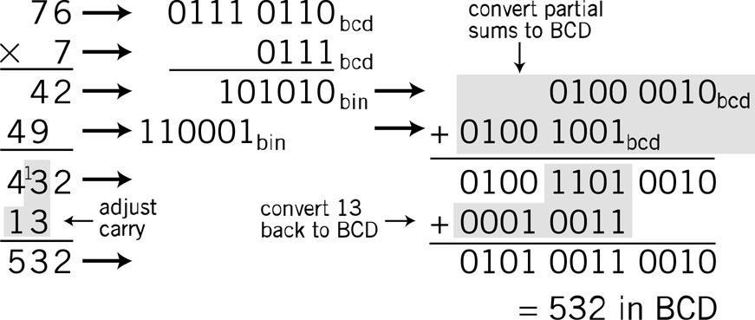
Simple BCD Multiplication
Copyright 2010 John Wiley & Sons, Inc
5-*

Slide 7
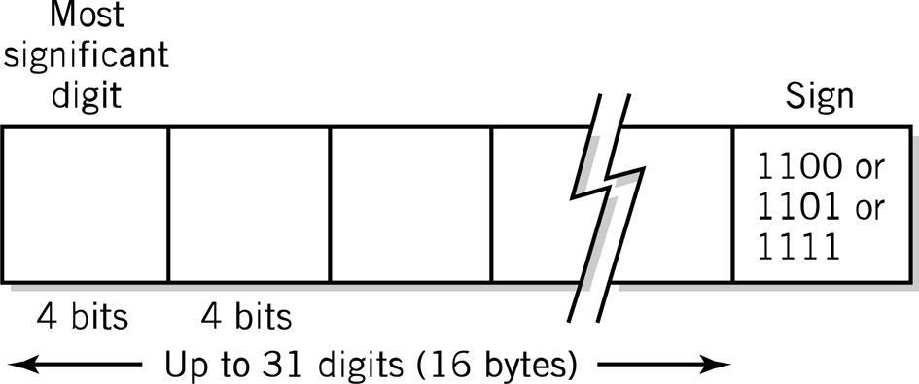
Packed Decimal Format
Real numbers representing dollars and cents
Support by business-oriented languages like COBOL
IBM System 370/390 and Compaq Alpha
Copyright 2010 John Wiley & Sons, Inc
5-*

Slide 8
Signed-Integer Representation
No obvious direct way to represent the sign in binary notation
Options:
Sign-and-magnitude representation
1’s complement
2’s complement (most common)
Copyright 2010 John Wiley & Sons, Inc
5-*

Slide 9
Sign-and-Magnitude
Use left-most bit for sign
0 = plus; 1 = minus
Total range of integers the same
Half of integers positive; half negative
Magnitude of largest integer half as large
Example using 8 bits:
Unsigned: 1111 1111 = +255
Signed: 0111 1111 = +127 1111 1111 = -127
Note: 2 values for 0: +0 (0000 0000) and -0 (1000 0000)
Copyright 2010 John Wiley & Sons, Inc
5-*

Slide 10
Difficult Calculation Algorithms
Sign-and-magnitude algorithms complex and difficult to implement in hardware
Must test for 2 values of 0
Useful with BCD
Order of signed number and carry/borrow makes a difference
Example: Decimal addition algorithm
Addition: 2 Positive Numbers | Addition: 1 Signed Number
4 +2 6 | 4 - 2 2 | 2 - 4 -2 | 12 - 4 8
Copyright 2010 John Wiley & Sons, Inc
5-*

Slide 11
Complementary Representation
Sign of the number does not have to be handled separately
Consistent for all different signed combinations of input numbers
Two methods
Radix: value used is the base number
Diminished radix: value used is the base number minus 1
9’s complement: base 10 diminished radix
1’s complement: base 2 diminished radix
Copyright 2010 John Wiley & Sons, Inc
5-*

Slide 12
9’s Decimal Complement
Taking the complement: subtracting a value from a standard basis value
Decimal (base 10) system diminished radix complement
Radix minus 1 = 10 – 1 9 as the basis
3-digit example: base value = 999
Range of possible values 0 to 999 arbitrarily split at 500
Numbers | Negative |  | Positive
Representation method | Complement |  | Number itself
Range of decimal numbers | -499 | -000 | +0 | 499
Calculation | 999 minus number |  | none
Representation example | 500 | 999 | 0 | 499
 | – Increasing value +
999 – 499
Copyright 2010 John Wiley & Sons, Inc
5-*

Slide 13
9’s Decimal Complement
Necessary to specify number of digits or word size
Example: representation of 3-digit number
First digit = 0 through 4 positive number
First digit = 5 through 9 negative number
Conversion to sign-and-magnitude number for 9’s complement
321 remains 321
521: take the complement (999 – 521) = – 478
Copyright 2010 John Wiley & Sons, Inc
5-*

Slide 14
Choice of Representation
Must be consistent with rules of normal arithmetic
- (-value) = value
If we complement the value twice, it should return to its original value
Complement = basis – value
Complement twice
Basis – (basis – value) = value
Copyright 2010 John Wiley & Sons, Inc
5-*

Slide 15
Modular Addition
Counting upward on scale corresponds to addition
Example in 9’s complement: does not cross the modulus
 |  |  | +250 |  |  |  |  | +250
Representation | 500 | 649 |  | 899 | 999 | 0 | 170 |  | 420 | 499
Number represented | -499 | -350 |  | -100 | -000 | 0 | 170 |  | 420 | 499
 |  |  | +250 |  |  |  |  | +250
Copyright 2010 John Wiley & Sons, Inc
5-*

Slide 16
Addition with Wraparound
Count to the right to add a negative number
Wraparound scale used to extend the range for the negative result
Counting left would cross the modulus and give incorrect answer because there are 2 values for 0 (+0 and -0)
 |  |  |  |  |  | +699
Representation | 500 | 999 | 0 | 200 | 499 |  | 500 | 899 | 999
Number represented | -499 | -000 | 0 | 200 | 499 |  | -499 | -100 | -000
 |  |  |  |  |  | -300
Wrong Answer!! |  |  |  | +699
Representation | 500 | 898 | 999 |  | 0 | 200 | 499
Number represented | -499 | -101 | -000 |  | 0 | 200 | 499
 |  |  |  | - 300
Copyright 2010 John Wiley & Sons, Inc
5-*

Slide 17
Addition with End-around Carry
Count to the right crosses the modulus
End-around carry
Add 2 numbers in 9’s complementary arithmetic
If the result has more digits than specified, add carry to the result
 |  |  |  | +300
Representation | 500 | 799 | 999 |  | 0 | 99 | 499
Number represented | -499 | -200 | -000 |  | 0 | 100 | 499
 |  |  |  | +300
(1099)
799 300
1099
1
100
Copyright 2010 John Wiley & Sons, Inc
5-*

Slide 18
Overflow
Fixed word size has a fixed range size
Overflow: combination of numbers that adds to result outside the range
End-around carry in modular arithmetic avoids problem
Complementary arithmetic: numbers out of range have the opposite sign
Test: If both inputs to an addition have the same sign and the output sign is different, an overflow occurred
Copyright 2010 John Wiley & Sons, Inc
5-*

Slide 19
1’s Binary Complement
Taking the complement: subtracting a value from a standard basis value
Binary (base 2) system diminished radix complement
Radix minus 1 = 2 – 1 1 as the basis
Inversion: change 1’s to 0’s and 0’s to 1s
Numbers beginning with 0 are positive
Numbers beginning with 1 are negative
2 values for zero
Example with 8-bit binary numbers
Numbers | Negative |  | Positive
Representation method | Complement |  | Number itself
Range of decimal numbers | -127₁₀ | -0₁₀ | +0₁₀ | 127₁₀
Calculation | Inversion |  | None
Representation example | 10000000 | 11111111 | 00000000 | 01111111
Copyright 2010 John Wiley & Sons, Inc
5-*

Slide 20
Conversion between Complementary Forms
Cannot convert directly between 9’s complement and 1’s complement
Modulus in 3-digit decimal: 999
Positive range 499
Modulus in 8-bit binary: 11111111 or 255₁₀
Positive range 01111111 or 127₁₀
Intermediate step: sign-and-magnitude representation
Copyright 2010 John Wiley & Sons, Inc
5-*

Slide 21
Addition
Add 2 positive 8-bit numbers
Add 2 8-bit numbers with different signs
Take the 1’s complement of 58 (i.e., invert)0011 10101100 0101
0010 1101 | = | 45
0011 1010 | = | 58
0110 0111 | = | 103
0010 1101 | = | 45
1100 0101 | = | –58
1111 0010 | = | –13
0000 1101
8 + 4 + 1 | = | 13
Invert to get magnitude
Copyright 2010 John Wiley & Sons, Inc
5-*

Slide 22
Addition with Carry
8-bit number
Invert 0000 0010 (2₁₀) 1111 1101
Add
9 bits
End-around carry
0110 1010 | = | 106
1111 1101 | = | –2
10110 0111
+1
0110 1000 | = | 104
Copyright 2010 John Wiley & Sons, Inc
5-*

Slide 23
Subtraction
8-bit number
Invert 0101 1010 (90₁₀) 1010 0101
Add
9 bits
End-around carry
0110 1010 | = | 106
-0101 1010 | = | 90
0110 1010 | = | 106
–1010 0101 | = | 90
10000 1111
+1
0001 0000 | = | 16
Copyright 2010 John Wiley & Sons, Inc
5-*

Slide 24
Overflow
8-bit number
256 different numbers
Positive numbers: 0 to 127
Add
Test for overflow
2 positive inputs produced negative result overflow!
Wrong answer!
Programmers beware: some high-level languages, e.g., some versions of BASIC, do not check for overflow adequately
0100 0000 | = | 64
0100 0001 | = | 65
1000 0001 |  | -126
0111 1110
126₁₀
Invert to get magnitude
Copyright 2010 John Wiley & Sons, Inc
5-*

Slide 25
10’s Complement
Create complementary system with a single 0
Radix complement: use the base for complementary operations
Decimal base: 10’s complement
Example: Modulus 1000 as the as reflection point
Numbers | Negative |  | Positive
Representation method | Complement |  | Number itself
Range of decimal numbers | -500 | -001 | 0 | 499
Calculation | 1000 minus number |  | none
Representation example | 500 | 999 | 0 | 499
Copyright 2010 John Wiley & Sons, Inc
5-*

Slide 26
Examples with 3-Digit Numbers
Example 1:
10’s complement representation of 247
247 (positive number)
10’s complement of 227
1000 – 247 = 753 (negative number)
Example 2:
10’s complement of 17
1000 – 017 = 983
Example 3:
10’s complement of 777
Negative number because first digit is 7
1000 – 777 = 223
Signed value = -223
Copyright 2010 John Wiley & Sons, Inc
5-*

Slide 27
Alternative Method for 10’s Complement
Based on 9’s complement
Example using 3-digit number
Note: 1000 = 999 + 1
9’s complement = 999 – value
Rewriting
10’s complement = 1000 – value = 999 + 1 – value
Or: 10’s complement = 9’s complement + 1
Computationally easier especially when working with binary numbers
Copyright 2010 John Wiley & Sons, Inc
5-*

Slide 28
2’s Complement
Modulus = a base 2 “1” followed by specified number of 0’s
For 8 bits, the modulus = 1000 0000
Two ways to find the complement
Subtract value from the modulus or invert
Numbers | Negative |  | Positive
Representation method | Complement |  | Number itself
Range of decimal numbers | -128₁₀ | -1₁₀ | +0₁₀ | 127₁₀
Calculation | Inversion |  | None
Representation example | 10000000 | 11111111 | 00000000 | 01111111
Copyright 2010 John Wiley & Sons, Inc
5-*

Slide 29
Estimating Integer Size
Positive numbers begin with 0
Small negative numbers (close to 0) begin with multiple 0’s
1111 1110 = -2 in 8-bit 2’s complements
1000 0000 = -128, largest negative 2’s complements
Invert all 1’s and 0’s and approximate the value
Copyright 2010 John Wiley & Sons, Inc
5-*

Slide 30
Overflow and Carry Conditions
Carry flag: set when the result of an addition or subtraction exceeds fixed number of bits allocated
Overflow: result of addition or subtraction overflows into the sign bit
Copyright 2010 John Wiley & Sons, Inc
5-*

Slide 31
Exponential Notation
Also called scientific notation
4 specifications required for a number
Sign (“+” in example)
Magnitude or mantissa (12345)
Sign of the exponent (“+” in 10⁵)
Magnitude of the exponent (5)
Plus
Base of the exponent (10)
Location of decimal point (or other base) radix point
12345 | 12345 x 10⁰
0.12345 x 10⁵ | 123450000 x 10⁻⁴
Copyright 2010 John Wiley & Sons, Inc
5-*

Slide 32
Summary of Rules
Sign of the mantissa |  | Sign of the exponent
 | -0.35790 x 10⁻⁶
Location of decimal point | Mantissa | Base | Exponent
Copyright 2010 John Wiley & Sons, Inc
5-*

Slide 33
Format Specification
Predefined format, usually in 8 bits
Increased range of values (two digits of exponent) traded for decreased precision (two digits of mantissa)
Sign of the mantissa
SEEMMMMM
2-digit Exponent | 5-digit Mantissa
Copyright 2010 John Wiley & Sons, Inc
5-*

Slide 34
Format
Mantissa: sign digit in sign-magnitude format
Assume decimal point located at beginning of mantissa
Excess-N notation: Complementary notation
Pick middle value as offset where N is the middle value
Representation | 0 | 49 | 50 | 99
Exponent being represented | -50 | -1 | 0 | 49
 | – Increasing value +
Copyright 2010 John Wiley & Sons, Inc
5-*

Slide 35
Overflow and Underflow
Possible for the number to be too large or too small for representation
Copyright 2010 John Wiley & Sons, Inc
5-*

Slide 36
Floating Point Calculations
Addition and subtraction
Exponent and mantissa treated separately
Exponents of numbers must agree
Align decimal points
Least significant digits may be lost
Mantissa overflow requires exponent again shifted right
Copyright 2010 John Wiley & Sons, Inc
5-*

Slide 37
Addition and Subtraction
Add 2 floating point numbers | 05199520+ 04967850
Align exponents | 05199520 0510067850
Add mantissas; (1) indicates a carry | (1)0019850
Carry requires right shift | 05210019(850)
Round | 05210020
Check results
05199520 = 0.99520 x 10¹ | = 9.9520
04967850 = 0.67850 x 10¹ | = 0.06785
 | = 10.01985
In exponential form | = 0.1001985 x 10²
Copyright 2010 John Wiley & Sons, Inc
5-*

Slide 38
Multiplication and Division
Mantissas: multiplied or divided
Exponents: added or subtracted
Normalization necessary to
Restore location of decimal point
Maintain precision of the result
Adjust excess value since added twice
Example: 2 numbers with exponent = 3 represented in excess-50 notation
53 + 53 =106
Since 50 added twice, subtract: 106 – 50 =56
Copyright 2010 John Wiley & Sons, Inc
5-*

Slide 39
Multiplication and Division
Maintaining precision:
Normalizing and rounding multiplication
Multiply 2 numbers | 05220000 x 04712500
Add exponents, subtract offset | 52 + 47 – 50 = 49
Multiply mantissas | 0.20000 x 0.12500 = 0.025000000
Normalize the results | 04825000
Round | 05210020
Check results
05220000 = | 0.20000 x 10²
04712500 = | 0.125 x 10⁻³
= | 0.0250000000 x 10⁻¹
Normalizing and rounding = | 0.25000 x 10⁻²
Copyright 2010 John Wiley & Sons, Inc
5-*

Slide 40
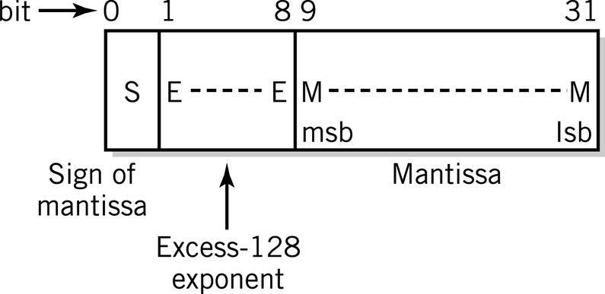
Floating Point in the Computer
Typical floating point format
32 bits provide range ~10⁻³⁸ to 10⁺³⁸
8-bit exponent = 256 levels
Excess-128 notation
23/24 bits of mantissa: approximately 7 decimal digits of precision
Copyright 2010 John Wiley & Sons, Inc
5-*

Slide 41
IEEE 754 Standard
32-bit Floating Point Value Definition
Exponent | Mantissa | Value
0 | ±0 | 0
0 | Not 0 | ±2⁻¹²⁶ x 0.M
1⁻²⁵⁴ | Any | ±2⁻¹²⁷ x 1.M
255 | ±0 | ±∞
255 | not 0 | special condition
Copyright 2010 John Wiley & Sons, Inc
5-*

Slide 42
Conversion: Base 10 and Base 2
Two steps
Whole and fractional parts of numbers with an embedded decimal or binary point must be converted separately
Numbers in exponential form must be reduced to a pure decimal or binary mixed number or fraction before the conversion can be performed
Copyright 2010 John Wiley & Sons, Inc
5-*

Slide 43
Conversion: Base 10 and Base 2
Convert 253.75₁₀ to binary floating point form
Multiply number by 100 | 25375
Convert to binary equivalent | 110 0011 0001 1111 or 1.1000 1100 0111 11 x 2¹⁴
IEEE Representation | 0 10001101 10001100011111
Divide by binary floating point equivalent of 100₁₀ to restore original decimal value
Sign
Excess-127 Exponent = 127 + 14
Mantissa
Copyright 2010 John Wiley & Sons, Inc
5-*

Slide 44
Programming Considerations
Integer advantages
Easier for computer to perform
Potential for higher precision
Faster to execute
Fewer storage locations to save time and space
Most high-level languages provide 2 or more formats
Short integer (16 bits)
Long integer (64 bits)
Copyright 2010 John Wiley & Sons, Inc
5-*

Slide 45
Programming Considerations
Real numbers
Variable or constant has fractional part
Numbers take on very large or very small values outside integer range
Program should use least precision sufficient for the task
Packed decimal attractive alternative for business applications
Copyright 2010 John Wiley & Sons, Inc
5-*

Slide 46
Copyright 2010 John Wiley & Sons
All rights reserved. Reproduction or translation of this work beyond that permitted in section 117 of the 1976 United States Copyright Act without express permission of the copyright owner is unlawful. Request for further information should be addressed to the Permissions Department, John Wiley & Sons, Inc. The purchaser may make back-up copies for his/her own use only and not for distribution or resale. The Publisher assumes no responsibility for errors, omissions, or damages caused by the use of these programs or from the use of the information contained herein.”
Copyright 2010 John Wiley & Sons, Inc
5-*

