Slide 1
CHAPTER 4: Data Formats
The Architecture of Computer Hardware, Systems Software & Networking: An Information Technology Approach
4th Edition, Irv Englander
John Wiley and Sons ©2010
PowerPoint slides authored by Wilson Wong, Bentley University
PowerPoint slides for the 3rd edition were co-authored with Lynne Senne, Bentley University

Slide 2
Data Formats
Computers
Process and store all forms of data in binary format
Human communication
Includes language, images and sounds
Data formats:
Specifications for converting data into computer-usable form
Define the different ways human data may be represented, stored and processed by a computer
Copyright 2010 John Wiley & Sons, Inc.
4-*
Notes:
*

Slide 3
Sources of Data
Binary input
Begins as discrete input
Example: keyboard input such as A 1+2=3 math
Keyboard generates a binary number code for each key
Analog
Continuous data such as sound or images
Requires hardware to convert data into binary numbers
Figure 3.1 with this color scheme
Computer
1101000101010101…
A 1+2=3 math
Input device
Copyright 2010 John Wiley & Sons, Inc.
4-*
Notes:
*

Slide 4
Common Data Representations
Type of Data | Standard(s)
Alphanumeric | Unicode, ASCII, EDCDIC
Image (bitmapped) | GIF (graphical image format) TIF (tagged image file format) PNG (portable network graphics)
Image (object) | PostScript, JPEG, SWF (Macromedia Flash), SVG
Outline graphics and fonts | PostScript, TrueType
Sound | WAV, AVI, MP3, MIDI, WMA
Page description | PDF (Adobe Portable Document Format), HTML, XML
Video | Quicktime, MPEG-2, RealVideo, WMV
Copyright 2010 John Wiley & Sons, Inc.
4-*
Notes:
*

Slide 5
Internal Data Representation
Reflects the
Complexity of input source
Type of processing required
Trade-offs
Accuracy and resolution
Simple photo vs. painting in an art book
Compactness (storage and transmission)
More data required for improved accuracy and resolution
Compression represents data in a more compact form
Metadata: data that describes or interprets the meaning of data
Ease of manipulation:
Processing simple audio vs. high-fidelity sound
Standardization
Proprietary formats for storing and processing data (WordPerfect vs. Word)
De facto standards: proprietary standards based on general user acceptance (PostScript)
Copyright 2010 John Wiley & Sons, Inc.
4-*
Notes:
*

Slide 6
Data Types: Numeric
Used for mathematical manipulation
Add, subtract, multiply, divide
Types
Integer (whole number)
Real (contains a decimal point)
Covered in Chapters 4 and 5
Copyright 2010 John Wiley & Sons, Inc.
4-*
Notes:
*

Slide 7
Data Types: Alphanumeric
Alphanumeric:
Characters: b T
Number digits: 7 9
Punctuation marks: ! ;
Special-purpose characters: $ &
Numeric characters vs. numbers
Both entered as ordinary characters
Computer converts into numbers for calculation
Examples: Variables declared as numbers by the programmer (Salary$ in BASIC)
Treated as characters if processed as text
Examples: Phone numbers, ZIP codes
Copyright 2010 John Wiley & Sons, Inc.
4-*
Notes:
*

Slide 8
Alphanumeric Codes
Arbitrary choice of bits to represent characters
Consistency: input and output device must recognize same code
Value of binary number representing character corresponds to placement in the alphabet
Facilitates sorting and searching
Copyright 2010 John Wiley & Sons, Inc.
4-*
Notes:
*

Slide 9
Representing Characters
ASCII - most widely used coding scheme
EBCDIC: IBM mainframe (legacy)
Unicode: developed for worldwide use
Copyright 2010 John Wiley & Sons, Inc.
4-*
Notes:
*

Slide 10
ASCII
Developed by ANSI (American National Standards Institute)
Represents
Latin alphabet, Arabic numerals, standard punctuation characters
Plus small set of accents and other European special characters
ASCII
7-bit code: 128 characters
Copyright 2010 John Wiley & Sons, Inc.
4-*
Notes:
*

Slide 11
ASCII Reference Table
MSD LSD | 0 | 1 | 2 | 3 | 4 | 5 | 6 | 7
0 | NUL | DLE | SP | 0 | @ | P |  | p
1 | SOH | DC1 | ! | 1 | A | Q | a | W
2 | STX | DC2 | “ | 2 | B | R | b | r
3 | ETX | DC3 | # | 3 | C | S | c | s
4 | EOT | DC4 | $ | 4 | D | T | d | t
5 | ENQ | NAK | % | 5 | E | U | e | u
6 | ACJ | SYN | & | 6 | F | V | f | v
7 | BEL | ETB | ‘ | 7 | G | W | g | w
8 | BS | CAN | ( | 8 | H | X | h | x
9 | HT | EM | ) | 9 | I | Y | i | y
A | LF | SUB | * | : | J | Z | j | z
B | VT | ESC | + | ; | K | [ | k | {
C | FF | FS | , | < | L | \ | l | |
D | CR | GS | - | = | M | ] | m | }
E | SO | RS | . | > | N | ^ | n | ~
F | SI | US | / | ? | O | _ | o | DEL
74₁₆
111 0100
Copyright 2010 John Wiley & Sons, Inc.
4-*
Notes:
*

Slide 12
EBCDIC
Extended Binary Coded Decimal Interchange Code developed by IBM
Restricted mainly to IBM or IBM compatible mainframes
Conversion software to/from ASCII available
Common in archival data
Character codes differ from ASCII
 | ASCII | EBCDIC
Space | 20₁₆ | 40₁₆
A | 41₁₆ | C1₁₆
b | 62₁₆ | 82₁₆
Copyright 2010 John Wiley & Sons, Inc.
4-*
Notes:
*

Slide 13
Unicode
Most common 16-bit form represents 65,536 characters
ASCII Latin-I subset of Unicode
Values 0 to 255 in Unicode table
Multilingual: defines codes for
Nearly every character-based alphabet
Large set of ideographs for Chinese, Japanese and Korean
Composite characters for vowels and syllabic clusters required by some languages
Allows software modifications for local-languages
Copyright 2010 John Wiley & Sons, Inc.
4-*
Notes:
*

Slide 14
Collating Sequence
Alphabetic sorting if software handles mixed upper- and lowercase codes
In ASCII, numbers collate first; in EBCDIC, last
ASCII collating sequence for string of characters
Letters |  |  |  |  |  |  |  |  | Numeric Characters
Adam | A | d | a | m |  |  |  |  | 1 | 011 | 0001
Adamian | A | d | a | m | i | a | n |  | 12 | 011 | 0001 | 011 | 0010
Adams | A | d | a | m | s |  |  |  | 2 | 011 | 0010
Copyright 2010 John Wiley & Sons, Inc.
4-*
Notes:
*

Slide 15
2 Classes of Codes
Printing characters
Produced on the screen or printer
Control characters
Control position of output on screen or printer
Cause action to occur
Communicate status between computer and I/O device
VT: vertical tab | LF: Line feed
BEL: bell rings | DEL: delete current character
ESC: provides extensions by changing the meaning of a specified number of contiguous following characters
Copyright 2010 John Wiley & Sons, Inc.
4-*
Notes:
*

Slide 16
Keyboard Input
Scan code
Two different scan codes on keyboard
One generated when key is struck and another when key is released
Converted to Unicode, ASCII or EBCDIC by software in terminal or PC
Advantage
Easily adapted to different languages or keyboard layout
Separate scan codes for key press/release for multiple key combinations
Examples: shift and control keys
Copyright 2010 John Wiley & Sons, Inc.
4-*
Notes:
*

Slide 17
Other Alphanumeric Input
OCR (optical character reader)
Scans text and inputs it as character data
Used to read specially encoded characters
Example: magnetically printed check numbers
Bar Code Readers
Used in applications that require fast, accurate and repetitive input with minimal employee training
Examples: supermarket checkout counters and inventory control
Magnetic stripe reader: alphanumeric data from credit cards
RFID: store and transmit data between RFID tags and computers
Voice
Digitized audio recording common but conversion to alphanumeric data difficult
Requires knowledge of sound patterns in a language (phonemes) plus rules for pronunciation, grammar, and syntax
Copyright 2010 John Wiley & Sons, Inc.
4-*
Notes:
*

Slide 18
Image Data
Photographs, figures, icons, drawings, charts and graphs
Two approaches:
Bitmap or raster images of photos and paintings with continuous variation
Object or vector images composed of graphical objects like lines and curves defined geometrically
Differences include:
Quality of the image
Storage space required
Time to transmit
Ease of modification
Copyright 2010 John Wiley & Sons, Inc.
4-*
Notes:
*

Slide 19
Bitmap Images
Used for realistic images with continuous variations in shading, color, shape and texture
Examples:
Scanned photos
Clip art generated by a paint program
Preferred when image contains large amount of detail and processing requirements are fairly simple
Input devices:
Scanners
Digital cameras and video capture devices
Graphical input devices like mice and pens
Managed by photo editing software or paint software
Editing tools to make tedious bit by bit process easier
Copyright 2010 John Wiley & Sons, Inc.
4-*
Notes:
*

Slide 20
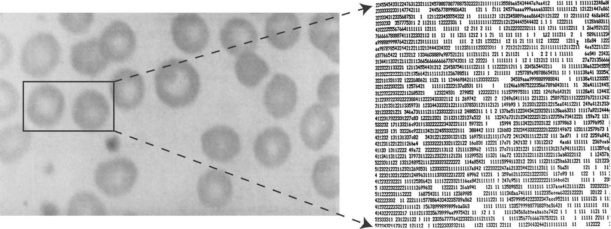
Bitmap Images
Each individual pixel (pi(x)cture element) in a graphic stored as a binary number
Pixel: A small area with associated coordinate location
Example: each point below represented by a 4-bit code corresponding to 1 of 16 shades of gray
Copyright 2010 John Wiley & Sons, Inc.
4-*
Notes:
*

Slide 21
Bitmap Display
Monochrome: black or white
1 bit per pixel
Gray scale: black, white or 254 shades of gray
1 byte per pixel
Color graphics: 16 colors, 256 colors, or 24-bit true color (16.7 million colors)
4, 8, and 24 bits respectively
Copyright 2010 John Wiley & Sons, Inc.
4-*
Notes:
*

Slide 22
Storing Bitmap Images
Frequently large files
Example: 600 rows of 800 pixels with 1 byte for each of 3 colors ~1.5MB file
File size affected by
Resolution (the number of pixels per inch)
Amount of detail affecting clarity and sharpness of an image
Levels: number of bits for displaying shades of gray or multiple colors
Palette: color translation table that uses a code for each pixel rather than actual color value
Data compression
Copyright 2010 John Wiley & Sons, Inc.
4-*
Notes:
*

Slide 23
GIF (Graphics Interchange Format)
First developed by CompuServe in 1987
GIF89a enabled animated images
allows images to be displayed sequentially at fixed time sequences
Color limitation: 256
Image compressed by LZW (Lempel-Zif-Welch) algorithm
Preferred for line drawings, clip art and pictures with large blocks of solid color
Lossless compression
Copyright 2010 John Wiley & Sons, Inc.
4-*
Notes:
*

Slide 24
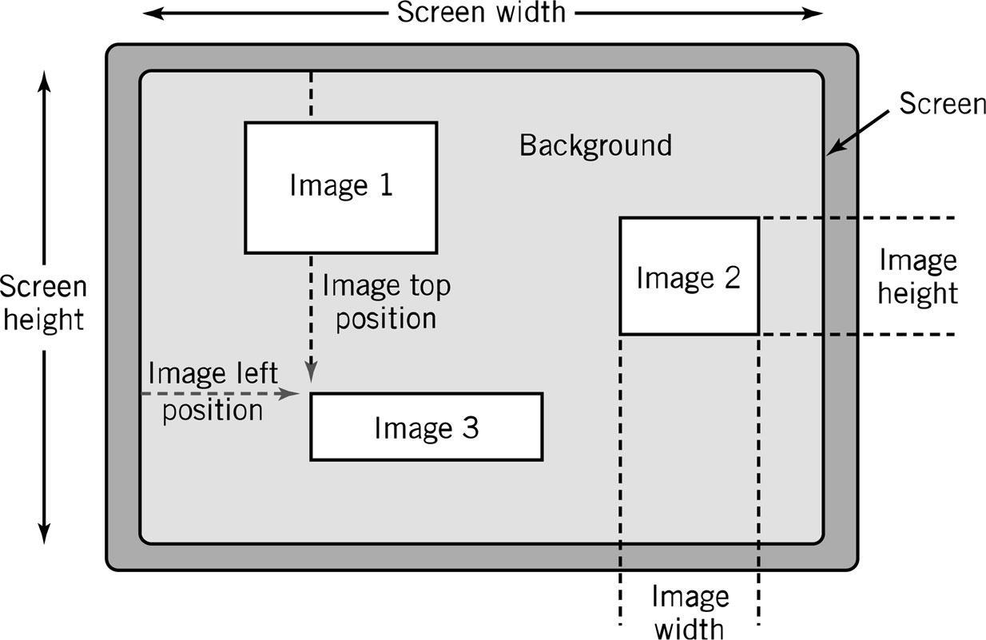
GIF (Graphics Interchange Format)
Copyright 2010 John Wiley & Sons, Inc.
4-*
Notes:
*

Slide 25
JPEG (Joint Photographers Expert Group)
Allows more than 16 million colors
Suitable for highly detailed photographs and paintings
Employs lossy compression algorithm that
Discards data to decreases file size and transmission speed
May reduce image resolution, tends to distort sharp lines
Copyright 2010 John Wiley & Sons, Inc.
4-*
Notes:
*

Slide 26
Object Images
Created by drawing packages or output from spreadsheet data graphs
Composed of lines and shapes in various colors
Computer translates geometric formulas to create the graphic
Storage space depends on image complexity
number of instructions to create lines, shapes, fill patterns
Movies Shrek and Toy Story use object images
Copyright 2010 John Wiley & Sons, Inc.
4-*
Notes:
*

Slide 27
Object Images
Based on mathematical formulas
Easy to move, scale and rotate without losing shape and identity as bitmap images may
Require less storage space than bitmap images
Cannot represent photos or paintings
Cannot be displayed or printed directly
Must be converted to bitmap since output devices except plotters are bitmap
Copyright 2010 John Wiley & Sons, Inc.
4-*
Notes:
*

Slide 28
PostScript
Page description language: list of procedures and statements that describe each of the objects to be printed on a page
Stored in ASCII or Unicode text file
Interpreter program in computer or output device reads PostScript to generate image
Scalable font support
Font outline objects specified like other objects
Copyright 2010 John Wiley & Sons, Inc.
4-*
Notes:
*

Slide 29
Bitmap vs. Object Images
Bitmap (Raster) | Object (Vector)
Pixel map | Geometrically defined shapes
Photographic quality | Complex drawings
Paint software | Drawing software
Larger storage requirements | Higher computational requirements
Enlarging images produces jagged edges | Objects scale smoothly
Resolution of output limited by resolution of image | Resolution of output limited by output device
Copyright 2010 John Wiley & Sons, Inc.
4-*
Notes:
*

Slide 30
Video Images
Require massive amount of data
Video camera producing full screen 640 x 480 pixel true color image at 30 frames/sec 27.65 MB of data/sec
1-minute film clip 1.6 GB storage
Options for reducing file size: decrease size of image, limit number of colors, reduce frame rate
Method depends on how video delivered to users
Streaming video: video displayed as it is downloaded from the Web server
Local data (file on DVD or downloaded onto system) for higher quality
MPEG-2: movie quality images with high compression require substantial processing capability
Copyright 2010 John Wiley & Sons, Inc.
4-*
Notes:
*

Slide 31
Audio Data
Transmission and processing requirements less demanding than those for video
Waveform audio: digital representation of sound
MIDI (Musical Instrument Digital Interface): instructions to recreate or synthesize sounds
Analog sound converted to digital values by A-to-D converter
Copyright 2010 John Wiley & Sons, Inc.
4-*
Notes:
*

Slide 32
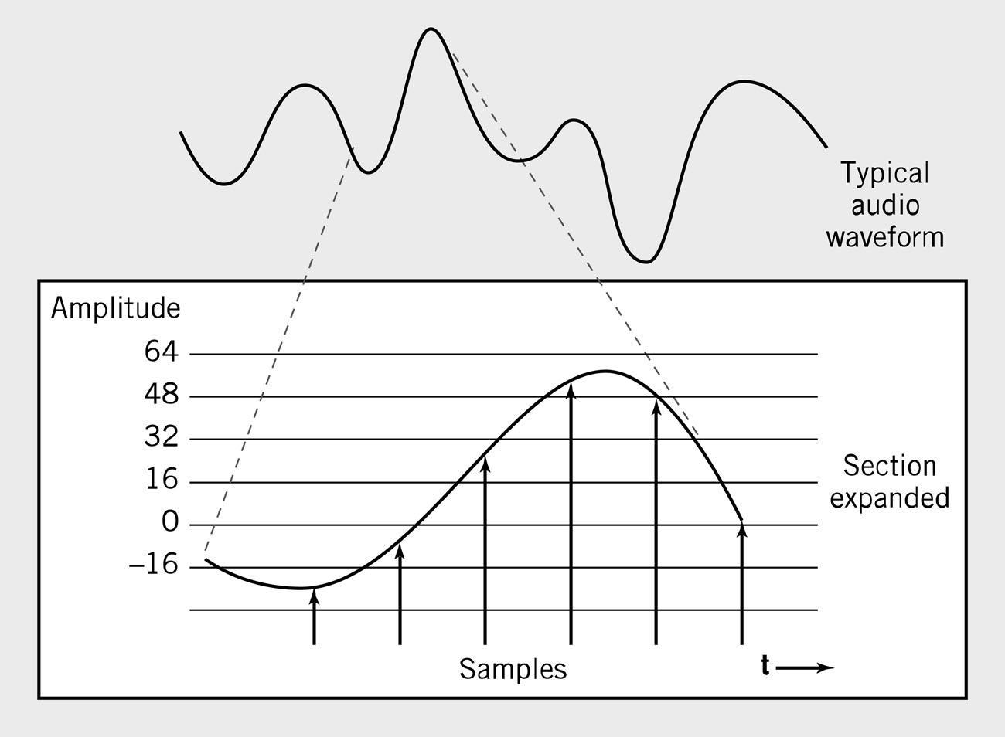
Waveform Audio
Sampling rate normally 50KHz
Copyright 2010 John Wiley & Sons, Inc.
4-*
Notes:
*

Slide 33
Sampling Rate
Number of times per second that sound is measured during the recording process.
1000 samples per second = 1 KHz (kilohertz)
Example: Audio CD sampling rate = 44.1KHz
Height of each sample saved as:
8-bit number for radio-quality recordings
16-bit number for high-fidelity recordings
2 x 16-bits for stereo
Copyright 2010 John Wiley & Sons, Inc.
4-*
Notes:
*

Slide 34
Audio Formats
MP3
Derivative of MPEG-2 (ISO Moving Picture Experts Group)
Uses psychoacoustic compression techniques to reduce storage requirements
WAV
Developed by Microsoft as part of its multimedia specification
General-purpose format for storing and reproducing small snippets of sound
Copyright 2010 John Wiley & Sons, Inc.
4-*
Notes:
*

Slide 35
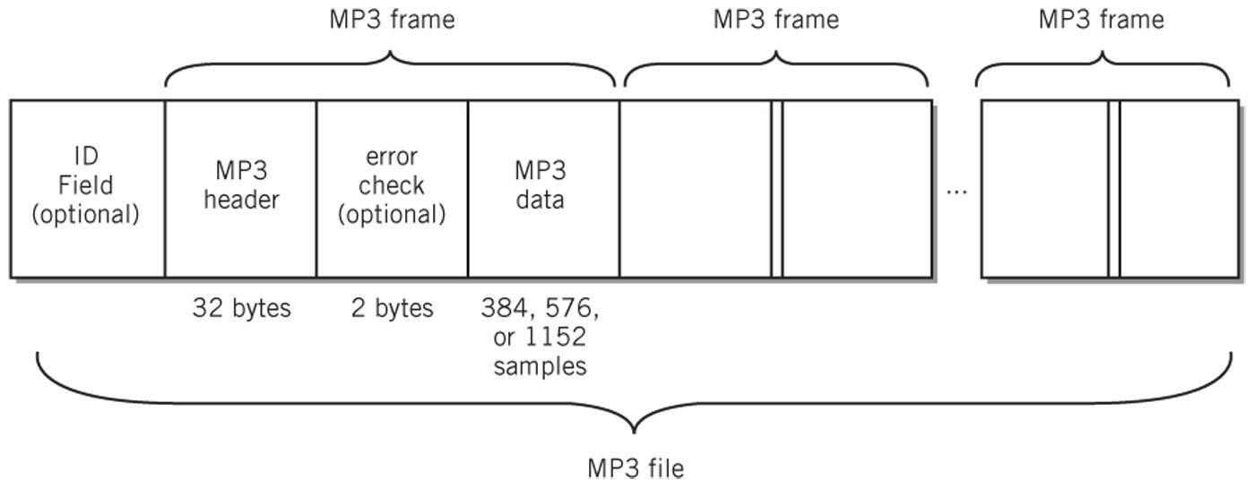
Audio Data Formats
WAV file
Copyright 2010 John Wiley & Sons, Inc.
4-*
Notes:
*

Slide 36
Data Compression
Compression: recoding data so that it requires fewer bytes of storage space.
Compression ratio: the amount file is shrunk
Lossless: inverse algorithm restores data to exact original form
Examples: GIF, PCX, TIFF
Lossy: trades off data degradation for file size and download speed
Much higher compression ratios, often 10 to 1
Example: JPEG
Common in multimedia
MPEG-2: uses both forms for ratios of 100:1
Copyright 2010 John Wiley & Sons, Inc.
4-*
Notes:
*

Slide 37
Page Description Languages
Describe layout of objects on a displayed or printed page
Objects may include text, object images, bitmap images, multimedia objects, and other data formats
Examples
HTML, XHTML, XML
PDF
Postscript
Copyright 2010 John Wiley & Sons, Inc.
4-*

Slide 38
Internal Computer Data Format
All data stored as binary numbers
Interpreted based on
Operations computer can perform
Data types supported by programming language used to create application
Copyright 2010 John Wiley & Sons, Inc.
4-*
Notes:
*

Slide 39
5 Simple Data Types
Boolean: 2-valued variables or constants with values of true or false
Char: Variable or constant that holds alphanumeric character
Enumerated
User-defined data types with possible values listed in definition
Type DayOfWeek = Mon, Tues, Wed, Thurs, Fri, Sat, Sun
Integer: positive or negative whole numbers
Real
Numbers with a decimal point
Numbers whose magnitude, large or small, exceeds computer’s capability to store as an integer
Copyright 2010 John Wiley & Sons, Inc.
4-*
Notes:
*

Slide 40
Copyright 2010 John Wiley & Sons
All rights reserved. Reproduction or translation of this work beyond that permitted in section 117 of the 1976 United States Copyright Act without express permission of the copyright owner is unlawful. Request for further information should be addressed to the Permissions Department, John Wiley & Sons, Inc. The purchaser may make back-up copies for his/her own use only and not for distribution or resale. The Publisher assumes no responsibility for errors, omissions, or damages caused by the use of these programs or from the use of the information contained herein.”
Copyright 2010 John Wiley & Sons, Inc.
4-*

